Slide 1
LO: Combining
Averages

Slide 2

5, 5, 5, 5, ?
What score would you need on the last test to get a mean average of 5?
5

Slide 3
5, 5, 5, 5, ?
What score would you need on the last test to get a mean average of 6?
Total needed = 5 x 6 = 30
30 – 20 = 10

Slide 4
Boys 5, 5, 5, 5, 5
Girls 4, 6, 3, 7, 5
What is the mean score of the boys?
5

Slide 5
Boys 5, 5, 5, 5, 5
Girls 4, 6, 3, 7, 5
What is the mean score of the girls?
5

Slide 6
Boys 5, 5, 5, 5, 5
Girls 4, 6, 3, 7, 5
What is the mean score of the class?
5

Slide 7
Boys 5, 5, 5, 5, 5
Girls 4, 6, 3, 7, ?
What is the missing score that give the class a mean of 5.5?
Total needed = 10 x 5.5 = 55
55 – 45 = 10

Slide 8
5 Boys Mean 4
Girls 4, 6, 3, 7, ?
What is the missing score that give the class a mean of 4.8?
Total needed = 10 x 4.8 = 48
48 – 40 = 8

Slide 9
5 Boys Mean 4
5 Girls Mean 5
What is the mean score of the class?
Total = (5 x 4) + (5 x 5) = 45
45 ÷ 10 = 4.5

Slide 10
4 Boys Mean 4
6 Girls Mean 5
What is the mean score of the class?
Total = (4 x 4) + (5 x 6) = 46
46 ÷ 10 = 4.6

Slide 11
10 Boys Mean 12
15 Girls Mean 10
What is the mean score of the class?
Total = (10 x 12) + (15 x 10) = 270
270 ÷ 25 = 10.8

Slide 12
10 Boys Mean 12
15 Girls Mean 10
What is the mean score of the class?
Total = (10 x 12) + (15 x 10) = 270
270 ÷ 25 = 10.8

Slide 13
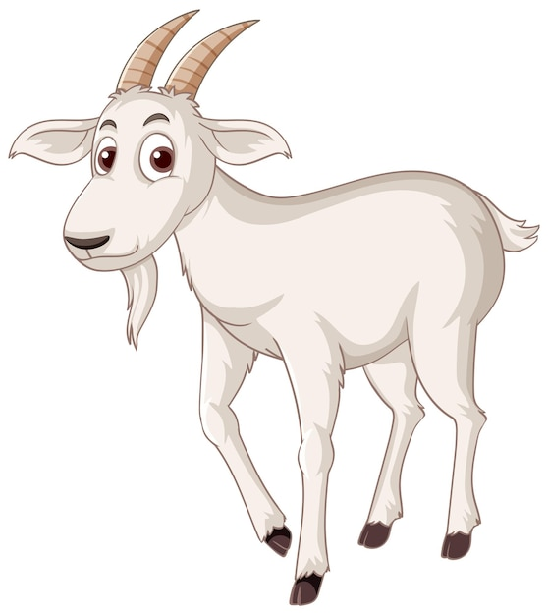
John has seven goats.
They have a mean height of 70cm.
Pete buys an eighth goat.
The height of this goat is 78cm.
Find the mean height of all eight goats.
Seven Goats Total Height =
7 x 70 = 490
Eight Goats Total Height =
490 + 78 = 568
Eight Goats Mean =
568 ÷ 8 = 71

