Slide 1

Junior Challenge 4
Silver

Slide 2
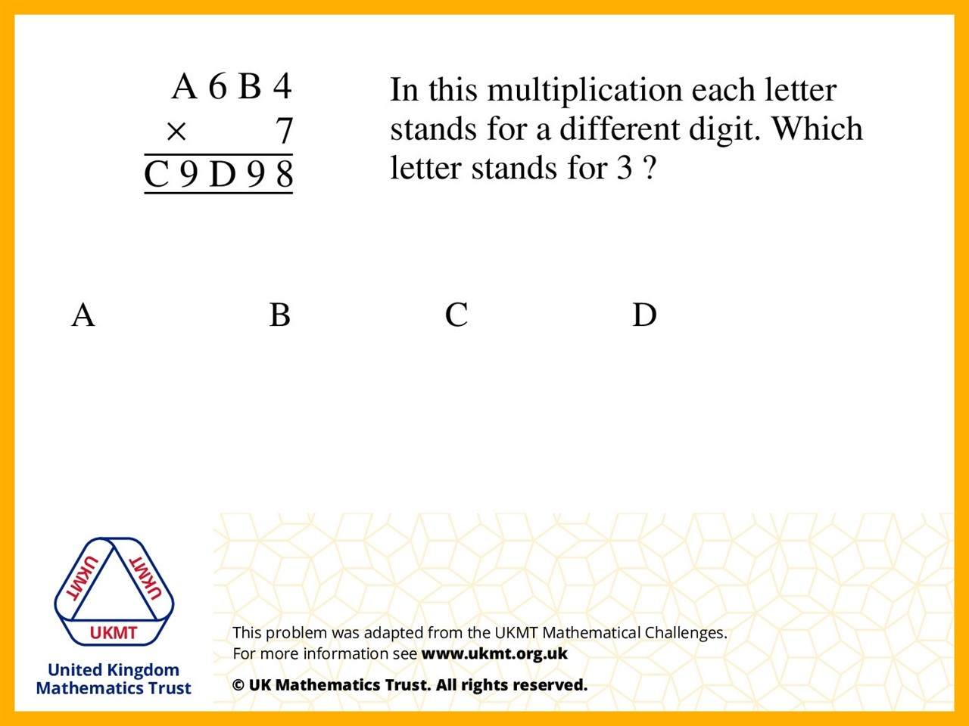
Q1.
5614 x 7 = 39298

Slide 3
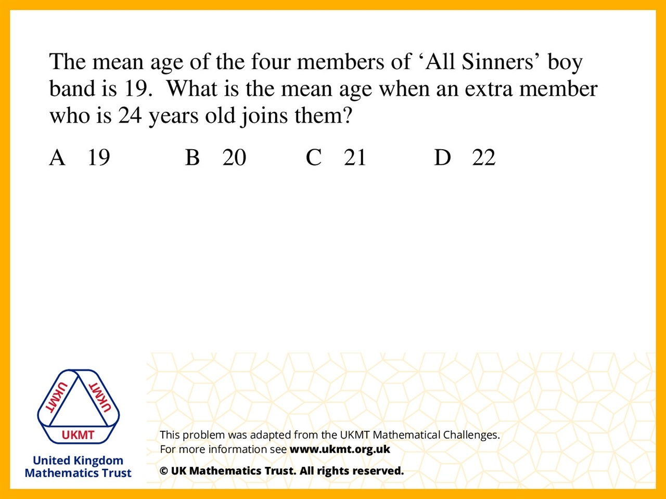
Q2.
19 x 4 = 76
76 + 24 = 100
100 ÷ 5 = 20

Slide 4
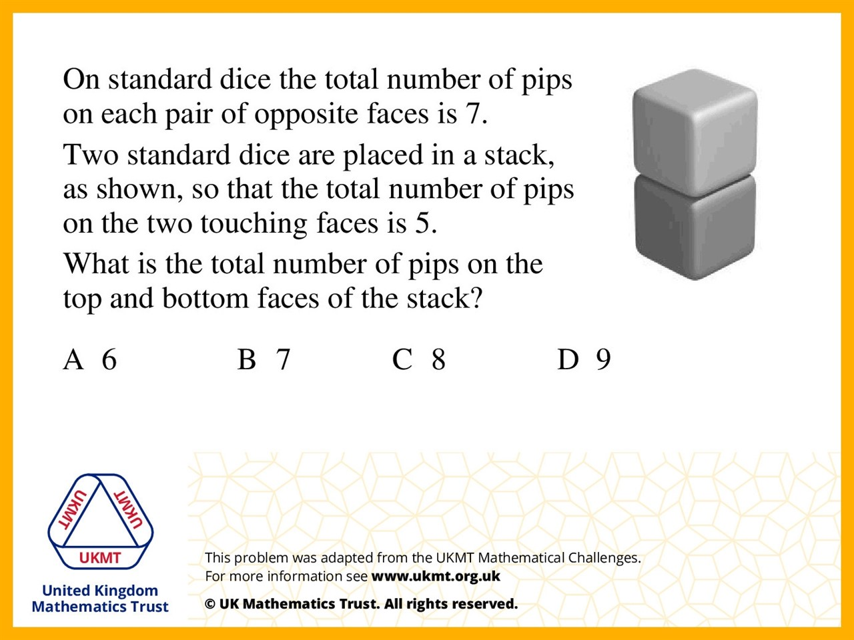
Q3.
Because the 2 pairs on top and bottom add up to 14, and subtract the 2 touching faces, 14 – 5 = 9

Slide 5
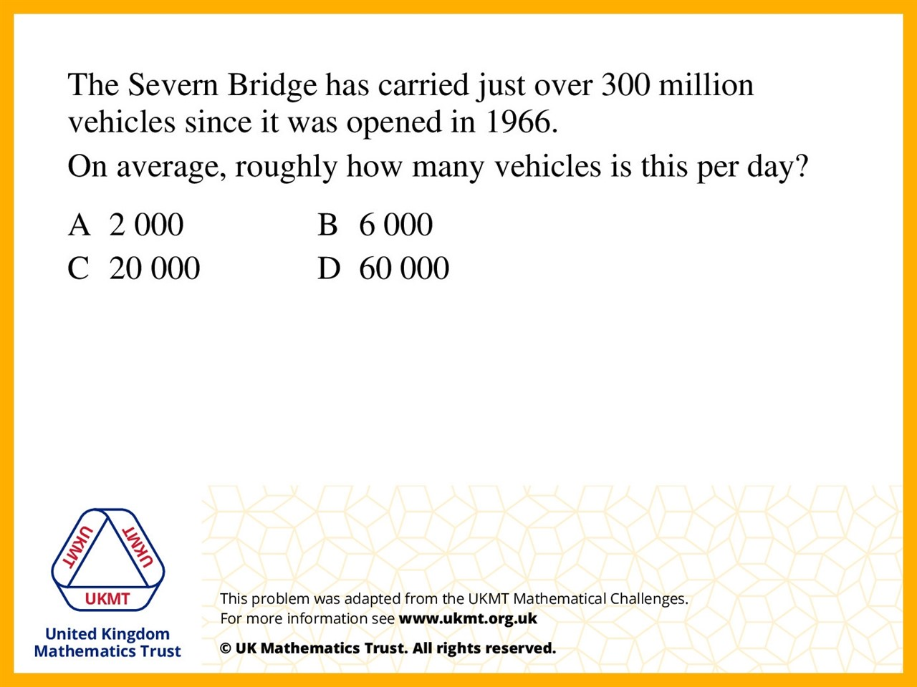
Q4.
Current Year 2017
2017 – 1966 = 51
51 x 365 = 18615
300,000,000 ÷ 18615 is about 20,000

Slide 6
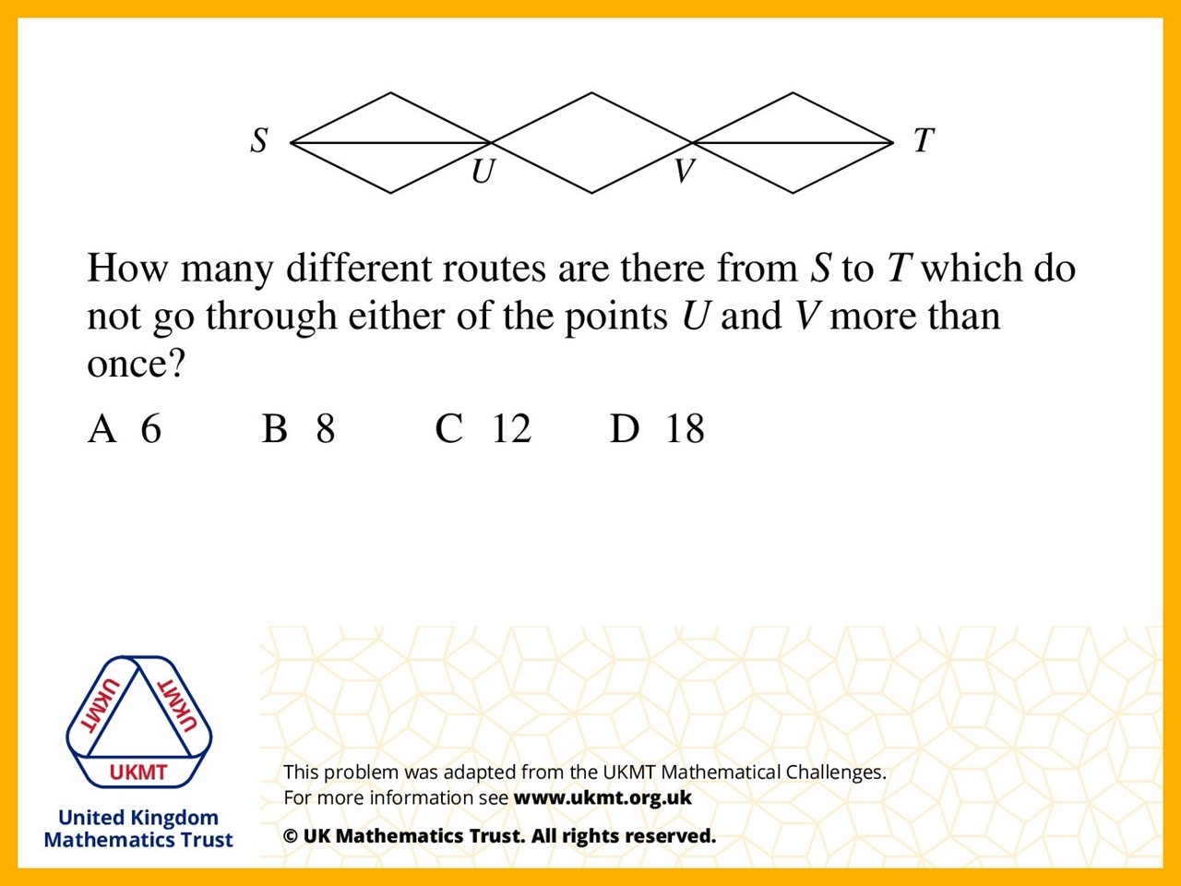
Q5.
As there is 9 ways to get across with the top line in the middle quadrilateral, then you can times by 2 as you can use all the ways you just did with the bottom line in the middle quadrilateral.

