Slide 1
LO: Averages (Frequency Table)

Slide 2
Time (mins) | Frequency
0 | 1
4 | 1
5 | 1
6 | 2
Total Frequency = 6
True or False

Slide 3
Time (mins) | Frequency
0 | 1
4 | 0
5 | 1
6 | 2
Total Frequency = 15
True or False

Slide 4
Time (mins) | Frequency
0 | 1
4 | 1
5 | 1
6 | 2
Total Frequency = 5
True or False

Slide 5
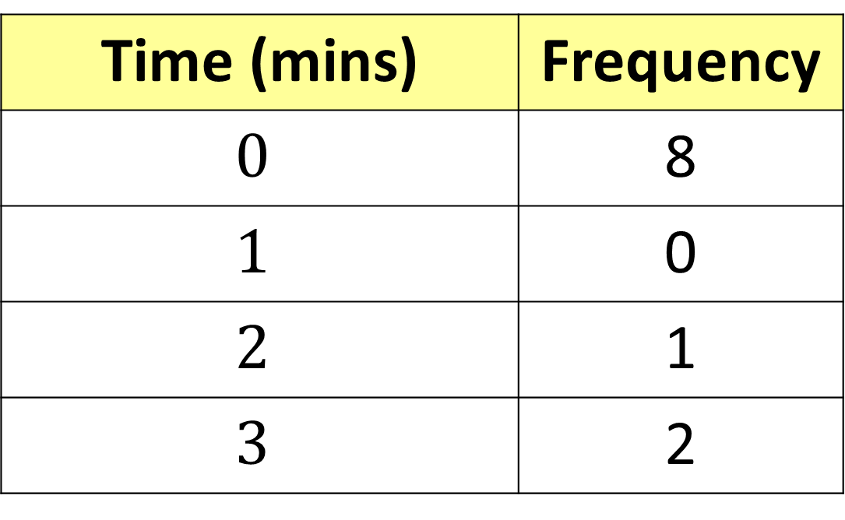
Time (mins) | Frequency
$$0$$ | 8
$$1$$ | 0
$$2$$ | 1
$$3$$ | 2
Total Frequency = 4
True or False

Slide 6
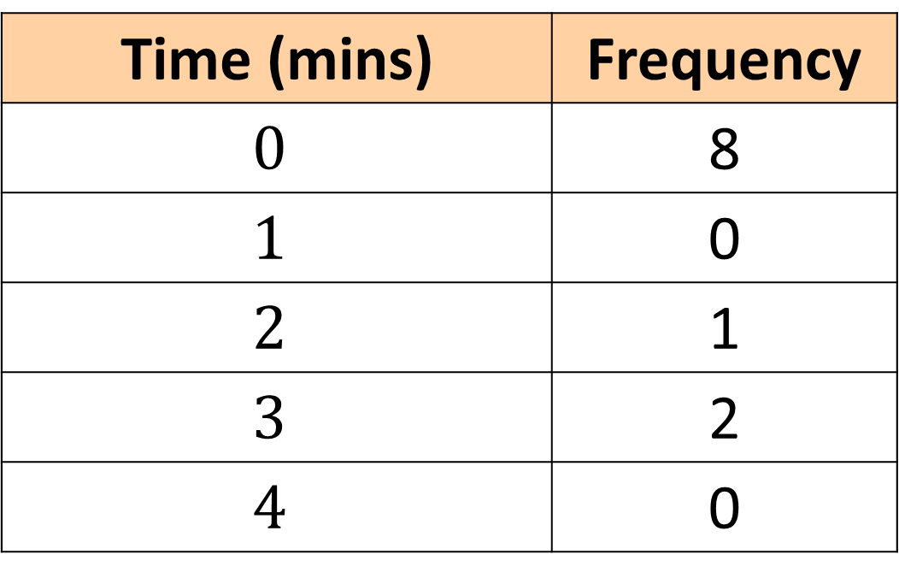
Time (mins) | Frequency
$$0$$ | 8
$$1$$ | 0
$$2$$ | 1
$$3$$ | 2
$$4$$ | 0
Total Frequency = 11
True or False

Slide 7
Listed data |  |  |  |  |  | Frequency Table
 |  |  |  |  |  | Goals Scored | Frequency
0 | 0 | 0 |  |  |  | 0
1 | 1 | 1 |  |  |  | 1
2 | 2 | 2 | 2 | 2 |  | 2
3 | 3 | 3 | 3 | 3 | 3 | 3
4 | 4 |  |  |  |  | 4
5 |  |  |  |  |  | 5
3
3
5
6
2
1

Slide 8


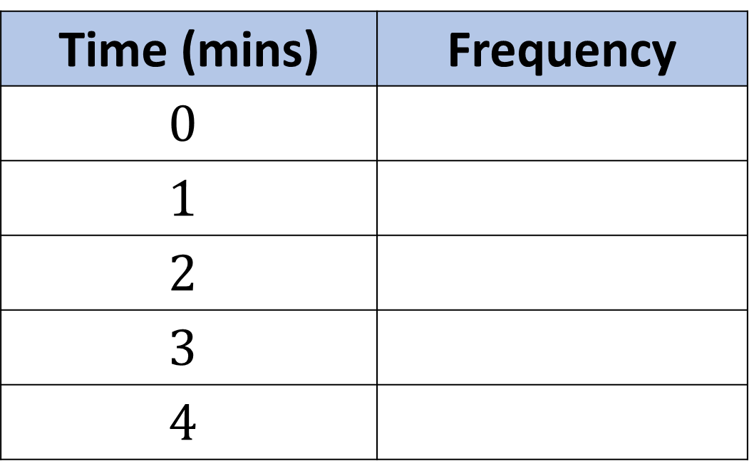



0, 0, 1, 2, 2, 2, 3, 3, 3, 3, 4
Put the listed data into the frequency table.
Time (mins) | Frequency
$$0$$
$$1$$
$$2$$
$$3$$
$$4$$
$$2$$
$$1$$
$$3$$
$$4$$
$$1$$

Slide 9
Which list of data goes with the table.
Goals Scored | Frequency
0 | 1
1 | 3
2 | 4
3 | 0
4 | 2
5 | 1
List B
1
3
4,4
0,0,0
5
List A
0
1,1,1
2,2,2,2
4,4,
5

Slide 10
Which list of data goes with the table.
Goals Scored | Frequency
0 | 3
1 | 3
2 | 5
3 | 6
4 | 2
5 | 1
List B
3
5,5
6,6,6
2,2,2,2
1,1,1,1,1
List A
0,0,0
1,1,1
2,2,2,2,2
3,3,3,3,3,3
4,4,
5

Slide 11


What is the mode?
Goals Scored in a match | Frequency
0 | 3
1 | 3
2 | 5
3 | 6
4 | 2
5 | 1
3
Mode =

Slide 12

What is the mean?
0+0+0
+1+1+1
+2+2+2+2+2
+3+3+3+3+3+3
+4+4
+5
Goals Scored in a match | Frequency
0 | 3
1 | 3
2 | 5
3 | 6
4 | 2
5 | 1
Total
44
Mean =
$$\frac{44}{20}=$$
2.2

Slide 13
What is the range?
Goals Scored in a match | Frequency
0 | 3
1 | 3
2 | 5
3 | 7
4 | 2
5 | 1
0,0,0,1,1,1,2,2,2,2
2,3,3,3,3,3,3,3,4,4,5
5
Range =

Slide 14
What is the median?
Goals Scored in a match | Frequency
0 | 3
1 | 3
2 | 5
3 | 6
4 | 2
5 | 1
0,0,0,1,1,1,2,2,2,2
2,3,3,3,3,3,3,4,4,5
2
Median =

Slide 15
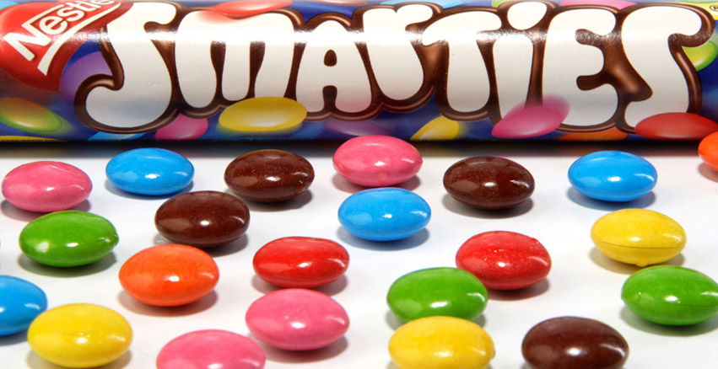
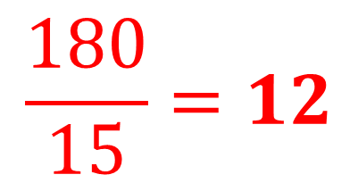
The frequency table shows the number of smarties in a tube.
Work out the averages and range.
Smarties in a Tube | Frequency
10 | 3
11 | 3
12 | 4
13 | 2
14 | 2
15 | 1
Mode | =
Mean | =
Median | =
Range | =
12
30
33
48
26
28
15
180
$$\frac{180}{15}=12$$
12
15
15 – 10 = 5

Slide 16
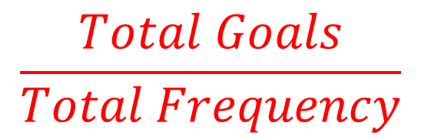
Goals | Frequency
0 | 3
1 | 3
2 | 4
3 | 2
4 | 2
 | Total Frequency 14
Most Goals
Mode | =
Mean | =
Median | =
Range | =
0 x 3 = 0
1 x 3 = 3
2 x 4 = 8
3 x 2 = 6
4 x 2 = 8
Total Goals 25
$$\frac{Total Goals}{Total Frequency}$$
Middle Value
Biggest Goals
–
Smallest Goals
0,0,0,1,1,1,2,2,2,2,3,3,4,4

