Slide 1
LO: Box Plot From a
Cumulative Frequency Graph

Slide 2
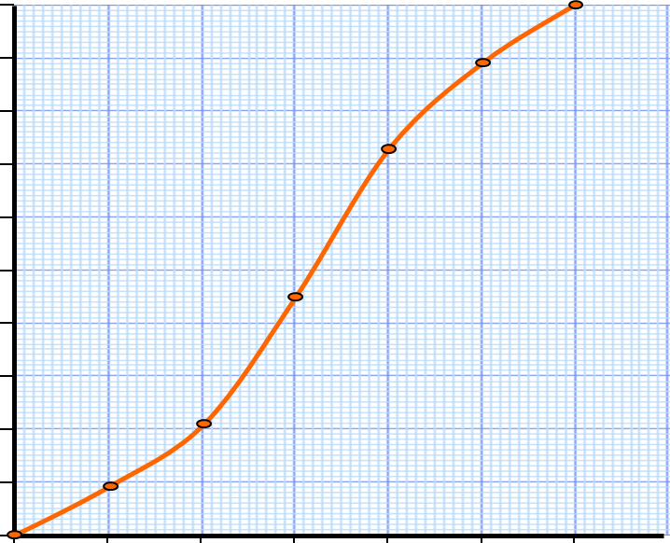
What information can you get from a cumulative frequency graph?
What information can you get from a box plot?

Slide 3

Step 1: Draw a cumulative frequency graph
100
90
80
70
Step 2: Identify the LQ, median and UQ values
60
Cumulative frequency
50
40
Step 3: Use these values to draw the box plot on the scale below
30
20
10
0
30
35
40
45
50
55
60
30
35
40
45
50
55
60
Time in seconds

Slide 4
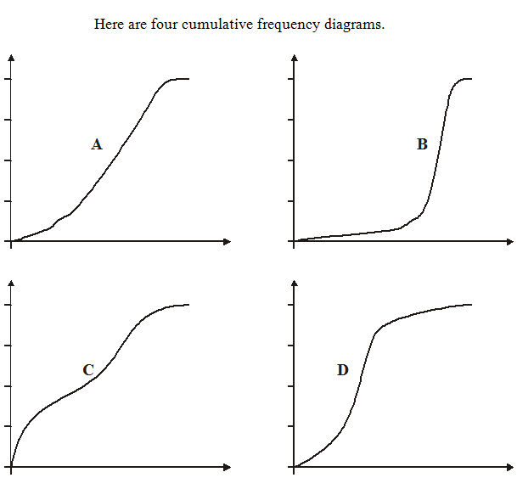
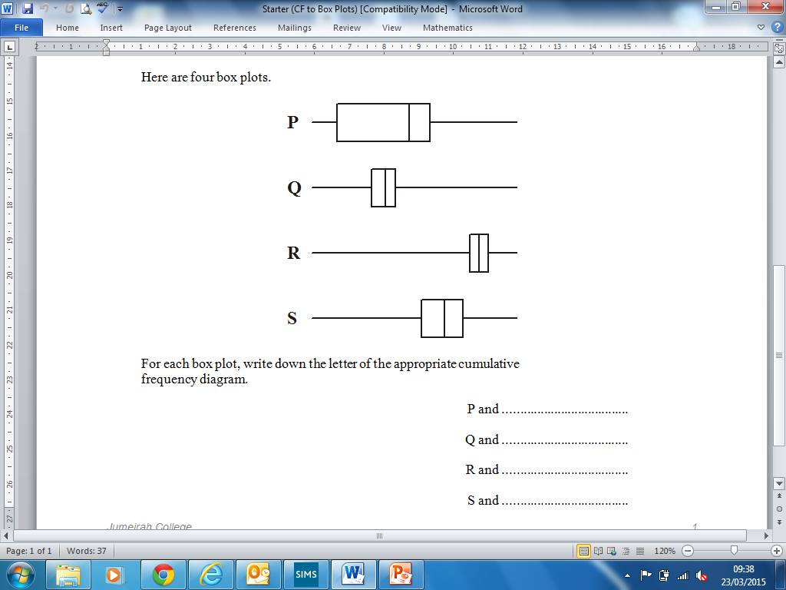
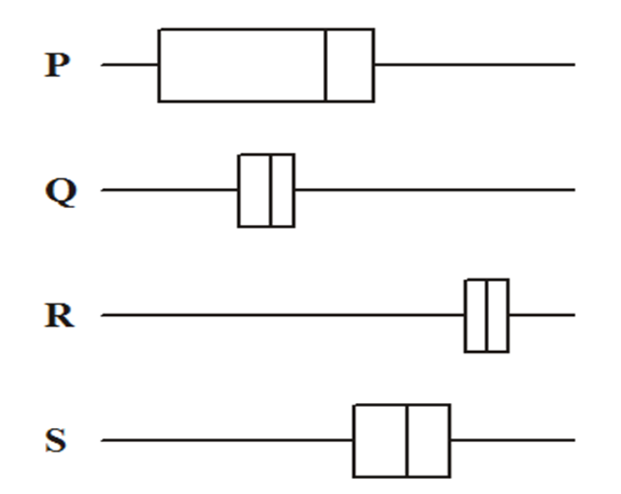
C
D
B
A

