Slide 1
LO: The Golden Ratio

Slide 2
Which rectangle do you like the look of most?
B
A
D
C
E

Slide 3
The number 1.618033989
is associated with beauty.
Shapes that are in the ratio 1 : 1.618 are considered to be nicer to look at.
This ratio is known as the
GOLDEN RATIO.

Slide 4
The Golden Ratio and Shapes.
A golden rectangle is a rectangle who's
width to height is in the golden ratio.
A
Width | : | Length
1 | : | 1.618
Did you vote for rectangle A?

Slide 5
The Golden Ratio and Fibonacci Numbers.
1, 1, 2, 3, 5, 8, 13, 21, 34, 55, 89………
1/1 | = | 1
2/1 | = | 2
3/2 | = | 1.5
5/3 | = | 1.6666..
8/5 | = | 1.6
13/8 | = | 1.625
21/13 | = | 1.61538..
34/21 | = | 1.61905..
55/34 | = | 1.61764..
89/55 | = | 1.61861..
The further you go through the sequence the closer to the golden ratio you get.

Slide 6
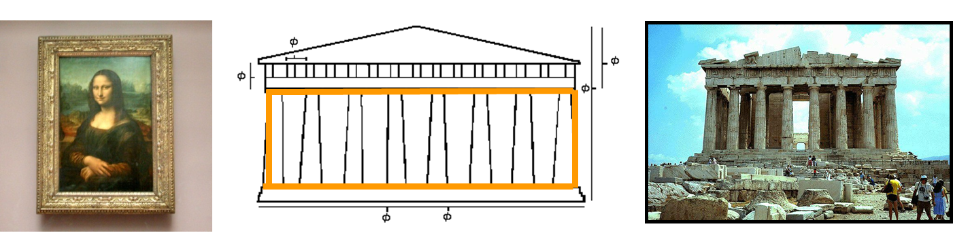
The Golden Ratio, Art and Architecture.
Leonardo da Vinci used the golden ratio in a lot of his paints.
Many buildings through the years have used the golden ratio.

Slide 7
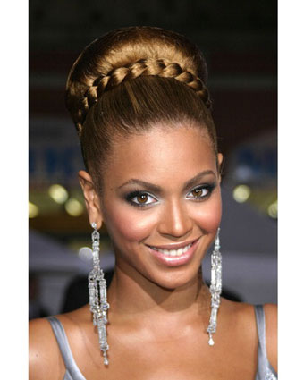
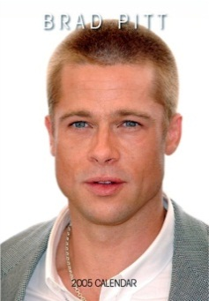
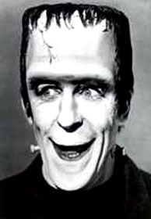
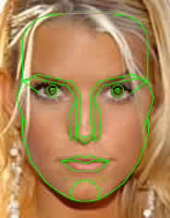
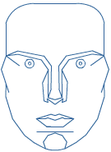
The Golden Ratio and the Human Face
Do these faces seem attractive to you? Why?
This mask of the human face is based on the golden ratio.
The proportions of the length of the nose, the position of the eyes and the length of the chin all conform to some aspect of the golden ratio.
Beauty is mathematical!!!

Slide 8
