Slide 1
LO: Simultaneous Equations
(Elimination Method)

Slide 2




ALICE
Total cost £7.80
BEN
Total cost £6.20
Find the cost of one portion of fries?
Find the cost of one burger?

Slide 3



£7.80
£6.20
£1.60
£0.80

Slide 4
£6.20
£5.40
£2.70

Slide 5
2b + 3f = 7.80
2b + 3f = 6.20
2f = 1.60
2f = 0.80
b = 2.70

Slide 6

Simultaneous Equations

Slide 7




Davina
Total cost £6.10
Charlie
Total cost £4.40
Find the cost of one muffin?
Find the cost of one fish burger?

Slide 8

£6.10
£4.40
£6.10
£8.80

Slide 9
£6.10
£8.80
£2.70
£0.90

Slide 10
£6.10
£5.20
£2.60

Slide 11
2b + 3m = 6.10
2b + 2m = 4.40
2b + 3m = 6.10
2b + 4m = 8.80

Slide 12
2b + 3m = 6.10
2b + 4m = 8.80
3m = 2.70
2m = 0.90
b = 2.60

Slide 13
Simultaneous Equations

Slide 14

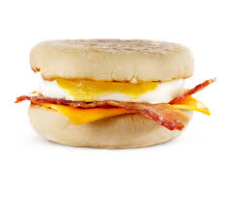


Ellie
Total cost
£4.70
Frank
Total cost
£4.30
Find the cost of one McMuffin?
Find the cost of one hash brown?

Slide 15
£4.70
£9.40
£4.30
£12.90
£3.50
£0.50

Slide 16
£4.70
£2.70
£0.90

Slide 17
3b + 4m = 4.70
2b + 5m = 4.30
6b + 8m = 9.40
6b + 15m = 12.90

Slide 18
6b + 8m = 9.40
6b + 15m = 12.90
7m = 3.50
2m = 0.50
b = 0.90

Slide 19
Rank these questions by
level of difficulty.
Give you reasons why.
3x + 3y = 15
2x + 4y = 16
4x + 3y = 23
2x + 2y = 19
2x + y = 16
2x + y = 11

Slide 20
2x + y = 16
2x + y = 11
2x + y = 15
25 + y = 6

Slide 21
4x + 3y = 23
2x + 2y = 19
4x + 3y = 23
4x + 2y = 18
y = 15
x = 2

Slide 22
3x + 3y = 15
2x + 4y = 16
6x + 6y = 30
6x + 12y = 48
6y = 18
6y = 13
x = 2

Slide 23
What makes this question difficult?
2x + 3y = 16
2x – 2y = 11

Slide 24
2x + 3y = 16
2x – 2y = 11
5y = 15
5y = 11
25 + x = 16.5

Slide 25
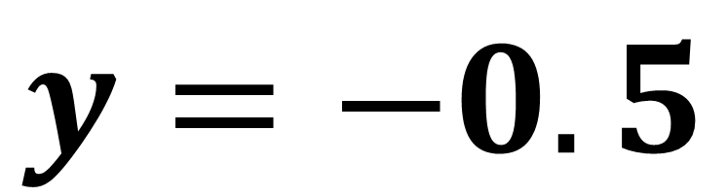
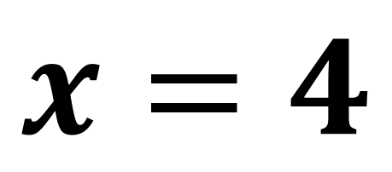
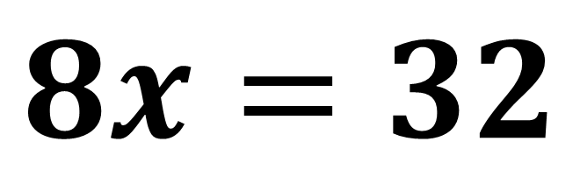
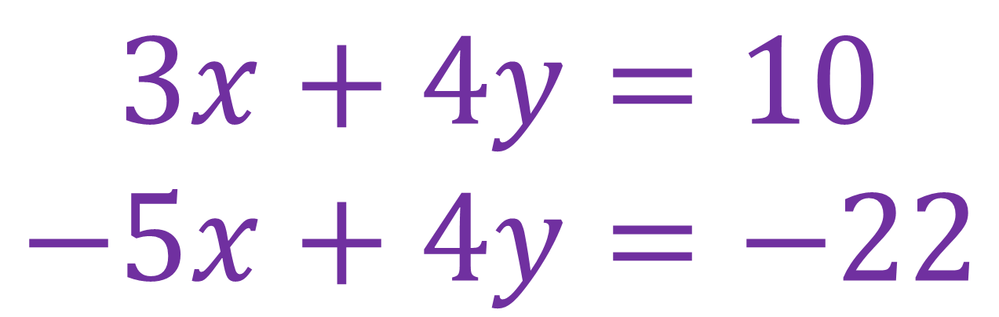
$$3x+4y=10$$
$$−5x+4y=−22$$
$$8x=32$$
$$x=4$$
$$y=−0.5$$

Slide 26
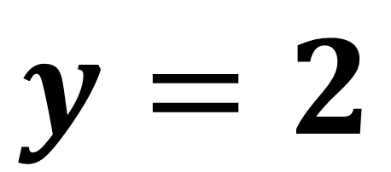

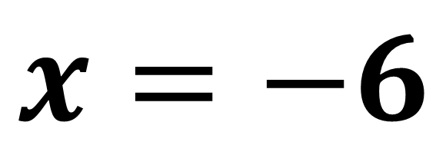
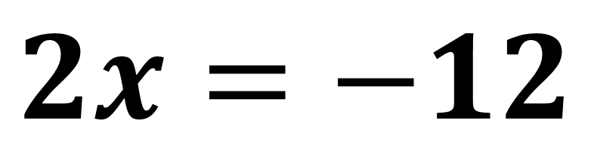
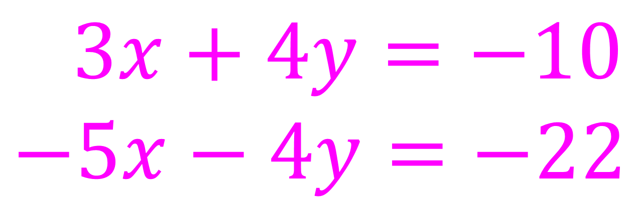
$$3x+4y=−10$$
$$−5x−4y=−22$$
$$−5x+4y=−22$$
$$2x=−12$$
$$x=−6$$
$$y=2$$

Slide 27
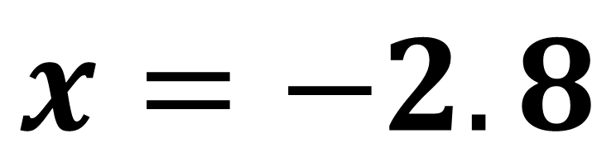
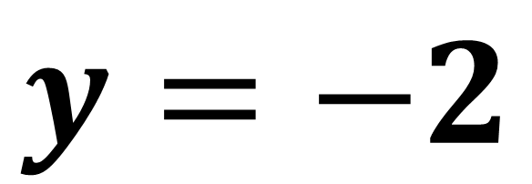
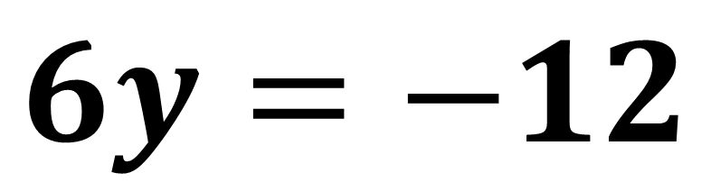
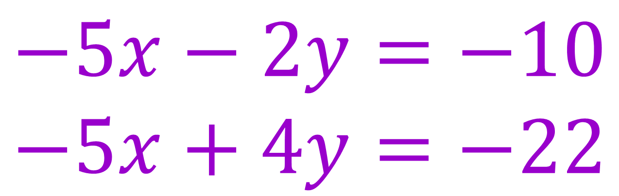
$$−5x−2y=−10$$
$$−5x+4y=−22$$
$$6y=−12$$
$$y=−2$$
$$x=−2.8$$

