Slide 1
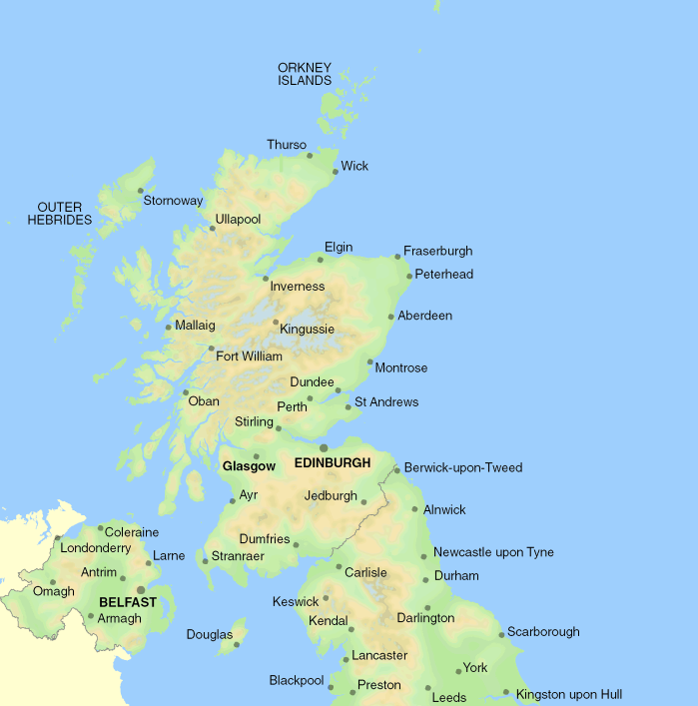
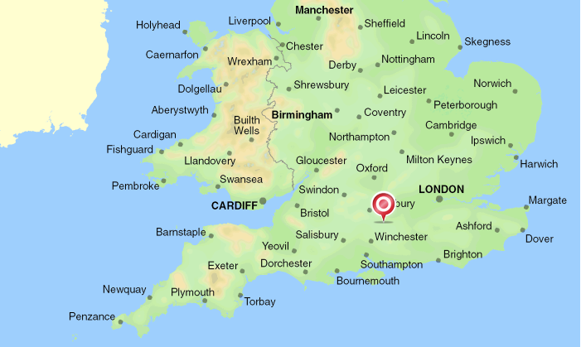
https://www.youtube.com/watch?v=MXo_d6tNWuY
1 cm represents approximately 30 miles

Slide 2
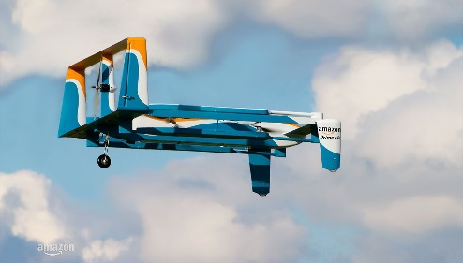
Amazon Prime Air
Background information:
You are designing routes for the new drone system.
The drones can fly a maximum of 60 miles before recharging.
Each city on the map has an Amazon warehouse.
Task 1:
You need to plan a journey between Penzance and Winchester.
You need to provide exact details of each place visited (to recharge), the bearing and distance of each flight.
You can choose any route you wish but must not go further than 60 miles in one journey (your drone will run out of battery!).
START LOCATION | END LOCATION | DISTANCE (CM) | DISTANCE (MILES) | BEARING (e.g. 030⁰)
Penzance | Newquay | 1 | 1 x 30 = 30 | 050⁰
Newquay

Slide 3
Task 2:
This task will involve more complicated bearings but all the start and end locations are already provided.
START LOCATION | END LOCATION | DISTANCE (CM) | DISTANCE (MILES) | BEARING (e.g. 030⁰)
Swansea | Builth Wells
Builth Wells | Shrewsbury
Shrewsbury | Derby
Derby | Sheffield
Sheffield | Leeds
Leeds | York
York | Darlington
Darlington | Durham
Durham | Carlisle
Carlisle | Dumfries
Dumfries | Ayr
Ayr | Glasgow
Glasgow | Edinburgh
Task 3:
Answer the below questions using your information collected for Task 2.
How many different countries did your drone fly in?
How many miles did your drone cover between Swansea and Edinburgh?
If your drone was able to fly straight to Edinburgh from Swansea without stopping, how many miles less would it have travelled?

Slide 4
Task 4:
a) If you are the Chief Executive of Amazon, why might Amazon Prime Air be a good invention? Give two reasons
1)
2)
b) If you are a customer of Amazon, why might Amazon Prime Air be a good invention? Give two reasons
1)
2)
c) What might be the negative effects of an invention such as Amazon Prime Air? Give two effects.
1)
2)
Reflection
Use the circles to draw smiley/sad faces to represent if you meet the learning objectives.
I can plan journeys using a map scale and bearings
I understand the real life uses of bearings and scale
I understand the impacts of Amazon Prime Air

