Slide 1
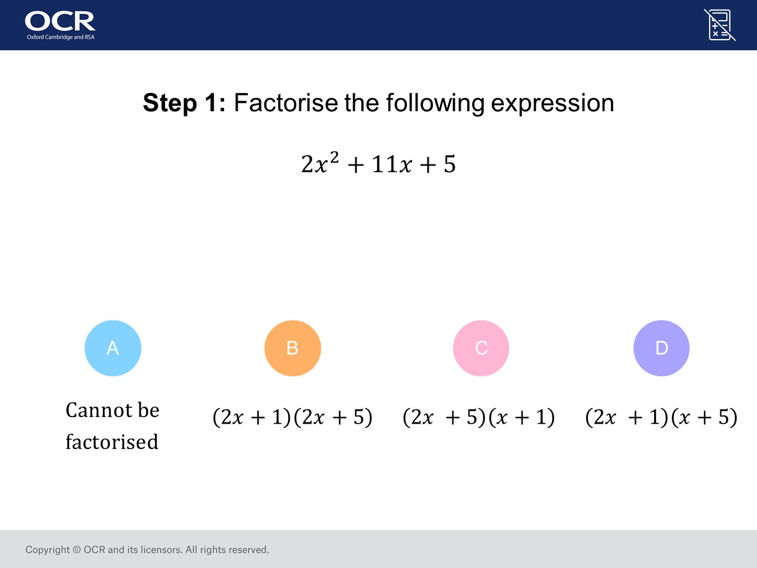
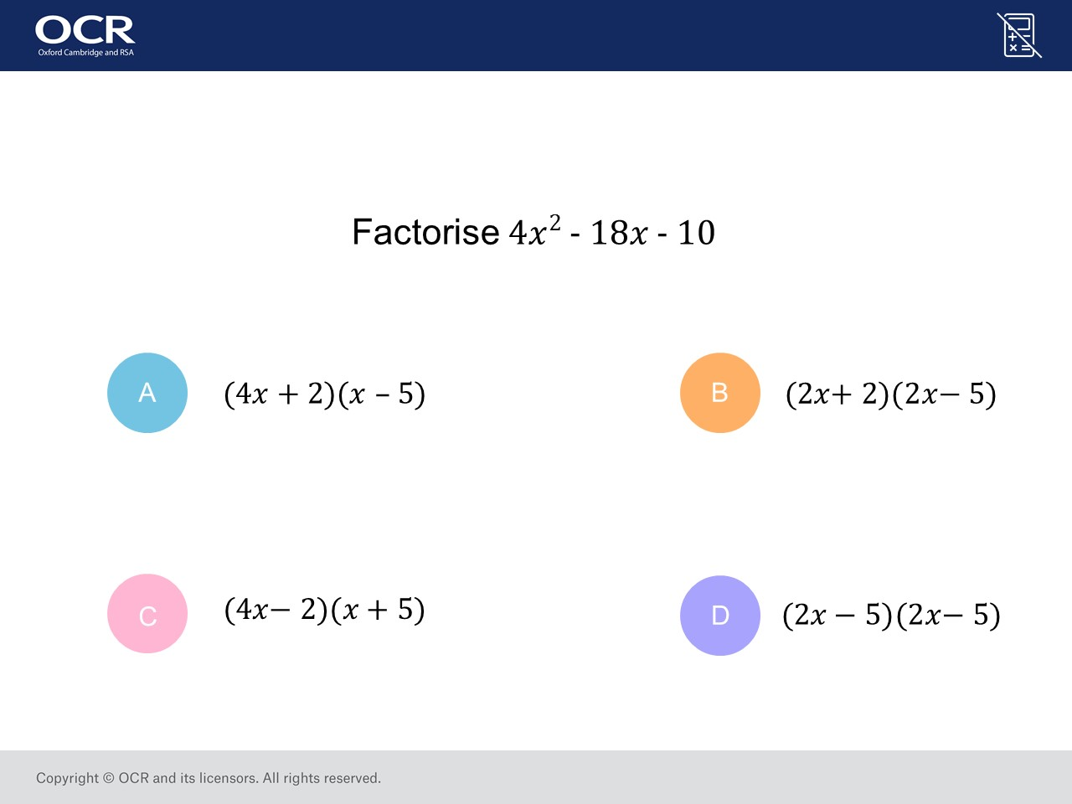
Worst answered question?
Most common wrong answer?

Slide 2
ANSWERS

Slide 3
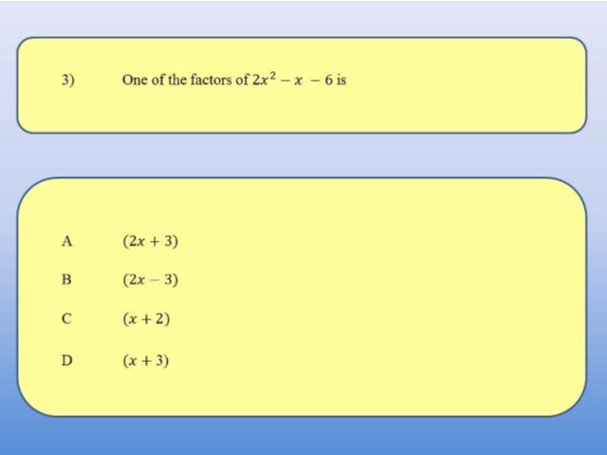
Worst answered question?

Slide 4
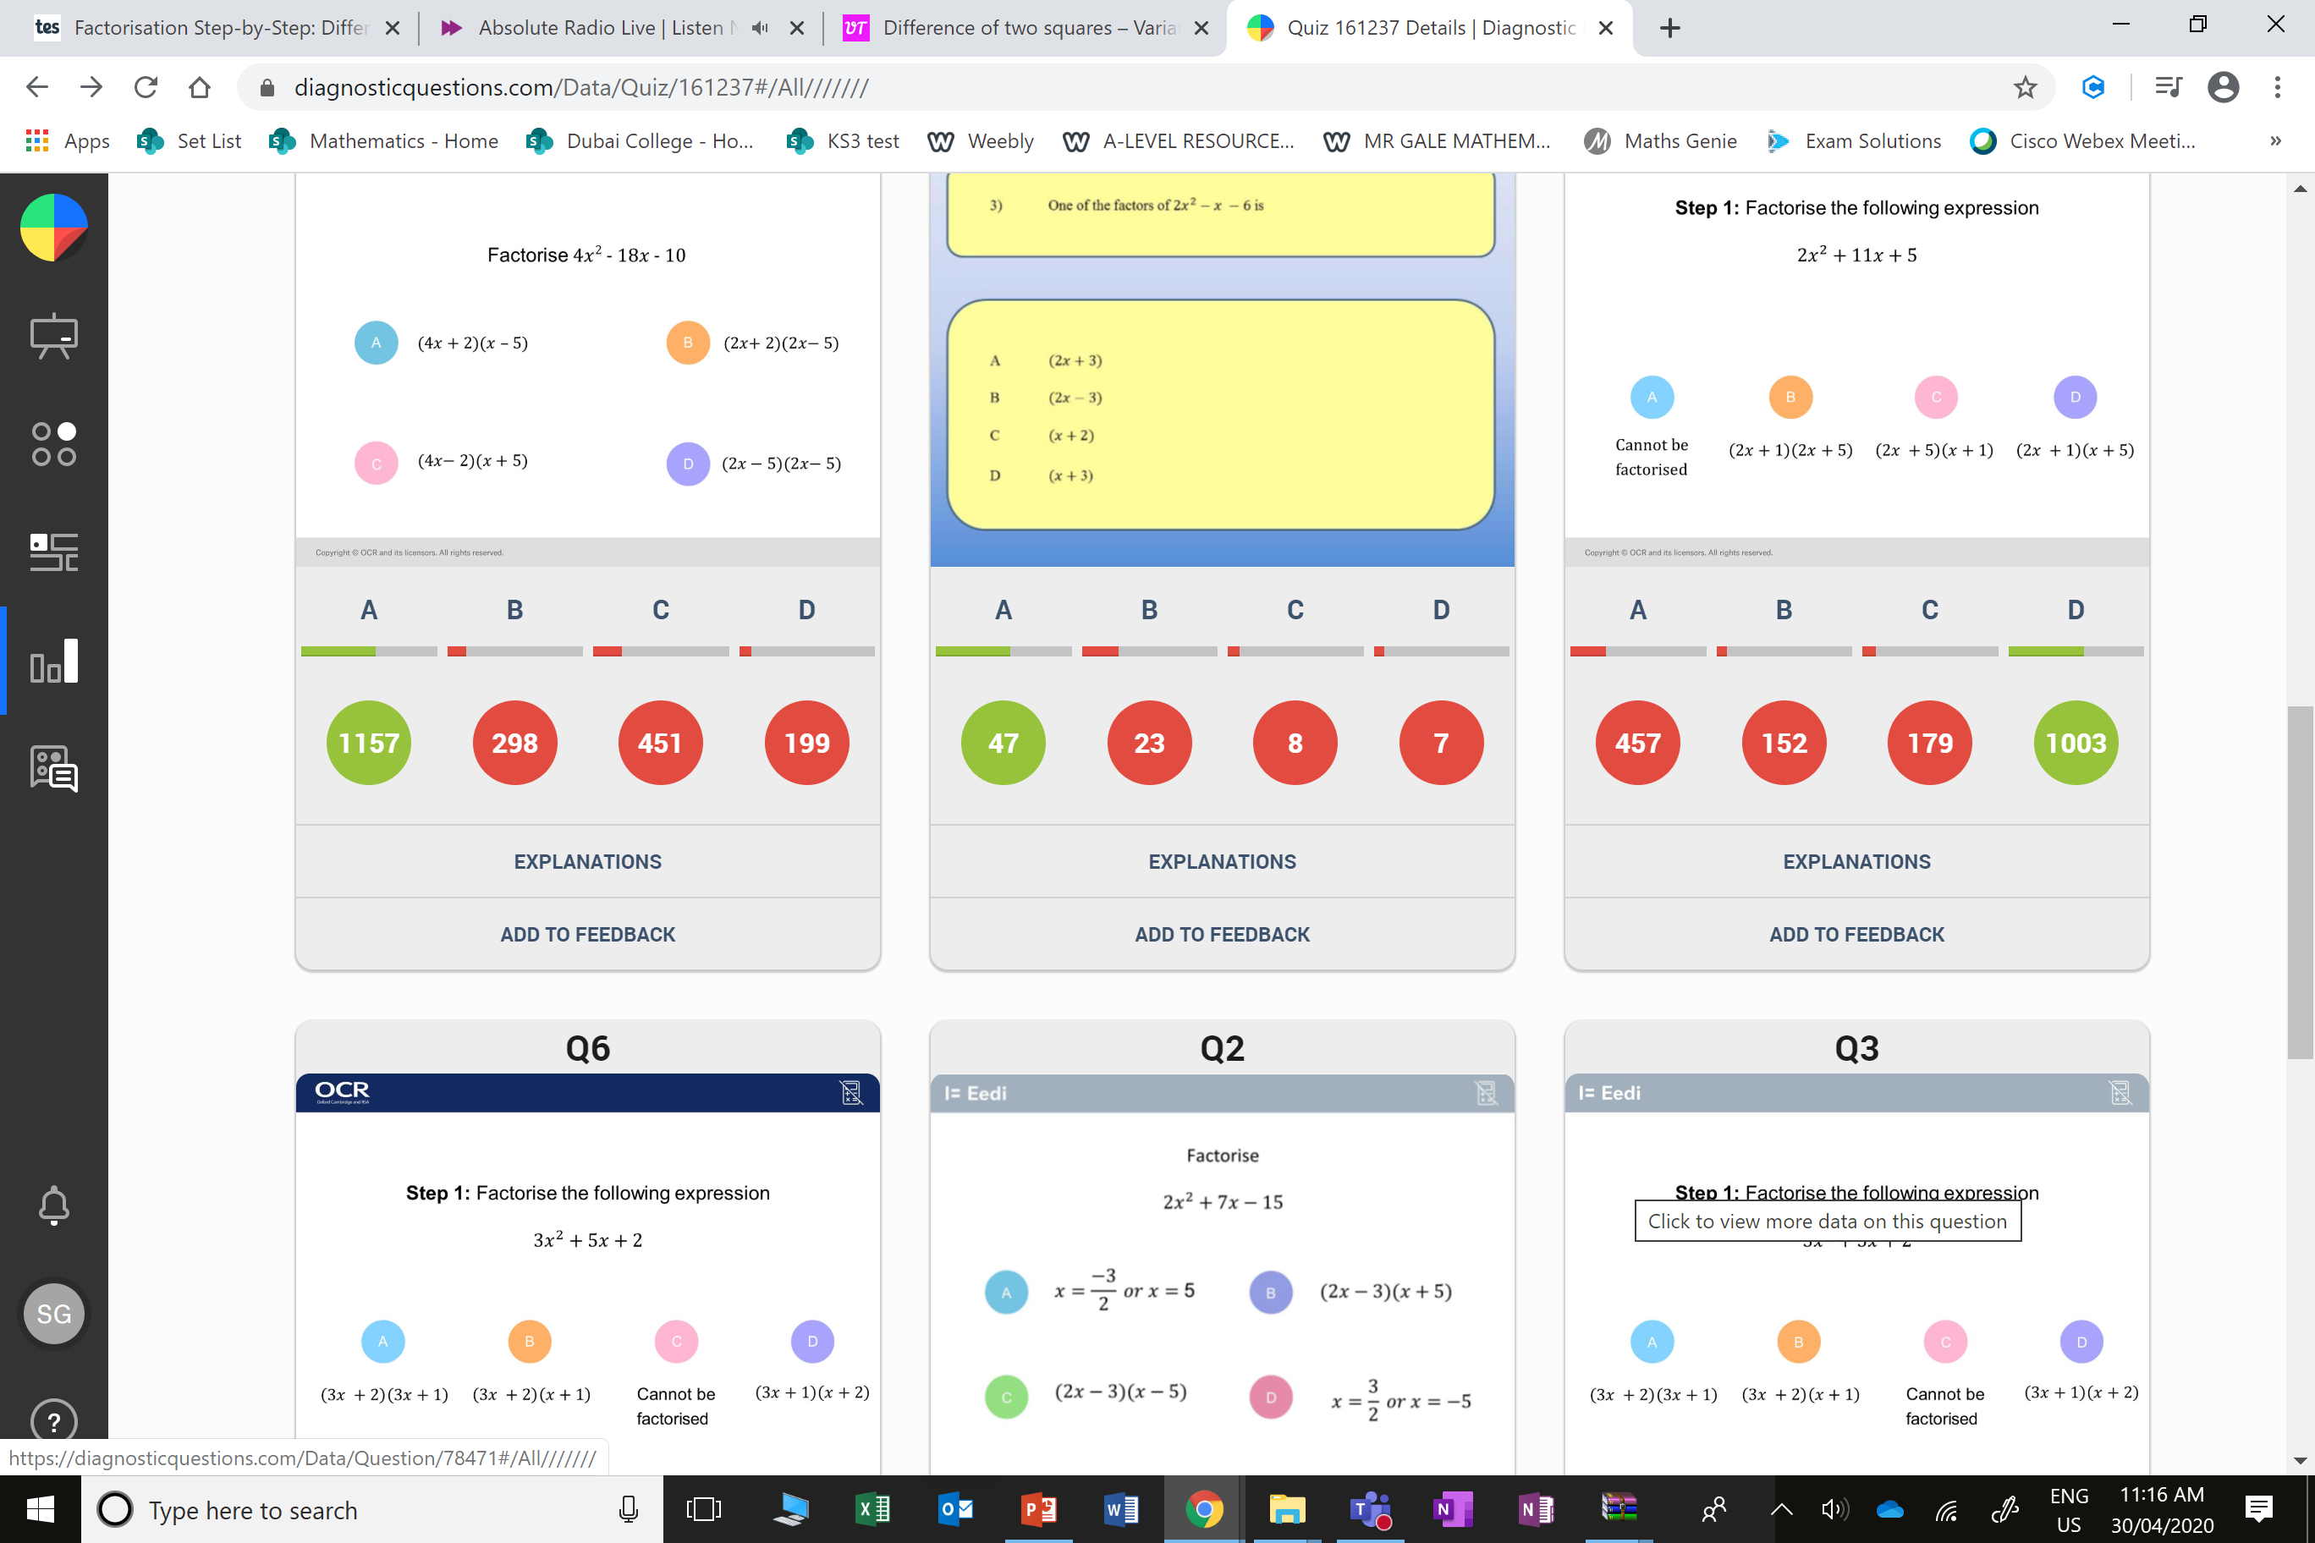
C
The x² term and the constant would be correct but not the x term.

Slide 5
B
It should have been a positive 3.

