Slide 1
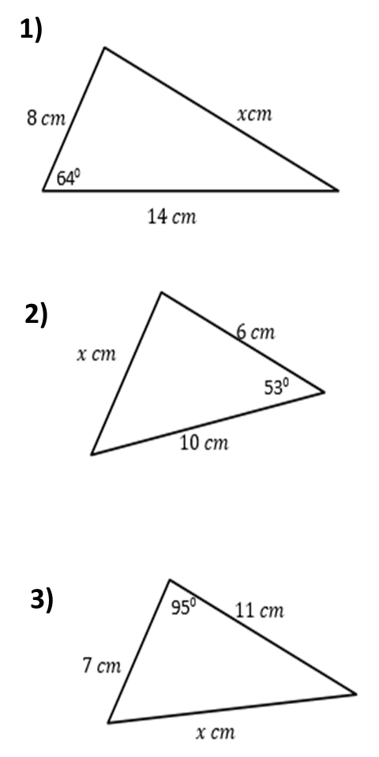
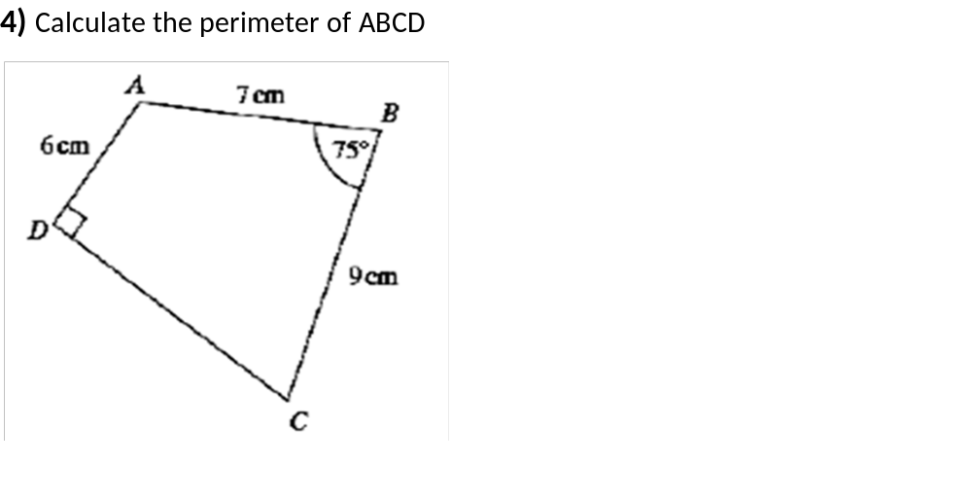

Slide 2
ANSWERS

Slide 3
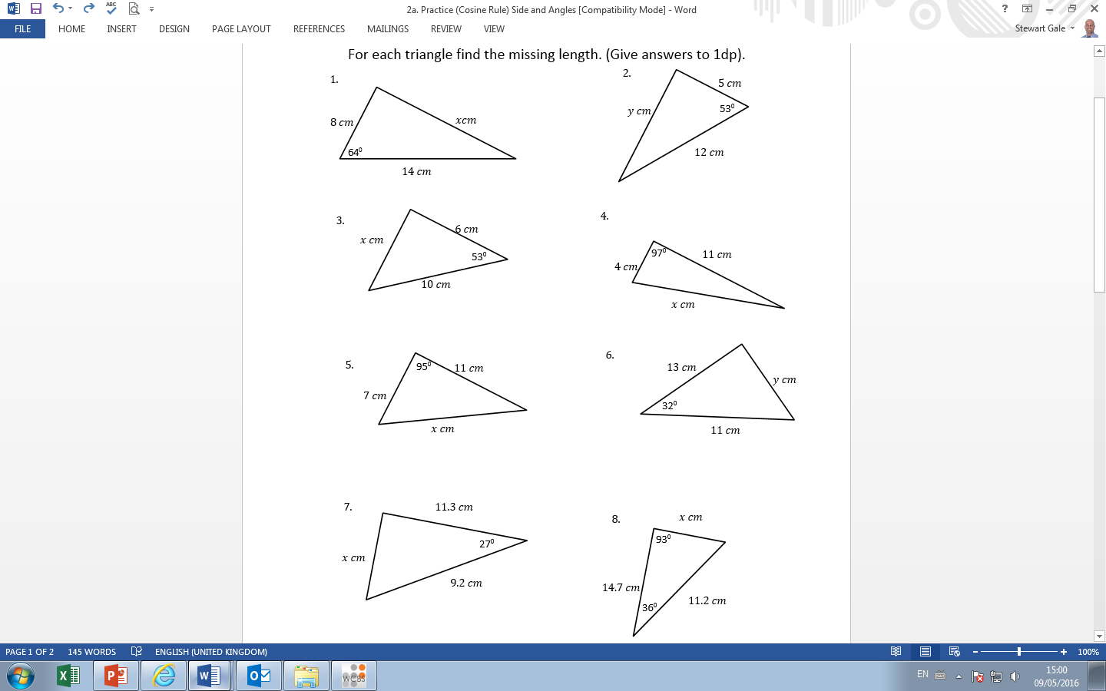
x² = 8² + 14² – 2(14)(8) cos 64
x = 12.7 cm

Slide 4
x² = 6² + 10² – 2(10)(6) cos 53
x = 8.0 cm

Slide 5
x² = 7² + 11² – 2(7)(11) cos 95
x = 13.5 cm

Slide 6

AC ² = 7² + 9² – 2(7)(9) cos 75
AC = 9.9 cm
DC = $\sqrt{\text{9.9}\text{2} \text{− 6}\text{2}}=$ 7.9
Perimeter
= 7 + 9 + 6 + 7.9
= 29.9

