Slide 1
Integration
Differential Equations
Chapter 11
(Part 11 of 12)

Slide 2
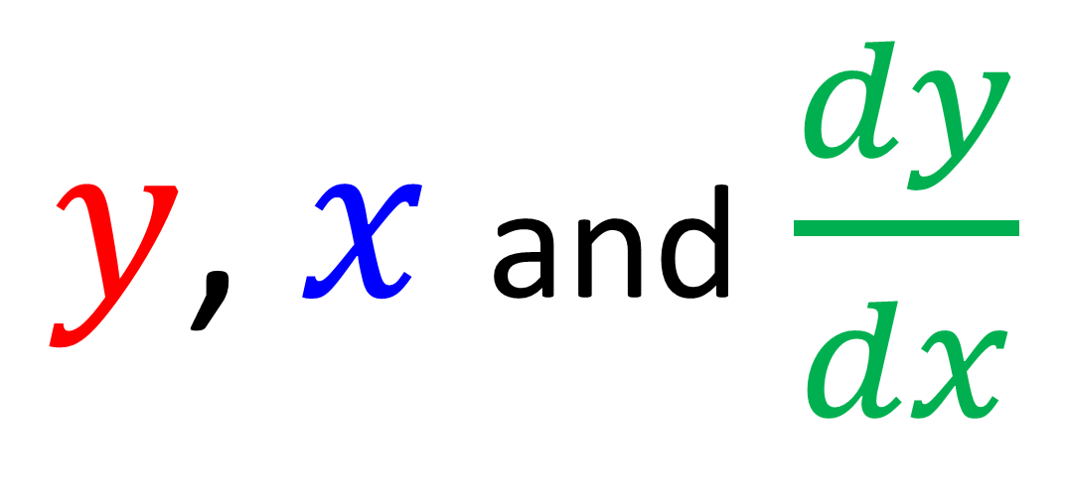
Differential Equations
are equations involving
a mix of variables and derivatives.
$y$, $x$ and $\frac{dy}{dx}$

Slide 3
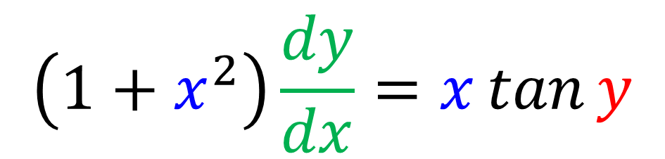
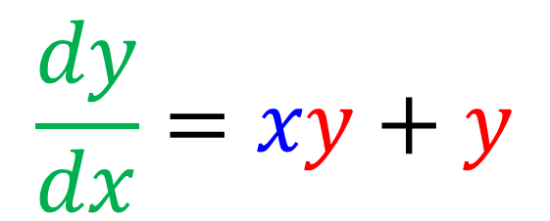
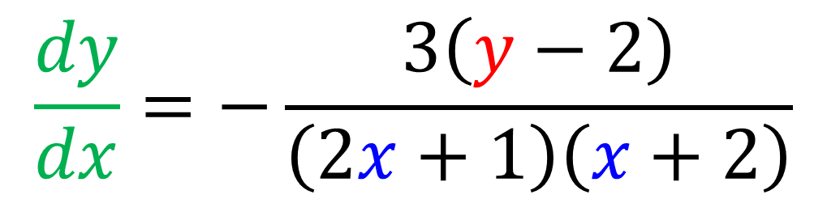
Examples of differential equations.
$$\frac{dy}{dx}=xy+y$$
$$\left(1+x^{2}\right)\frac{dy}{dx}=x\tan{y}$$
$$\frac{dy}{dx}=−\frac{3\left(y−2\right)}{\left(2x+1\right)\left(x+2\right)}$$

Slide 4
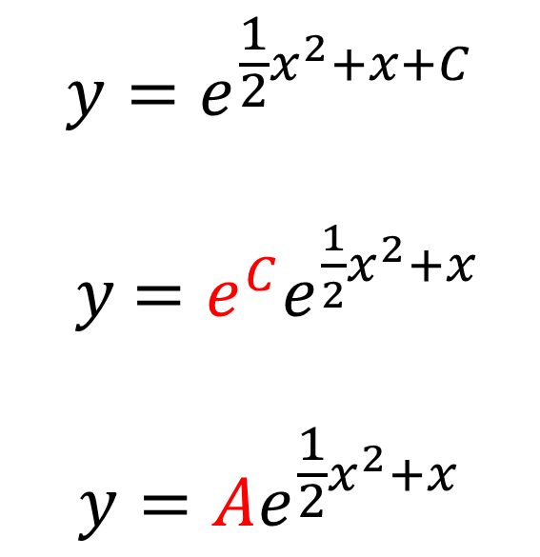
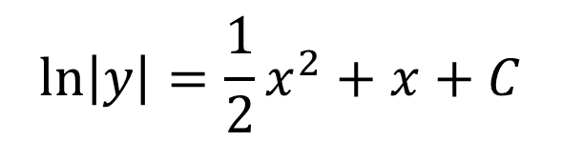
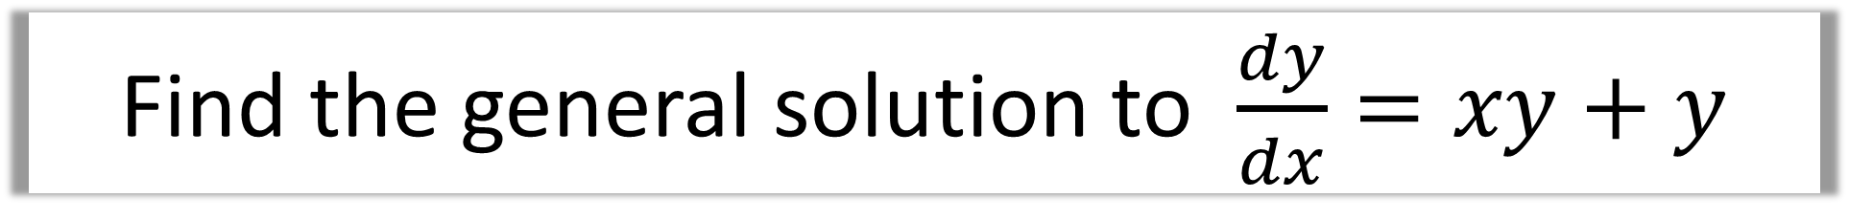
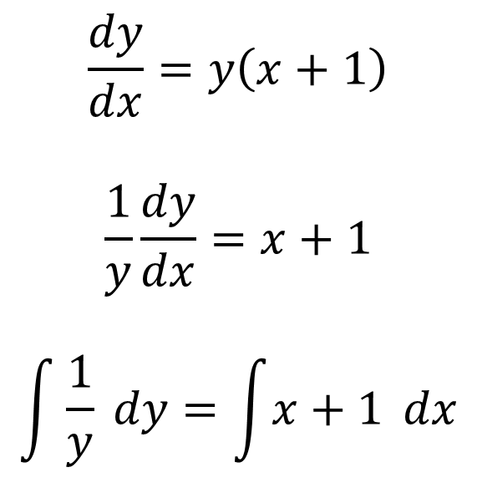


Find the general solution to $\frac{dy}{dx}=xy+y$
Separate $y$ and $x$
Integrate both sides
Make $y$ the subject
$$\frac{dy}{dx}=y\left(x+1\right)$$
$$\frac{1}{y}\frac{dy}{dx}=x+1$$
$$\int{\frac{1}{y}} dy=\int{x+1} dx$$
$$\ln\left|y\right|=\frac{1}{2}x^{2}+x+C$$
$$y=e^{\frac{1}{2}x^{2}+x+C}$$
$y$ $={e^{C}e}^{\frac{1}{2}x^{2}+x}$
$$y=Ae^{\frac{1}{2}x^{2}+x}$$

Slide 5
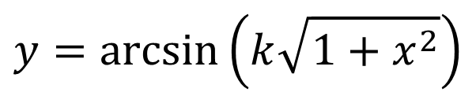



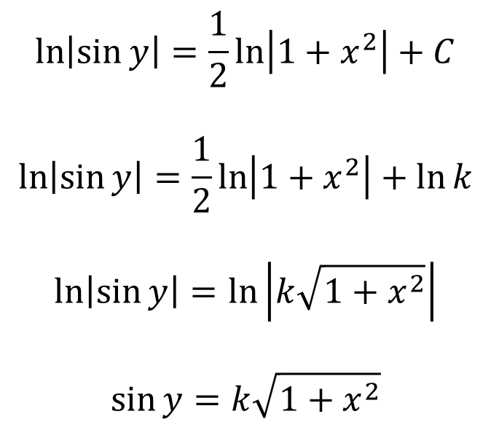
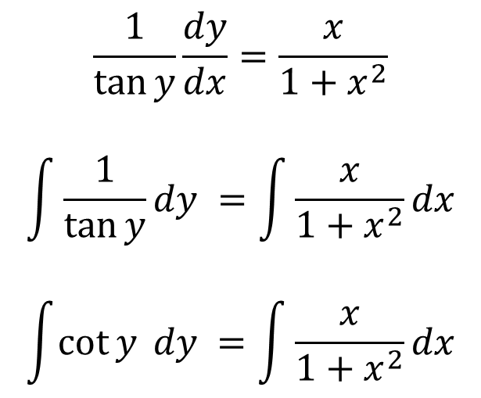
Find the general solution to $\left(1+x^{2}\right)\frac{dy}{dx}=x\tan{y}$
Separate $y$ and $x$
Integrate both sides
Make $y$ the subject
$$\frac{1}{\tan{y}}\frac{dy}{dx}=\frac{x}{1+x^{2}}$$
$$\int{\frac{1}{\tan{y}}dy }=\int{\frac{x}{1+x^{2}}dx}$$
$$\int{\cot{y} dy }=\int{\frac{x}{1+x^{2}}dx}$$
$$\ln\left|\sin{y}\right|=\frac{1}{2}\ln\left|1+x^{2}\right|+C$$
$$\ln\left|\sin{y}\right|=\frac{1}{2}\ln\left|1+x^{2}\right|+\ln{k}$$
$$\ln\left|\sin{y}\right|=\ln\left|k\sqrt{1+x^{2}}\right|$$
$$\sin{y}=k\sqrt{1+x^{2}}$$
$$y=\arcsin\left(k\sqrt{1+x^{2}}\right)$$

Slide 6
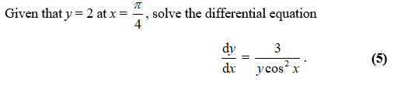

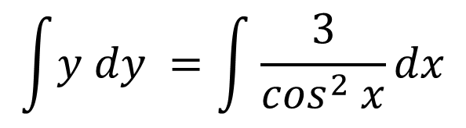

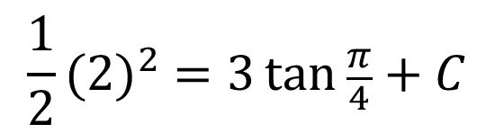

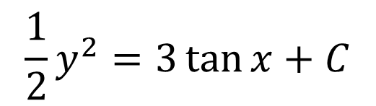

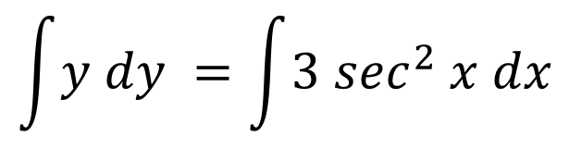

Separate $y$ and $x$
Integrate both sides
Make $y$ the subject
$$\int{y dy }=\int{\frac{3}{\cos^{2} x}dx}$$
$$\frac{1}{2}y^{2}=3\tan{x}+C$$
$$\frac{1}{2}{(2)}^{2} =3\tan{\frac{π}{4}}+C$$
$$C=−1$$
$$\int{y dy }=\int{3 \sec^{2} x dx}$$
$$y^{2}=6\tan{x}−2$$
$$y=\sqrt{6\tan{x −2}}$$

Slide 7
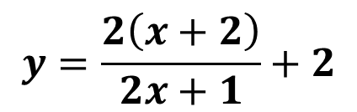

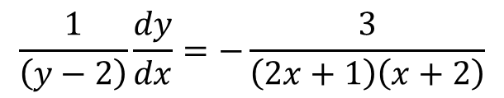
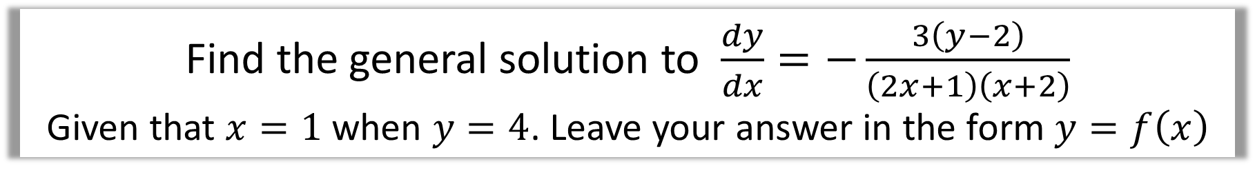
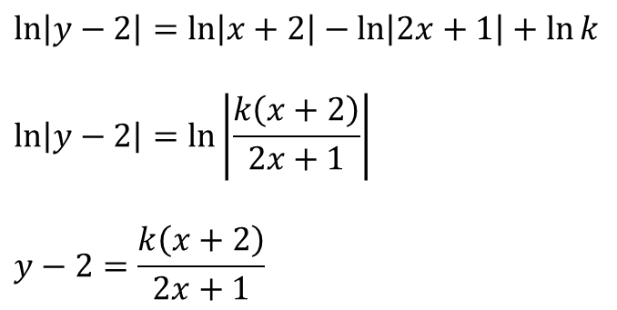
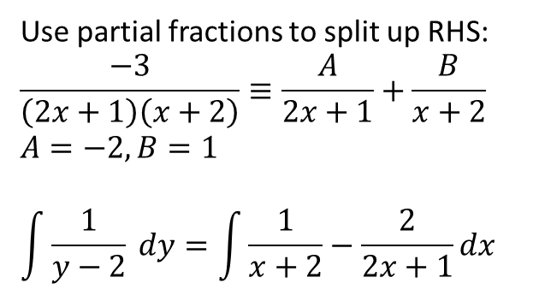

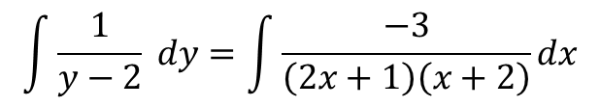
Find the general solution to $\frac{dy}{dx}=−\frac{3\left(y−2\right)}{\left(2x+1\right)\left(x+2\right)}$
Given that $x=1$ when $y=4$. Leave your answer in the form $y=f\left(x\right)$
Separate $y$ and $x$
Integrate both sides
Make $y$ the subject
$$\frac{1}{\left(y−2\right)}\frac{dy}{dx}=−\frac{3}{\left(2x+1\right)\left(x+2\right)}$$
$$\ln\left|y−2\right|=\ln\left|x+2\right|−\ln\left|2x+1\right|+\ln{k}$$
$$\ln\left|y−2\right|=\ln\left|\frac{k\left(x+2\right)}{2x+1}\right|$$
$$y−2=\frac{k\left(x+2\right)}{2x+1}$$
When $x=1,y=4$: $k=2$
$$y=\frac{2\left(x+2\right)}{2x+1}+2$$
$$\int{\frac{1}{y−2} dy}=\int{\frac{−3}{\left(2x+1\right)\left(x+2\right)}dx}$$
Use partial fractions to split up RHS:
$$\frac{−3}{\left(2x+1\right)\left(x+2\right)}≡\frac{A}{2x+1}+\frac{B}{x+2}$$
$$A=−2, B=1$$
$$\int{\frac{1}{y−2} dy}=\int{\frac{1}{x+2}−\frac{2}{2x+1}dx}$$

Slide 8
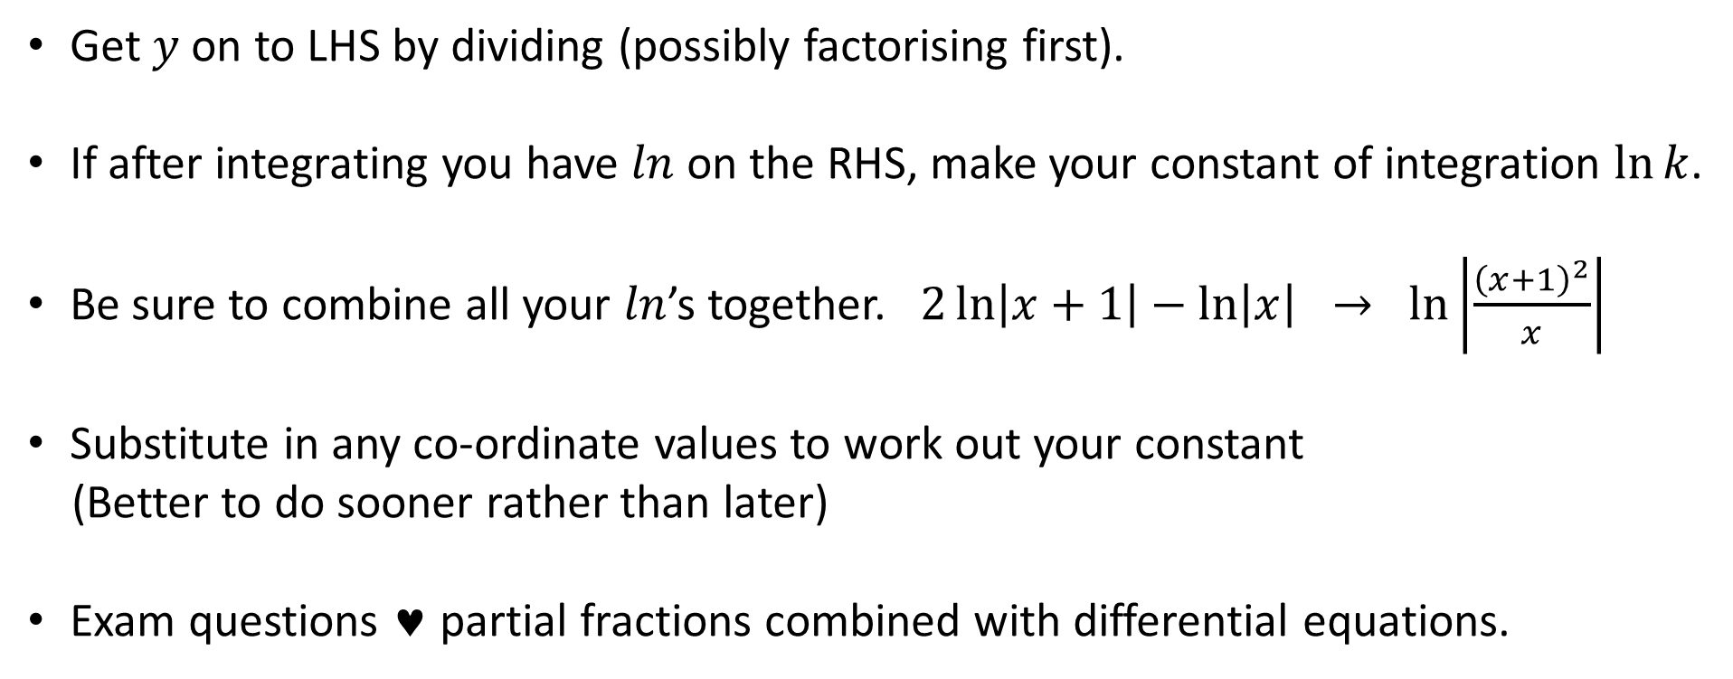
Key Points on Differential Equations
Get $y$ on to LHS by dividing (possibly factorising first).
If after integrating you have $ln$ on the RHS, make your constant of integration $\ln{k}$.
Be sure to combine all your $ln$’s together. $2\ln\left|x+1\right|−\ln\left|x\right| → \ln\left|\frac{{\left(x+1\right)}^{2}}{x}\right|$
Substitute in any co-ordinate values to work out your constant
(Better to do sooner rather than later)
Exam questions ♥ partial fractions combined with differential equations.

