Slide 1
FM Indices and Equations
(Changing Base Values)

Slide 2

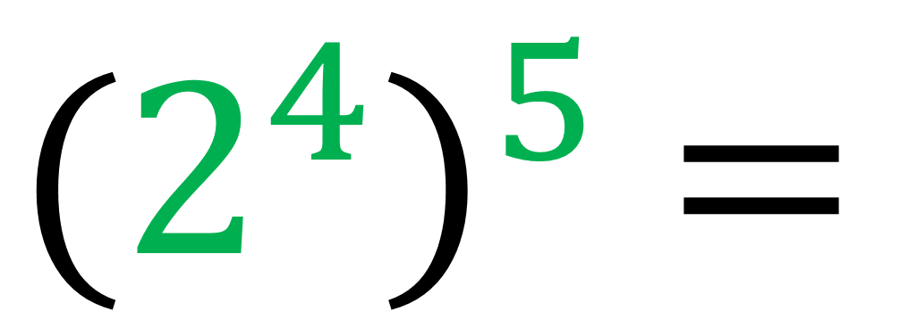
Simplify
$${(2^{4})}^{5} =$$
$$2^{20}$$

Slide 3
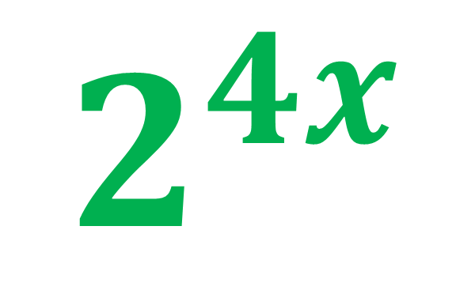
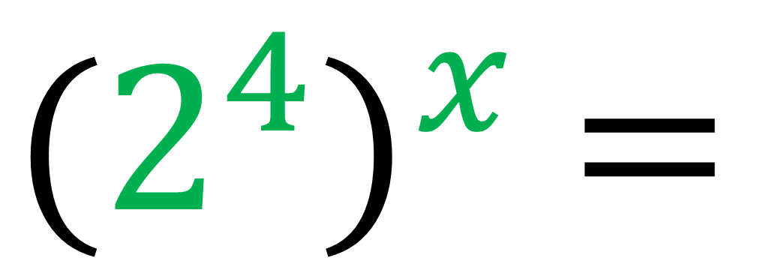
Simplify
$${(2^{4})}^{x} =$$
$$2^{4x}$$

Slide 4
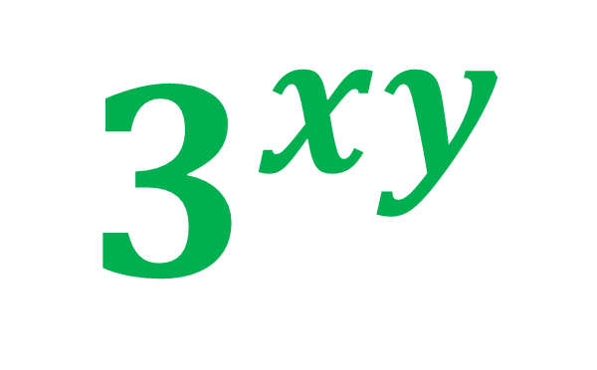
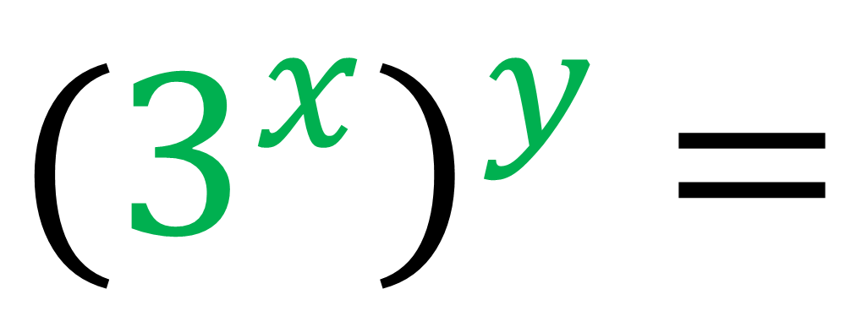
Simplify
$${(3^{x})}^{y} =$$
$$3^{xy}$$

Slide 5
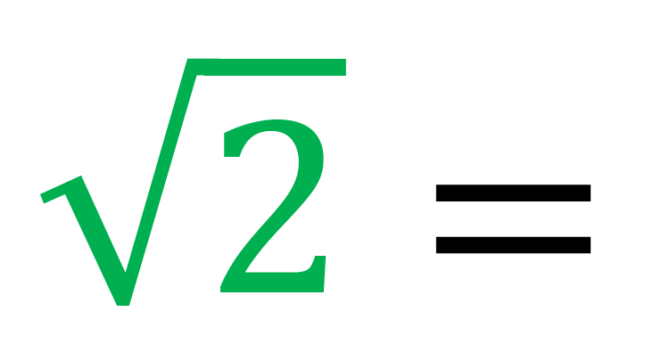
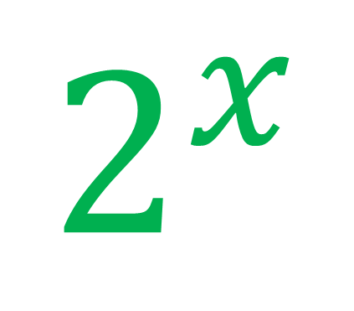


$$\sqrt{2}=$$
$$2^{x}$$
What is the value of x?
$$x=$$
$$\frac{1}{2}$$

Slide 6
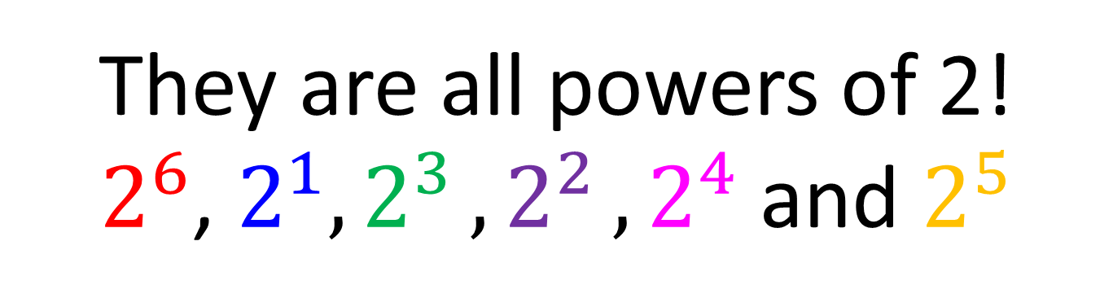

What do all of the numbers have in common?
$$2 , 8 , 4 , 16 , 32,64$$
They are all powers of 2!
$2^{6}$, $2^{1}{, 2}^{3}{, 2}^{2}{, 2}^{4}$ and $2^{5}$
They have a common base value.

Slide 7
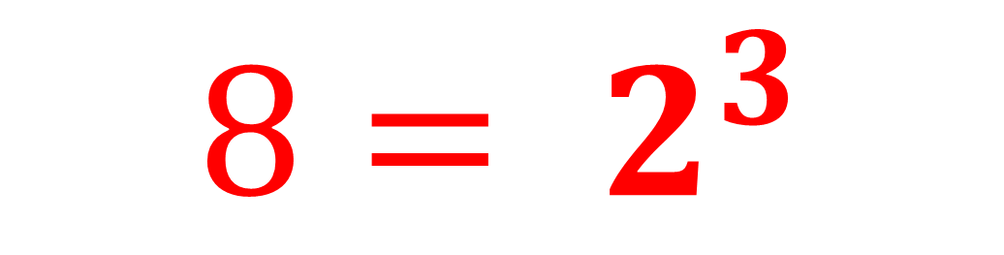
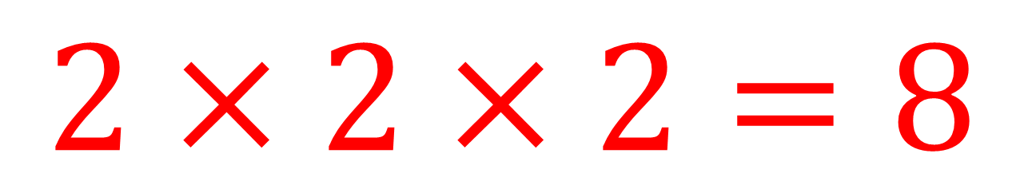
Write 8 as a power with a base value of 2.
$$2×2×2=8$$
$$8= 2^{3}$$

Slide 8
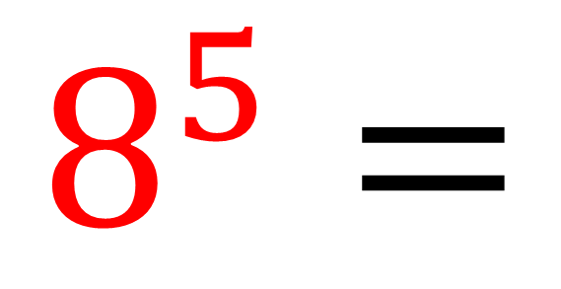

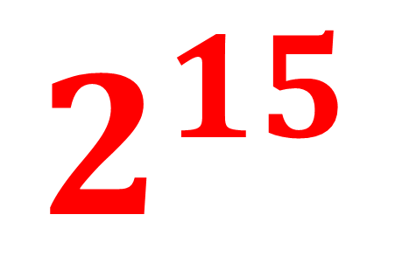
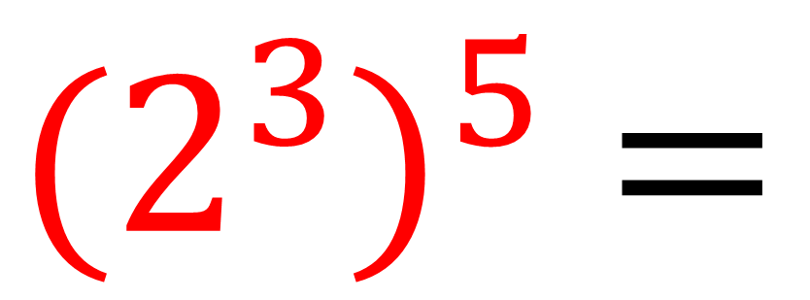
Write 8$5$ as a power of 2
$${(2^{3})}^{5} =$$
$$2^{15}$$
$$8^{5}=$$

Slide 9
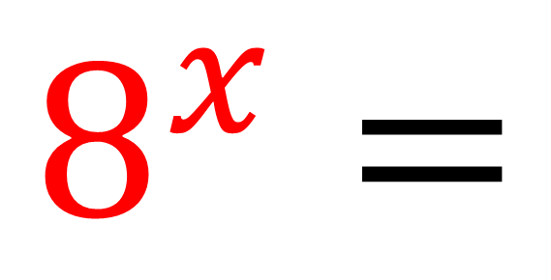

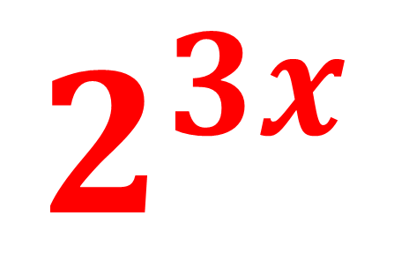
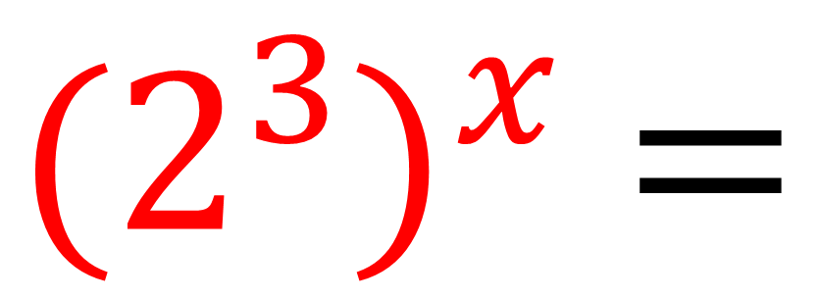
Write 8$x$ as a power of 2
$${(2^{3})}^{x} =$$
$$2^{3x}$$
$$8^{x}=$$

Slide 10
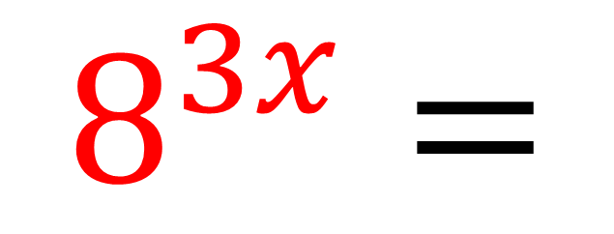

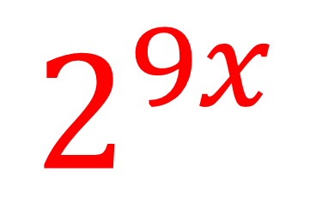
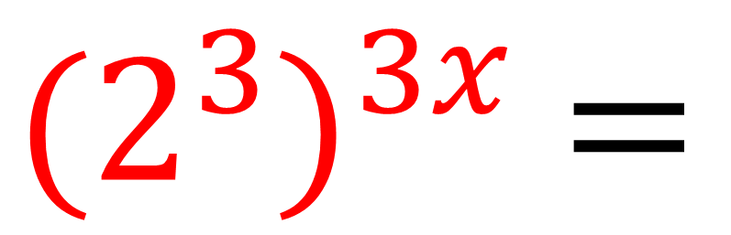
Write 8$3x$ as a power of 2
$$8^{3x}=$$
$${(2^{3})}^{3x} =$$
$$2^{9x}$$

Slide 11
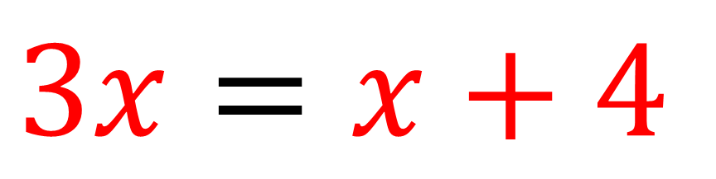
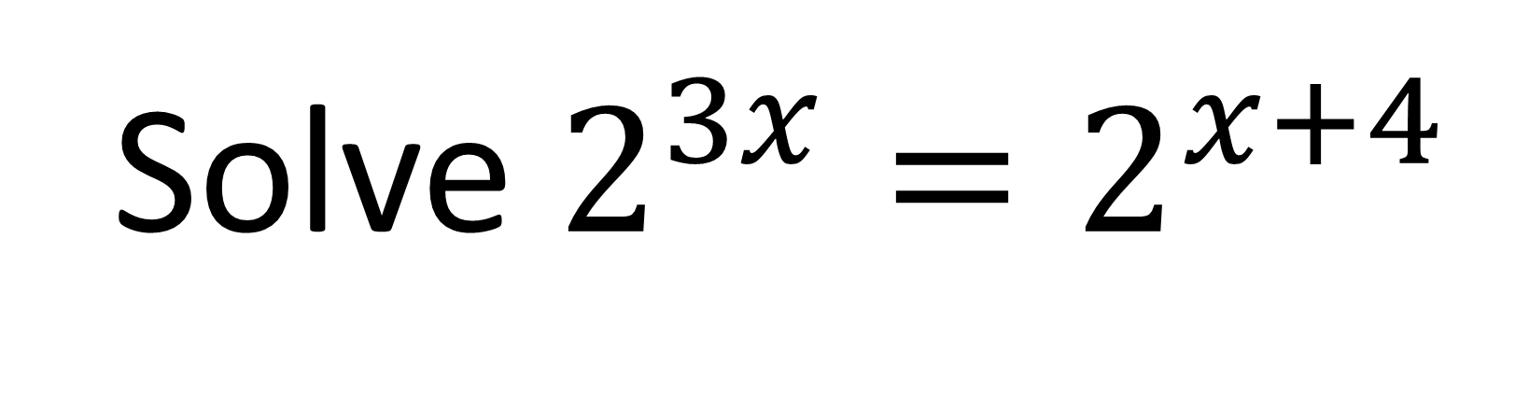

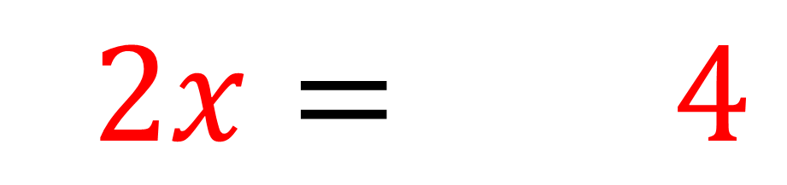
Solve $2^{3x}=2^{x+4}$
Both indices are equal.
$$3x=x+4$$
$$22x=1 4$$
$$22x=1 2$$

Slide 12
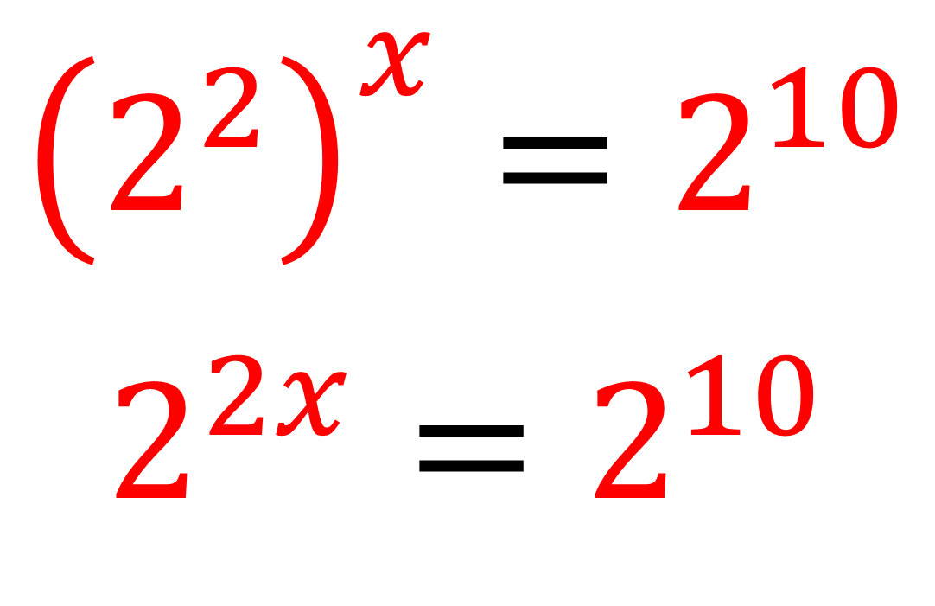
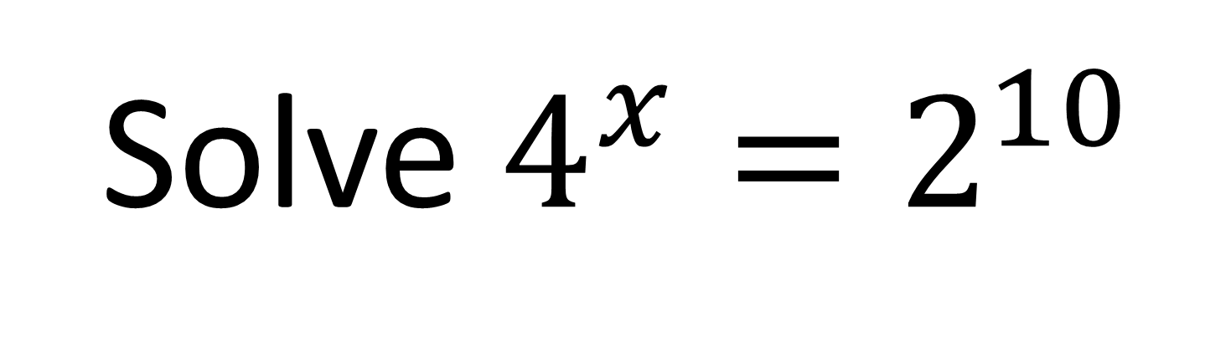
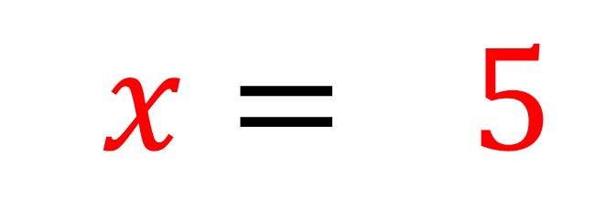
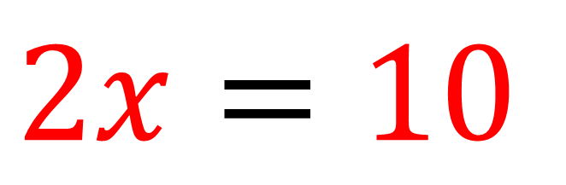
Solve $4^{x}=2^{10}$
The indices will be equal hence,
$${\left(2^{2}\right)}^{x}=2^{10}$$
$$2^{2x}=2^{10}$$
$$2x=10$$
$$2x=15$$

Slide 13
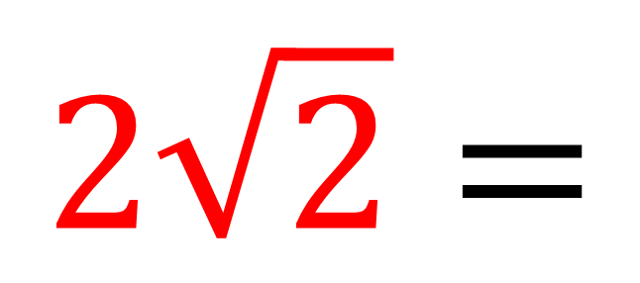
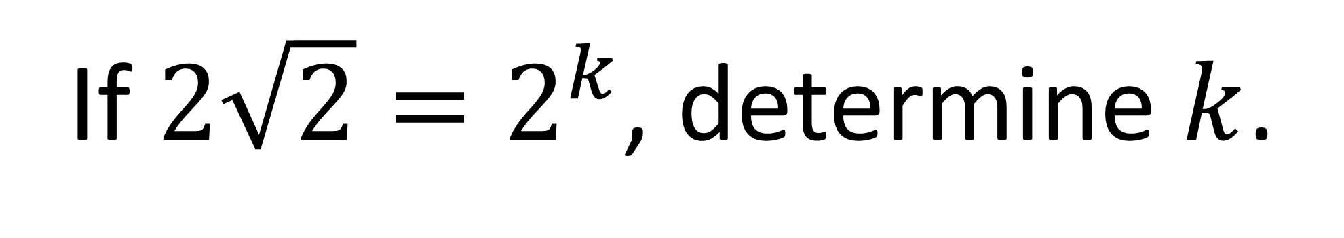
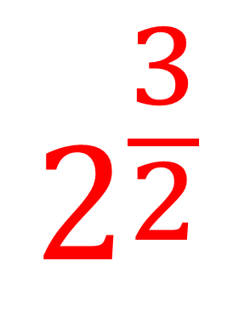
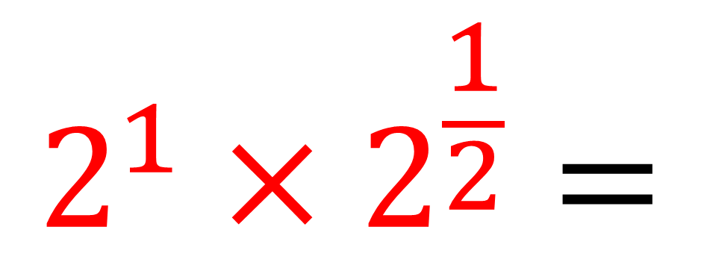
If $2\sqrt{2}=2^{k}$, determine $k$.
$$2^{1}×2^{\frac{1}{2}}=$$
$$2^{\frac{3}{2}}$$
$$2\sqrt{2}=$$
𝑘 = 1.5

Slide 14
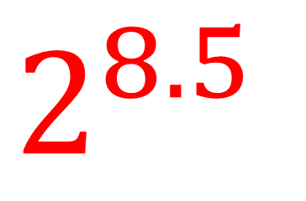
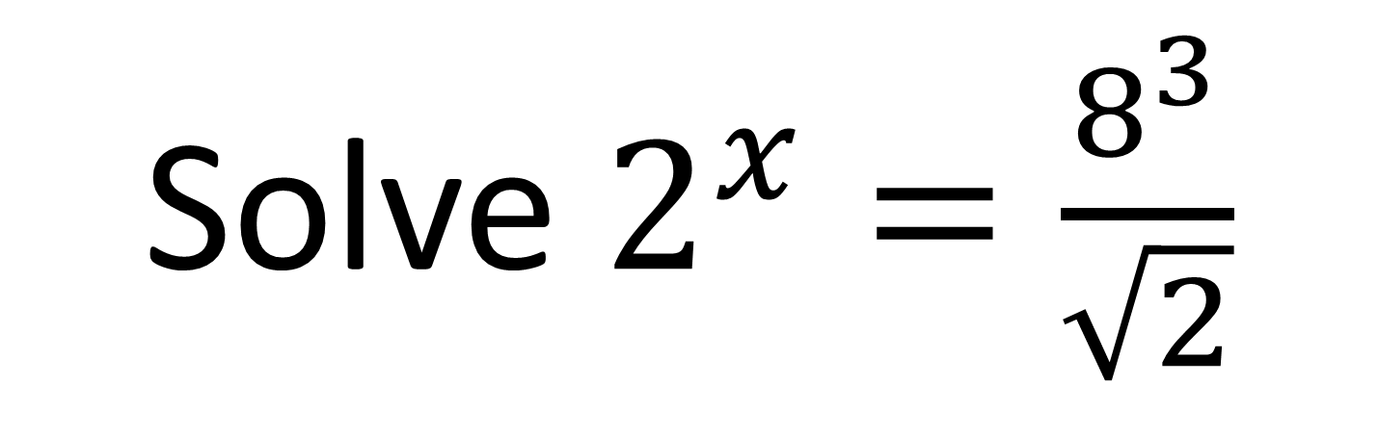
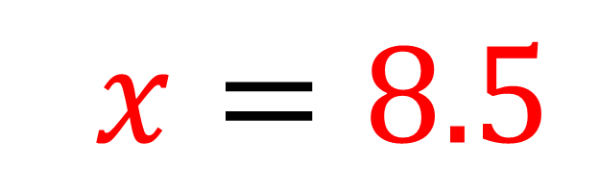
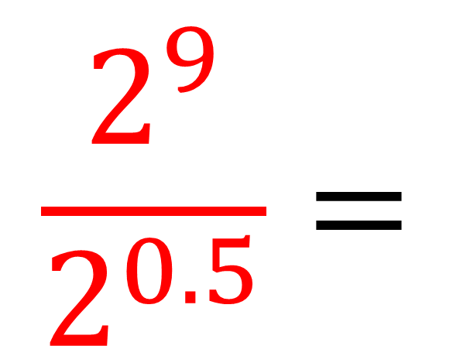
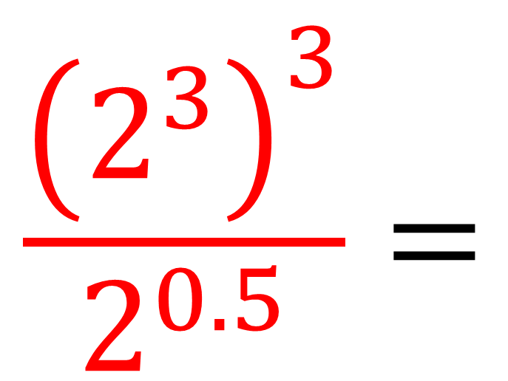
Solve $2^{x}=\frac{8^{3}}{\sqrt{2}}$
$$\frac{{\left(2^{3}\right)}^{3}}{2^{0.5}}=$$
$$\frac{2^{9}}{2^{0.5}}=$$
$$2^{8.5}$$
$$2x=8.5$$

