Slide 1
Question 1
The perimeter of a rectangle is P cm.
The length is (3x+1) cm and the width is (x+5) cm.
If P = 46 cm, find the value of x.
Question 2
Two triangles have equal perimeters.
The sides of the first triangle are 2x cm, (x+2) cm, and (x+4) cm.
The sides of the second triangle are 3x cm, (x+1) cm, and (x+3) cm.
Find the value of x.
Question 3
A father is 3 years older than twice his son's age.
The sum of their ages is 51.
Let the son's age be x.
Find the age of the father.
Question 4
The area of a trapezium is given by the formula A = ½(a+b)h.
The parallel sides are of length 3x cm and (x+2) cm.
The height is 6cm and the area is 48cm².
Find the value of x.
Question 5
A number is multiplied by 5 and then 12 is subtracted from the result.
This is the same as multiplying the number by 3 and adding 6 to the result.
Find the number.
Question 6
A company sells two types of coffee beans, A and B.
A bag of coffee A costs £(2x−3) and a bag of coffee B costs £(x+4).
If 5 bags of coffee A and 3 bags of coffee B cost the same amount, find the value of x.
Question 7
Two phone plans are offered. Plan A costs £15 plus 10p per minute.
Plan B costs £10 plus 15p per minute.
After how many minutes of calls will the cost of the two plans be the same?
Question 8
Two painters, A and B, are painting a wall.
Painter A has already painted 5 m2 and paints at a rate of 3 m2 per hour.
Painter B has already painted 8 m2 and paints at a rate of 2 m2 per hour.
How many hours will it take for them to have painted the same total area?
Question 9
A triangle has angles (4x+10)∘, (2x+15)∘, and (x+5)∘.
Find the value of x and the size of the largest angle.
Question 10
Two rectangles have the same area.
The first rectangle has a length of 3x and a width of 4.
The second rectangle has a length of (x+5) and a width of 6.
Find the value of x.

Slide 2
ANSWERS

Slide 3
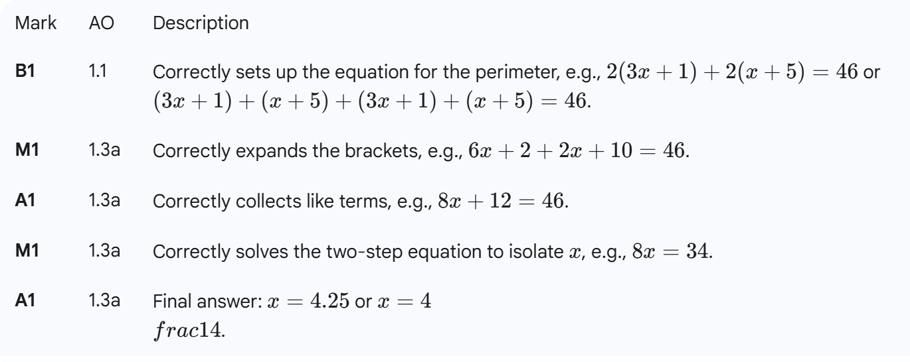
Question 1
The perimeter of a rectangle is P cm.
The length is (3x+1) cm and the width is (x+5) cm.
If P = 46 cm, find the value of x.

Slide 4
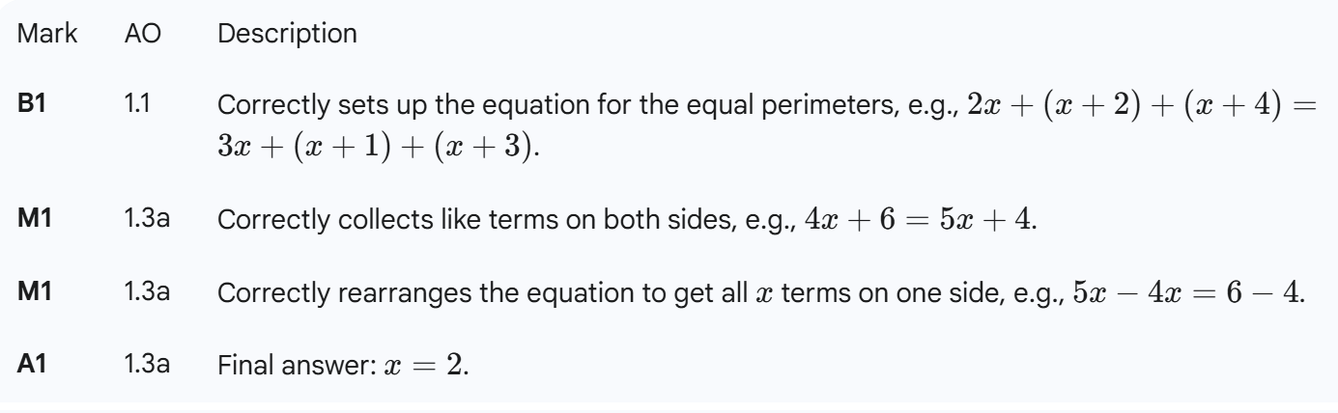
Question 2
Two triangles have equal perimeters.
The sides of the first triangle are 2x cm, (x+2) cm, and (x+4) cm.
The sides of the second triangle are 3x cm, (x+1) cm, and (x+3) cm.
Find the value of x.

Slide 5
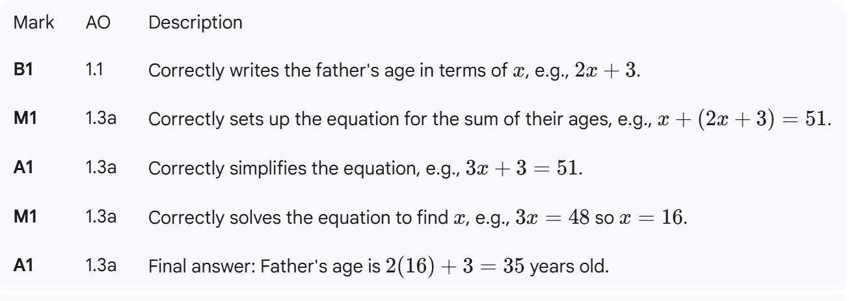
Question 3
A father is 3 years older than twice his son's age.
The sum of their ages is 51.
Let the son's age be x.
Find the age of the father.

Slide 6
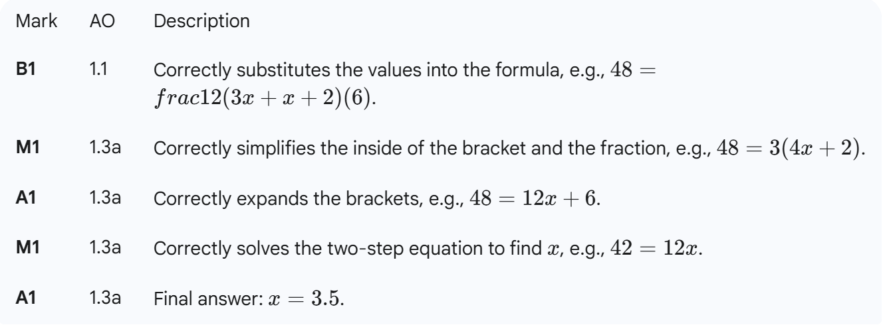
Question 4
The area of a trapezium is given by the formula A = ½(a+b)h.
The parallel sides are of length 3x cm and (x+2) cm.
The height is 6cm and the area is 48cm².
Find the value of x.

Slide 7
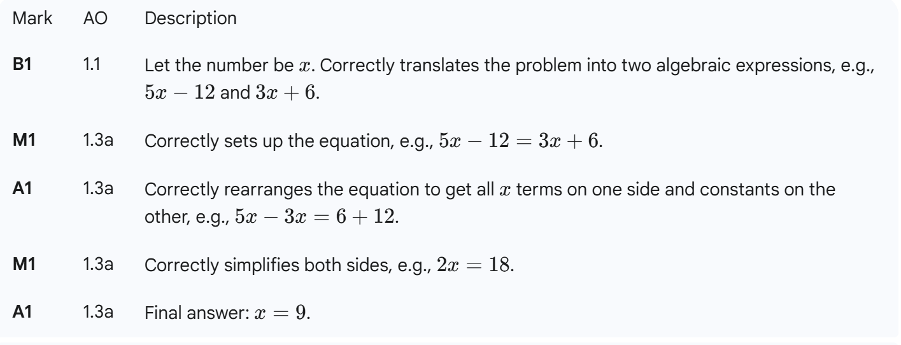
Question 5
A number is multiplied by 5 and then 12 is subtracted from the result.
This is the same as multiplying the number by 3 and adding 6 to the result.
Find the number.

Slide 8
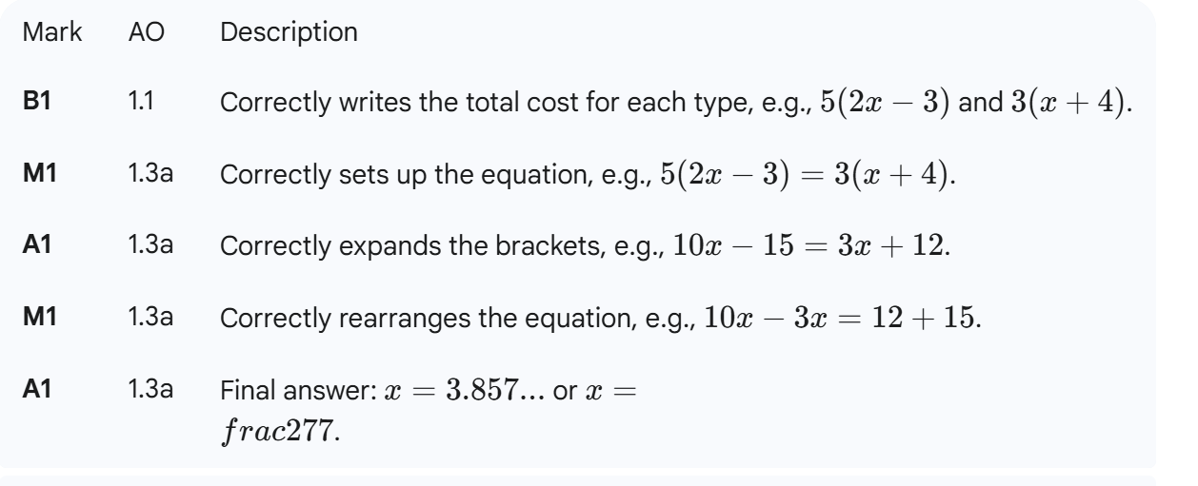
Question 6
A company sells two types of coffee beans, A and B.
A bag of coffee A costs £(2x−3) and a bag of coffee B costs £(x+4).
If 5 bags of coffee A and 3 bags of coffee B cost the same amount, find the value of x.

Slide 9
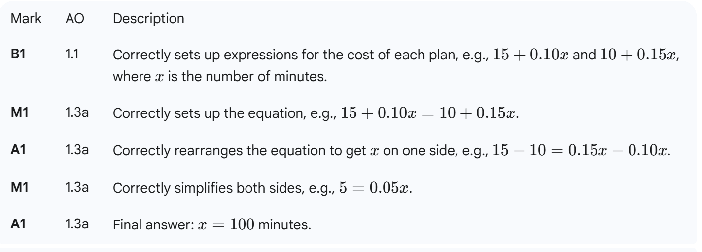
Question 7
Two phone plans are offered. Plan A costs £15 plus 10p per minute.
Plan B costs £10 plus 15p per minute.
After how many minutes of calls will the cost of the two plans be the same?

Slide 10
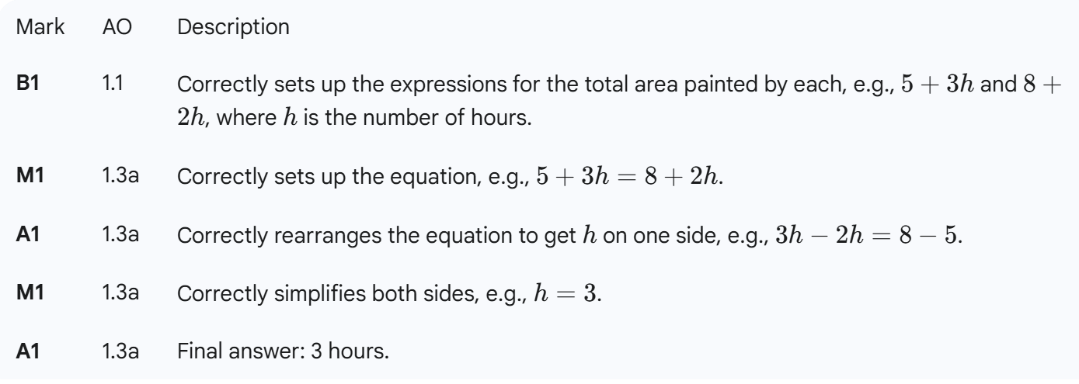
Question 8
Two painters, A and B, are painting a wall.
Painter A has already painted 5 m2 and paints at a rate of 3 m2 per hour.
Painter B has already painted 8 m2 and paints at a rate of 2 m2 per hour.
How many hours will it take for them to have painted the same total area?

Slide 11
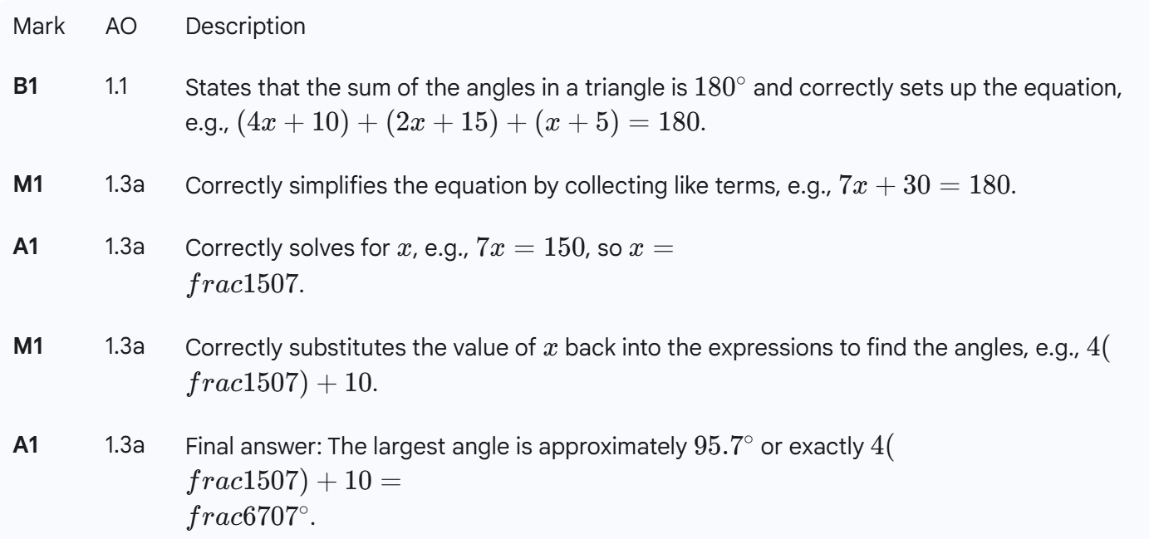
Question 9
A triangle has angles (4x+10)∘, (2x+15)∘, and (x+5)∘.
Find the value of x and the size of the largest angle.

Slide 12
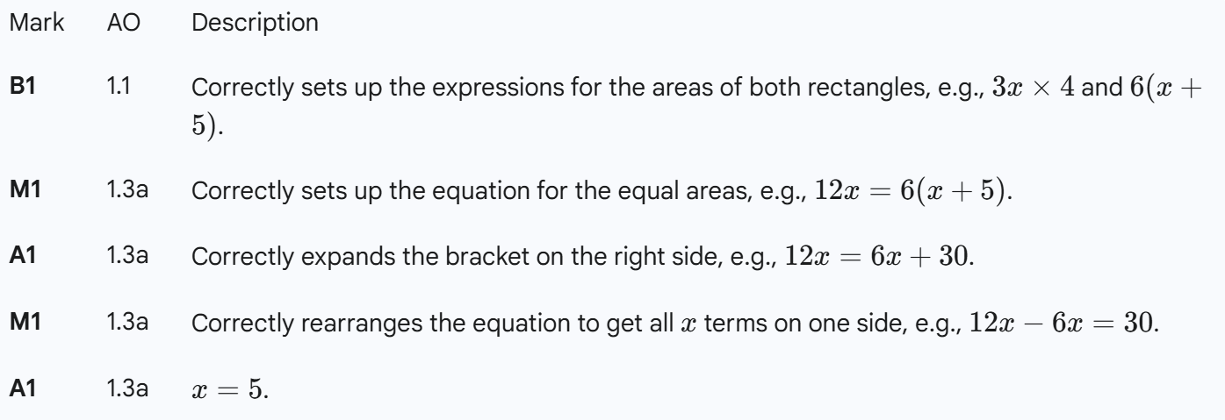
Question 10
Two rectangles have the same area.
The first rectangle has a length of 3x and a width of 4.
The second rectangle has a length of (x+5) and a width of 6.
Find the value of x.

