Slide 1
LO: Rounding Numbers
(Decimal Places)

Slide 2
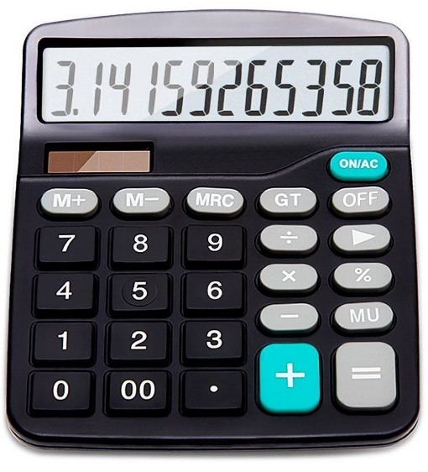
Why round numbers?
- to make calculations easier.
- to make a number user friendly

Slide 3
3.4
How many decimal places?
1 decimal place

Slide 4
3.04
How many decimal places?
2 decimal place

Slide 5
13.3304
How many decimal places?
4 decimal place

Slide 6
0.33
How many decimal places?
2 decimal place

Slide 7
0.042
How many decimal places?
3 decimal place

Slide 8
3
How many decimal places?
0 decimal places

Slide 9
3.0
How many decimal places?
1 decimal place

Slide 10
3.00
How many decimal places?
2 decimal place

Slide 11
Rounding to 1 d.p
4.8325
4.8325
4.8

Slide 12
Rounding to 1 d.p
4.8525
4.8525
4.9

Slide 13
Rounding to 1 d.p
14.8925
14.8925
14.9

Slide 14
Rounding to 2 d.p
14.8975
14.8975
14.90

Slide 15
Rounding to 2 d.p
14.8925
14.8925
14.89

Slide 16
Rounding to 2 d.p
0.7351
0.7351
0.74

Slide 17
Rounding to 3 d.p
0.03512
0.03512
0.035

Slide 18
Rounding to 3 d.p
0.99999
0.99999
1.000

Slide 19
What is wrong?
1.982
Rounding to 1 d.p
2

Slide 20
What is wrong?
1.999
Rounding to 2 d.p
2

Slide 21
What is wrong?
2.9954
Rounding to 3 d.p
3.0

