Slide 1
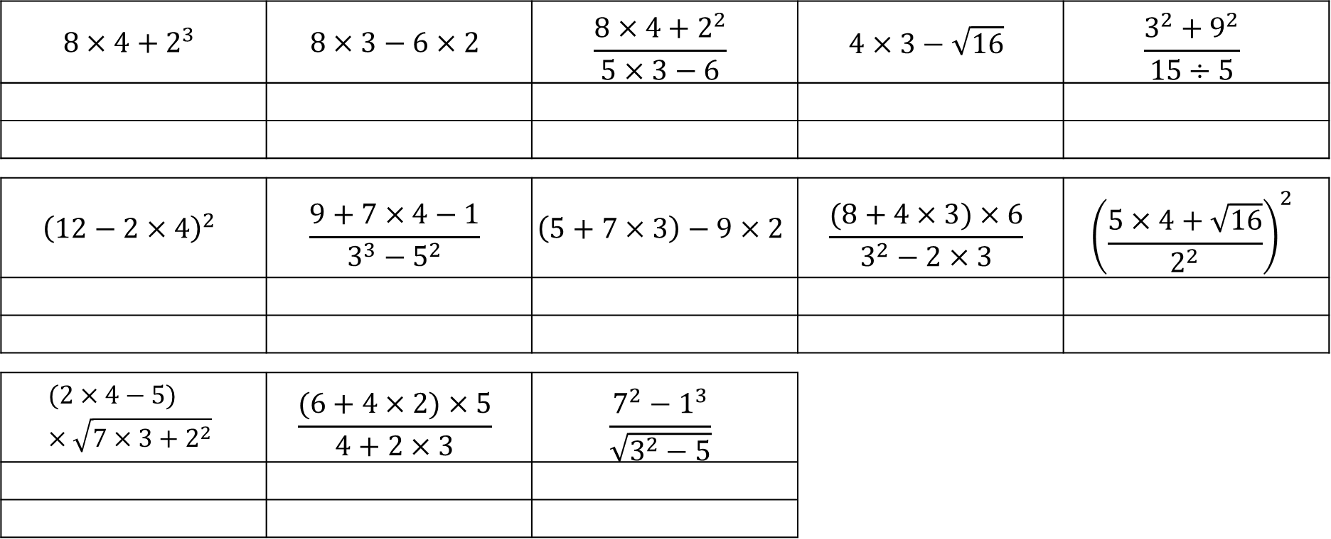
A | B | C | D | E | F | G | H | I | J | K | L | M
12 | 3 | 48 | 6 | 8 | 14 | 24 | 36 | 15 | 28 | 4 | 20 | 18
N | O | P | Q | R | S | T | U | V | W | X | Y | Z
7 | 16 | 2 | 17 | 21 | 30 | 40 | 60 | 10 | 5 | 9 | 13 | 23
$$8×4+2^{3}$$ | $$8×3−6×2$$ | $$\frac{8×4+2^{2}}{5×3−6}$$ | $$4×3−\sqrt{16}$$ | $$\frac{3^{2}+9^{2}}{15÷5}$$
$${\left(12−2×4\right)}^{2}$$ | $$\frac{9+7×4−1}{3^{3}−5^{2}}$$ | $$\left(5+7×3\right)−9×2$$ | $$\frac{(8+4×3)×6}{3^{2}−2×3}$$ | $${\left(\frac{5×4+\sqrt{16}}{2^{2}}\right)}^{2}$$
$$(2×4−5)×\sqrt{7×3+2^{2}}$$ | $$\frac{(6+4×2)×5}{4+2×3}$$ | $$\frac{7^{2}−1^{3}}{\sqrt{3^{2}−5}}$$
Reveal what kleptomaniacs do to treat their condition:

Slide 2
ANSWERS

Slide 3
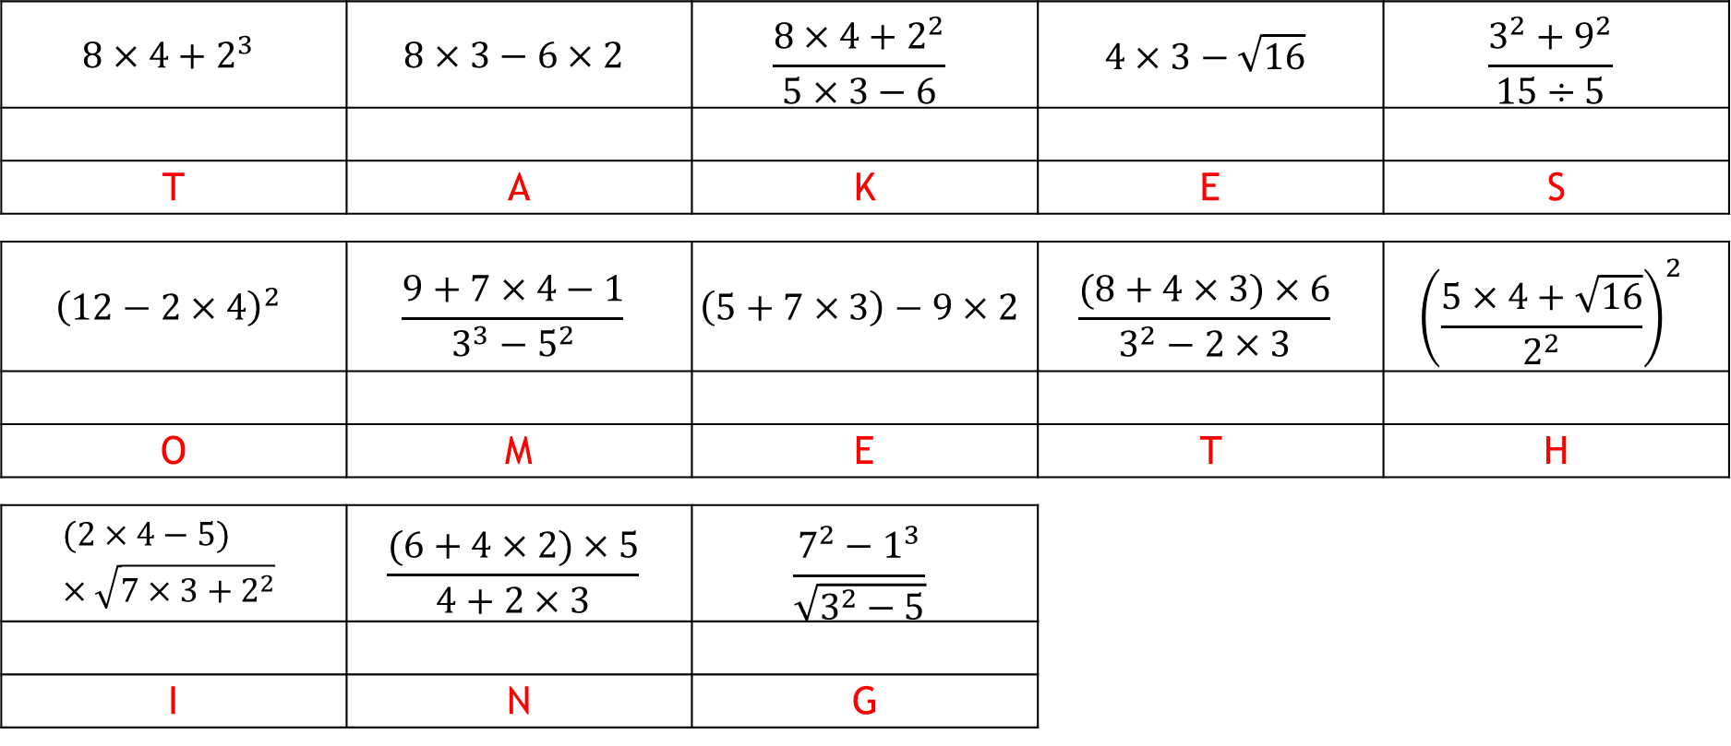
A | B | C | D | E | F | G | H | I | J | K | L | M
12 | 3 | 48 | 6 | 8 | 14 | 24 | 36 | 15 | 28 | 4 | 20 | 18
N | O | P | Q | R | S | T | U | V | W | X | Y | Z
7 | 16 | 2 | 17 | 21 | 30 | 40 | 60 | 10 | 5 | 9 | 13 | 23
$$8×4+2^{3}$$ | $$8×3−6×2$$ | $$\frac{8×4+2^{2}}{5×3−6}$$ | $$4×3−\sqrt{16}$$ | $$\frac{3^{2}+9^{2}}{15÷5}$$
T | A | K | E | S
$${\left(12−2×4\right)}^{2}$$ | $$\frac{9+7×4−1}{3^{3}−5^{2}}$$ | $$\left(5+7×3\right)−9×2$$ | $$\frac{(8+4×3)×6}{3^{2}−2×3}$$ | $${\left(\frac{5×4+\sqrt{16}}{2^{2}}\right)}^{2}$$
O | M | E | T | H
$$(2×4−5)×\sqrt{7×3+2^{2}}$$ | $$\frac{(6+4×2)×5}{4+2×3}$$ | $$\frac{7^{2}−1^{3}}{\sqrt{3^{2}−5}}$$
I | N | G
Reveal what kleptomaniacs do to treat their condition:

