Slide 1
Vectors
Magnitude and Unit Vectors
Chapter 12
(Part 3 of 6)

Slide 2
Magnitude of a vector
is the same as the
Length of a vector

Slide 3
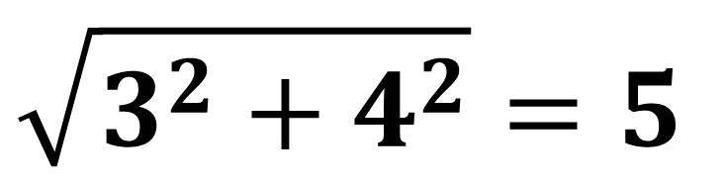

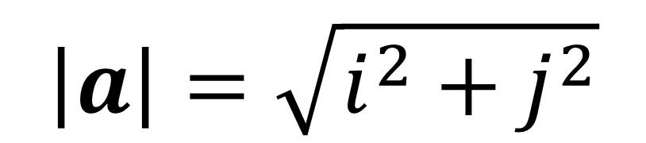


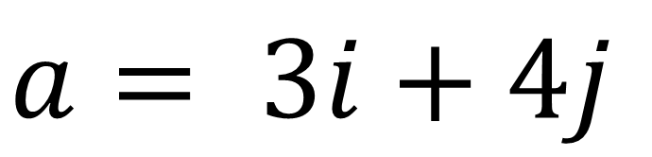
Magnitude of a 2D Vector (from the origin)
$$y$$
$$a= 3i+4j$$
$$a$$
4
$$x$$
3
$$\left|a\right|=\sqrt{i^{2}+j^{2}}$$
$$\sqrt{3^{2}+4^{2}}=5$$

Slide 4
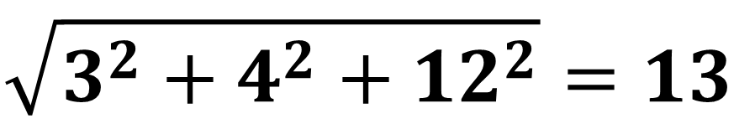
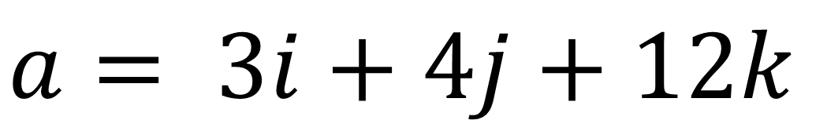
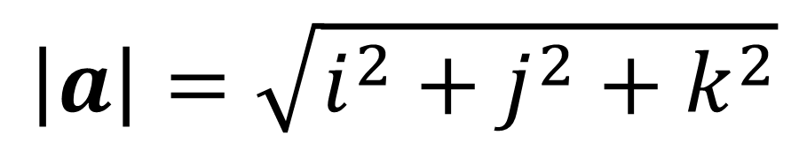



Magnitude of a 3D Vector (from the origin)
$$z$$
$$y$$
$$a= 3i+4j+12k$$
$$x$$
$$\left|a\right|=\sqrt{i^{2}+j^{2}+k^{2}}$$
$$\sqrt{3^{2}+4^{2}+12^{2}}=13$$

Slide 5
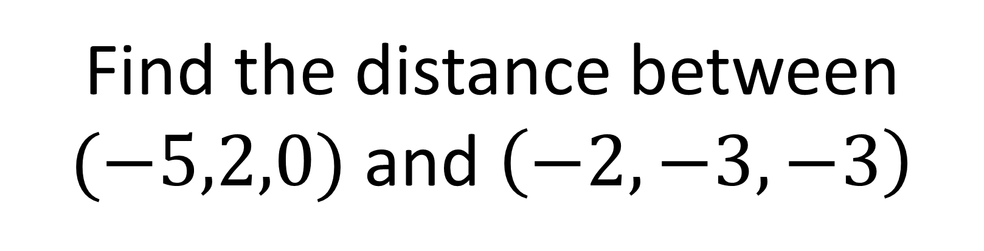
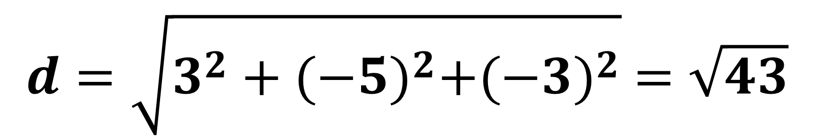
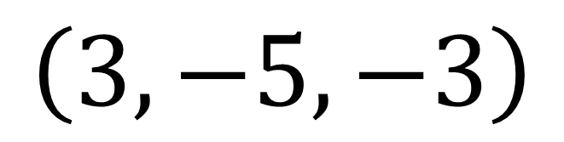
Distance between two 3D points
Find the distance between
$(−5,2,0)$ and $\left(−2,−3,−3\right)$
$$\left(3,−5,−3\right)$$
$$d=\sqrt{3^{2}+{(−5)}^{2}+{(−3)}^{2}} =\sqrt{43}$$

Slide 6
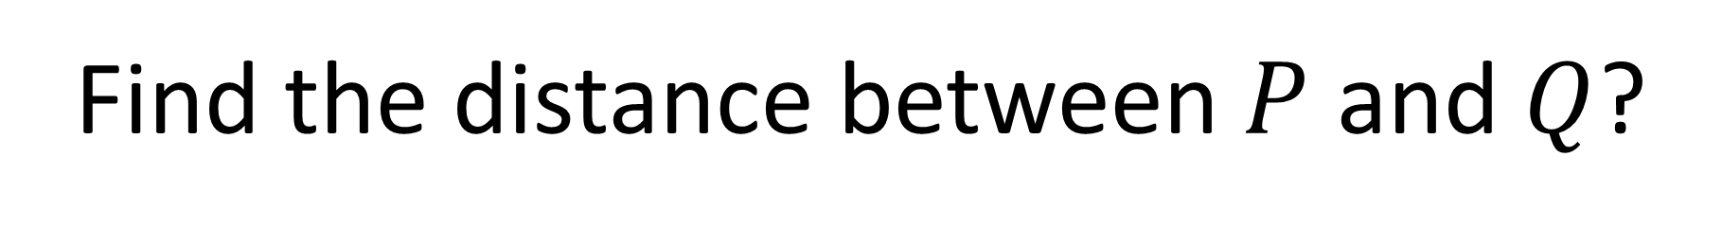

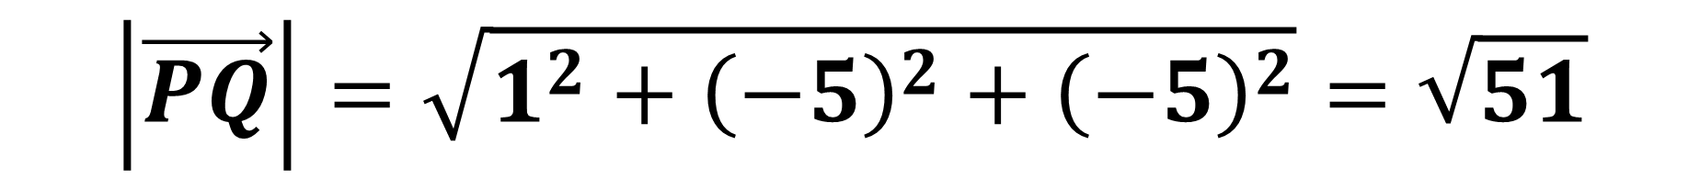




Find the distance between $P$ and $Q$?
$$z$$
$$y$$
$$P\left(3,4,12\right)$$
$$x$$
$$Q\left(4,−1,7\right)$$
$$\left|\vec{PQ}\right|=\sqrt{1^{2}+{\left(−5\right)}^{2}+{\left(−5\right)}^{2}}=\sqrt{51}$$

Slide 7
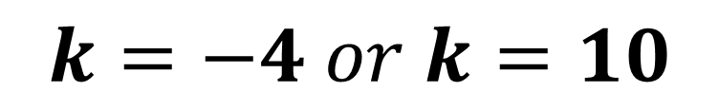
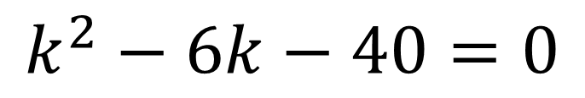
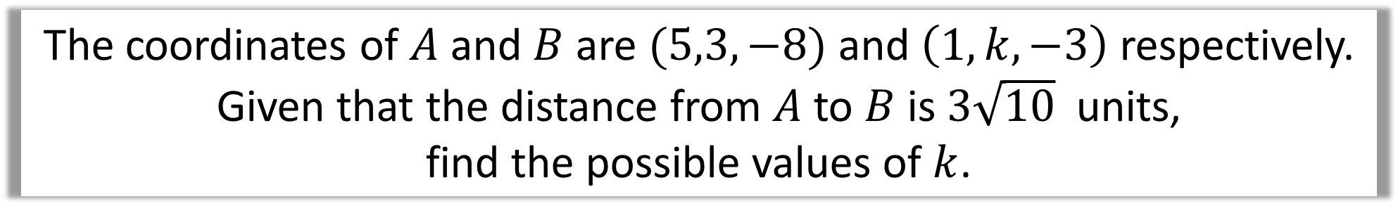
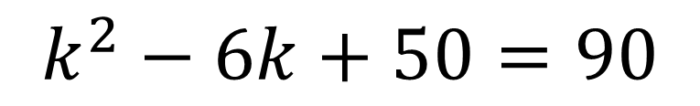
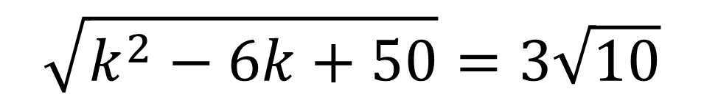
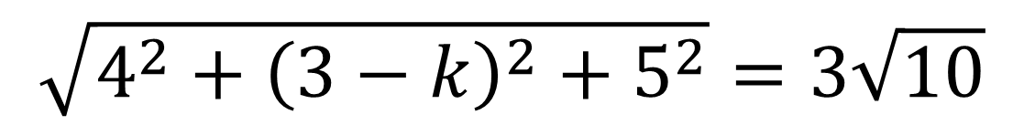
The coordinates of $A$ and $B$ are $(5,3,−8)$ and $\left(1,k,−3\right)$ respectively.
Given that the distance from $A$ to $B$ is $3\sqrt{10}$ units,
find the possible values of $k$.
$$\sqrt{4^{2}+{\left(3−k\right)}^{2}+5^{2}}=3\sqrt{10}$$
$$\sqrt{k^{2}−6k+50}=3\sqrt{10}$$
$$k^{2}−6k+50=90$$
$$k^{2}−6k−40=0$$
$$k=−4 or k=10$$

Slide 8

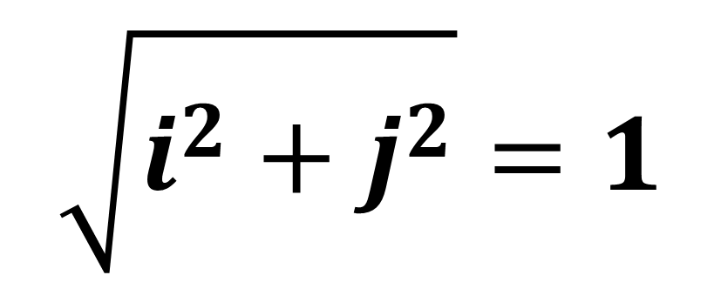

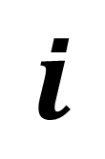
Unit Vectors
A unit vector has a length of 1.
$$1$$
$$\sqrt{i^{2}+j^{2}}=1$$
$$j$$
$$i$$

Slide 9
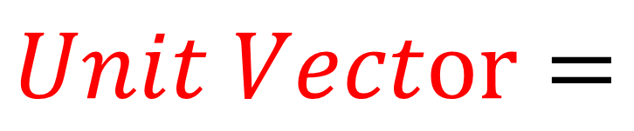
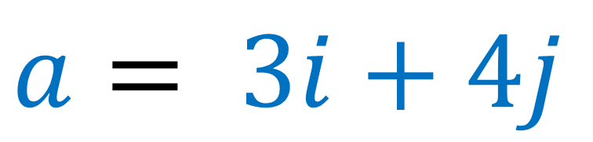
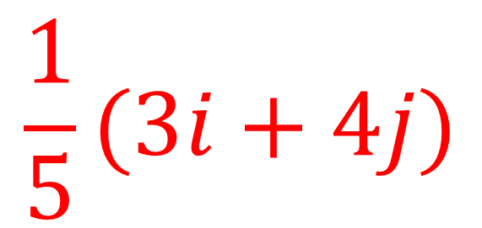


A unit vector has a length of 1.
$$a= 3i+4j$$
$$5$$
$$\frac{1}{5}(3i+4j)$$
$$Unit Vector=$$
$$1$$

Slide 10
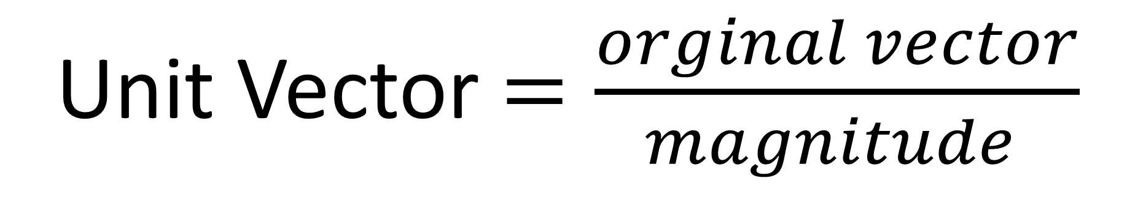
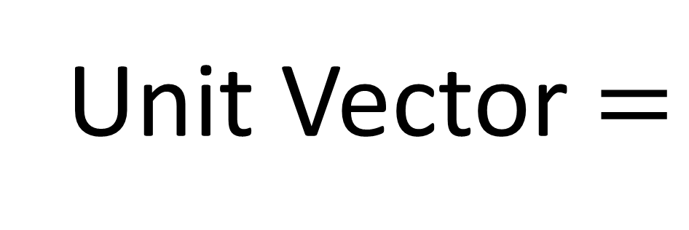
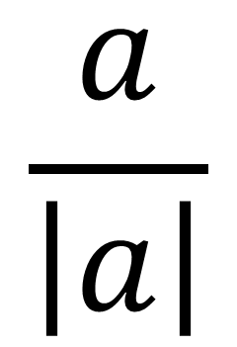
Unit Vector $=\frac{orginal vector}{magnitude }$
$$\frac{a}{\left|a\right|}$$
Unit Vector $=$

Slide 11
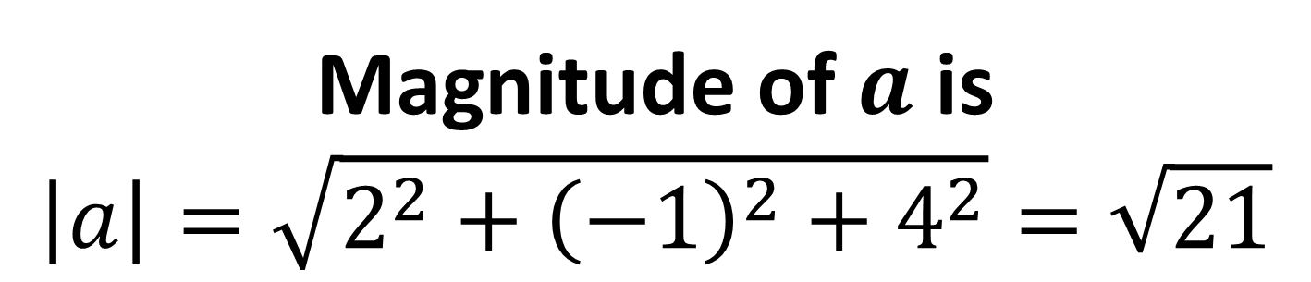
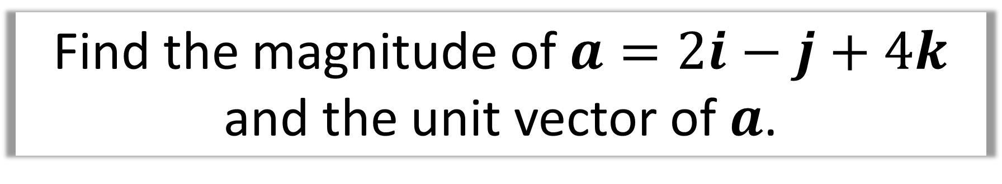
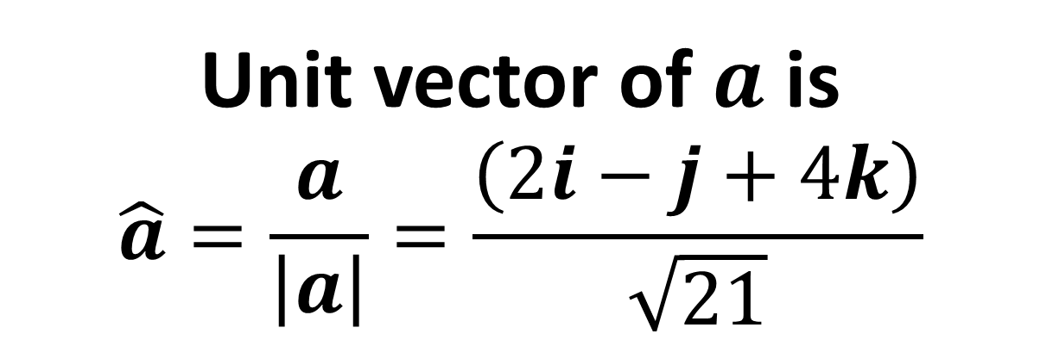
Find the magnitude of $a=2i−j+4k$
and the unit vector of $a$.
Magnitude of $a$ is
$$\left|a\right|=\sqrt{2^{2}+{\left(−1\right)}^{2}+4^{2}}=\sqrt{21}$$
Unit vector of $a$ is
$$\hat{a}=\frac{a}{\left|a\right|}=\frac{\left(2i−j+4k\right)}{\sqrt{21}}$$

