Slide 1
FM: Simplifying and Rationalising Surds

Slide 2
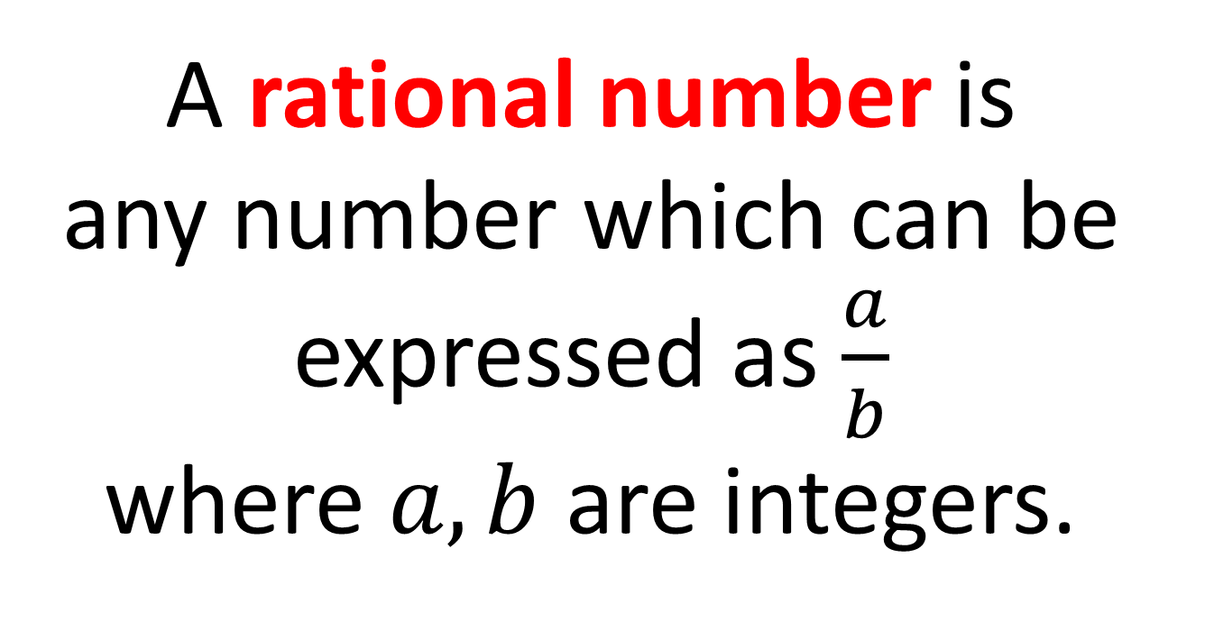
What is a rational number?
A rational number is
any number which can be
expressed as $\frac{a}{b}$
where $a,b$ are integers.

Slide 3
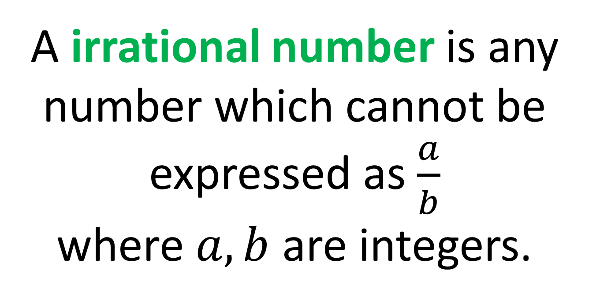
What is an irrational number?
A irrational number is any number which cannot be
expressed as $\frac{a}{b}$
where $a,b$ are integers.

Slide 4
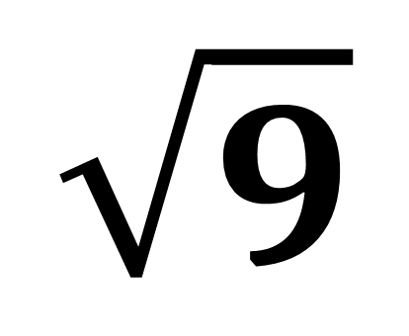
$$\sqrt{9}$$
Rational number or
Irrational Number?
Rational

Slide 5
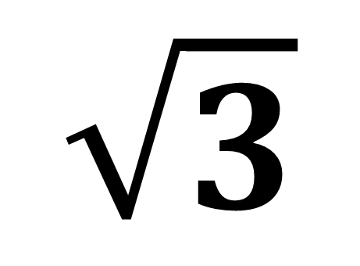
$$\sqrt{3}$$
Rational number or
Irrational Number?
Irrational

Slide 6
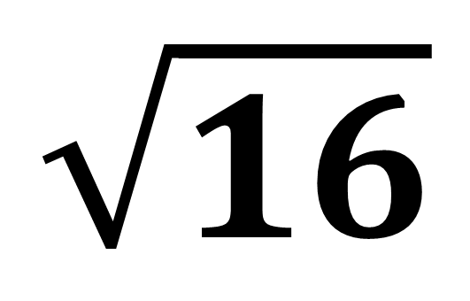
$$\sqrt{16}$$
Rational number or
Irrational Number?
Rational

Slide 7
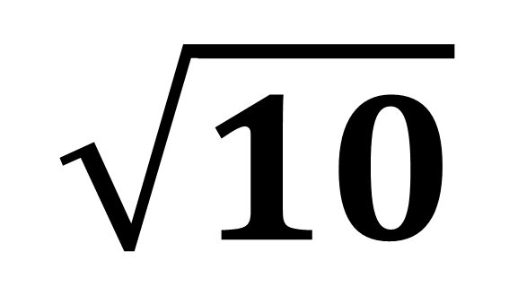
$$\sqrt{10}$$
Rational number or
Irrational Number?
Irrational

Slide 8
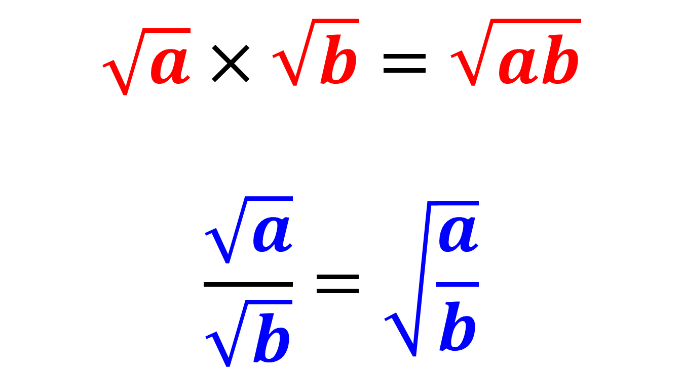
Laws to follow:
$$\sqrt{a}×\sqrt{b}=\sqrt{ab}$$
$$\frac{\sqrt{a}}{\sqrt{b}}=\sqrt{\frac{a}{b}}$$

Slide 9
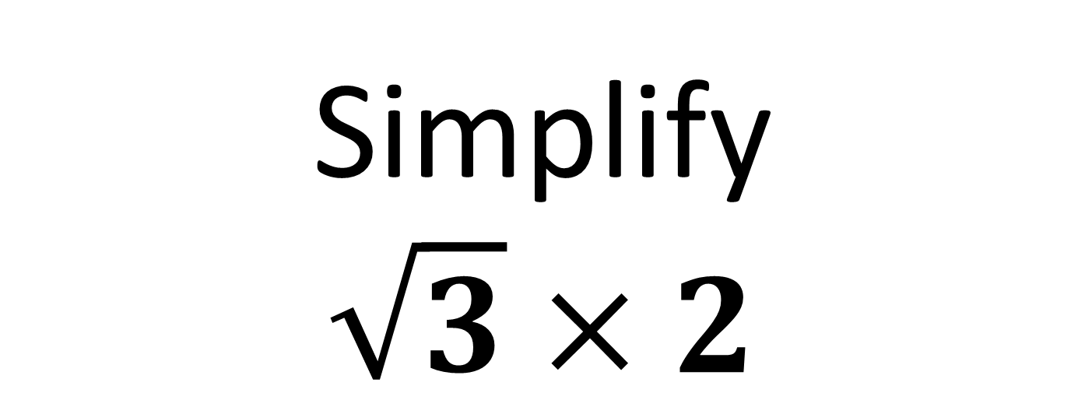
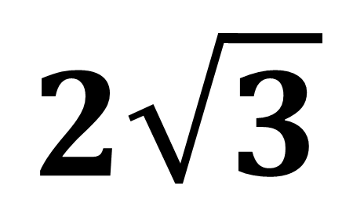
Simplify
$$\sqrt{3}×2$$
$$2\sqrt{3}$$

Slide 10
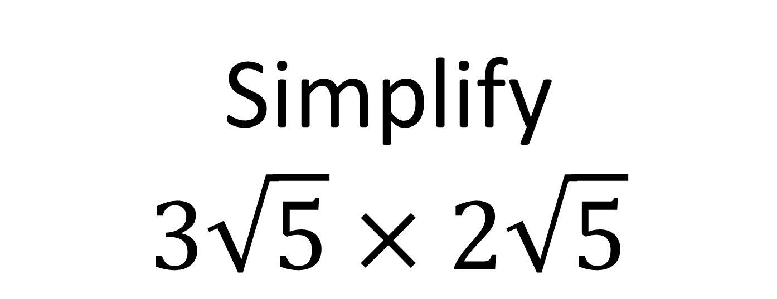
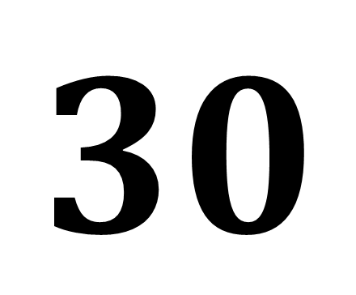
Simplify
$$3\sqrt{5}×2\sqrt{5}$$
$$30$$

Slide 11

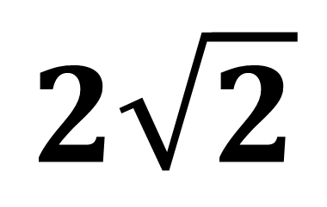
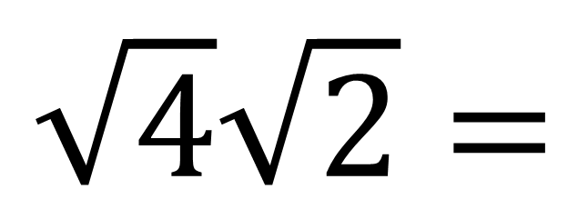
Simplify
$$\sqrt{8}$$
$$\sqrt{4}\sqrt{2}=$$
$$2\sqrt{2}$$

Slide 12
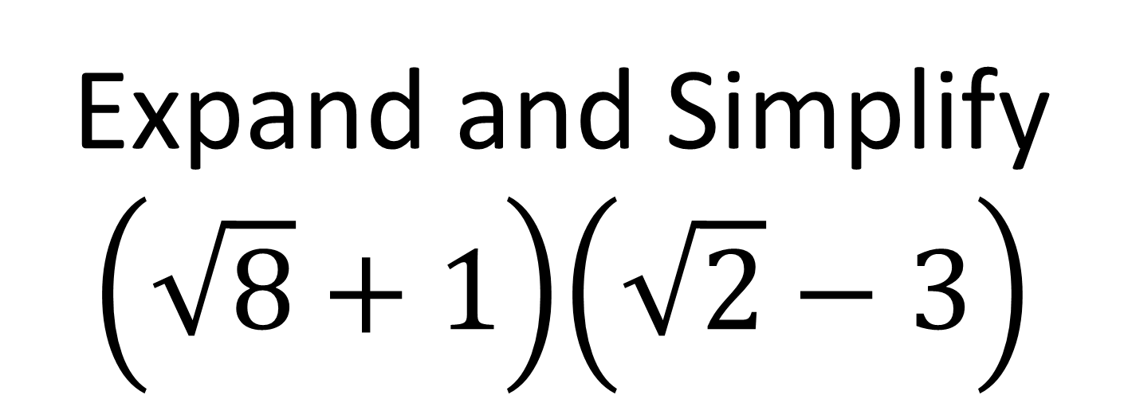
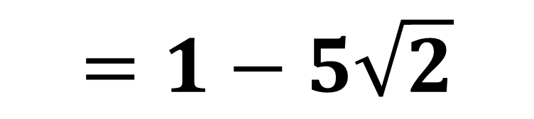
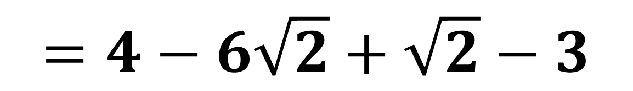
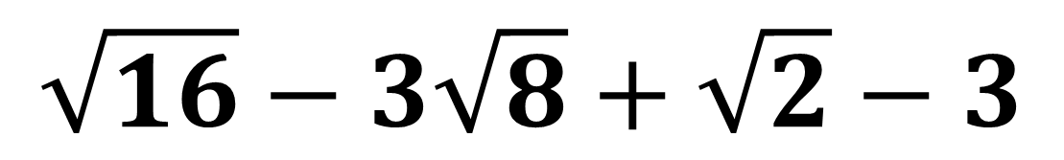
Expand and Simplify
$$\left(\sqrt{8}+1\right)\left(\sqrt{2}−3\right)$$
$$\sqrt{16}−3\sqrt{8}+\sqrt{2}−3$$
$$=4−6\sqrt{2}+\sqrt{2}−3$$
$$=1−5\sqrt{2}$$

Slide 13
How do you rationalise
the denominator?
Making the denominator
of a fraction
rational (not a Surd).

Slide 14
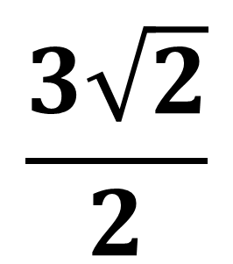
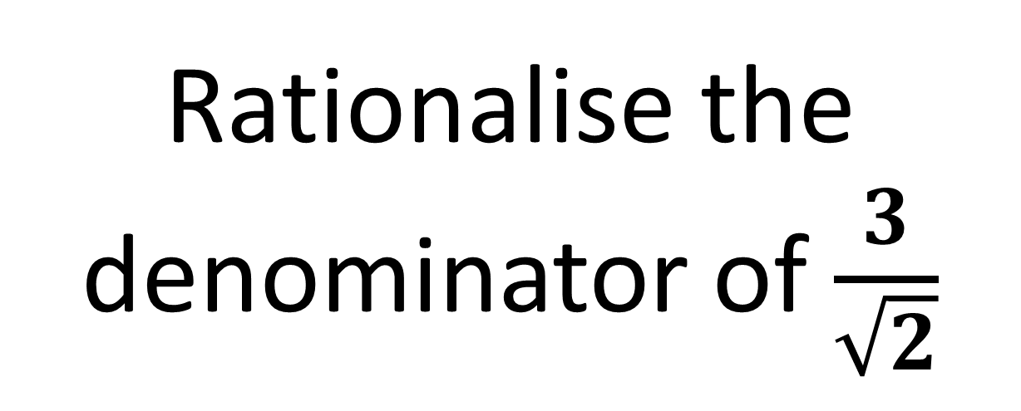
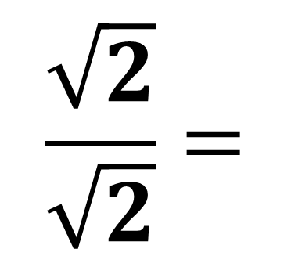
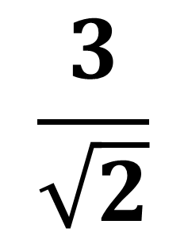
Rationalise the denominator of $\frac{3}{\sqrt{2}}$
$$\frac{\sqrt{2}}{\sqrt{2}}=$$
$$\frac{3\sqrt{2}}{2}$$
$$\frac{3}{\sqrt{2}}$$
X

Slide 15
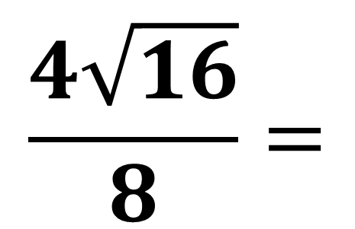
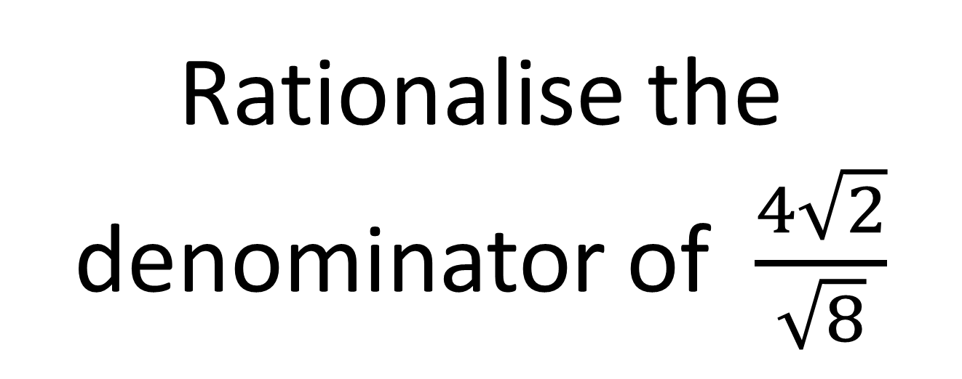

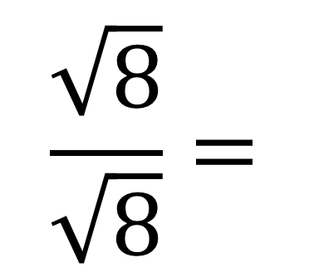
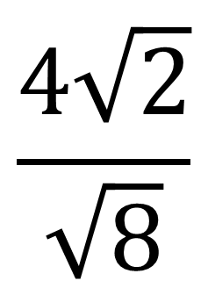
Rationalise the denominator of $\frac{4\sqrt{2}}{\sqrt{8}}$
$$\frac{4\sqrt{2}}{\sqrt{8}}$$
$$\frac{\sqrt{8}}{\sqrt{8}}=$$
$$\frac{4\sqrt{16}}{8}=$$
X
$$2$$

Slide 16
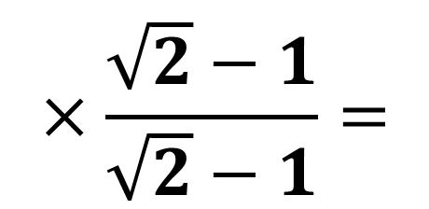
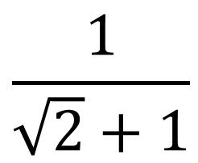
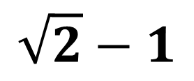
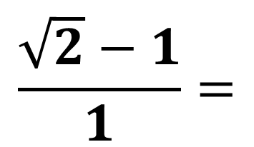
More complicated denominator!
$$\frac{1}{\sqrt{2}+1}$$
$$×\frac{\sqrt{2}−1}{\sqrt{2}−1}=$$
$$\frac{\sqrt{2}−1}{1}=$$
$$\sqrt{2}−1$$
Use the same expression
but with the opposite sign.

Slide 17
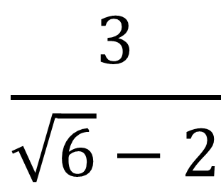
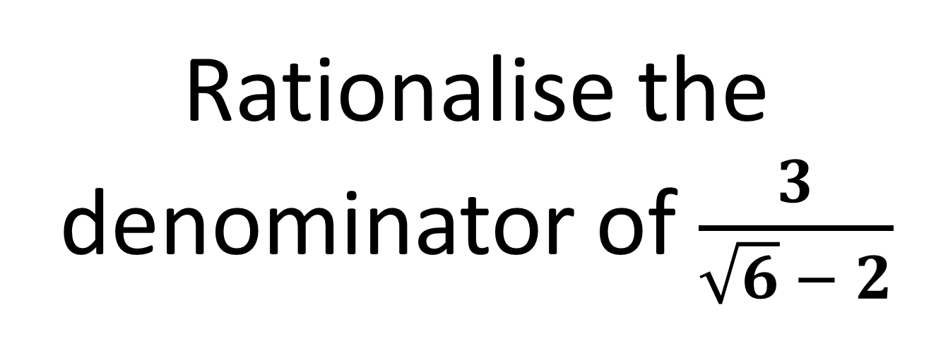
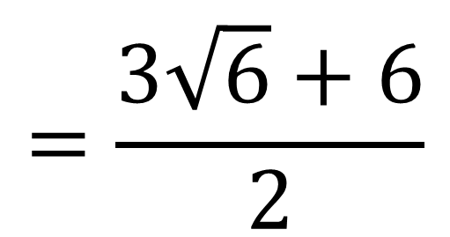
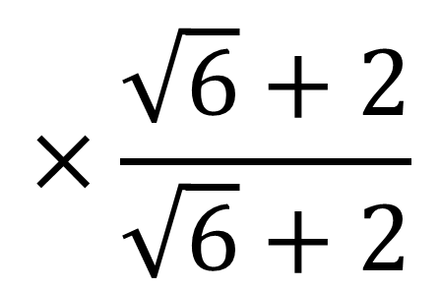
Rationalise the denominator of $\frac{3}{\sqrt{6} − 2}$
$$×\frac{\sqrt{6}+2}{\sqrt{6}+2}$$
$$=\frac{3\sqrt{6}+6}{2}$$
$$\frac{3}{\sqrt{6}−2}$$

Slide 18
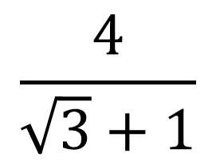
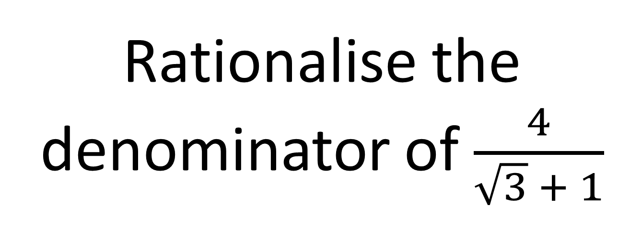
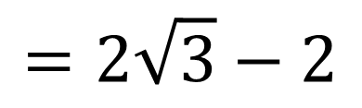
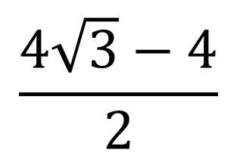
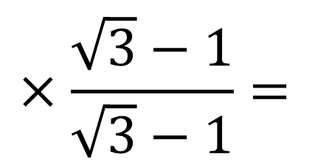
Rationalise the denominator of $\frac{4}{\sqrt{3} + 1}$
$$\frac{4}{\sqrt{3}+1}$$
$$×\frac{\sqrt{3}−1}{\sqrt{3}−1}=$$
$$\frac{4\sqrt{3}−4}{2}$$
$$=2\sqrt{3}−2$$

