Slide 1
LO: Trigonometry Ratios

Slide 2
The word trigonometry
comes from the Greek meaning
‘triangle measurement’.
Several ancient civilizations such as
the Egyptian, Babylonian, and Chinese
possessed considerable knowledge of concepts
that has lead to trigonometry.

Slide 3
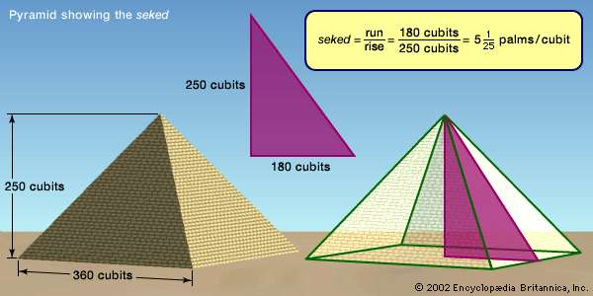
Trigonometry is used to find
a missing side or angle of right angle triangles.

Slide 4
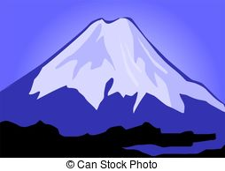
Trigonometry was used to discover
the height of Mount Everest!

Slide 5
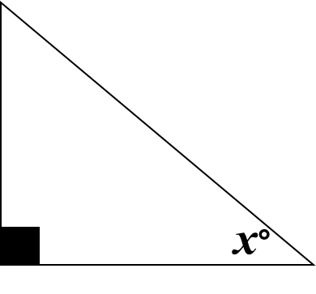
Hypotenuse
Opposite
Adjacent
Hypotenuse is the longest side of the triangle
Opposite is the side opposite the given angle
Adjacent is the side the one left over!

Slide 6

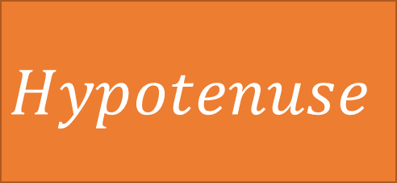


Name the side?
?
$$a$$
$$Hypotenuse$$
$$Opposite$$
$$Adjacent$$

Slide 7
Name the side?
$$a$$
?
$$Hypotenuse$$
$$Opposite$$
$$Adjacent$$

Slide 8
Name the side?
?
$$a$$
$$Hypotenuse$$
$$Opposite$$
$$Adjacent$$

Slide 9

Name the side?
?
$$a$$
$$Hypotenuse$$
$$Opposite$$
$$Adjacent$$

Slide 10
?
Name the side?
$$a$$
$$Hypotenuse$$
$$Opposite$$
$$Adjacent$$

Slide 11
Name the side?
?
$$a$$
$$Hypotenuse$$
$$Opposite$$
$$Adjacent$$

Slide 12

Name the side?
$$a$$
?
$$Hypotenuse$$
$$Opposite$$
$$Adjacent$$

Slide 13
Name the side?
?
$$a$$
$$Hypotenuse$$
$$Opposite$$
$$Adjacent$$

Slide 14
Name the side?
?
$$a$$
$$Hypotenuse$$
$$Opposite$$
$$Adjacent$$

