Slide 1
LO: Solving Equations
Algebraic Fractions
(Quadratics)

Slide 2
When solving an equation with fractions:
Step 1: Combine fractions into single fraction
Step 2: Multiply through by denominator.
Step 3: Simplify into a quadratic equal to zero
Step 4: Solve the Quadratic

Slide 3
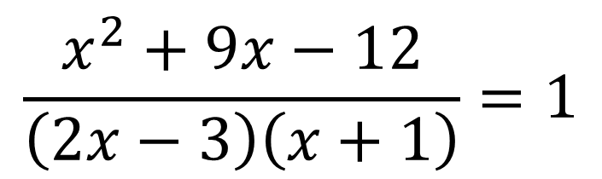
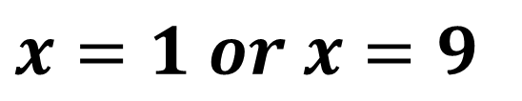
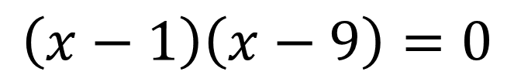
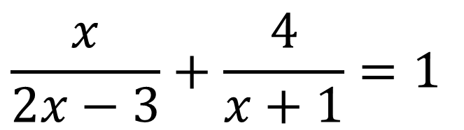
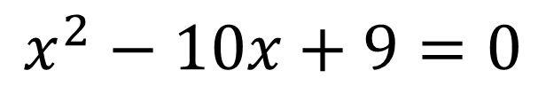
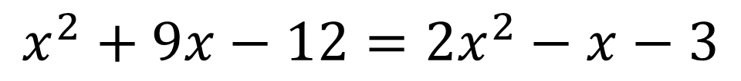
$$\frac{x}{2x−3}+\frac{4}{x+1}=1$$
$$\frac{x^{2}+9x−12}{\left(2x−3\right)\left(x+1\right)}=1$$
$$x^{2}+9x−12=\left(2x−3\right)\left(x+1\right)$$
$$x^{2}+9x−12=2x^{2}−x−3$$
$$x^{2}−10x+9=0$$
$$\left(x−1\right)\left(x−9\right)=0$$
$$x=1 or x=9$$

Slide 4
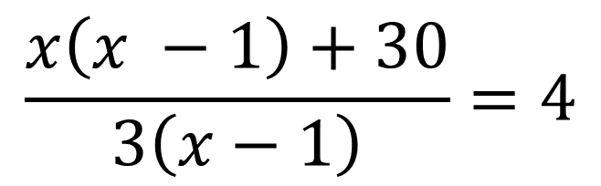
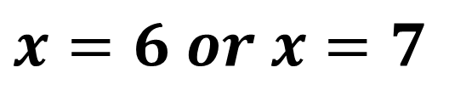
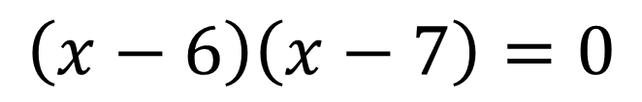
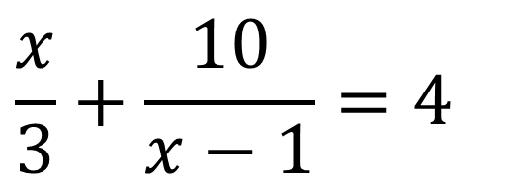
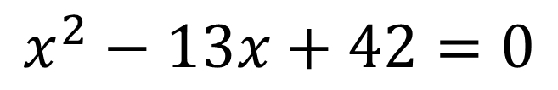
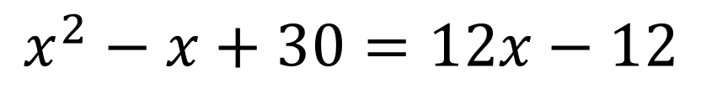
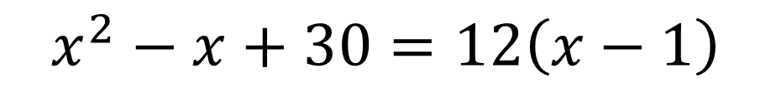
$$\frac{x}{3}+\frac{10}{x−1}=4$$
$$\frac{x\left(x −1\right)+30}{3\left(x−1\right)}=4$$
$$x^{2}−x+30=12\left(x−1\right)$$
$$x^{2}−x+30=12x−12$$
$$x^{2}−13x+42=0$$
$$\left(x−6\right)\left(x−7\right)=0$$
$$x=6 or x=7$$

Slide 5
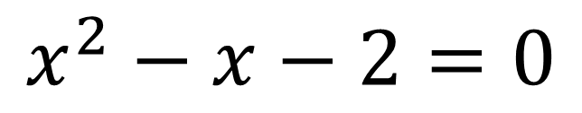
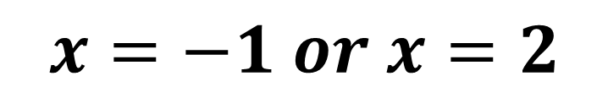
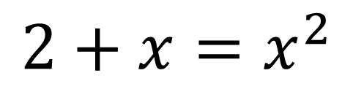
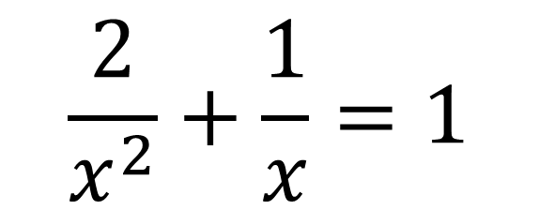
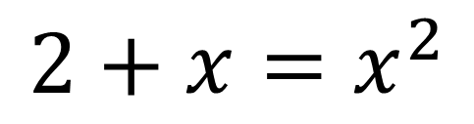
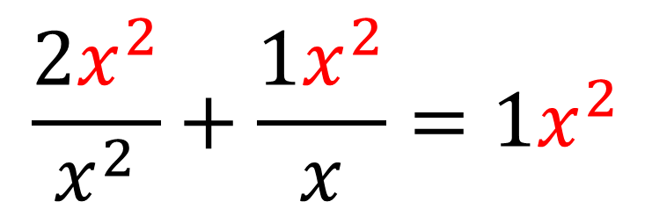
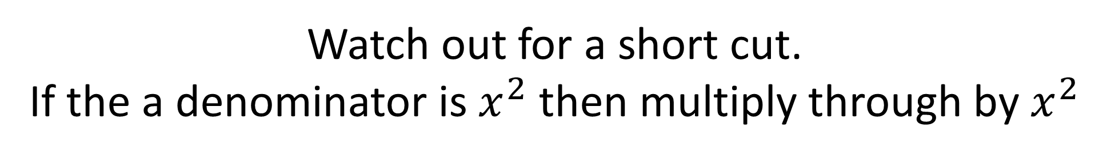
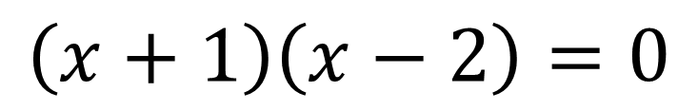
Watch out for a short cut.
If the a denominator is $x^{2}$ then multiply through by $x^{2}$
$$\frac{2}{x^{2}}+\frac{1}{x}=1$$
$$2+x=x^{2}$$
$$x^{2}−x−2=0$$
$$\frac{2x^{2}}{x^{2}}+\frac{{1x}^{2}}{x}={1x}^{2}$$
$$\left(x+1\right)\left(x−2\right)=0$$
$$2+x=x^{2}$$
$$x=−1 or x=2$$

