Slide 1
Moments
Tilting
Chapter 4
(Part 4 of 4)

Slide 2



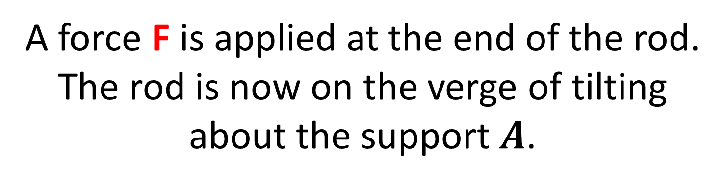
Tilting
$$F$$
$$A$$
$$B$$
A force F is applied at the end of the rod.
The rod is now on the verge of tilting
about the support $A$.
What is does it mean that it is on the point of titling?

Slide 3
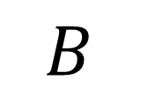
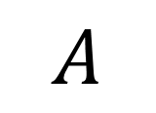

If a beam is on the point of tilting,
then there is no reactional force at B
and the system is still in equilibrium.
$$F$$
$$A$$
$$B$$

Slide 4
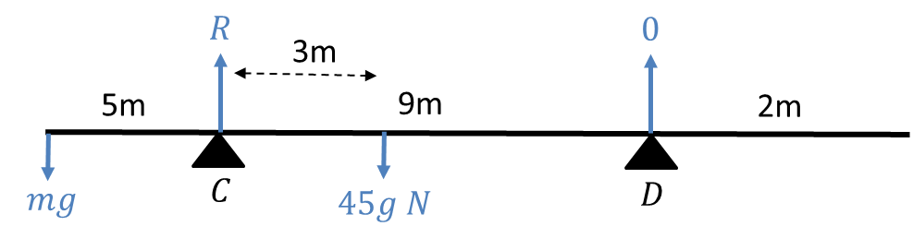
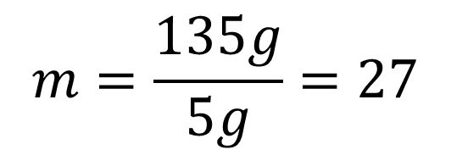

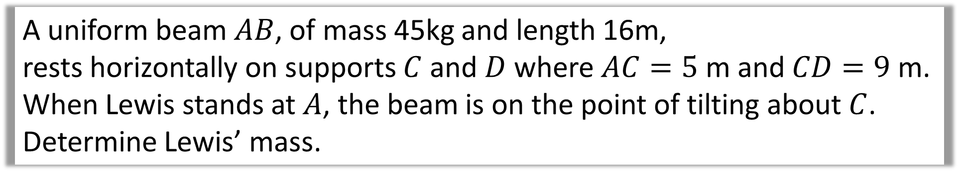


A uniform beam $AB$, of mass 45kg and length 16m,
rests horizontally on supports $C$ and $D$ where $AC=5$ m and $CD=9$ m.
When Lewis stands at $A$, the beam is on the point of tilting about $C$.
Determine Lewis’ mass.
Moments $(C)$
$$mg×5=3×45g$$
$$m=\frac{135g}{5g}=27$$
$$5mg=135g$$

Slide 5

Tilting - Suspended Systems

Slide 6
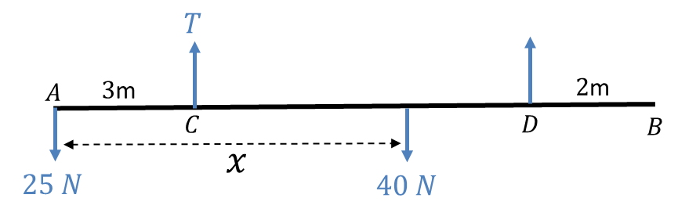
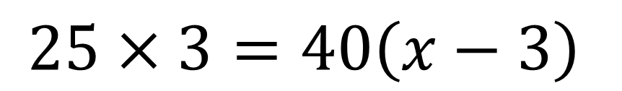
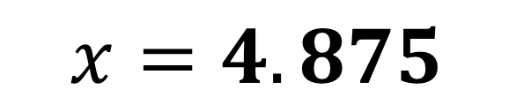
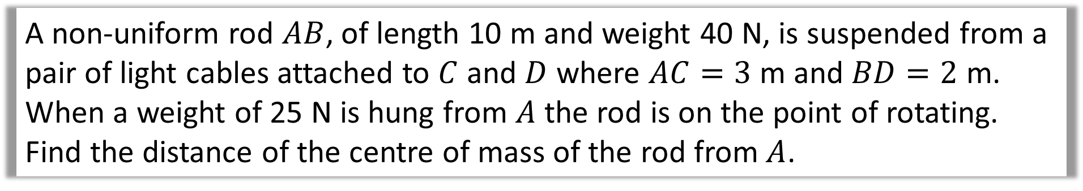

A non-uniform rod $AB$, of length 10 m and weight 40 N, is suspended from a pair of light cables attached to $C$ and $D$ where $AC=3$ m and $BD=2$ m.
When a weight of 25 N is hung from $A$ the rod is on the point of rotating.
Find the distance of the centre of mass of the rod from $A$.
$$0 N$$
Moments $(C)$
$$25×3=40\left(x−3\right)$$
$$x=4.875$$

