Slide 1
Exponentials and Logs
Laws and Equations
Chapter 14
(Part 2 of 9)

Slide 2
Logarithms - Laws of Logs
There are 3 laws of logs you need to know.
Multiplication Law
Division Law
Power Law
Terms and Condition:
These laws can only be applied if they have the same base value.

Slide 3
You use these laws
so that you can
write multiple logs
as a single log.

Slide 4
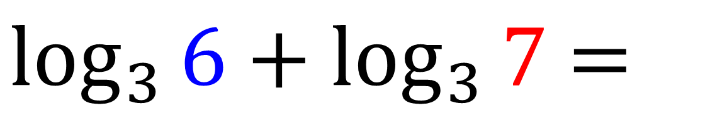
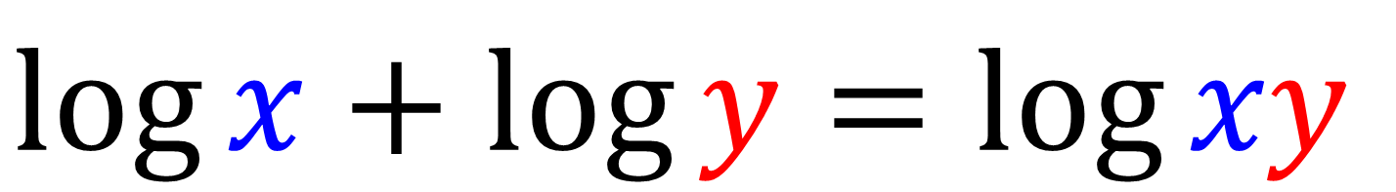
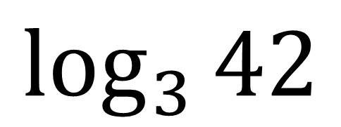
Multiplication Law
$$\log{x}+\log{y}=\log{xy}$$
$\log_{3}{6}+\log_{3}{7}$ $=$
$$\log_{3}{42}$$

Slide 5
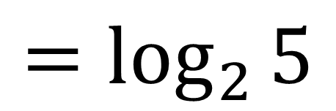
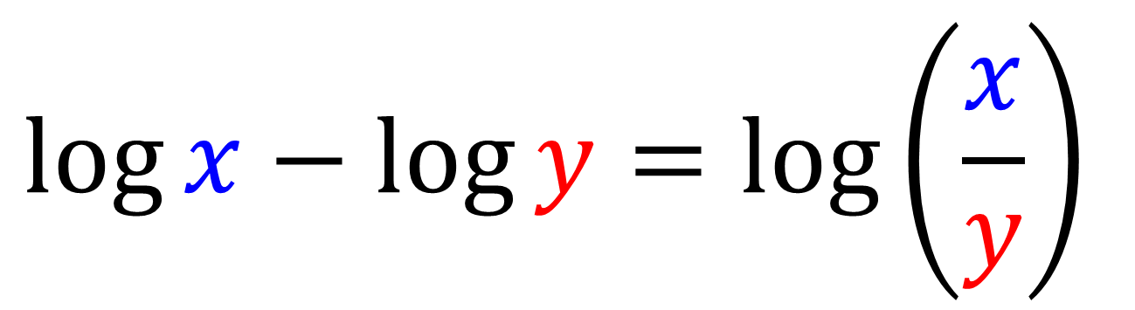
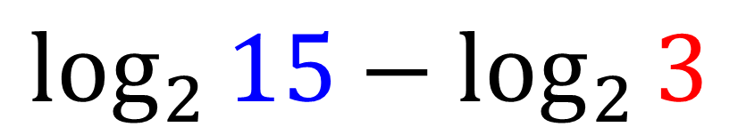
Division Law
$$\log{x}−\log{y}=\log\left(\frac{x}{y}\right)$$
$$\log_{2}{15}−\log_{2}{3}$$
$$=\log_{2}{5}$$

Slide 6
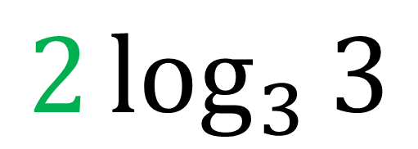
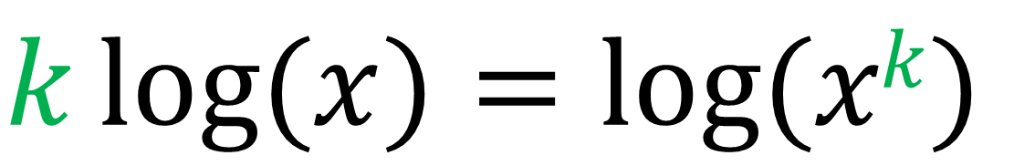
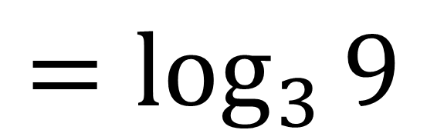
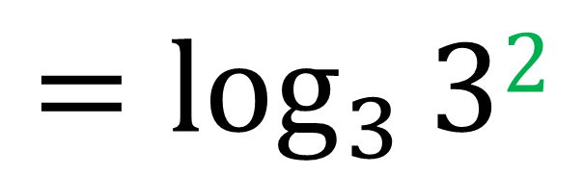
Power Law
$$k\log{(x)}=\log{(xk})$$
$$2\log_{3}{3}$$
$$=\log_{3}{32}$$
$$=\log_{3}{9}$$

Slide 7
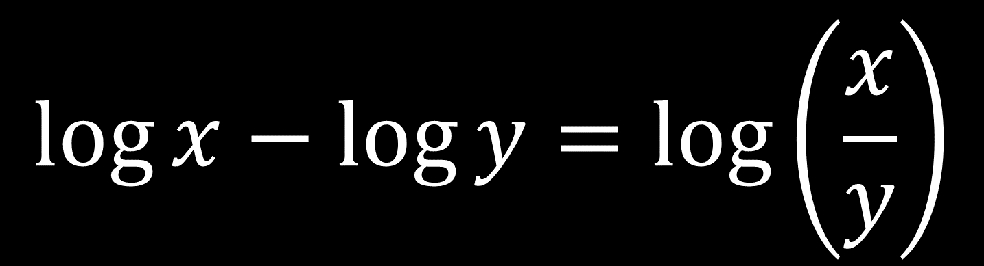
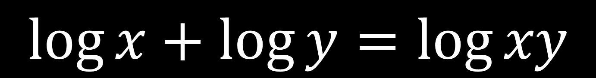
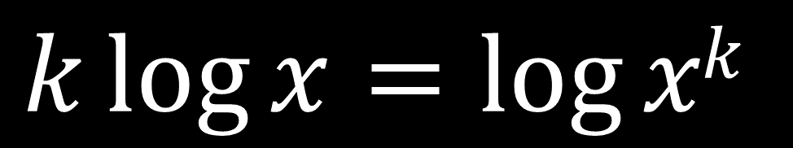
$$\log{x}+\log{y}=\log{xy}$$
$$\log{x}−\log{y}=\log\left(\frac{x}{y}\right)$$
$$k\log{x}=\log{xk}$$

Slide 8
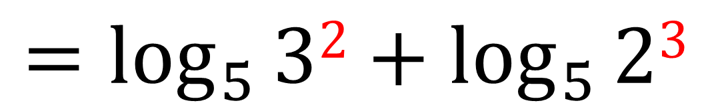
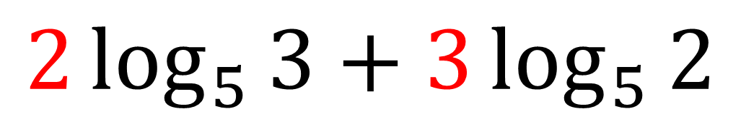

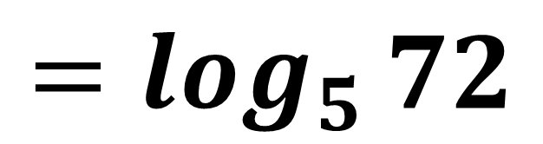
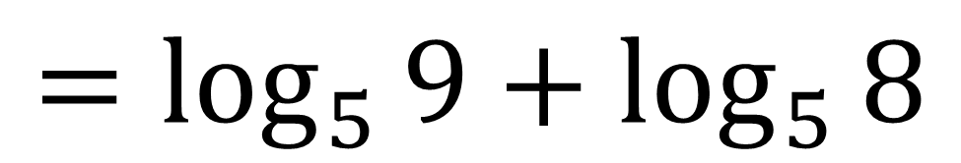
Write $2\log_{5}{3}+3\log_{5}{2}$ as a single log.
Tip: Apply the power law before you apply the multiplication and division laws.
$$2\log_{5}{3}+3\log_{5}{2}$$
$${=log}_{5}{32}+\log_{5}{23}$$
$${=log}_{5}{9}+\log_{5}{8}$$
$${=log}_{5}{72}$$

Slide 9
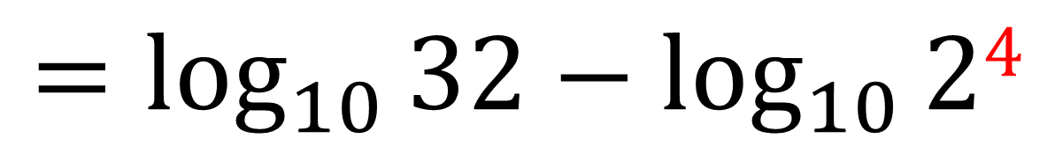
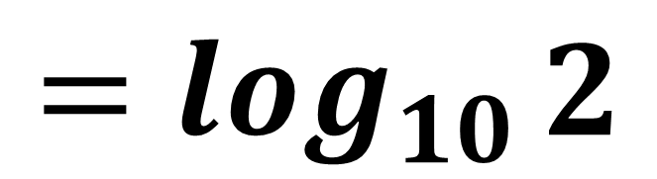

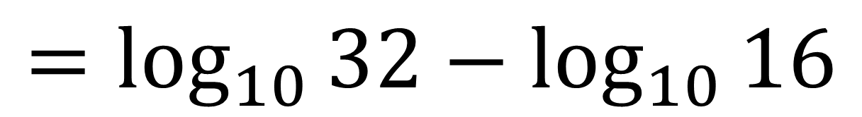
Write $\log_{10}{32}−4\log_{10}{2}$as a single log.
$${=log}_{10}{32}−\log_{10}{24}$$
$${=log}_{10}{32}−\log_{10}{16}$$
$${=log}_{10}{2}$$

Slide 10
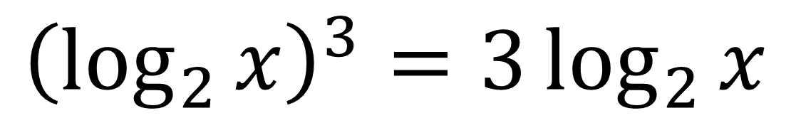
Common Mistakes
$$\log_{a}\left(b+c\right)=\log_{a}{b}+\log_{a}{c}$$
✗ FAIL
$${\left(\log_{2}{x}\right)}^{3}=3\log_{2}{x}$$
✗ FAIL

Slide 11
Solving Equations
involving multiple logs
To solve equations with multiple logs rewrite
the question as a single log.

Slide 12
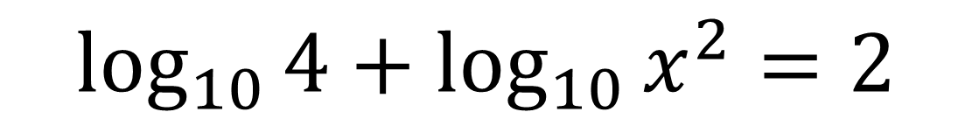
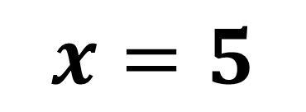
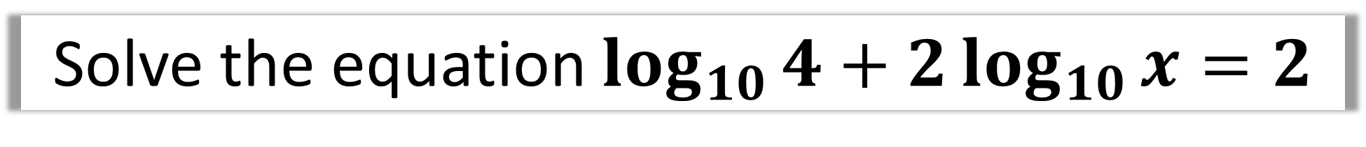



Solve the equation $\log_{10}{4}+2\log_{10}{x}=2$
$$\log_{10}{4}+\log_{10}{x^{2}}=2$$
$$\log_{10}\left(4x^{2}\right)=2$$
$${10}^{2}= 4x^{2}$$
$$x^{2}=25$$
$$x=5$$

Slide 13
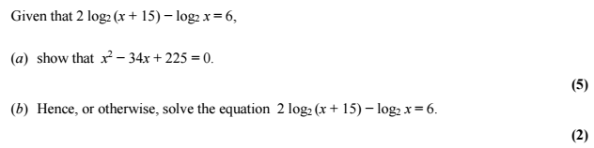




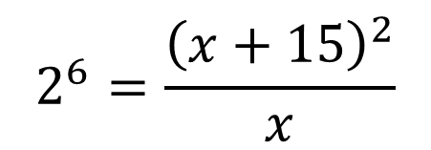
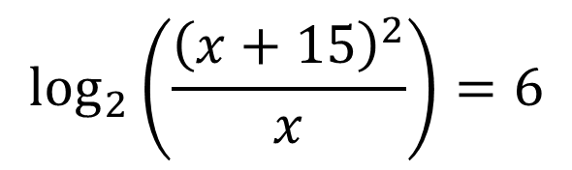
a)
$$\log_{2}{{\left(x+15\right)}^{2}}−\log_{2}{x}=6$$
$$64x={\left(x+15\right)}^{2}$$
$$\log_{2}\left(\frac{{\left(x+15\right)}^{2}}{x}\right)=6$$
$$64x=x^{2}+30x+225$$
Rewrite log as exponential
$$2^{6}=\frac{{\left(x+15\right)}^{2}}{x}$$
$$x^{2}−34x+225=0$$

Slide 14
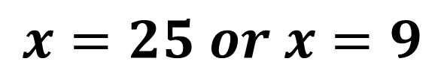
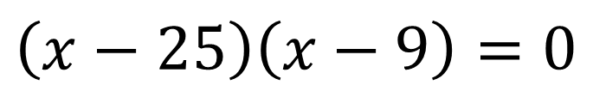
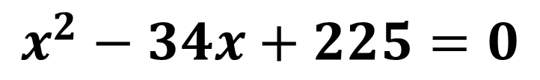
b)
$$x^{2}−34x+225=0$$
$$\left(x−25\right)\left(x−9\right)=0$$
$$x=25 or x=9$$

