Slide 1
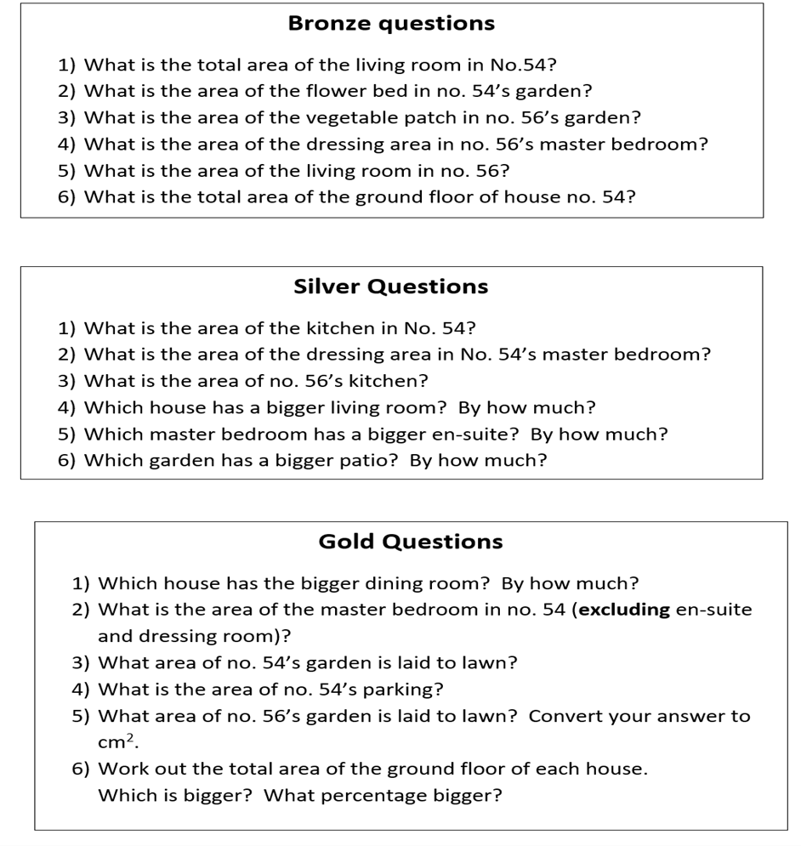
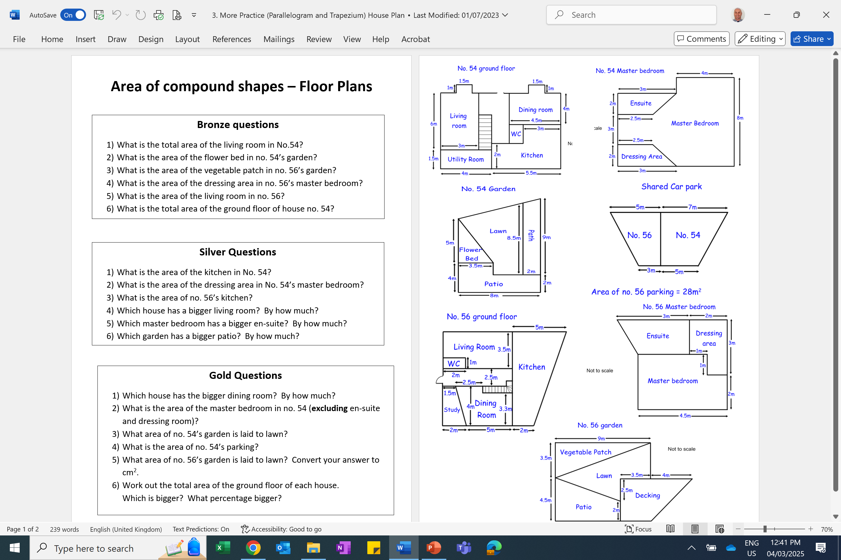

Slide 2
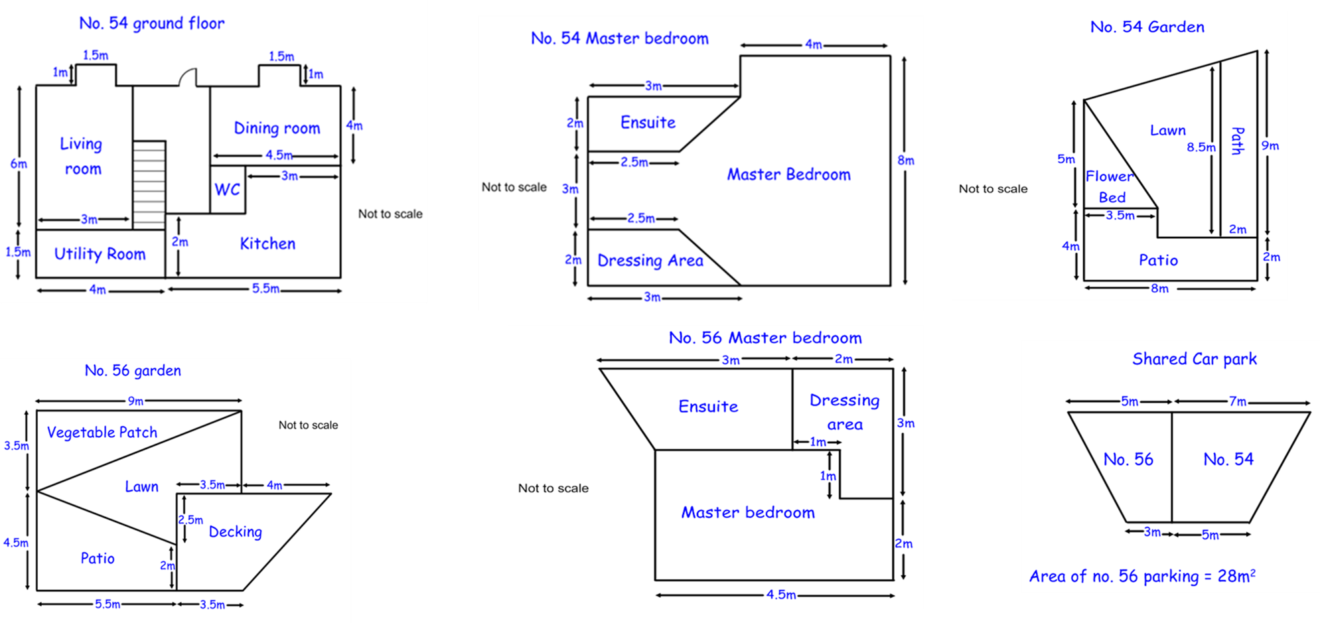
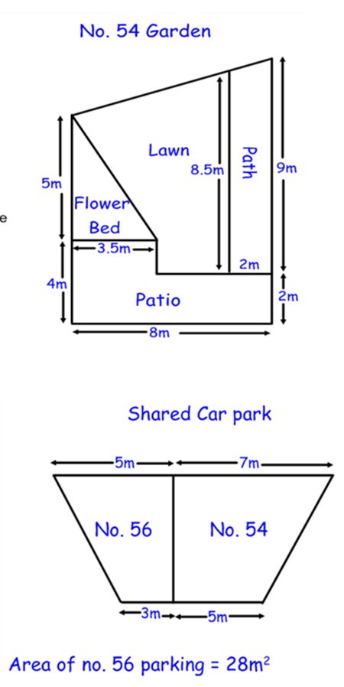
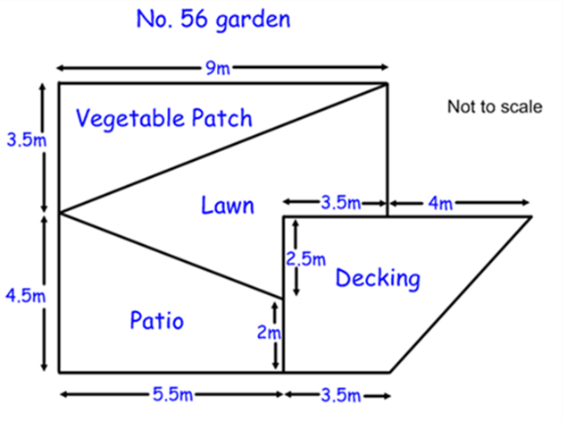

Slide 3
ANSWERS

Slide 4
Bronze questions
What is the total area of the living room in No.54?
What is the area of the flower bed in no. 54’s garden?
What is the area of the vegetable patch in no. 56’s garden?
What is the area of the dressing area in no. 56’s master bedroom?
What is the area of the living room in no. 56?
What is the total area of the ground floor of house no. 54?
19.5m²
8.75m²
15.75m²
5m²
22.5m²
74.25m²

Slide 5
Silver Questions
What is the area of the kitchen in No. 54?
What is the area of the dressing area in No. 54’s master bedroom?
What is the area of no. 56’s kitchen?
Which house has a bigger living room? By how much?
Which master bedroom has a bigger en-suite? By how much?
Which garden has a bigger patio? By how much?
15.5m²
5.5m²
35m²
House no. 56 by 3m²
Neither, they are both the same
House no. 54 by 5.125m²

Slide 6
Gold questions
Which house has the bigger dining room? By how much?
What is the area of the master bedroom in no. 54 (excluding en-suite and dressing room)?
What area of no. 54’s garden is laid to lawn?
What is the area of no. 54’s parking?
What area of no. 56’s garden is laid to lawn? Convert your answer to cm².
Work out the total area of the ground floor of each house.
Which is bigger? What percentage bigger?
House 54 by 0.6m²
42m²
30.75m²
42m²
22.625m² = 226,250cm²
House 56 ground floor is 41% bigger than house 54 ground floor.

