Slide 1
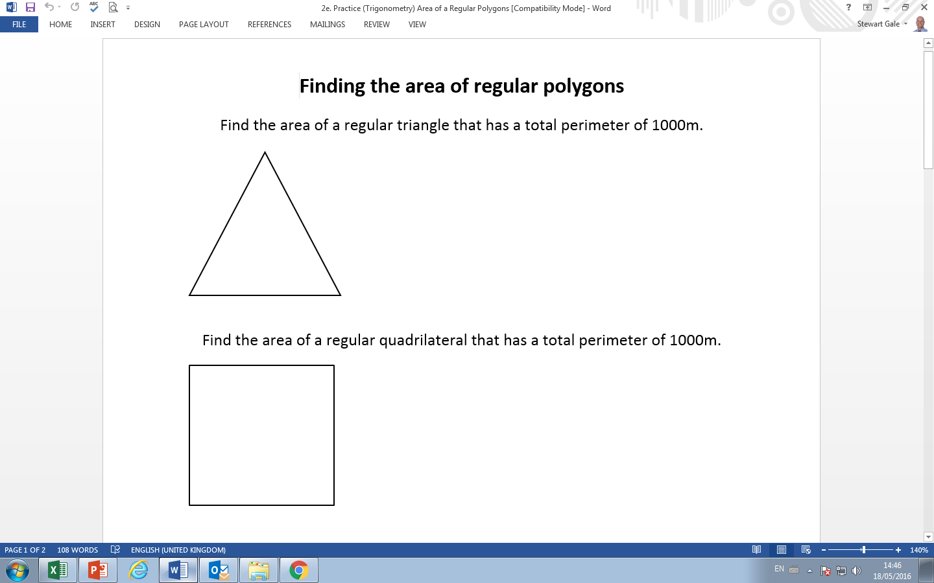

Slide 2
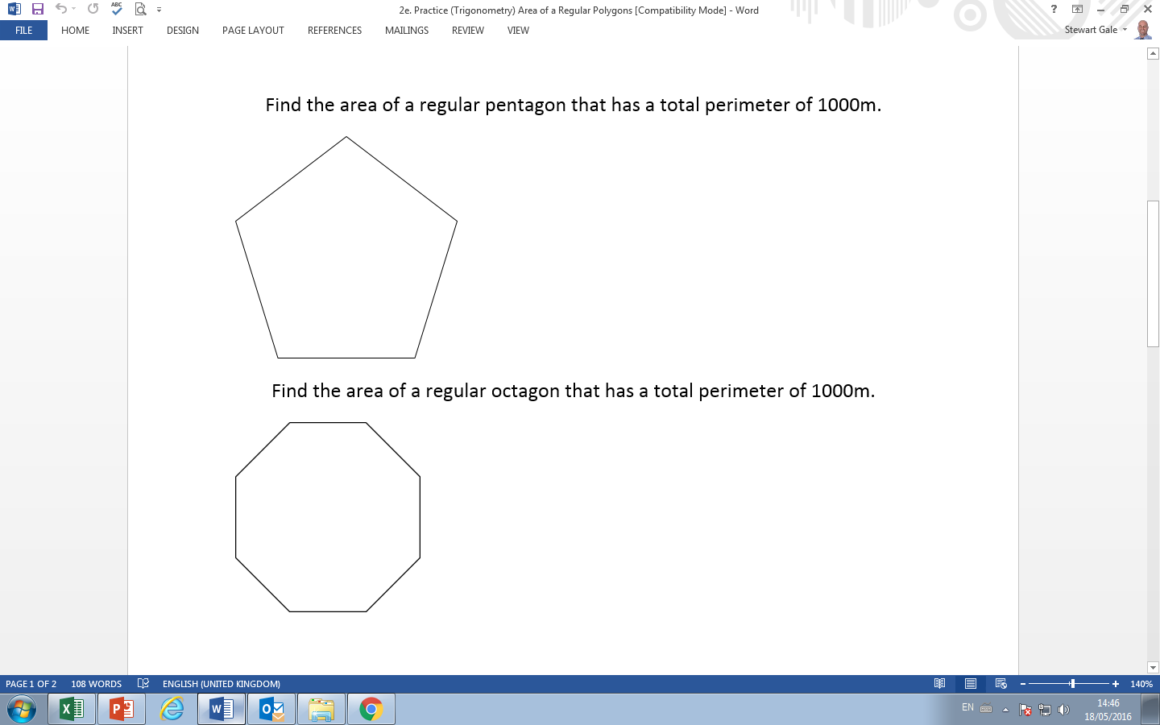

Slide 3
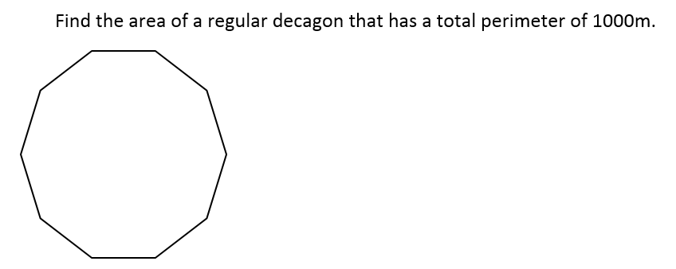

Slide 4
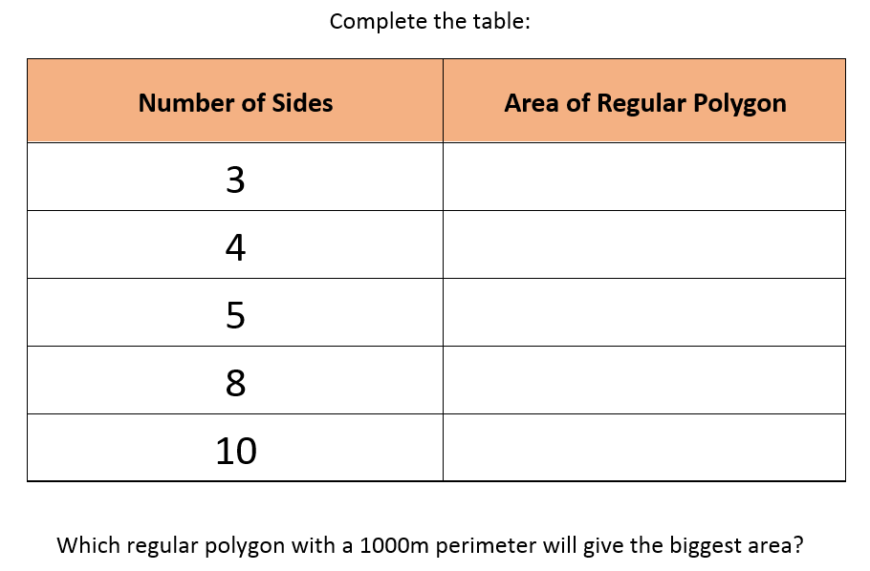

Slide 5
SUPPORT

Slide 6
Hint A:
Split the pentagon
into triangles
Hint B:
Split the triangle into a right angle triangle

Slide 7
ANSWERS

Slide 8
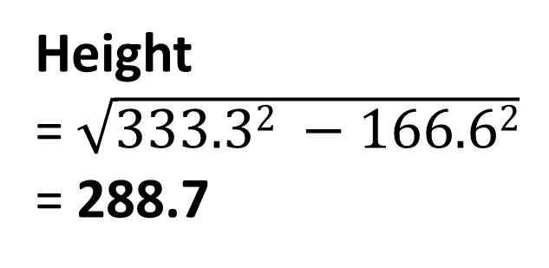
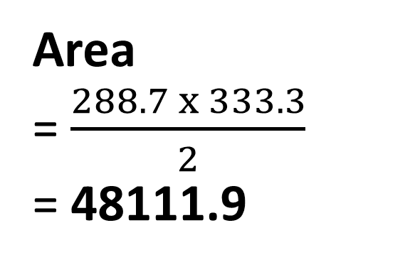
333.3
333.3
333.3
Area
= $\frac{288.7 x 333.3}{2}$
= 48111.9
Height
= $\sqrt{333.32 −166.62}$
= 288.7
333.3
166.6

Slide 9
250
250 x 250 = 62500
250

Slide 10
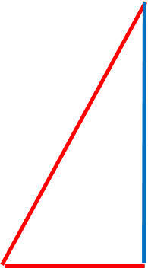
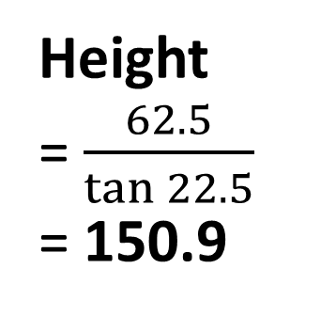
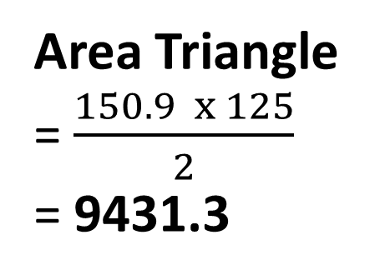
125
125
125
45°
125
125
125
125
125
Height
= $\frac{62.5}{\tan{22.5}}$
= 150.9
Area Triangle
= $\frac{150.9 x 125}{2}$
= 9431.3
125
22.5°
62.5
Area Pentagon
= 9431.3 x 8
= 75450

Slide 11
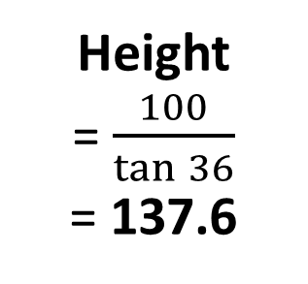
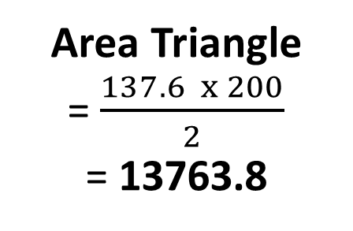
200
200
72°
200
200
200
Height
=$\frac{100}{\tan{36}}$
= 137.6
Area Triangle
= $\frac{137.6 x 200}{2}$
= 13763.8
200
36°
100
Area Pentagon
= 13763.8 x 5
= 68819

Slide 12
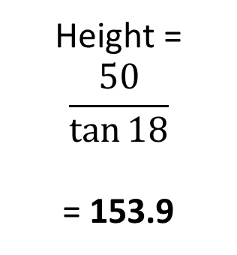
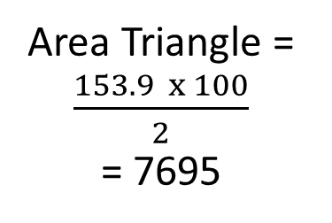
100
100
100
100
100
36°
100
100
100
100
100
100
Height =
$$\frac{50}{\tan{18}}$$
= 153.9
Area Triangle =
$\frac{153.9 x 100}{2}$
= 7695
18°
50
Area Pentagon = 7695 x 10 = 76950

Slide 13
Number of Sides | Area of Regular Polygon
3 | 48112
4 | 62500
5 | 68819
8 | 75450
10 | 76950

