Slide 1
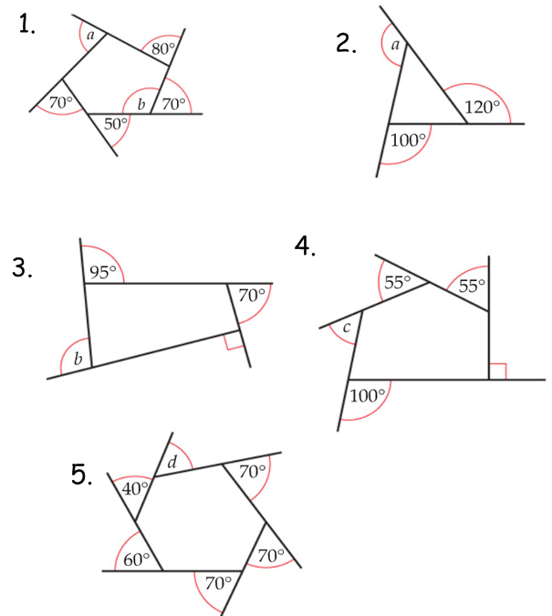
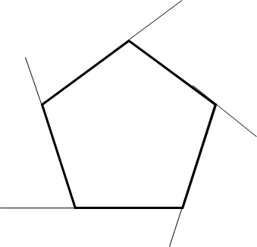
What are the missing angles of the following polygons
6. What are the missing angles of the following regular polygons?
a
b
a
b
a
b
b
a
b
a
b

Slide 2
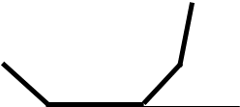
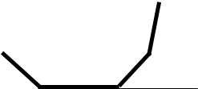
7. How many sides does this regular polygon have?
9. How many sides does this regular polygon have?
The diagram is not
drawn to scale.
The diagram is not
drawn to scale.
36°
168°
8. How many sides does this regular polygon have?
10. How many sides does this regular polygon have?
The diagram is not
drawn to scale.
The diagram is not
drawn to scale.
24°
135°
11. A regular polygon has an exterior angle of 60°.
How many sides does the regular polygon have?
12. A regular polygon has an interior angle of 140°.
How many sides does the regular polygon have?

Slide 3
ANSWERS

Slide 4
What are the missing angles of the following polygons
90
110
140
6. What are the missing angles of the following regular polygons?
a
72
b
60
a
b
105
a
b
60
b
a
b
50
a
b

Slide 5
7. How many sides does this regular polygon have?
9. How many sides does this regular polygon have?
The diagram is not
drawn to scale.
The diagram is not
drawn to scale.
36°
10 sides
168°
30 sides
8. How many sides does this regular polygon have?
10. How many sides does this regular polygon have?
The diagram is not
drawn to scale.
The diagram is not
drawn to scale.
24°
15 sides
135°
8 sides
11. A regular polygon has an exterior angle of 60°.
How many sides does the regular polygon have?
12. A regular polygon has an interior angle of 140°.
How many sides does the regular polygon have?
6 sides
9 sides

