Slide 1
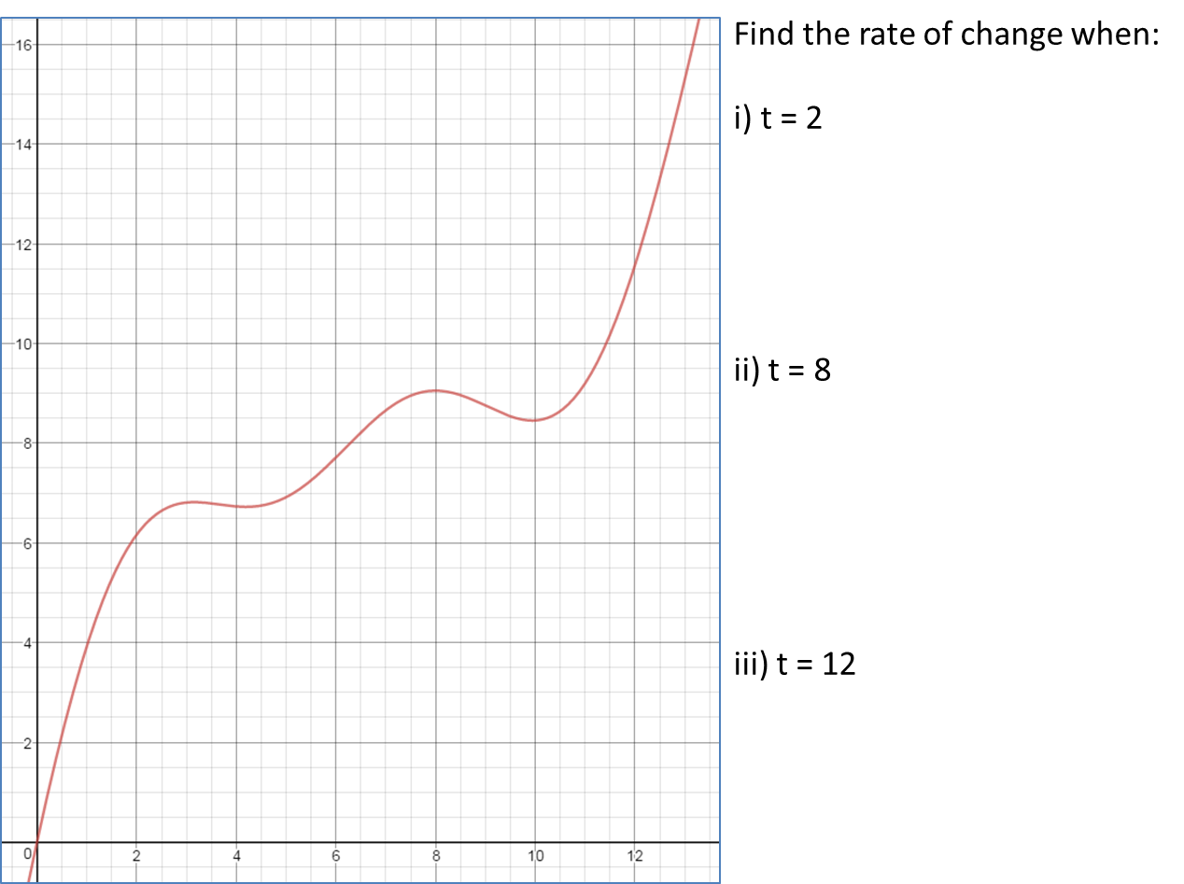
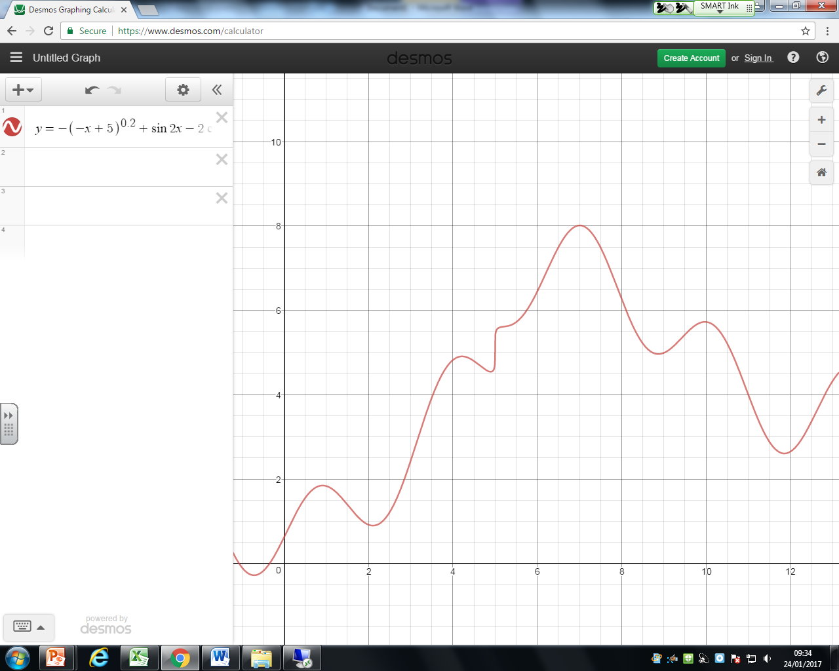
1) Estimate the rate of change when:
a) t = 2
b) t = 8
c) t = 12
2) Estimate the rate of change when:
a) t = 4
b) t = 8
c) t = 10

Slide 2
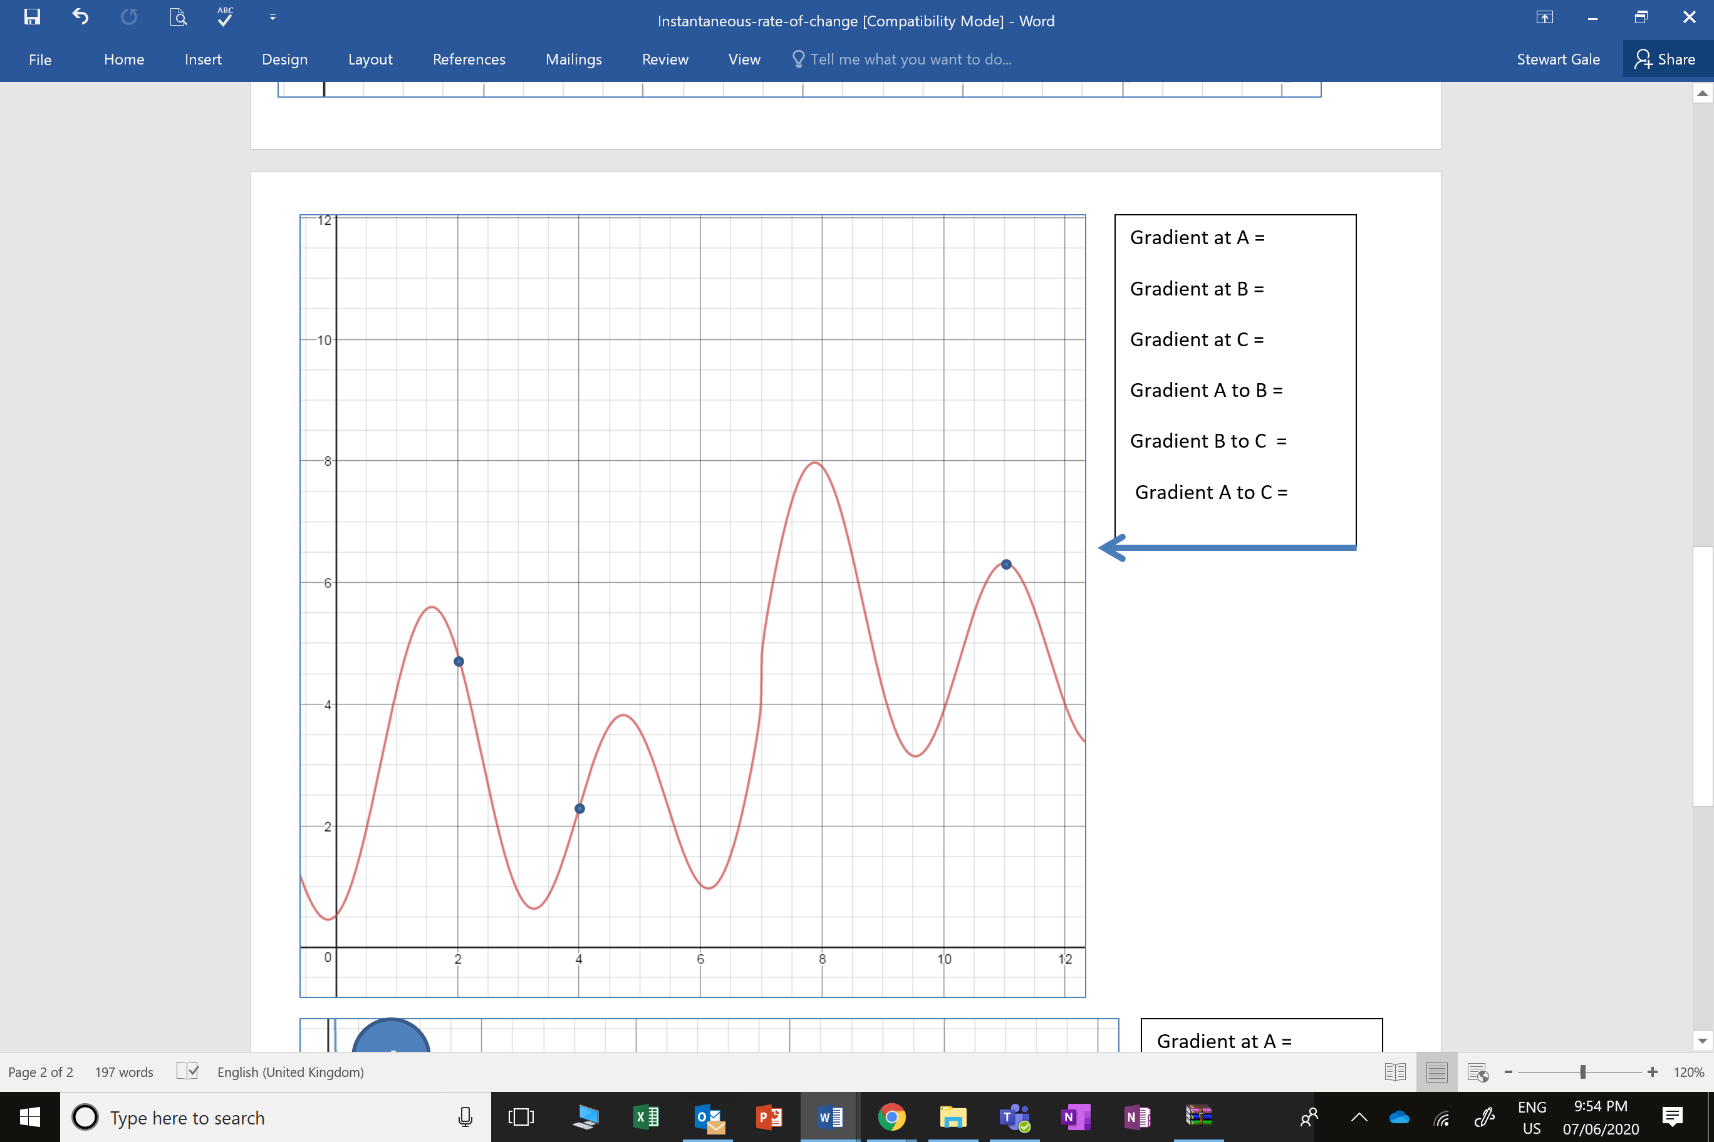
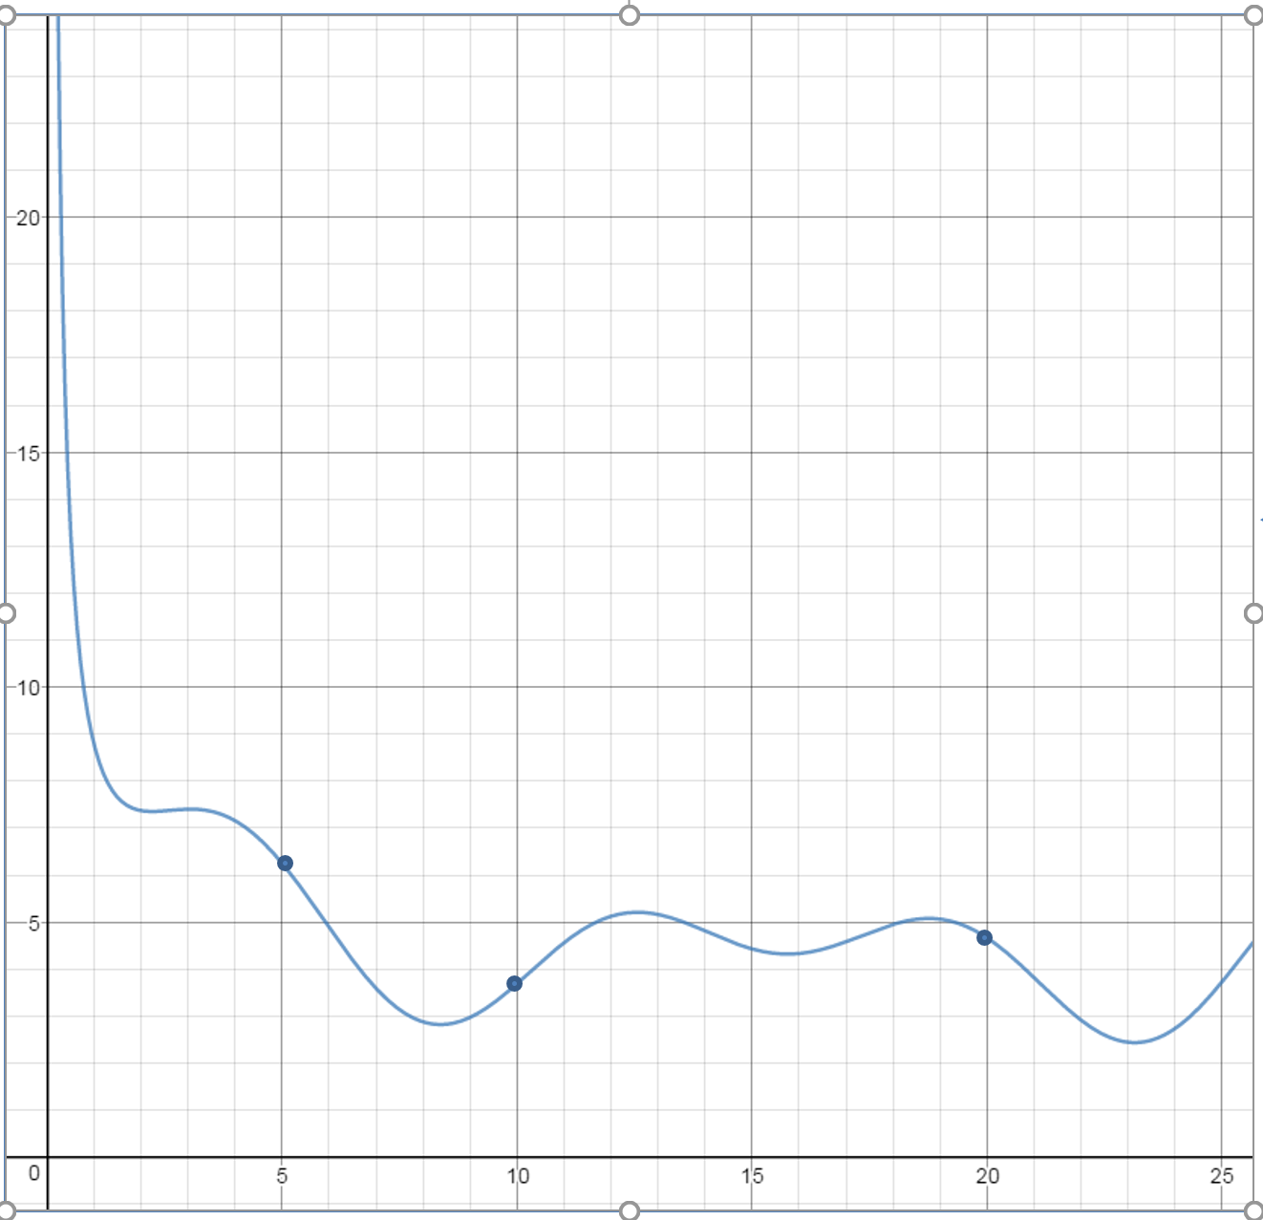
3) Estimate the rate of change when:
a) t = 2
b) t = 8
c) t = 11
4) Estimate the rate of change when:
a) t = 5
b) t = 10
c) t = 20

Slide 3
ANSWERS

Slide 4
Estimate the rate of change when:
i) t = 2
ii) t = 8
ii) t = 12
2 m/s²
0 m/s²
2.5 m/s²

Slide 5
Estimate the rate of change when:
i) t = 4
ii) t = 8
ii) t = 10
1.75 m/s²
-2.25 m/s²
0 m/s²

Slide 6
3) Estimate the rate of change when:
a) t = 2
b) t = 8
c) t = 11
-3 m/s²
3.5 m/s²
0 m/s²

Slide 7
4) Estimate the rate of change when:
a) t = 5
b) t = 10
c) t = 20
-1.1 m/s²
0.9 m/s²
0.6 m/s²

