Slide 1
Vectors
Components
Chapter 11
(Part 2 of 4)

Slide 2

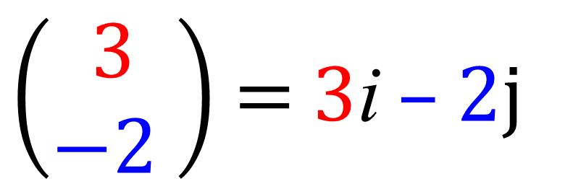


i and j Components
Vectors can be written using i and j components.
$$j$$
$$i$$
$\left(\begin{matrix}3 \\ −2 \end{matrix}\right)$ $=$ 3i – 2j

Slide 3




Write the vectors in terms of
i and j components.
2i – 3j
$$j$$
$$i$$
–4i
$$j$$
$$i$$

Slide 4
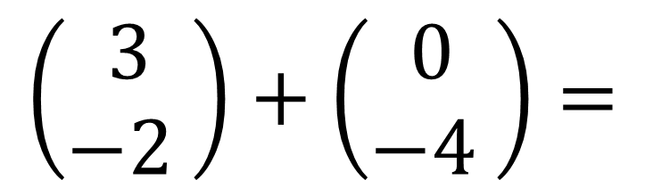
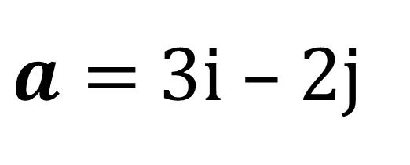
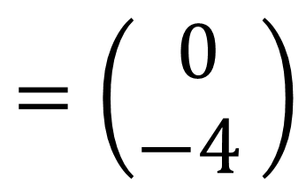
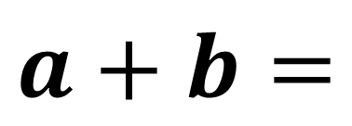
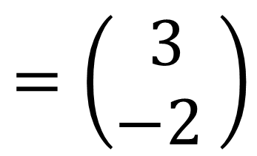
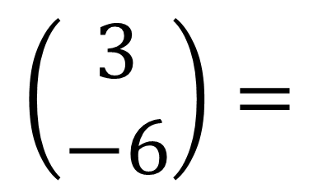
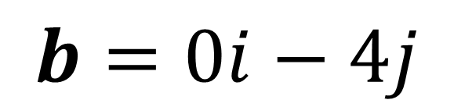
Vectors – adding vectors
$$=\left(\begin{matrix}3 \\ −2 \end{matrix}\right)$$
$$=\left(\begin{matrix}0 \\ −4 \end{matrix}\right)$$
$a=$ 3i – 2j
$$b=0i−4j$$
$$\left(\begin{matrix}3 \\ −2 \end{matrix}\right)+\left(\begin{matrix}0 \\ −4 \end{matrix}\right)=$$
$$\left(\begin{matrix}3 \\ −6\end{matrix}\right)=$$
$$a+b=$$
3i – 6j

Slide 5
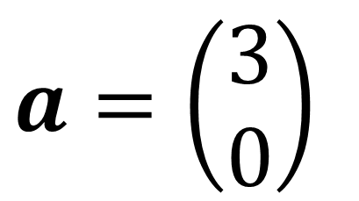
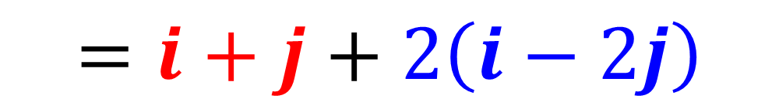
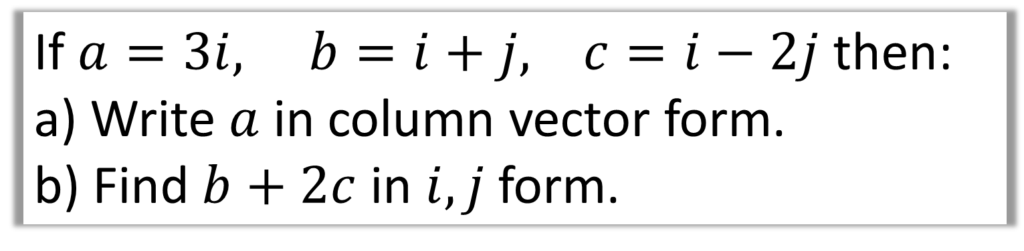
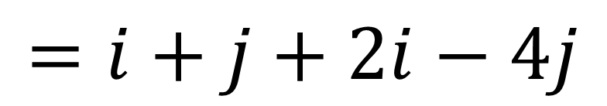
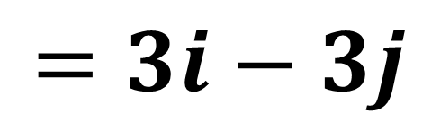
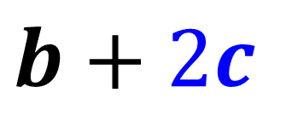
If $a=3i, b=i+j, c=i−2j$ then:
a) Write $a$ in column vector form.
b) Find $b+2c$ in $i,j$ form.
$$b+2c$$
a)
$$a=\left(\begin{matrix}3 \\ 0\end{matrix}\right)$$
b)
$$=i+j+2\left(i−2j\right)$$
$$=i+j+2i−4j$$
$$=3i−3j$$

Slide 6
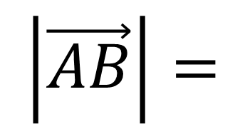
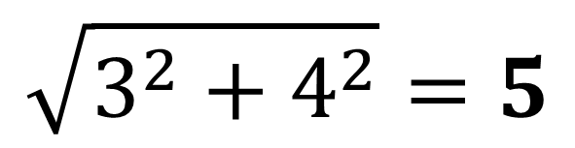



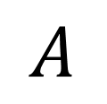
Vectors and Magnitude
The magnitude $|a|$ of a vector $a$ is its length.
$$B$$
$$3i+4j$$
$$\left|\vec{AB}\right|=$$
$$\sqrt{3^{2}+4^{2}}=5$$
4
$$A$$
3

Slide 7
Unit Vector
A unit vector is
a vector whose magnitude is 1.

Slide 8

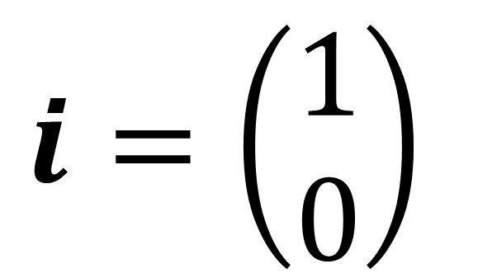
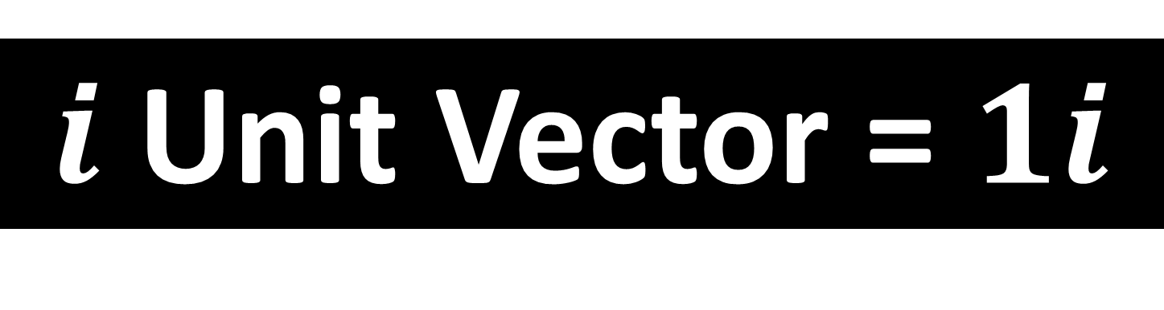
$i$ Unit Vector = $1i$
$$i=\left(\begin{matrix}1 \\ 0\end{matrix}\right)$$
$$i$$

Slide 9


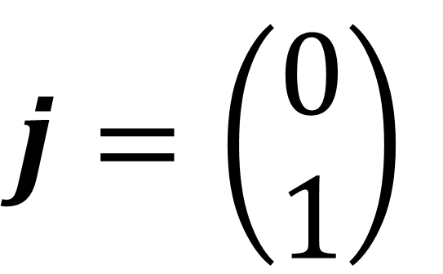
$j$ Unit Vector = $1j$
$$j=\left(\begin{matrix}0 \\ 1\end{matrix}\right)$$
$$j$$

Slide 10
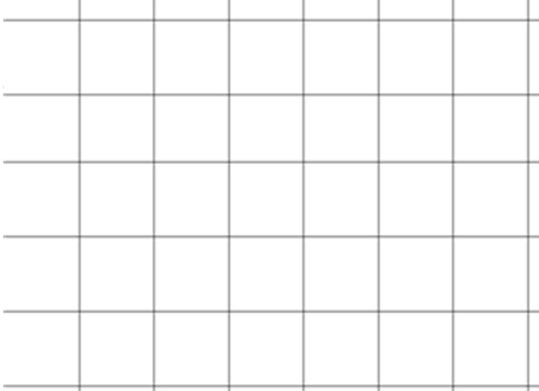
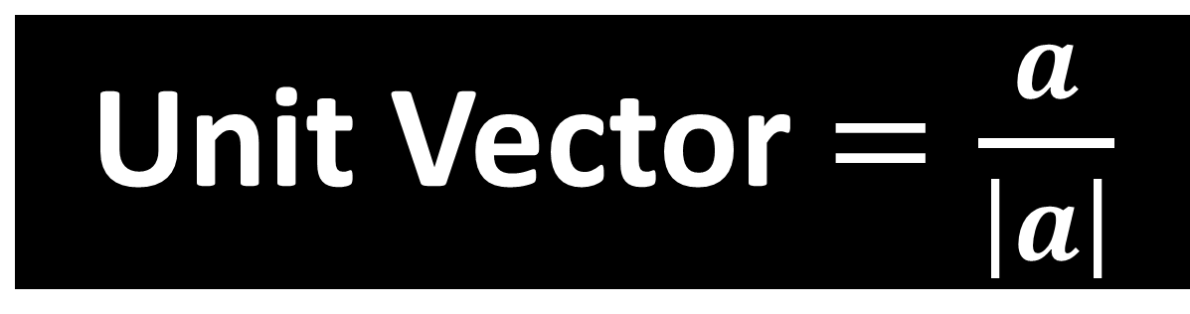
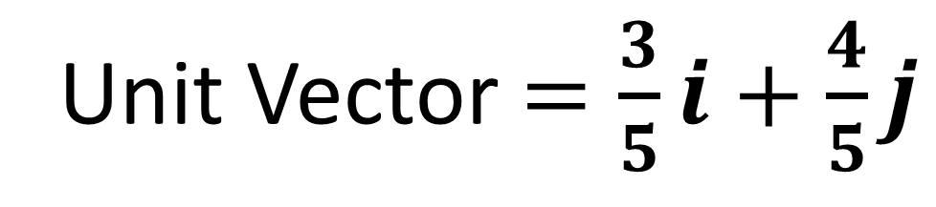
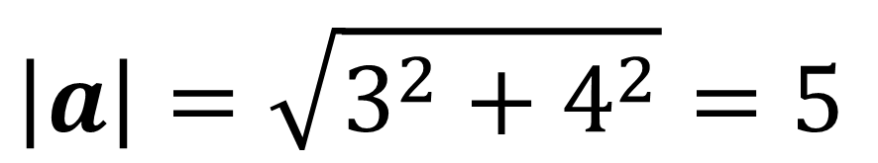
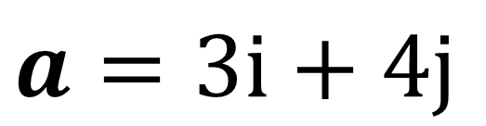
Unit Vector$=\frac{a}{\left|a\right|}$
$$\left|a\right|=\sqrt{3^{2}+4^{2}}=5$$
$$a=3i+4j$$
Unit Vector $=\frac{3}{5}i+\frac{4}{5}j$

Slide 11
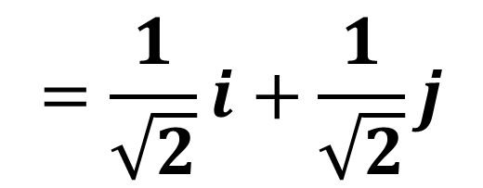
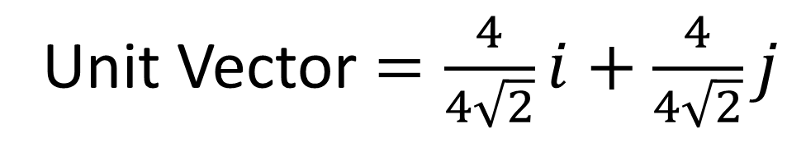
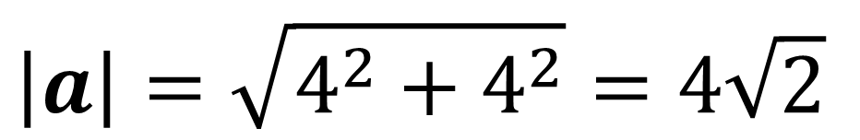
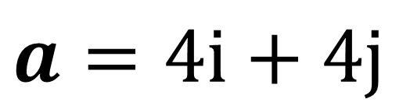
Unit Vector$=\frac{a}{\left|a\right|}$
$$\left|a\right|=\sqrt{4^{2}+4^{2}}=4\sqrt{2}$$
$$a=4i+4j$$
Unit Vector $=\frac{4}{4\sqrt{2}}i+\frac{4}{4\sqrt{2}}j$
$$=\frac{1}{\sqrt{2}}i+\frac{1}{\sqrt{2}}j$$

Slide 12
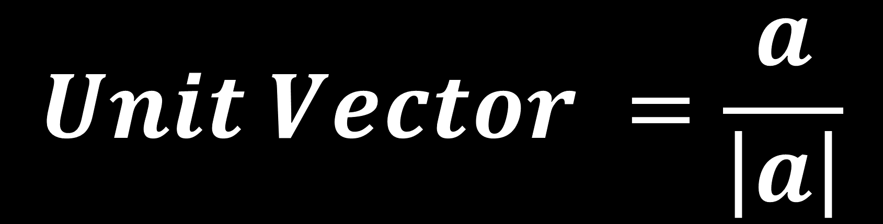
$$Unit Vector =\frac{a}{\left|a\right|}$$

