Slide 1
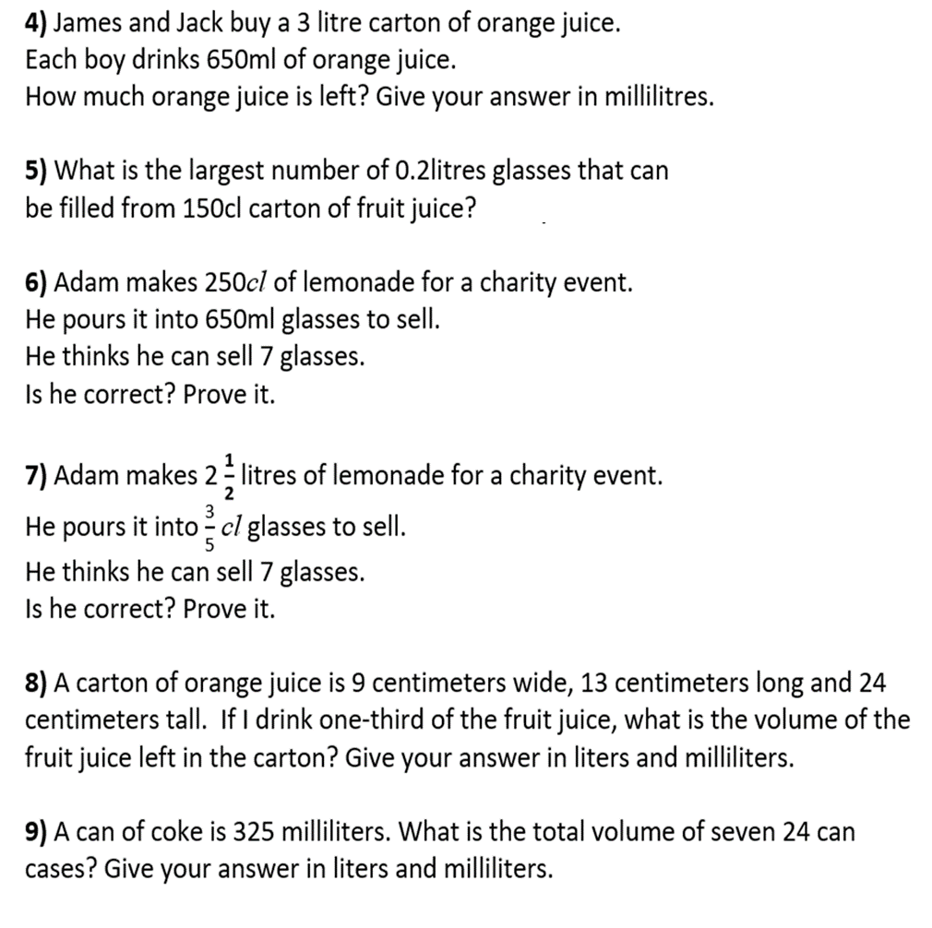
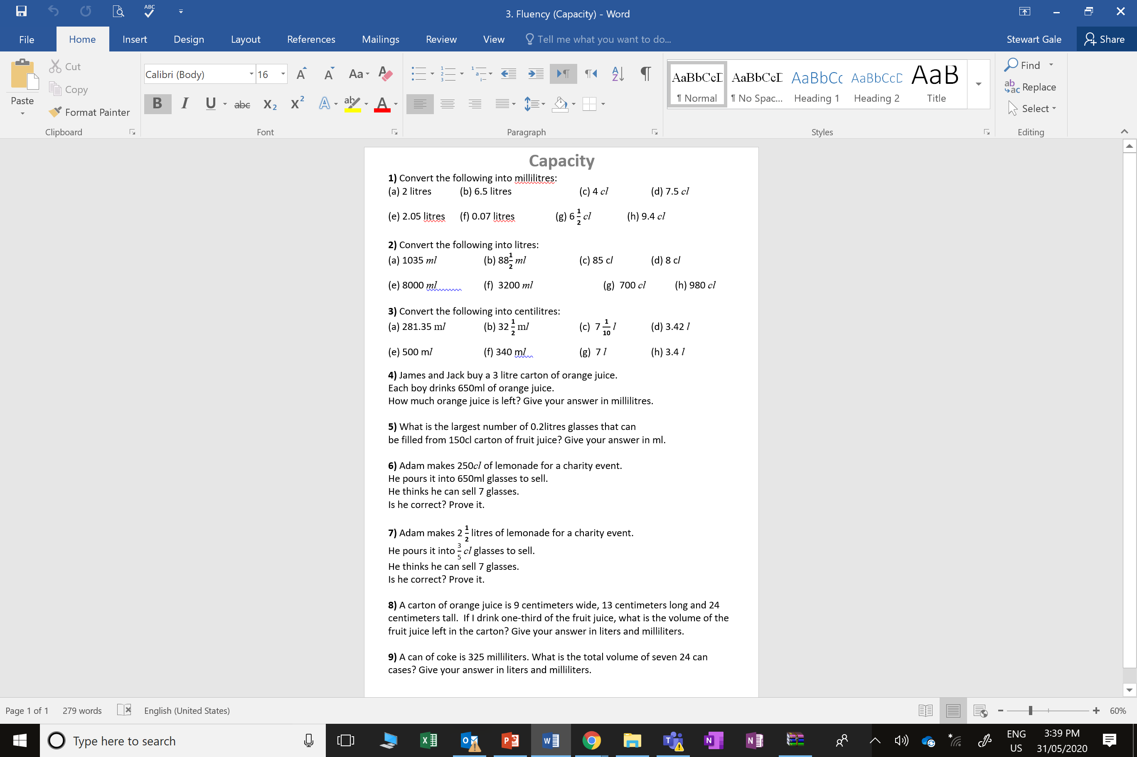

Slide 2
ANSWERS

Slide 3
2000ml
6500ml
40ml
75ml
2050ml
70ml
94ml
65ml

Slide 4
1.035l
0.0885l
0.85l
0.08l
8l
3.2l
7l
9.8l

Slide 5
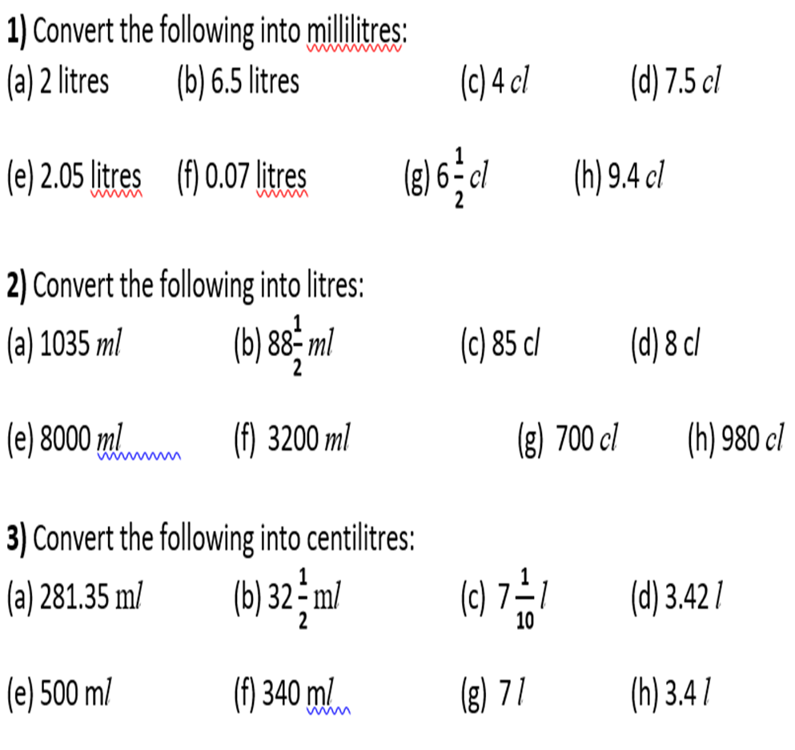
2.8135cl
3.250cl
710cl
342cl
50cl
34cl
700cl
340cl

Slide 6
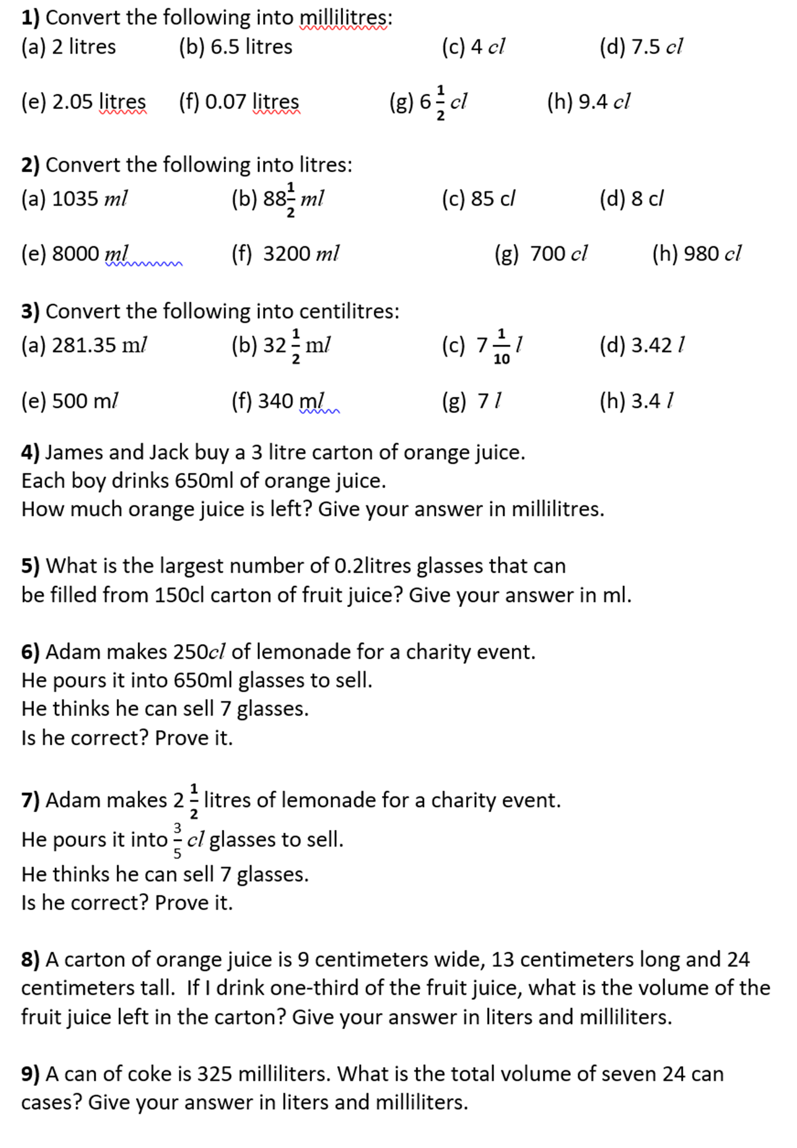
1700ml

Slide 7
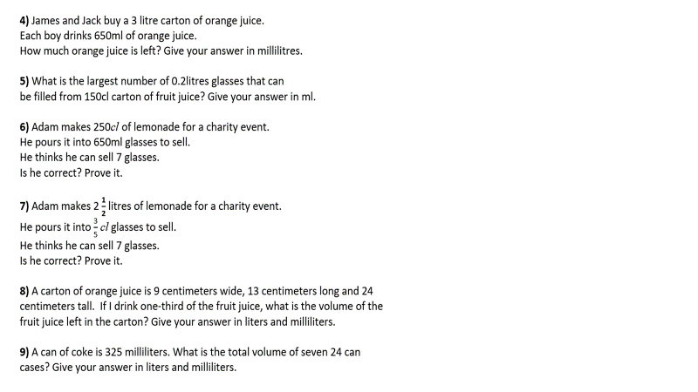
7 glasses

Slide 8
250cl = 2500ml
650ml x 7 = 4550ml
No

Slide 9
2.50l = 2500ml = 250cl
7 x 0.6 = 2.4cl
Yes

Slide 10
1872ml = 1l 872ml

Slide 11
7800ml = 7l 800ml

