Slide 1
Differentiation
Stationary Points
Chapter 12
(Part 6 of 8)

Slide 2
Stationary/Turning Points
Can you identify a stationary point on the curve?
Local maximum
Local minimum

Slide 3
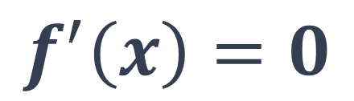
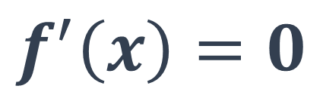
What can you stay about the
stationary points and their gradients?
$$f^{′}\left(x\right)=0$$
$$f^{′}\left(x\right)=0$$

Slide 4
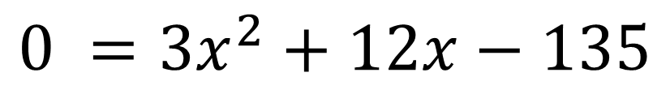
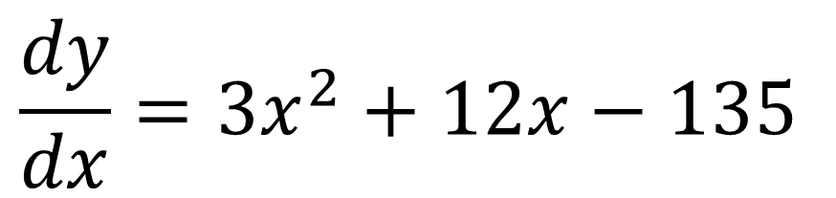
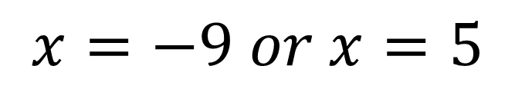

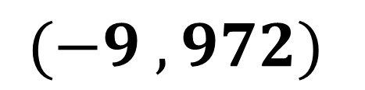
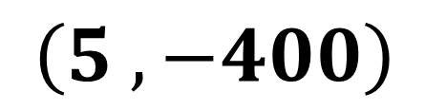

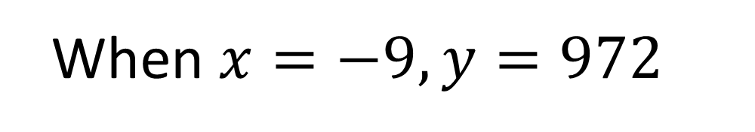
Find the co-ordinates of the turning points of $y=x^{3}+6x^{2}−135x$
$$\frac{dy}{dx}=3x^{2}+12x−135$$
When $x=5, y=−400$
When $x=−9, y=972$
$$0 =3x^{2}+12x−135$$
$$(−9 ,972)$$
$$x=−9 or x=5$$
$$\left(5 ,−400\right)$$

Slide 5
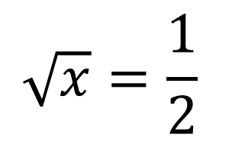
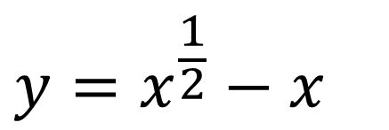
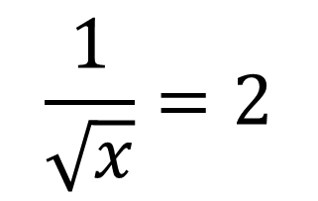
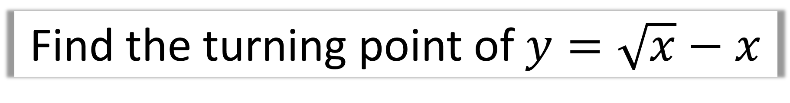
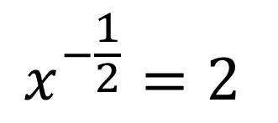
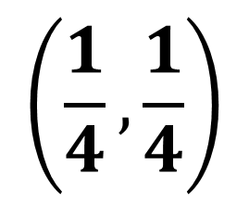
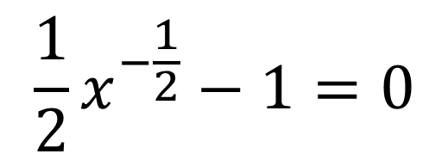
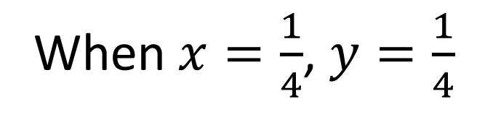
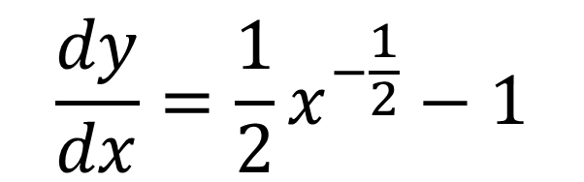
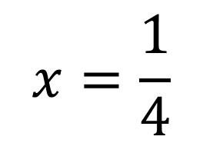
Find the turning point of $y=\sqrt{x}−x$
$$y=x^{\frac{1}{2}}−x$$
$$\frac{1}{\sqrt{x}}=2$$
$$\frac{dy}{dx}=\frac{1}{2}x^{−\frac{1}{2}}−1$$
$$\sqrt{x}=\frac{1}{2}$$
$$\frac{1}{2}x^{−\frac{1}{2}}−1=0$$
$$x=\frac{1}{4}$$
$$x^{−\frac{1}{2}}=2$$
$$\left(\frac{1}{4},\frac{1}{4}\right)$$
When $x=\frac{1}{4}$, $y=\frac{1}{4}$

Slide 6
How do you tell what type of stationary point?
Look at gradient just before and just after point.
Positive Gradient
Negative Gradient
Zero Gradient

Slide 7
Look at gradient just before and just after point.
Zero Gradient
Positive Gradient
Negative Gradient

Slide 8
Second Derivate
The second derivative
tells you the rate at which
the gradient is changing.

Slide 9
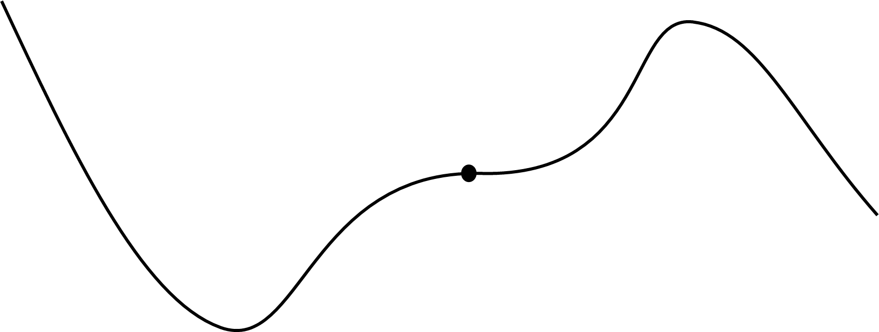

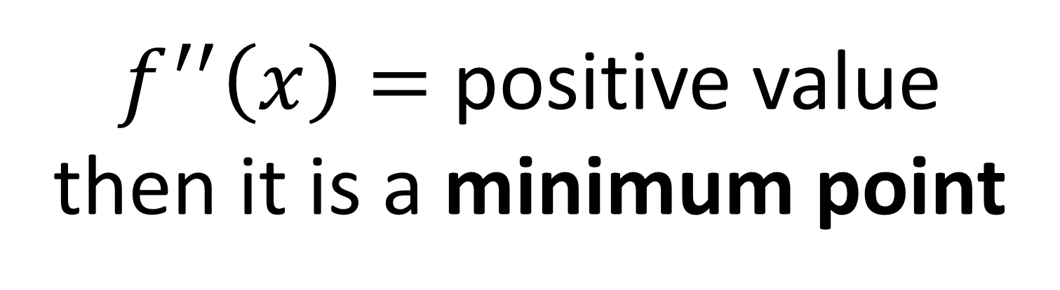
If $f^{′′}\left(x\right)$ is a positive value,
what is the nature of the turning point?
$f^{′′}\left(x\right)=$ positive value
then it is a minimum point

Slide 10

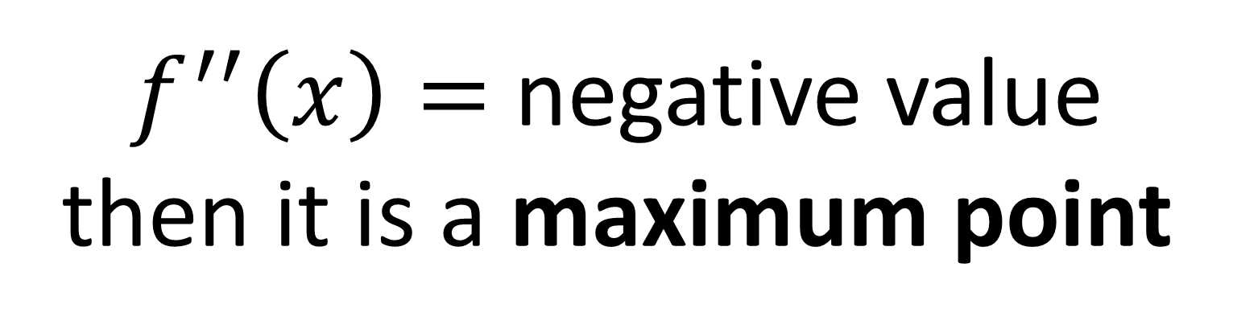
If $f^{′′}\left(x\right)$is a negative value,
what is the nature of the turning point?
$f^{′′}\left(x\right)=$ negative value
then it is a maximum point

Slide 11
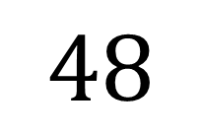
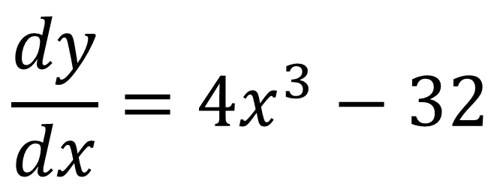
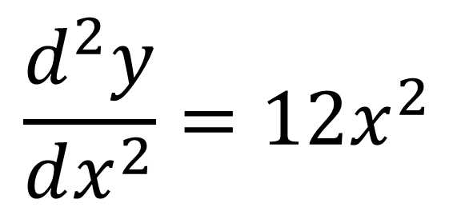
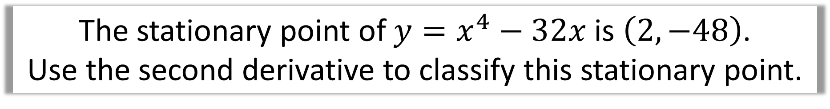
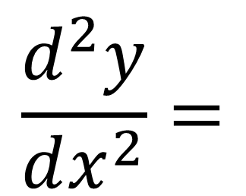
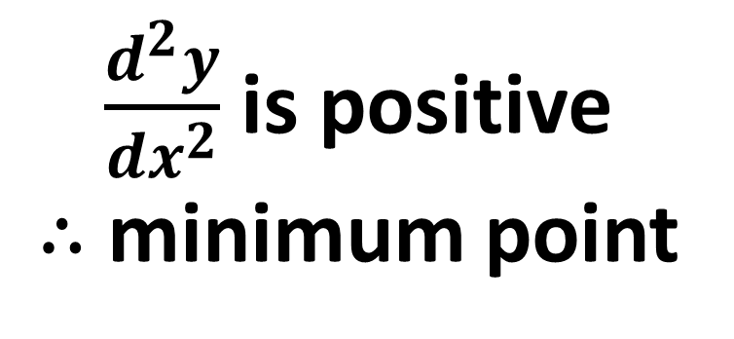
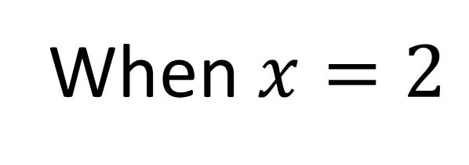
The stationary point of $y=x^{4}−32x$ is $\left(2,−48\right)$.
Use the second derivative to classify this stationary point.
When $x=2$
$$\frac{dy}{dx}=4x^{3}−32$$
$$\frac{d^{2}y}{dx^{2}}=$$
$$48$$
$$\frac{d^{2}y}{dx^{2}}=12x^{2}$$
$\frac{d^{2}y}{dx^{2}}$ is positive
$∴$minimum point

Slide 12
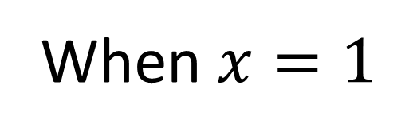
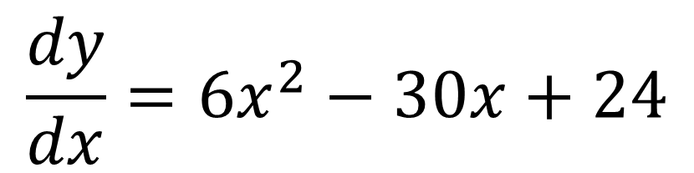
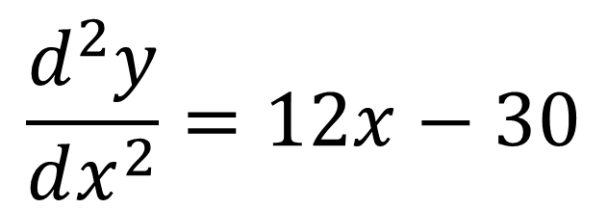
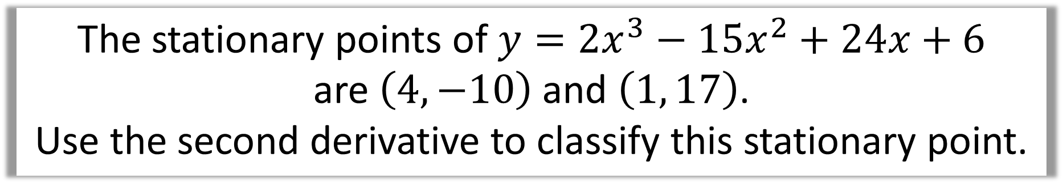
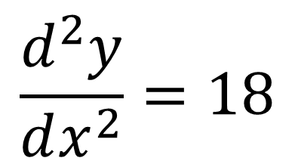
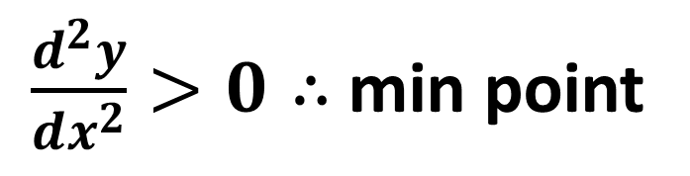
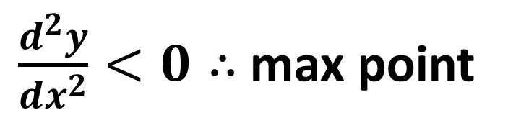
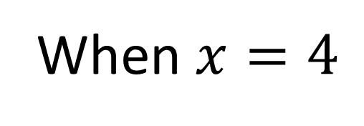
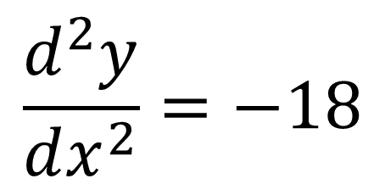
The stationary points of $y={2x}^{3}−{15x}^{2}+24x+6$
are $\left(4,−10\right)$ and $\left(1, 17\right)$.
Use the second derivative to classify this stationary point.
$$\frac{d^{2}y}{dx^{2}}=18$$
$$\frac{dy}{dx}={6x}^{2}−30x+24$$
When $x=4$
$\frac{d^{2}y}{dx^{2}}>0∴$min point
$$\frac{d^{2}y}{dx^{2}}=12x−30$$
$$\frac{d^{2}y}{dx^{2}}=−18$$
When $x=1$
$\frac{d^{2}y}{dx^{2}}<0∴$max point

Slide 13
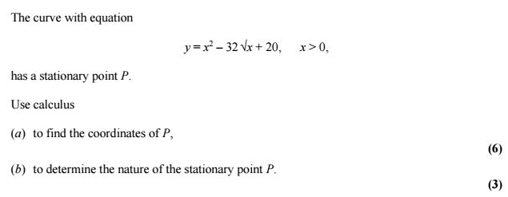

Slide 14
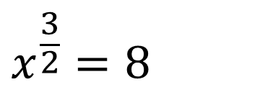
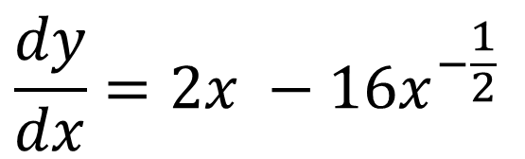
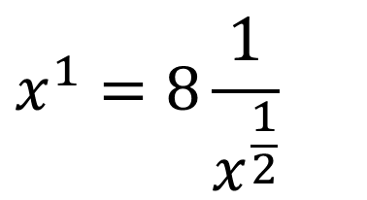

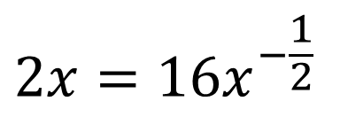
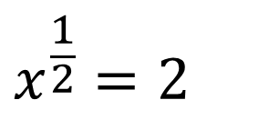
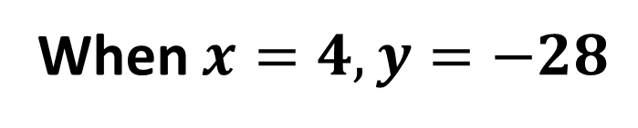
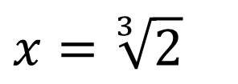
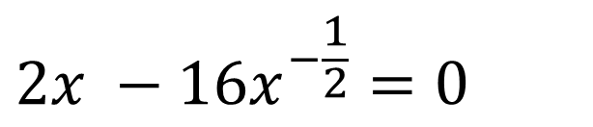
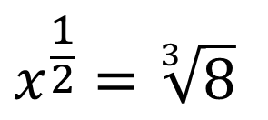
a)
$$\frac{dy}{dx}=2x −16x^{−\frac{1}{2}}$$
$$x^{1}=8\frac{1}{x^{\frac{1}{2}}}$$
$$x=\sqrt[3]{2}$$
$$x^{\frac{1}{2}}=2$$
$$2x −16x^{−\frac{1}{2}}=0$$
$$x^{\frac{3}{2}}=8$$
$${x=2}^{2}=4$$
$$2x=16x^{−\frac{1}{2}}$$
$$x^{\frac{1}{2}}=\sqrt[3]{8}$$
When $x=4, y=−28$

Slide 15
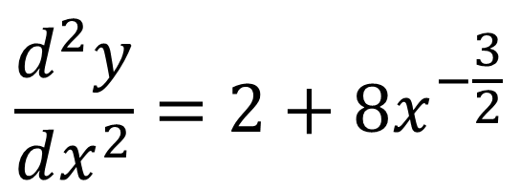
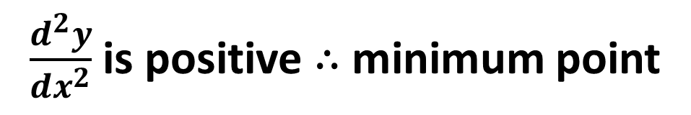
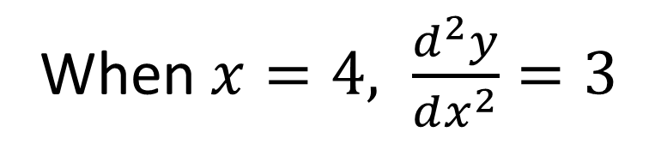
$$\frac{d^{2}y}{dx^{2}}=2+8x^{−\frac{3}{2}}$$
When $x=4, \frac{d^{2}y}{dx^{2}}=3$
b)
$\frac{d^{2}y}{dx^{2}}$ is positive $∴$minimum point

Slide 16
There’s a third type of stationary point!
Points of Inflection

Slide 17


A point of inflection is where,
the curve changes from concave to convex
(or vice versa).
$$f^{′}\left(x\right)=$$
$$0$$
convex
concave

Slide 18



If a function f(x) has a stationary point, then
$f^{′′}\left(x\right)>0$ Local minimum
$f^{′′}\left(x\right)<0$ Local maximum
$f^{′′}\left(x\right)=0$ min or max or inflection
Find the gradient either side of the point to determine it nature.

