Slide 1
FM: Geometric Proofs

Slide 2
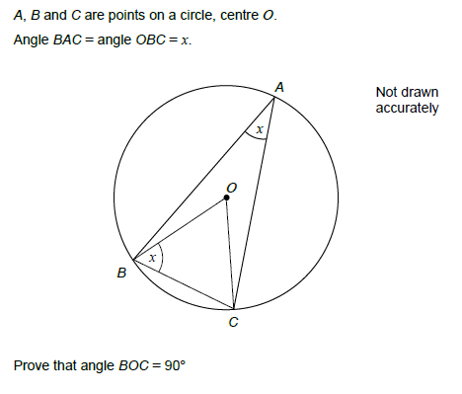

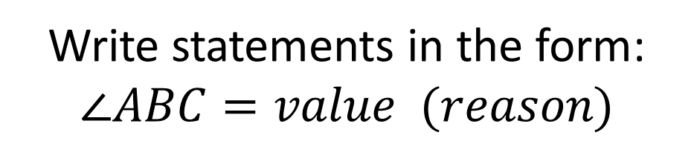


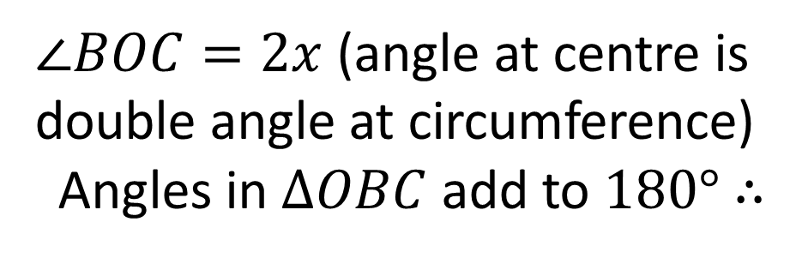
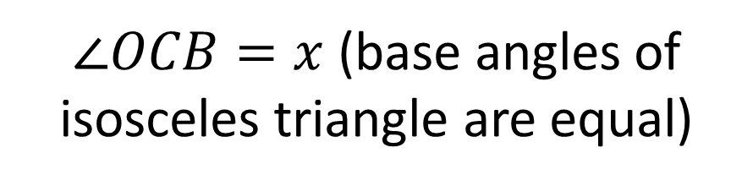
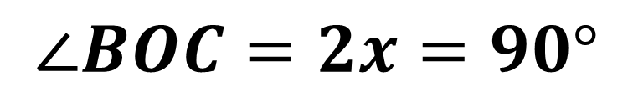
Write statements in the form:
$$∠ABC=value (reason)$$
$∠OCB=x$ (base angles of isosceles triangle are equal)
$∠BOC=2x$ (angle at centre is double angle at circumference)
Angles in $ΔOBC$ add to $180°$ $∴$
$$x+x+2x=180$$
$$4x=180$$
$$∠BOC=2x=90°$$
$$x=45$$

Slide 3
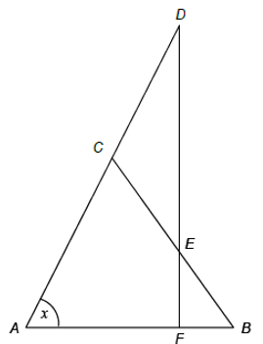

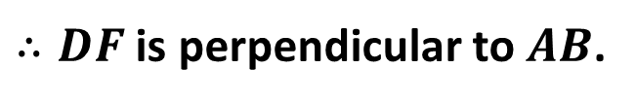
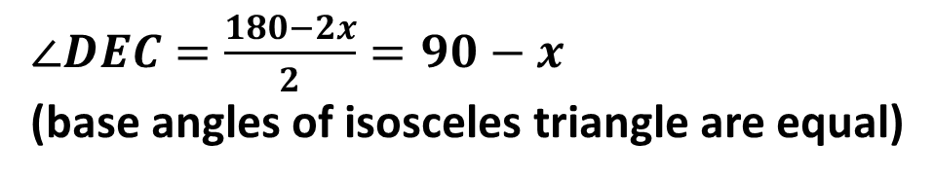
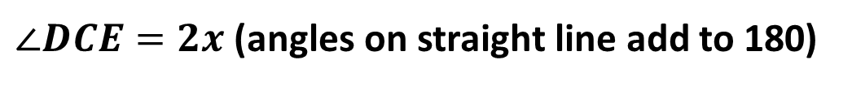
Triangle $ABC$ is isosceles with $AC=BC$.
Triangle $CDE$ is isosceles with $CD=CE$.
$ACD$ and $DEF$ are straight lines.
Prove that angle $DCE=2x$
Prove that $DF$ is perpendicular to $AB$.
$∠CBA=x$ (base angles of isosceles triangle are equal)
$∠DCE=2x$ (angles on straight line add to 180)
$∠ACB=180−2x$ (angles in $ΔABC$ add to 180)
$∠DEC=\frac{180−2x}{2}=90−x$
(base angles of isosceles triangle are equal)
$$∠DFA=180−\left(90−x\right)−x=90°$$
$∴DF$ is perpendicular to $AB$.

Slide 4






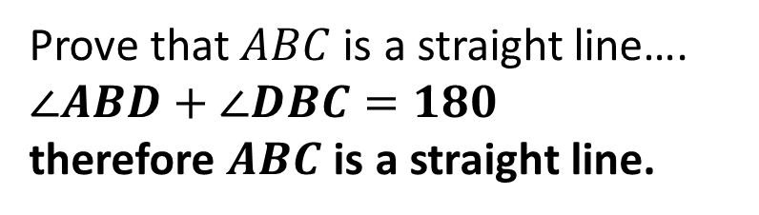
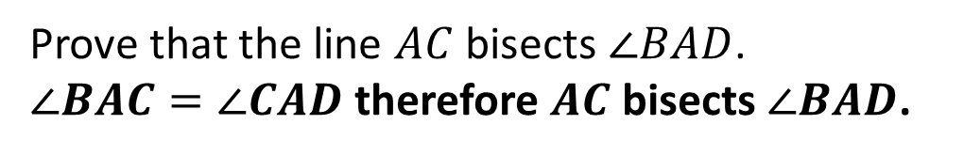

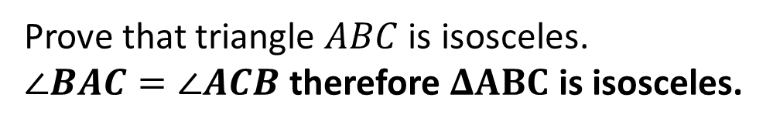




What do you think we would be the last step
in your proof in each of these cases?
$$D$$
Prove that $ABC$ is a straight line….
$∠ABD+∠DBC=180$
therefore $ABC$ is a straight line.
$$C$$
$$B$$
$$A$$
$$B$$
$$C$$
Prove that the line $AC$ bisects $∠BAD$.
$∠BAC=∠CAD$ therefore $AC$ bisects $∠BAD$.
$$A$$
$$D$$
$$B$$
Prove that triangle $ABC$ is isosceles.
$∠BAC=∠ACB$ therefore $ΔABC$ is isosceles.
$$A$$
$$C$$
Tip: It’s a good idea to finish by stating the thing you’re trying to prove.

Slide 5
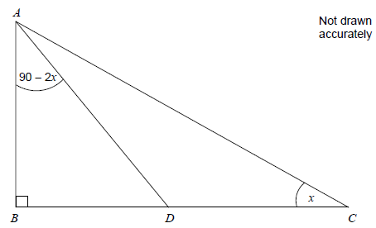
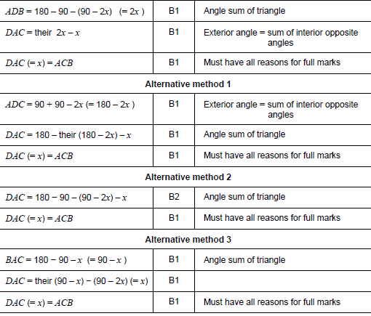
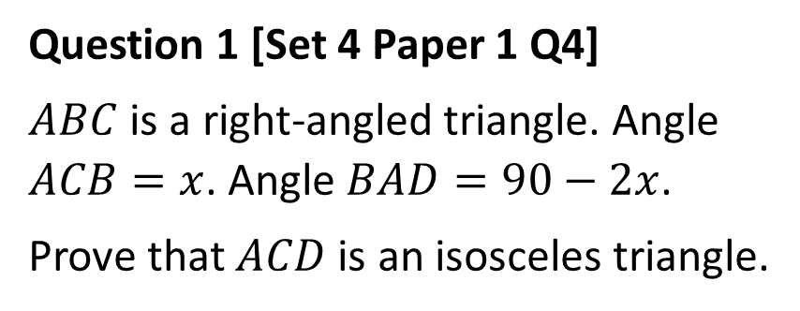
Question 1 [Set 4 Paper 1 Q4]
$ABC$ is a right-angled triangle. Angle $ACB=x$. Angle $BAD=90−2x$.
Prove that $ACD$ is an isosceles triangle.

Slide 6
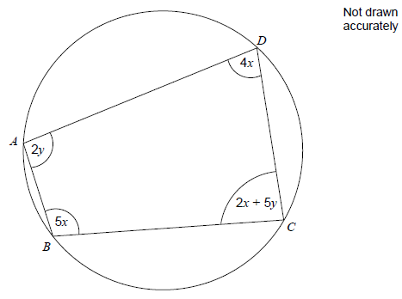
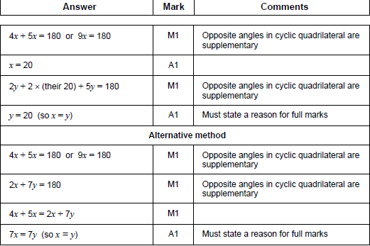
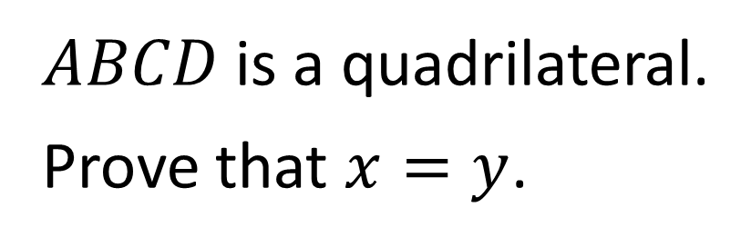
$ABCD$ is a quadrilateral.
Prove that $x=y$.

Slide 7
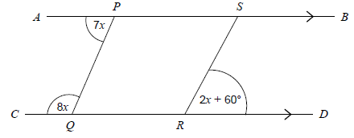
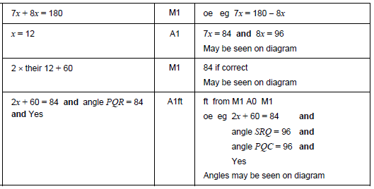
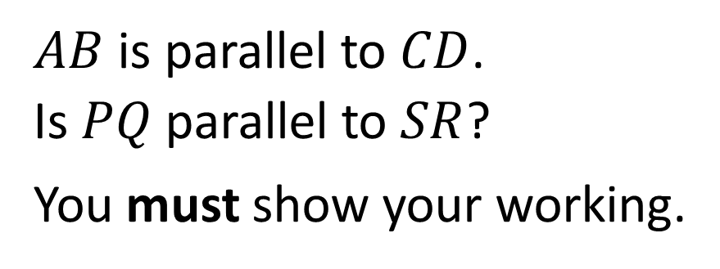
$AB$ is parallel to $CD$.
Is $PQ$ parallel to $SR$?
You must show your working.

Slide 8
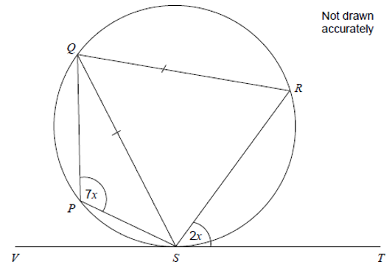
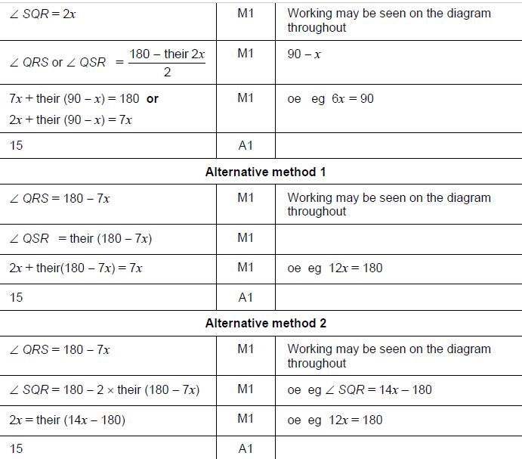
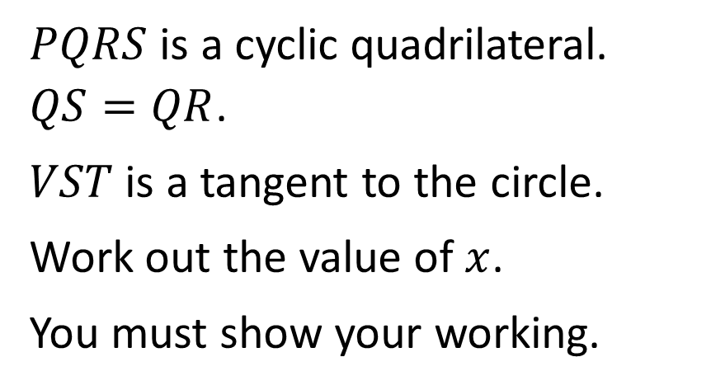
$PQRS$ is a cyclic quadrilateral. $QS=QR$.
$VST$ is a tangent to the circle.
Work out the value of $x$.
You must show your working.

Slide 9
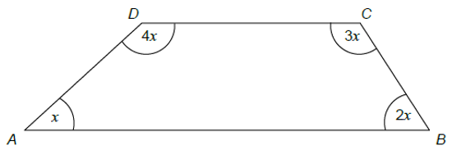
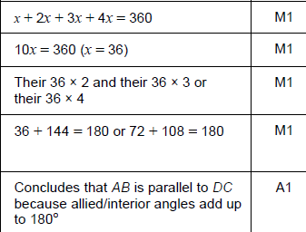
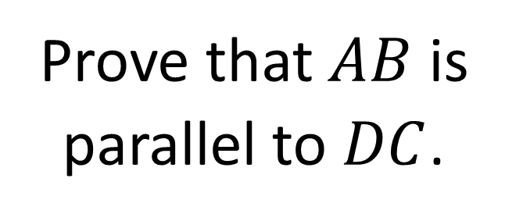
Prove that $AB$ is parallel to $DC$.

Slide 10
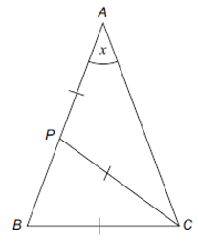
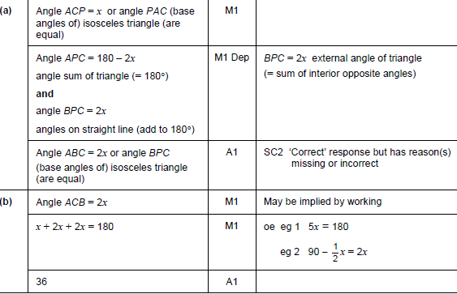
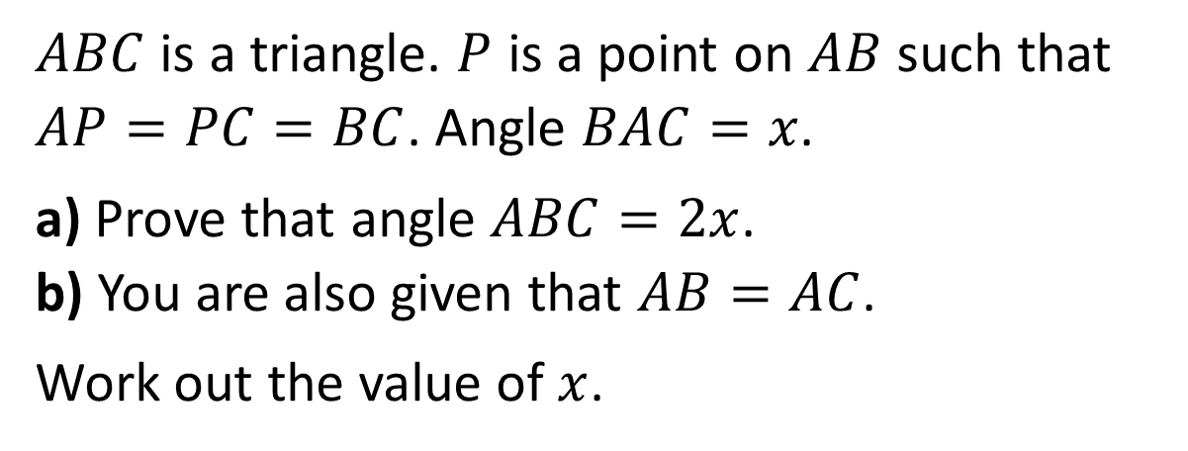
$ABC$ is a triangle. $P$ is a point on $AB$ such that $AP=PC=BC$. Angle $BAC=x$.
a) Prove that angle $ABC=2x$.
b) You are also given that $AB=AC$.
Work out the value of $x$.

