Slide 1
LO: Inequalities
and Number Lines

Slide 2

What do the following symbols mean?
=
>
<
≥
≤
Equals
Greater than
Less than
Greater than or equal to
Less than or equal to

Slide 3
5 > 3
Reading right to left.
Three is Less than Five

Slide 4
5 > 3
Reading left to right.
Five is Greater than Three

Slide 5
x > 4
What values could x be?
Any value greater than 4

Slide 6
3 < x ≤ 8
What integers could x be?
4, 5, 6, 7, 8

Slide 7
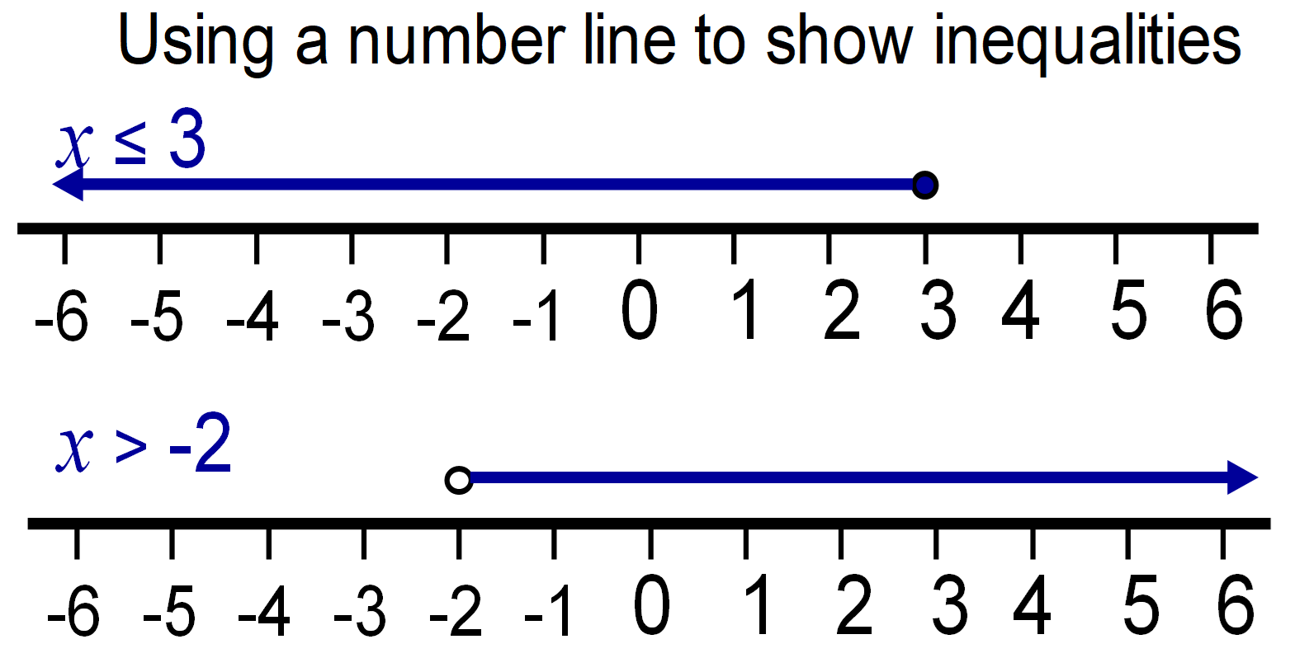
What is the difference between
the number lines?
x > -3
x ≥ -3

Slide 8
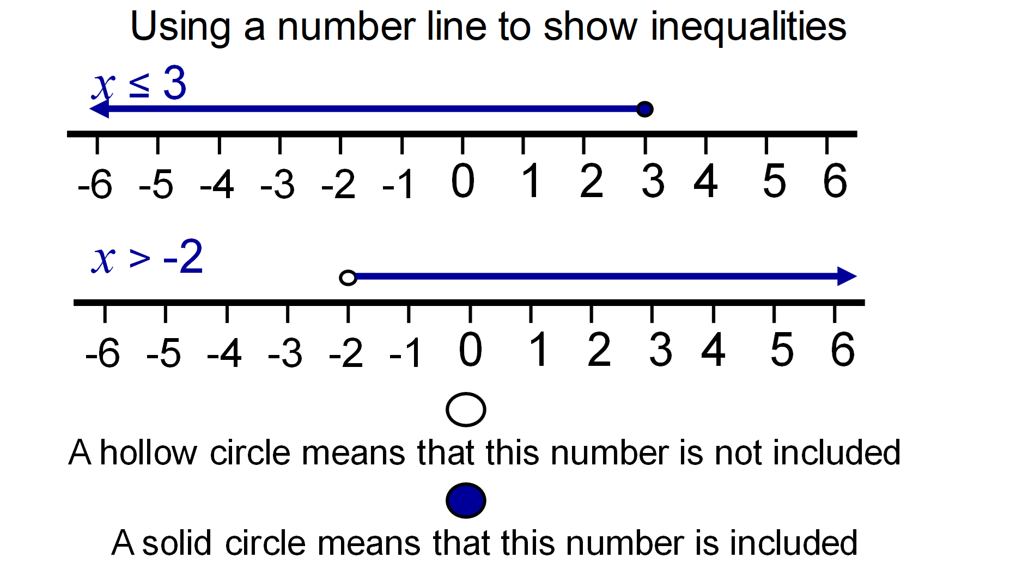
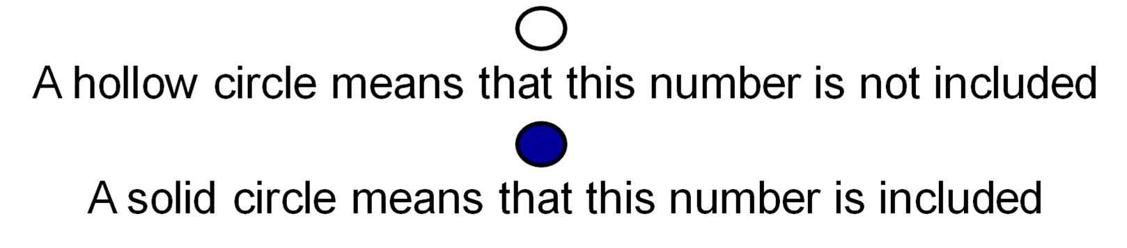

Slide 9
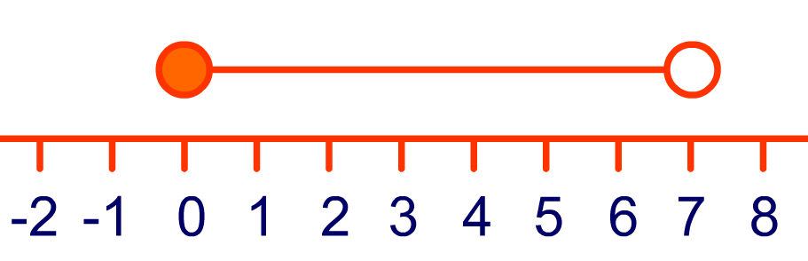
Write an inequality for
the following number lines.
0 ≤ x < 7

Slide 10
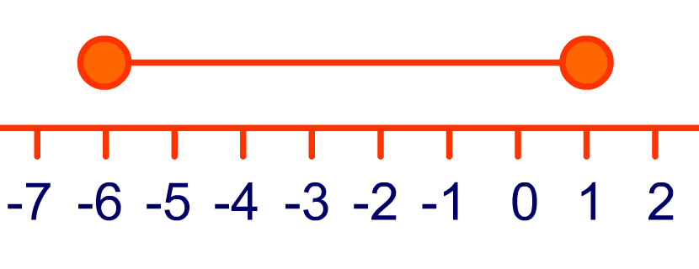
Write an inequality for
the following number lines.
-6 ≤ x ≤ 1

Slide 11

Write an inequality for
the following number lines.
-2 ≤ x < 4

