Slide 1
Parametric Equations
Points of Intersection
Chapter 8
(Part 3 of 3)

Slide 2
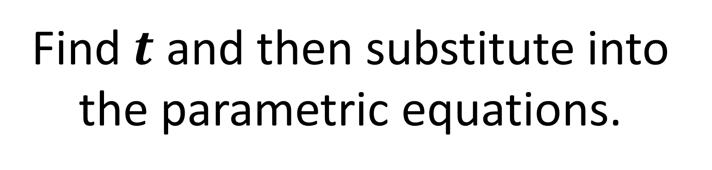
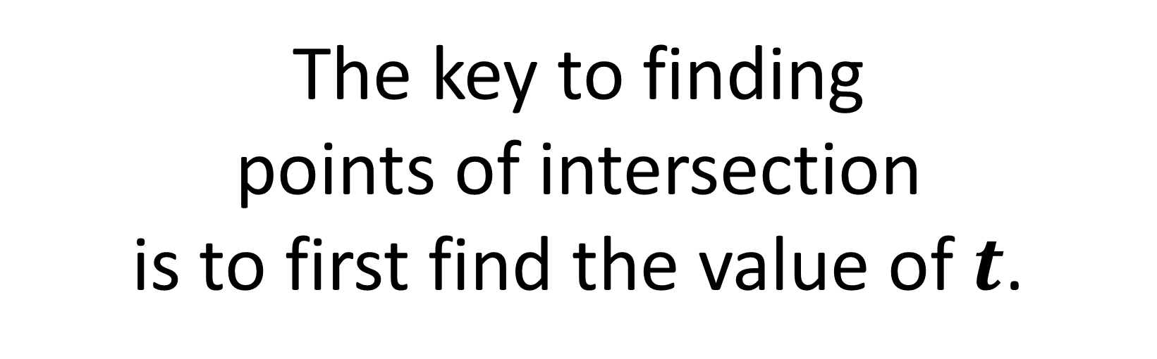
Parametric Curves - Points of Intersection
The key to finding
points of intersection
is to first find the value of $t$.
Find $t$ and then substitute into the parametric equations.

Slide 3
Whenever you want to solve a
Cartesian equation and parametric equations simultaneously,
substitute the Parametric equations
into the Cartesian.

Slide 4
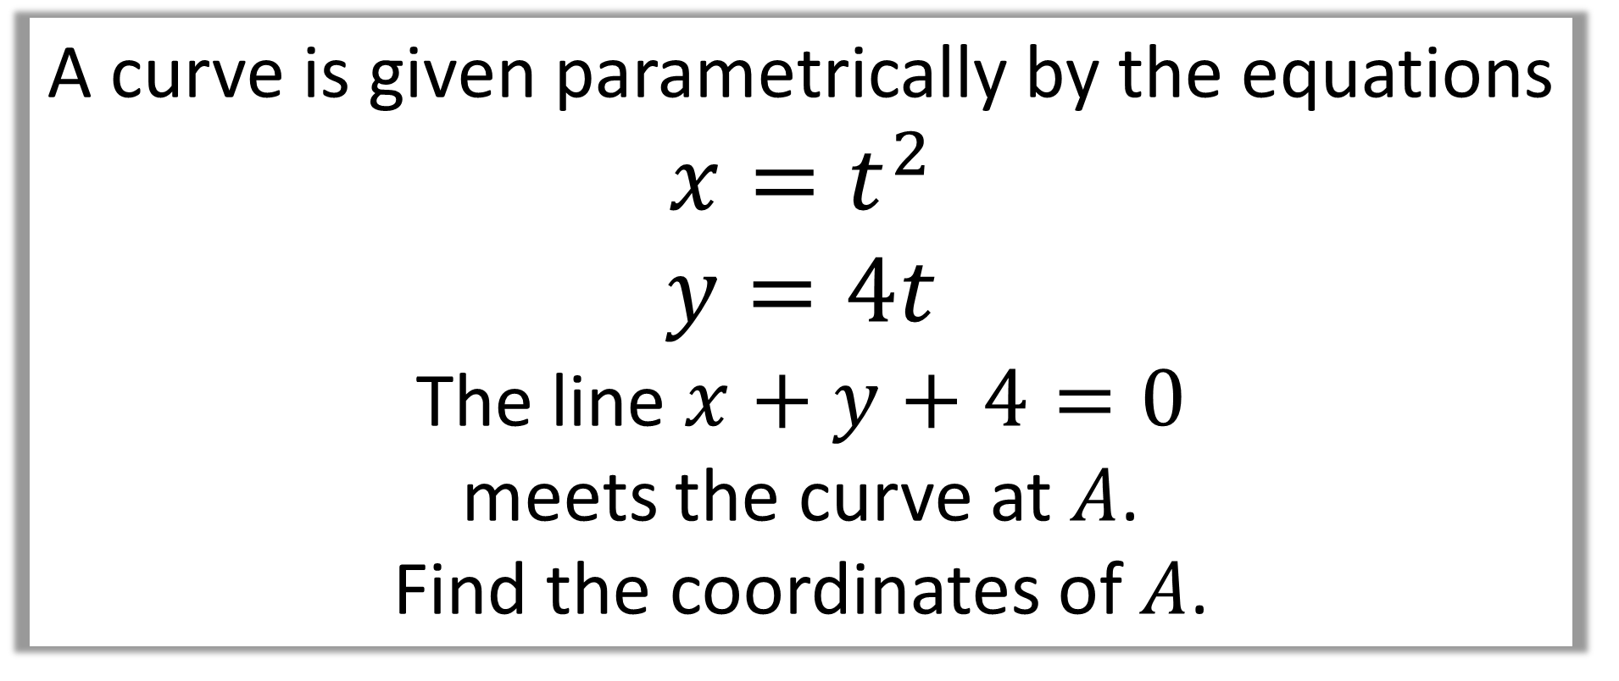
Question A
A curve is given parametrically by the equations
$$x=t^{2}$$
$$y=4t$$
The line $x+y+4=0$
meets the curve at $A$.
Find the coordinates of $A$.

Slide 5
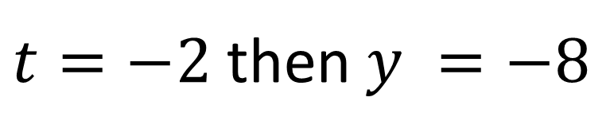

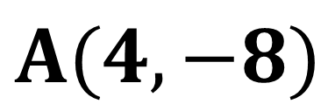
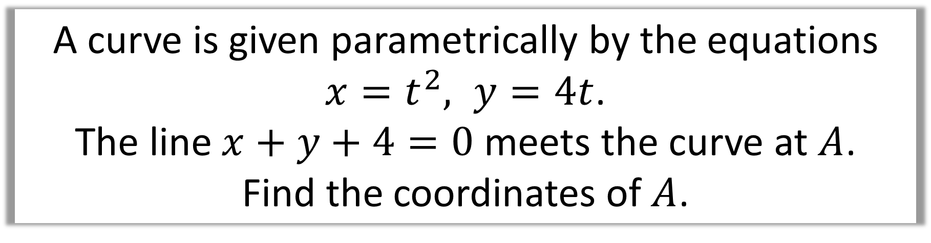
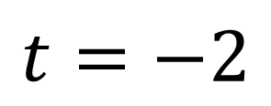
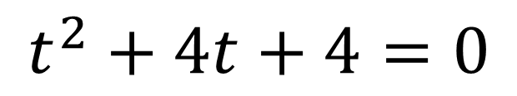
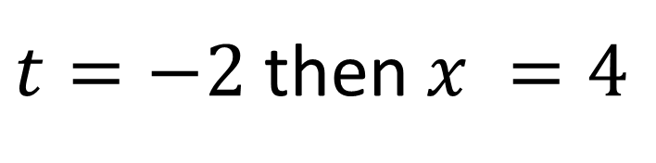
A curve is given parametrically by the equations
$x=t^{2}, y=4t$.
The line $x+y+4=0$ meets the curve at $A$.
Find the coordinates of $A$.
$$x+y+4=0$$
$t=−2$ then $x =4$
$$t^{2}+4t+4=0$$
$t=−2$ then $y =−8$
$$t=−2$$
$$A(4,−8)$$

Slide 6
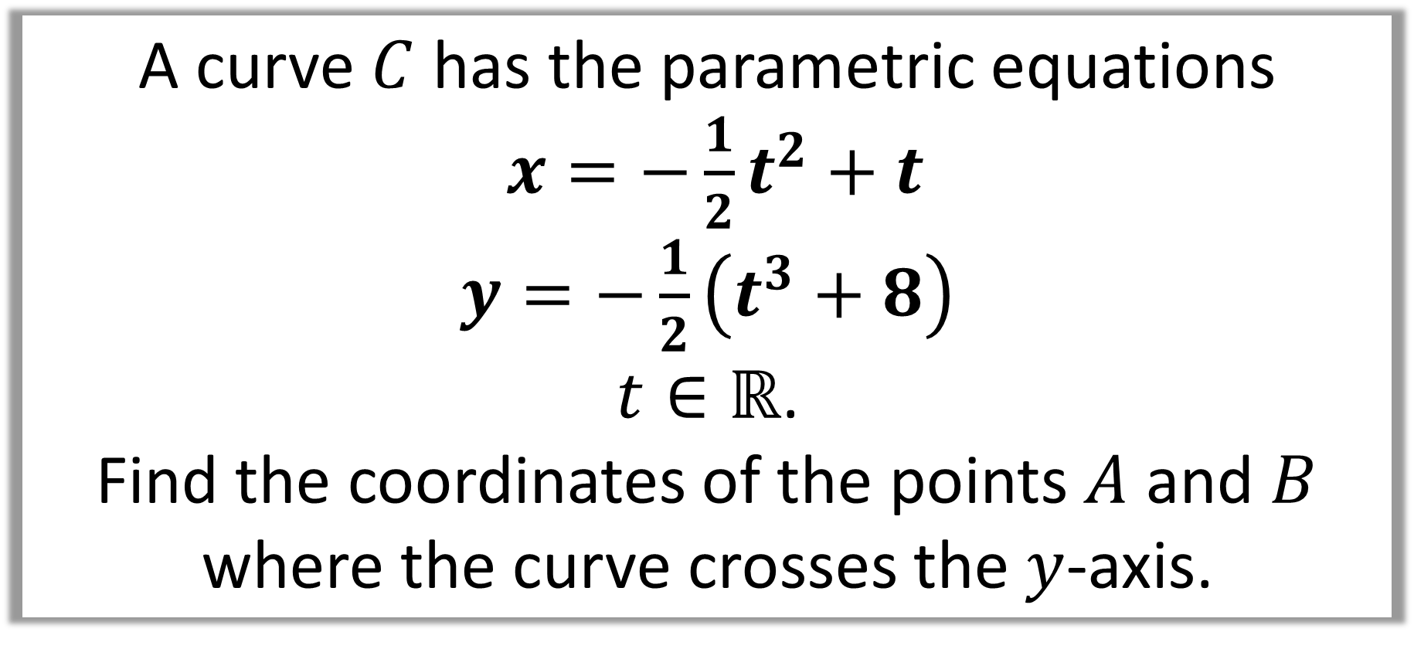
Question B
A curve $C$ has the parametric equations
$x=−\frac{1}{2}t^{2}+t$
$y=−\frac{1}{2}\left(t^{3}+8\right)$
$t∈ℝ$.
Find the coordinates of the points $A$ and $B$
where the curve crosses the $y$-axis.

Slide 7
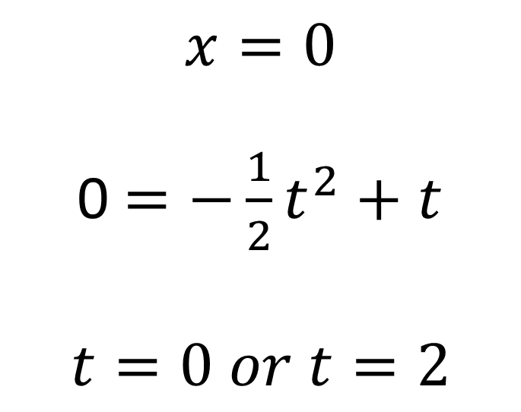
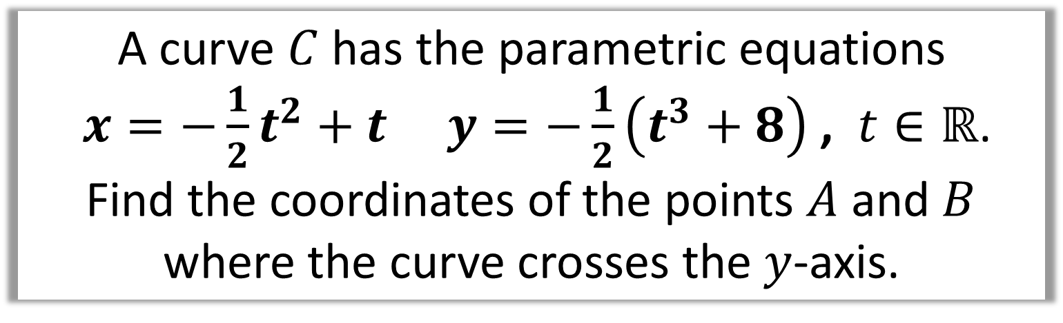
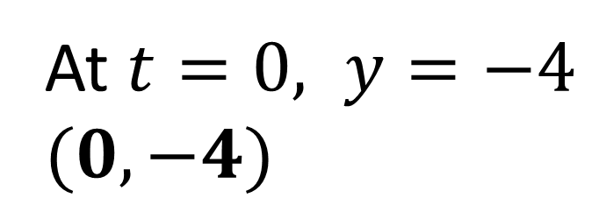
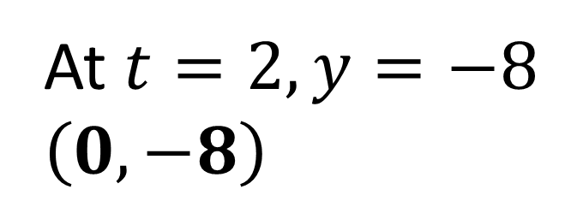
A curve $C$ has the parametric equations
$x=−\frac{1}{2}t^{2}+t$ $y=−\frac{1}{2}\left(t^{3}+8\right)$ , $t∈ℝ$.
Find the coordinates of the points $A$ and $B$
where the curve crosses the $y$-axis.
$$x=0$$
0 $=−\frac{1}{2}t^{2}+t$
$$t=0 or t=2$$
At $t=2, y=−8$
$$\left(0,−8\right)$$
At $t=0, y=−4$
$$(0,−4)$$

Slide 8
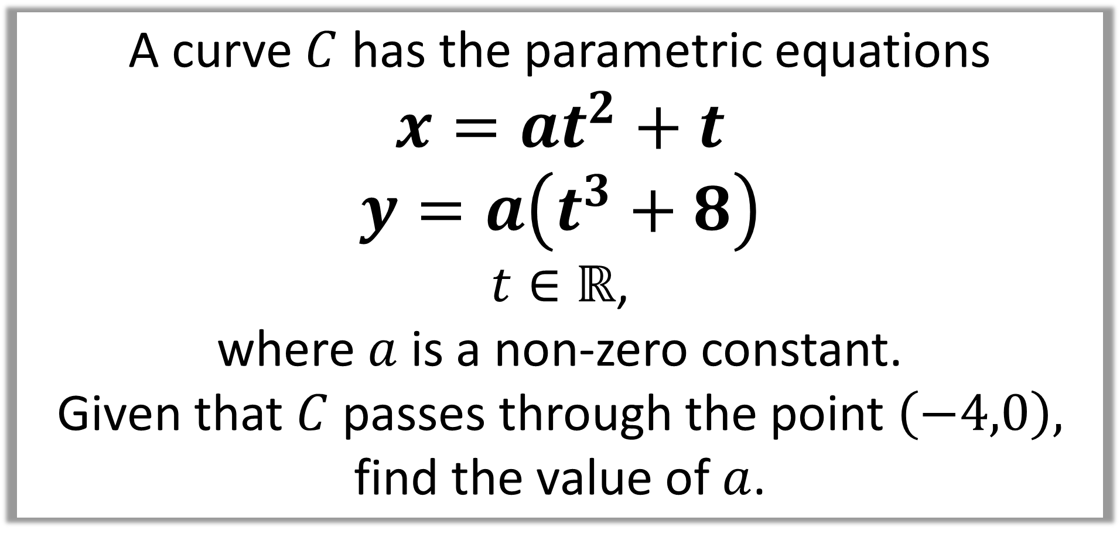
Question C
A curve $C$ has the parametric equations
$$x=at^{2}+t$$
$$y=a\left(t^{3}+8\right)$$
$t∈ℝ$,
where $a$ is a non-zero constant.
Given that $C$ passes through the point $\left(−4,0\right),$
find the value of $a$.

Slide 9
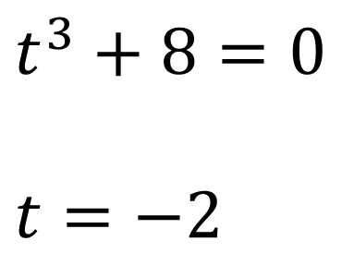
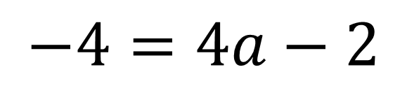
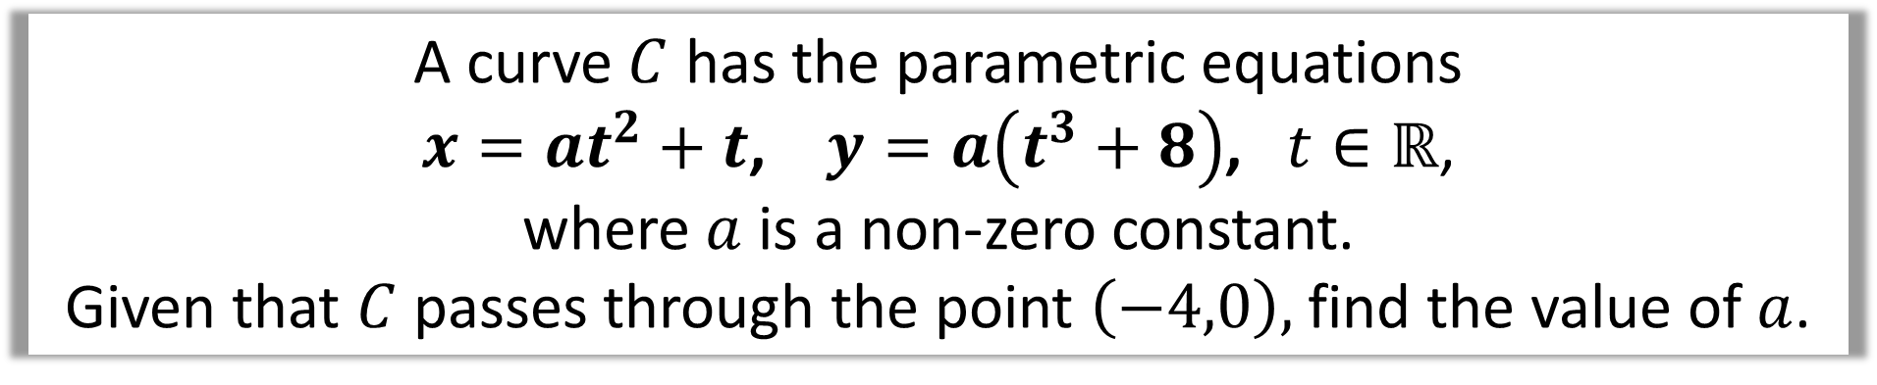
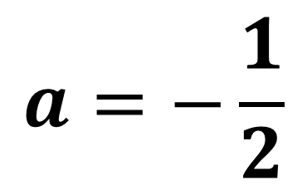
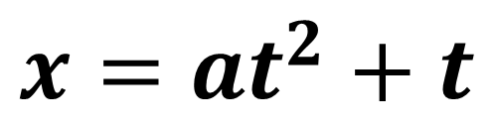
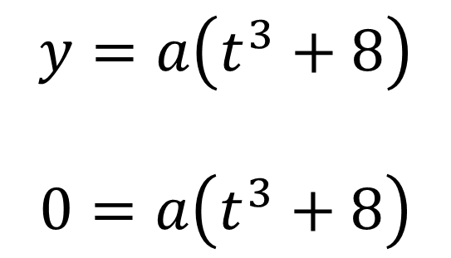
A curve $C$ has the parametric equations
$x=at^{2}+t$, $y=a\left(t^{3}+8\right)$, $t∈ℝ$,
where $a$ is a non-zero constant.
Given that $C$ passes through the point $\left(−4,0\right),$ find the value of $a$.
$$y=a\left(t^{3}+8\right)$$
$$0=a\left(t^{3}+8\right)$$
$$x=at^{2}+t$$
$$−4=4a−2$$
$$t^{3}+8=0$$
$$t=−2$$
$$a=−\frac{1}{2}$$

Slide 10
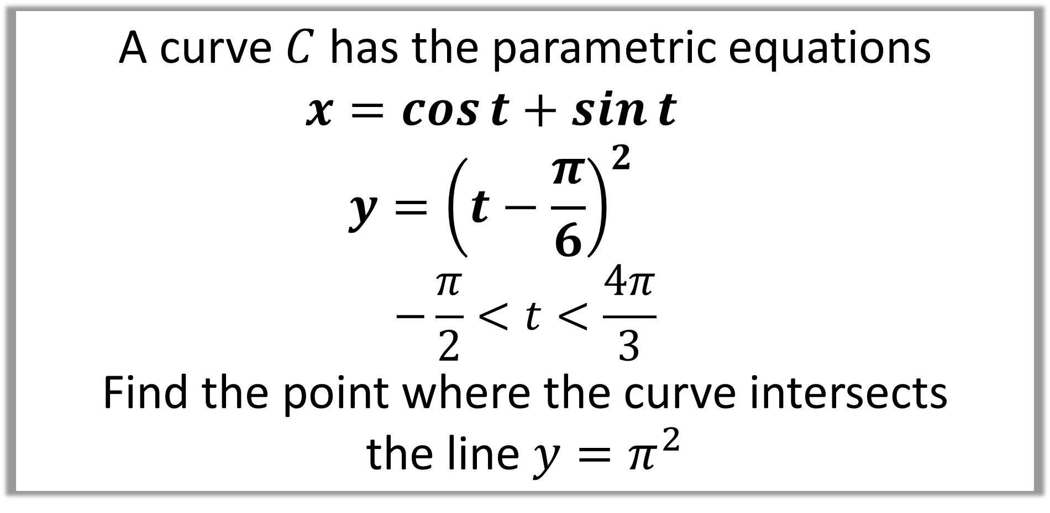
Question D
A curve $C$ has the parametric equations
$$x=\cos{t}+\sin{t}$$
$$y={\left(t−\frac{π}{6}\right)}^{2}$$
$$−\frac{π}{2}<t<\frac{4π}{3}$$
Find the point where the curve intersects
the line $y=π^{2}$

Slide 11
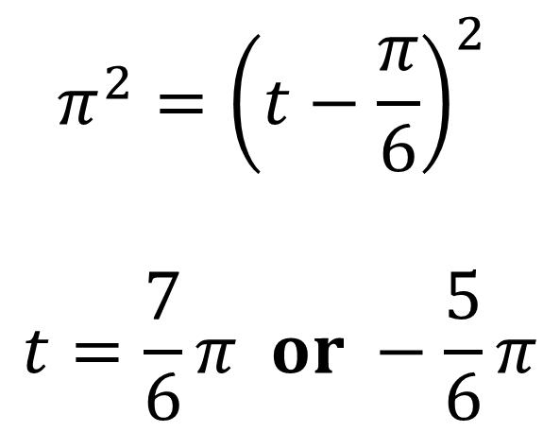
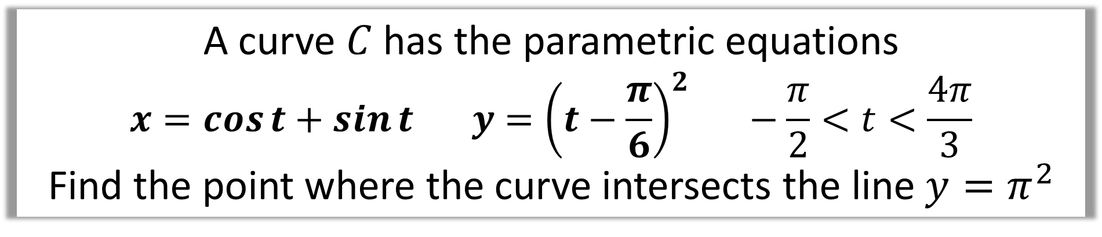
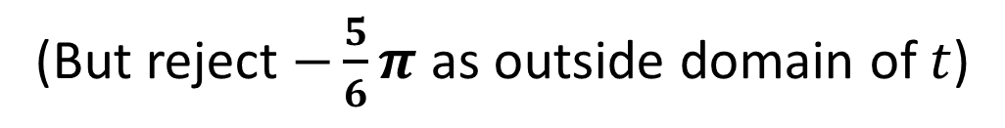
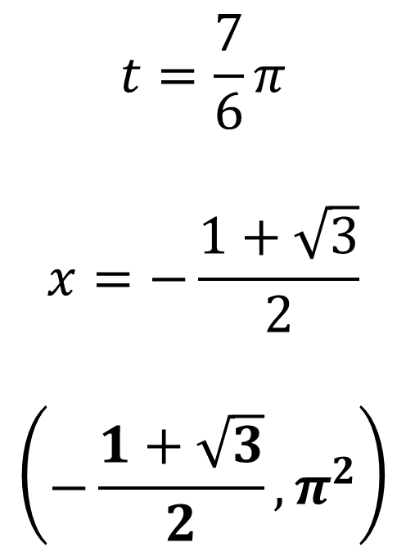
A curve $C$ has the parametric equations
$$x=\cos{t}+\sin{t} y={\left(t−\frac{π}{6}\right)}^{2} −\frac{π}{2}<t<\frac{4π}{3}$$
Find the point where the curve intersects the line $y=π^{2}$
$$π^{2}={\left(t−\frac{π}{6}\right)}^{2}$$
$$t=\frac{7}{6}π or −\frac{5}{6}π$$
$$t=\frac{7}{6}π$$
$$x=−\frac{1+\sqrt{3}}{2}$$
$$\left(−\frac{1+\sqrt{3}}{2},π^{2}\right)$$
(But reject $−\frac{5}{6}π$ as outside domain of $t$)

Slide 12
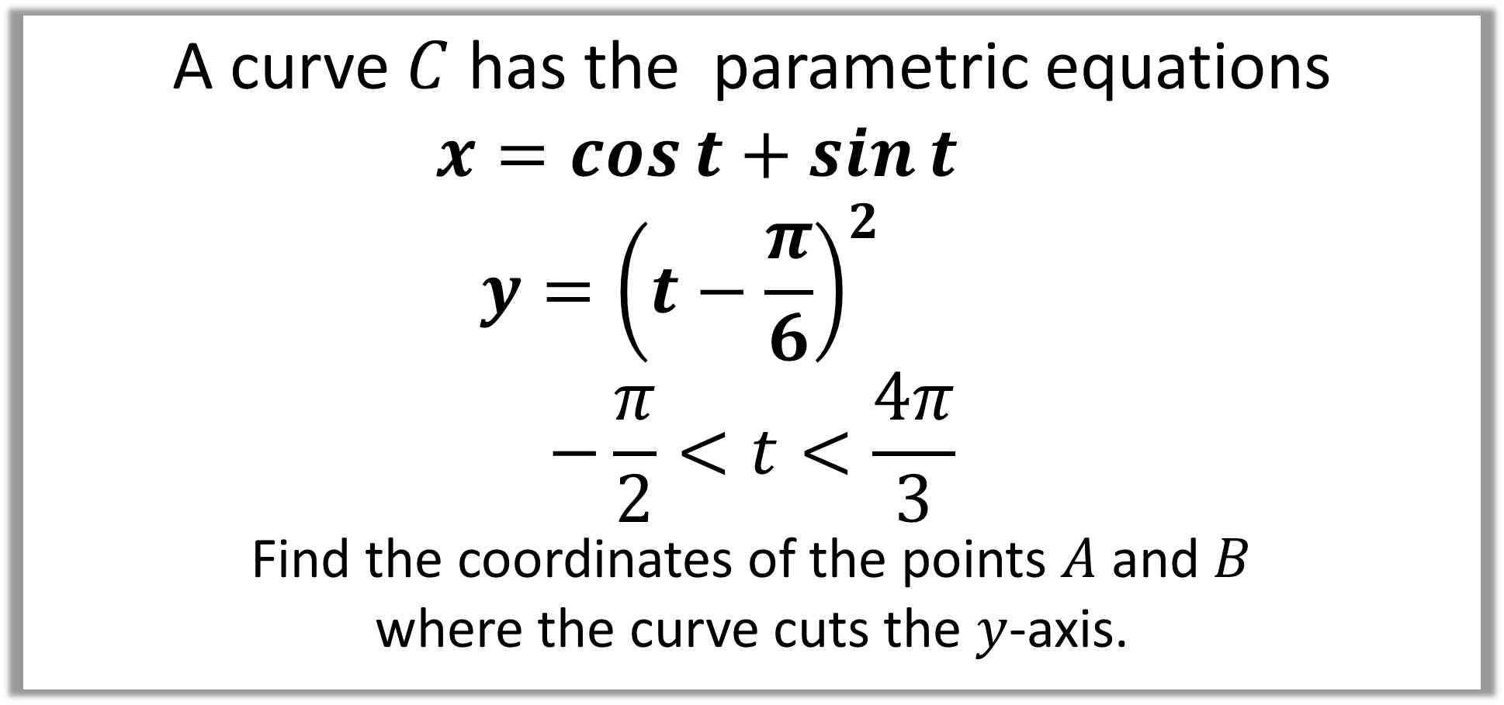
Question E
A curve $C$ has the parametric equations
$$x=\cos{t}+\sin{t}$$
$$y={\left(t−\frac{π}{6}\right)}^{2}$$
$$−\frac{π}{2}<t<\frac{4π}{3}$$
Find the coordinates of the points $A$ and $B$
where the curve cuts the $y$-axis.

Slide 13
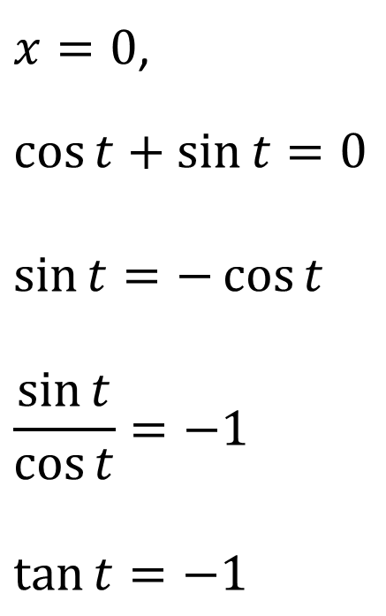
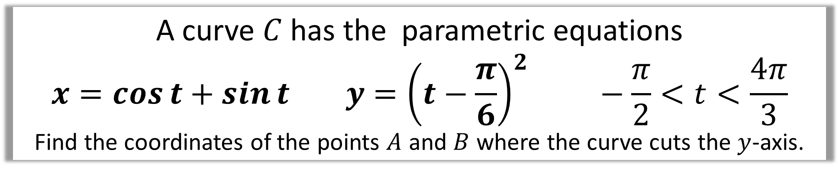
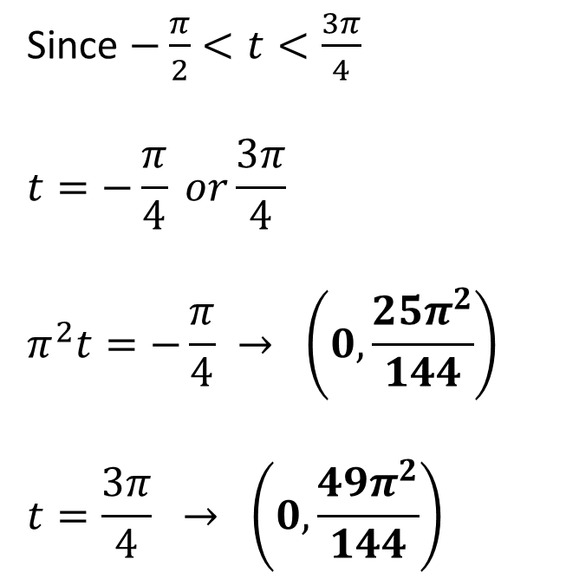
A curve $C$ has the parametric equations
$$x=\cos{t}+\sin{t} y={\left(t−\frac{π}{6}\right)}^{2} −\frac{π}{2}<t<\frac{4π}{3}$$
Find the coordinates of the points $A$ and $B$ where the curve cuts the $y$-axis.
$x=0$,
$$\cos{t}+\sin{t}=0$$
$$\sin{t}=−\cos{t}$$
$$\frac{\sin{t}}{\cos{t}}=−1$$
$$\tan{t}=−1$$
Since $−\frac{π}{2}<t<\frac{3π}{4}$
$$t=−\frac{π}{4} or\frac{3π}{4}$$
$$π^{2}t=−\frac{π}{4} → \left(0,\frac{25π^{2}}{144}\right)$$
$$t=\frac{3π}{4} → \left(0,\frac{49π^{2}}{144}\right)$$

Slide 14
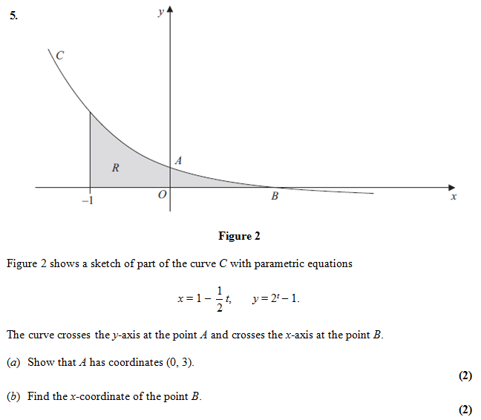
Question F

Slide 15
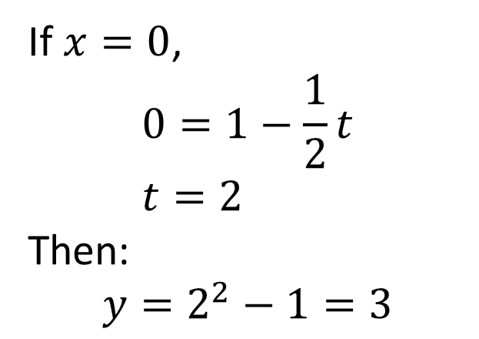
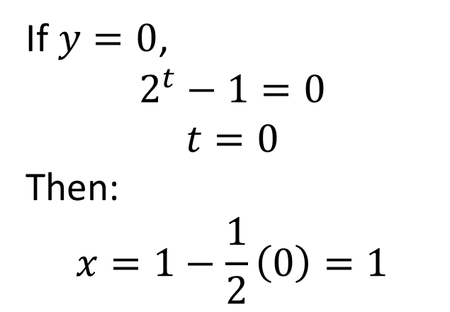
a)
If $x=0$,
$$0=1−\frac{1}{2}t \\ t=2$$
Then:
$$y=2^{2}−1=3$$
b)
If $y=0$,
$$2^{t}−1=0 \\ t=0$$
Then:
$$x=1−\frac{1}{2}\left(0\right)=1$$

