Slide 1

Diagnostic
uestions
Misconceptions

Slide 2
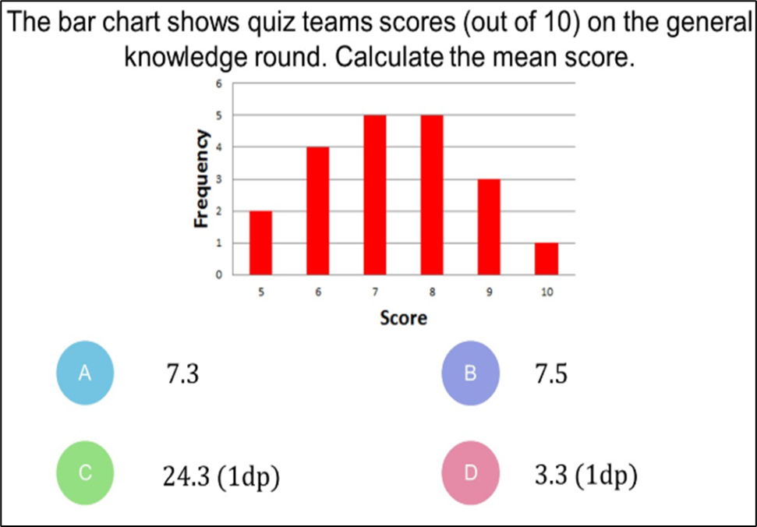
Worst answered question?
What is the mean number of pets?
A 1.6 | B 2.5
C 4 | D 2
Calculate the mean score.
A 7.3 | B 7.5
C 24.3 (1dp) | D 3.3 (1dp)
Pets | Frequency
0 | 2
1 | 3
2 | 2
3 | 3
61% Incorrect
69% Incorrect

Slide 3
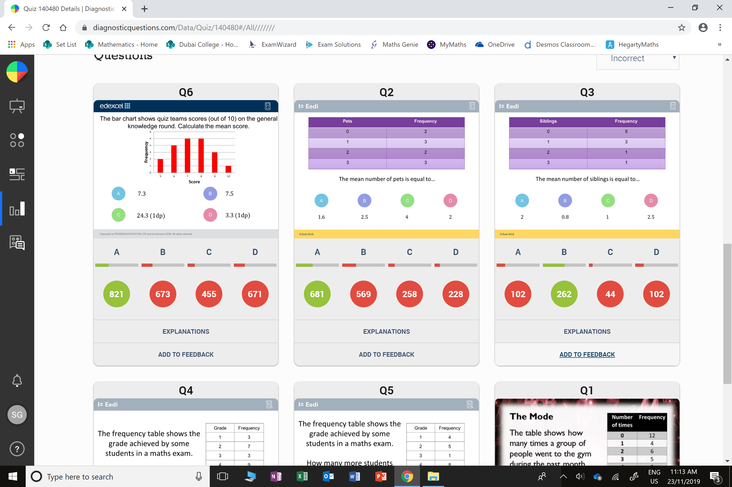
Most common wrong answer?
What is the mean number of pets?
A 1.6 | B 2.5
C 4 | D 2
Pets | Frequency
0 | 2
1 | 3
2 | 2
3 | 3
B
The student has given the mean of the pet's column.

Slide 4
Most common wrong answer?
Calculate the mean score.
A 7.3 | B 7.5
C 24.3 (1dp) | D 3.3 (1dp)
B
45 total scores divide by 6.

