Slide 1
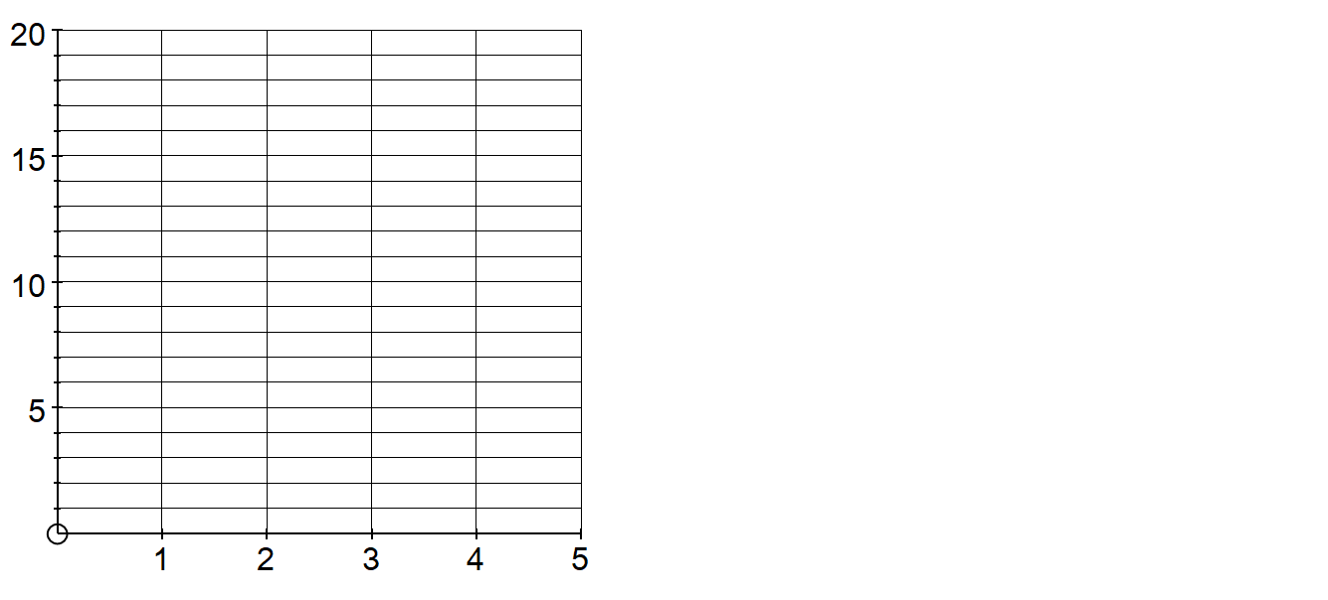
1)
Pattern:
Formula:
Pattern 1
Pattern 2
Pattern 3
Table:
Graph:
Pattern number n | Number of squares S
1
2
3
4
10
100
Number of squares
Pattern number
Notes:
Layout of worksheets in this task has been copied somewhat from another TES user – flibit – but I have used my own choice of sequences, so that they can be explored further in the next task.

Slide 2
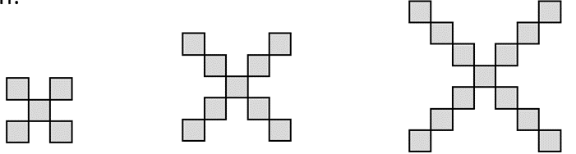
2)
Pattern:
Formula:
Pattern 1
Pattern 2
Pattern 3
Table:
Graph:
Pattern number n | Number of squares S
1
2
3
4
10
100
Number of squares
Pattern number
Notes:
Layout of worksheets in this task has been copied somewhat from another TES user – flibit – but I have used my own choice of sequences, so that they can be explored further in the next task.

Slide 3
3)
Pattern:
Formula:
Pattern 1
Pattern 2
Pattern 3
Table:
Graph:
Pattern number n | Number of squares S
1
2
3
4
10
100
Number of squares
Pattern number
Notes:
Layout of worksheets in this task has been copied somewhat from another TES user – flibit – but I have used my own choice of sequences, so that they can be explored further in the next task.

Slide 4
4)
Pattern:
Formula:
Pattern 1
Pattern 2
Pattern 3
Table:
Graph:
Pattern number n | Number of squares S
1
2
3
4
10
100
Number of squares
Pattern number
Notes:
Layout of worksheets in this task has been copied somewhat from another TES user – flibit – but I have used my own choice of sequences, so that they can be explored further in the next task.

Slide 5
5)
Pattern:
Formula:
Pattern 1
Pattern 2
Pattern 3
Table:
Graph:
Pattern number n | Number of squares S
1
2
3
4
10
100
Number of squares
Pattern number
Notes:
Layout of worksheets in this task has been copied somewhat from another TES user – flibit – but I have used my own choice of sequences, so that they can be explored further in the next task.

Slide 6
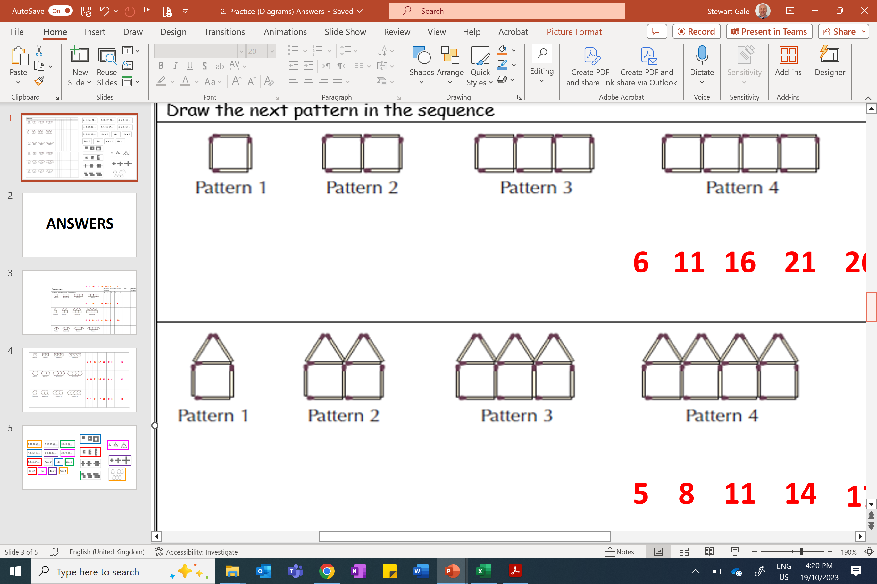
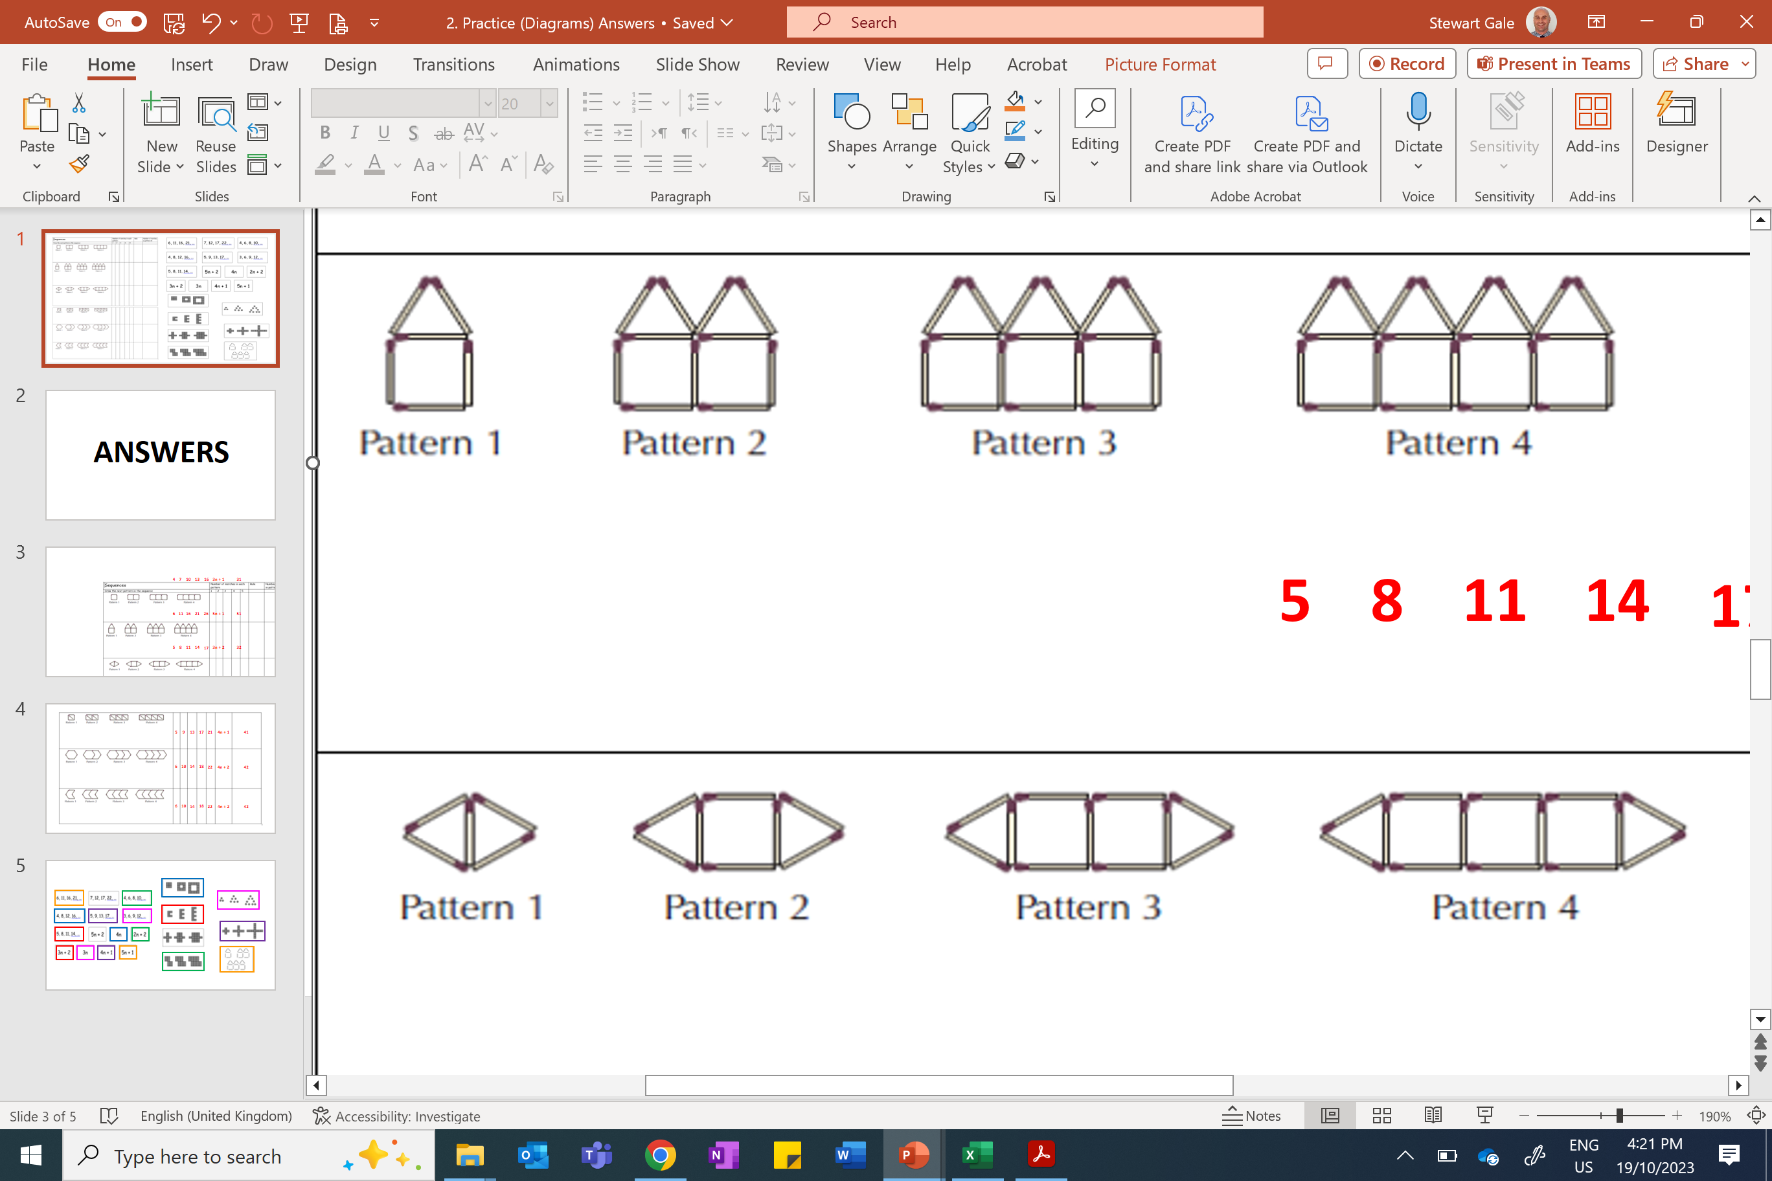
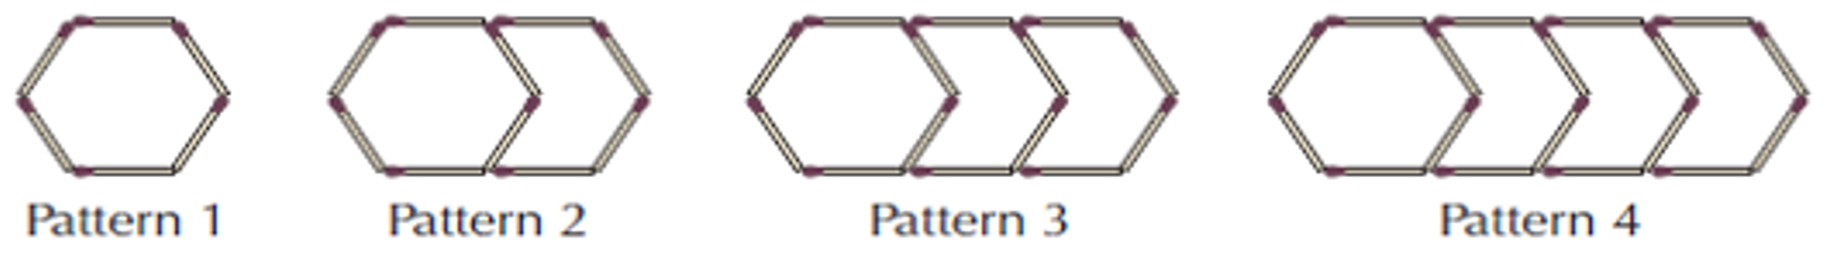
Find the formula for the number of sticks ($S$) in terms of pattern number ($n$).
6)
7)
8)
9)

Slide 7
ANSWERS

Slide 8
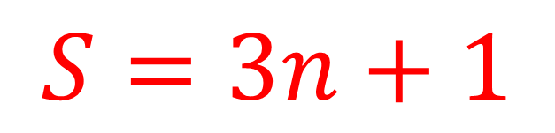
1)
Pattern:
Formula:
$$S=3n+1$$
Pattern 1
Pattern 2
Pattern 3
Table:
Graph:
Pattern number n | Number of squares S
1
2
3
4
10
100
4
7
Number of squares
10
13
31
301
Pattern number
Notes:
Layout of worksheets in this task has been copied somewhat from another TES user – flibit – but I have used my own choice of sequences, so that they can be explored further in the next task.

Slide 9
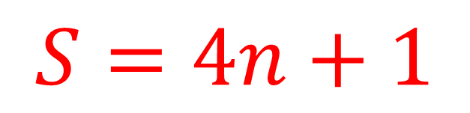
2)
Pattern:
Formula:
$$S=4n+1$$
Pattern 1
Pattern 2
Pattern 3
Table:
Graph:
Pattern number n | Number of squares S
1
2
3
4
10
100
5
9
Number of squares
13
17
41
401
Pattern number
Notes:
Layout of worksheets in this task has been copied somewhat from another TES user – flibit – but I have used my own choice of sequences, so that they can be explored further in the next task.

Slide 10
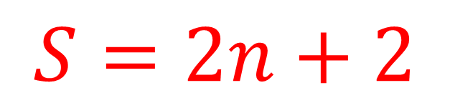
3)
Pattern:
Formula:
$$S=2n+2$$
Pattern 1
Pattern 2
Pattern 3
Table:
Graph:
Pattern number n | Number of squares S
1
2
3
4
10
100
4
6
Number of squares
8
10
22
202
Pattern number
Notes:
Layout of worksheets in this task has been copied somewhat from another TES user – flibit – but I have used my own choice of sequences, so that they can be explored further in the next task.

Slide 11
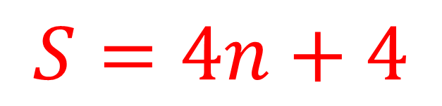
4)
Pattern:
Formula:
$$S=4n+4$$
Pattern 1
Pattern 2
Pattern 3
Table:
Graph:
Pattern number n | Number of squares S
1
2
3
4
10
100
8
12
Number of squares
16
20
44
404
Pattern number
Notes:
Layout of worksheets in this task has been copied somewhat from another TES user – flibit – but I have used my own choice of sequences, so that they can be explored further in the next task.

Slide 12
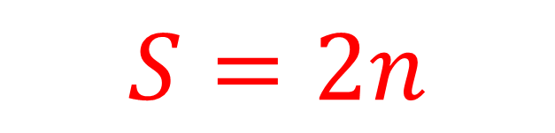
5)
Pattern:
Formula:
$$S=2n$$
Pattern 1
Pattern 2
Pattern 3
Table:
Graph:
Pattern number n | Number of squares S
1
2
3
4
10
100
2
4
Number of squares
6
8
20
200
Pattern number
Notes:
Layout of worksheets in this task has been copied somewhat from another TES user – flibit – but I have used my own choice of sequences, so that they can be explored further in the next task.

Slide 13
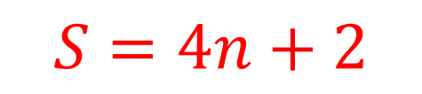
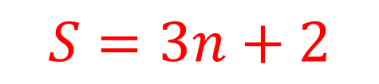
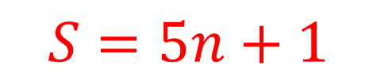
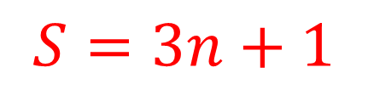
Find the formula for the number of sticks ($S$) in terms of pattern number ($n$).
6)
$$S=3n+1$$
7)
$$S=5n+1$$
8)
$$S=3n+2$$
9)
$$S=4n+2$$

