Slide 1
Normal Distribution
Missing Mean and Standard Deviation
Chapter 3
(Part 5 of 7)

Slide 2
When
𝜇 and 𝜎 are missing
simultaneous equations
are needed.

Slide 3
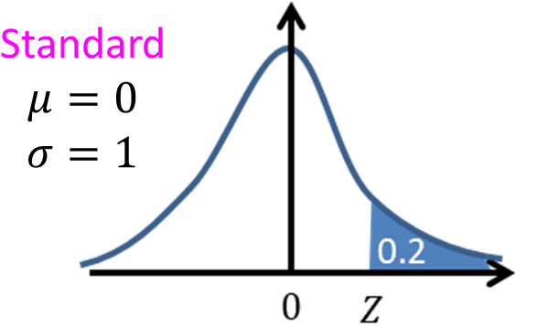
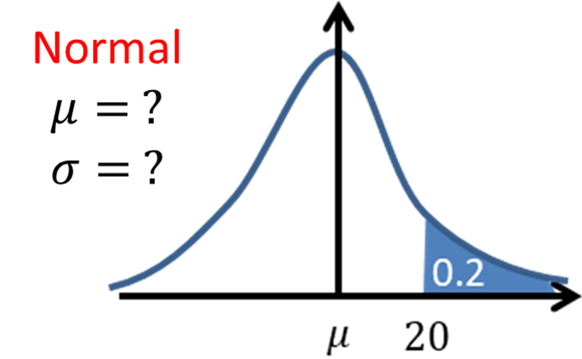
𝜇 and 𝜎 are missing
use standard deviation
to set up two equations.

Slide 4
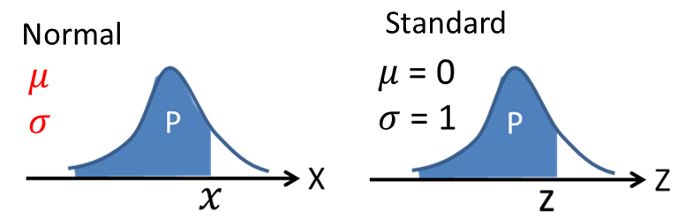
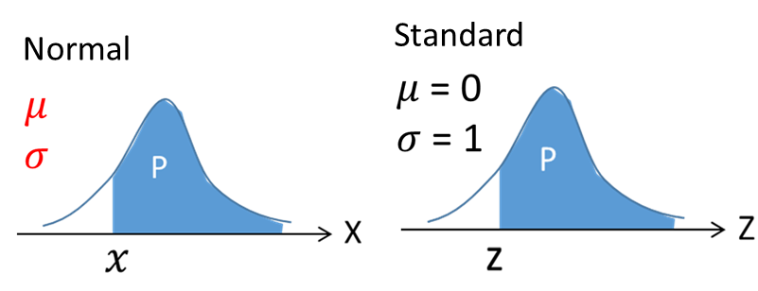
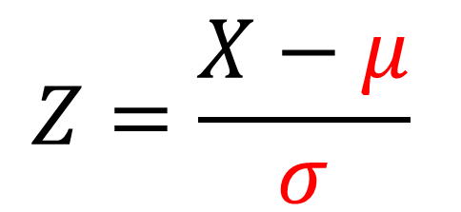
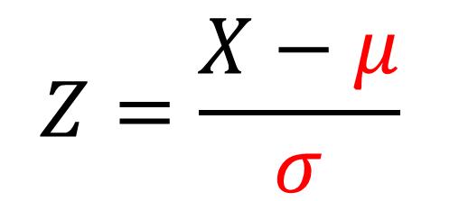
$$Z=\frac{X−μ}{σ}$$
$$Z=\frac{X−μ}{σ}$$

Slide 5
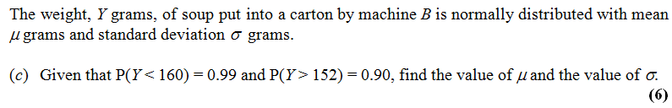


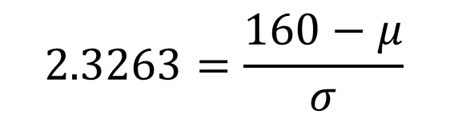



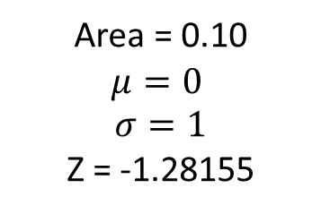
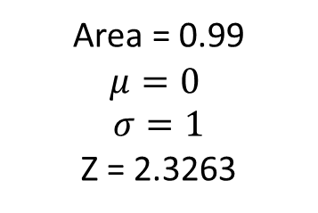







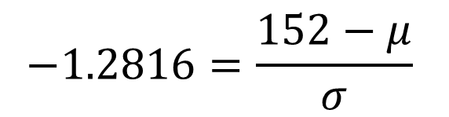




Normal
Standard
Area = 0.99
$$μ=0$$
$$σ=1$$
Z = 2.3263
$$0.99$$
$$μ= ?$$
$$σ= ?$$
$$0.99$$
$$μ=0$$
$$σ=1$$
$$2.3263=\frac{160−μ}{σ}$$
$$160$$
$$μ$$
$$z$$
$$0$$
Normal
Standard
Area = 0.10
$$μ=0$$
$$σ=1$$
Z = -1.28155
$$μ= ?$$
$$σ= ?$$
$$0.90$$
$$μ=0$$
$$σ=1$$
$$0.90$$
$$−1.2816=\frac{152−μ}{σ}$$
$$152$$
$$μ$$
$$z$$
$$0$$

Slide 6

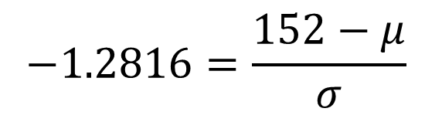

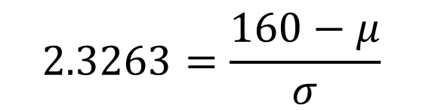




$$2.3263=\frac{160−μ}{σ}$$
$$−1.2816=\frac{152−μ}{σ}$$
$2.3263σ=$ $160−μ$
$$−1.2816σ=152−μ$$
$2.3263σ+μ=$ $160$
$$−1.2816σ+μ=152$$
$$σ=2.22$$
$$μ=154.84$$

Slide 7
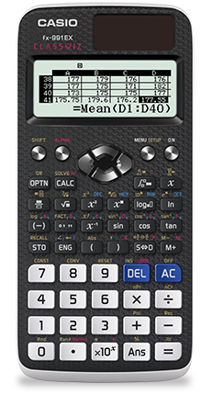
Your Classwiz solves simultaneous equations.
Look under the EQUATIONS mode.
Menu
Scroll and select A: Equation/Func
1: Simul Equation
2 (unknowns)
Enter in both equations
Press = to find solutions

