Slide 1
LO: Plans and
Elevations

Slide 2
3D Shapes drawn from 2D Views
3D View
2D View

Slide 3
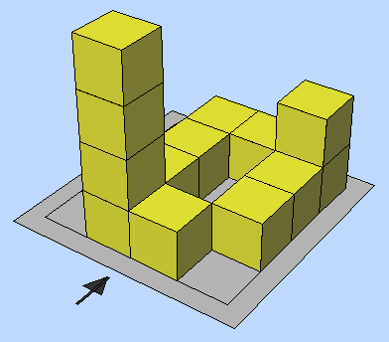
Front Elevation

Slide 4
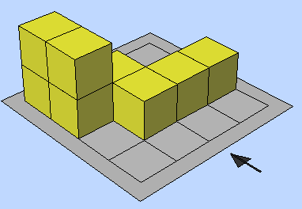
Side Elevation

Slide 5
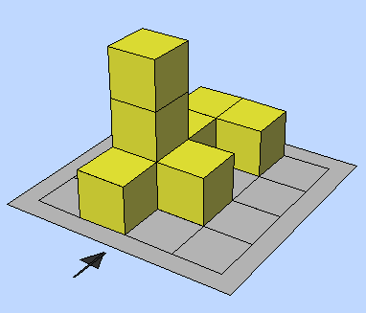
Plan Elevation

Slide 6
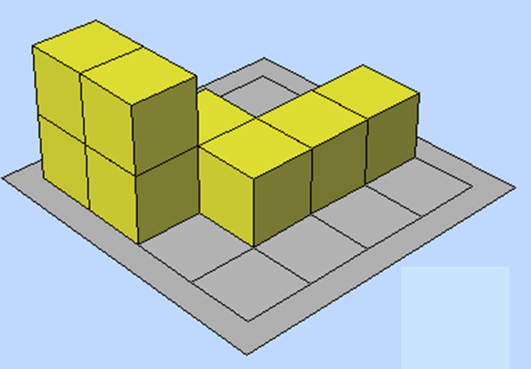
Front Elevation
Side Elevation
Plan

Slide 7
P
F
S

Slide 8
F
P
S

Slide 9
F
S
P

Slide 10
S
F
P

Slide 11
A

Slide 12
C

Slide 13
A

Slide 14
B

