Slide 1

Senior Challenge 2
SILVER

Slide 2
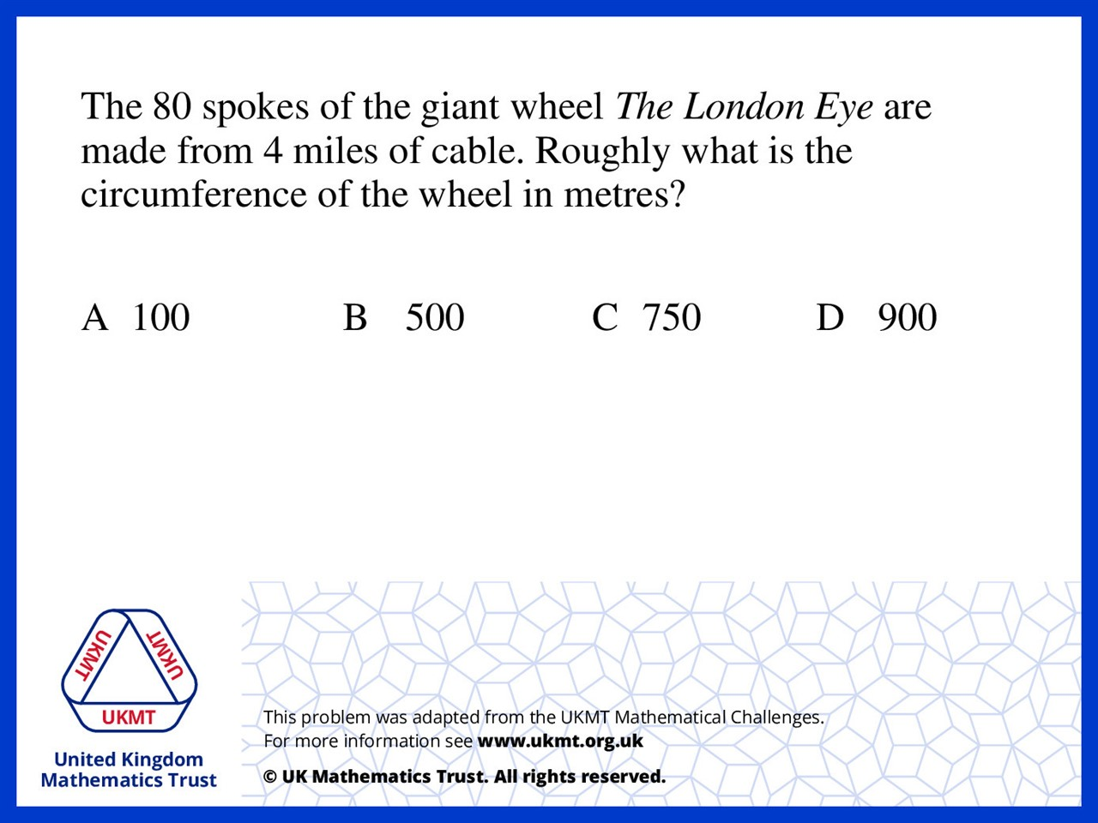
Q1.
4 x 1600 = 6400 metres
6400 ÷ 80 = 80 which is the radius.
80 x 2 x π which approx 500

Slide 3
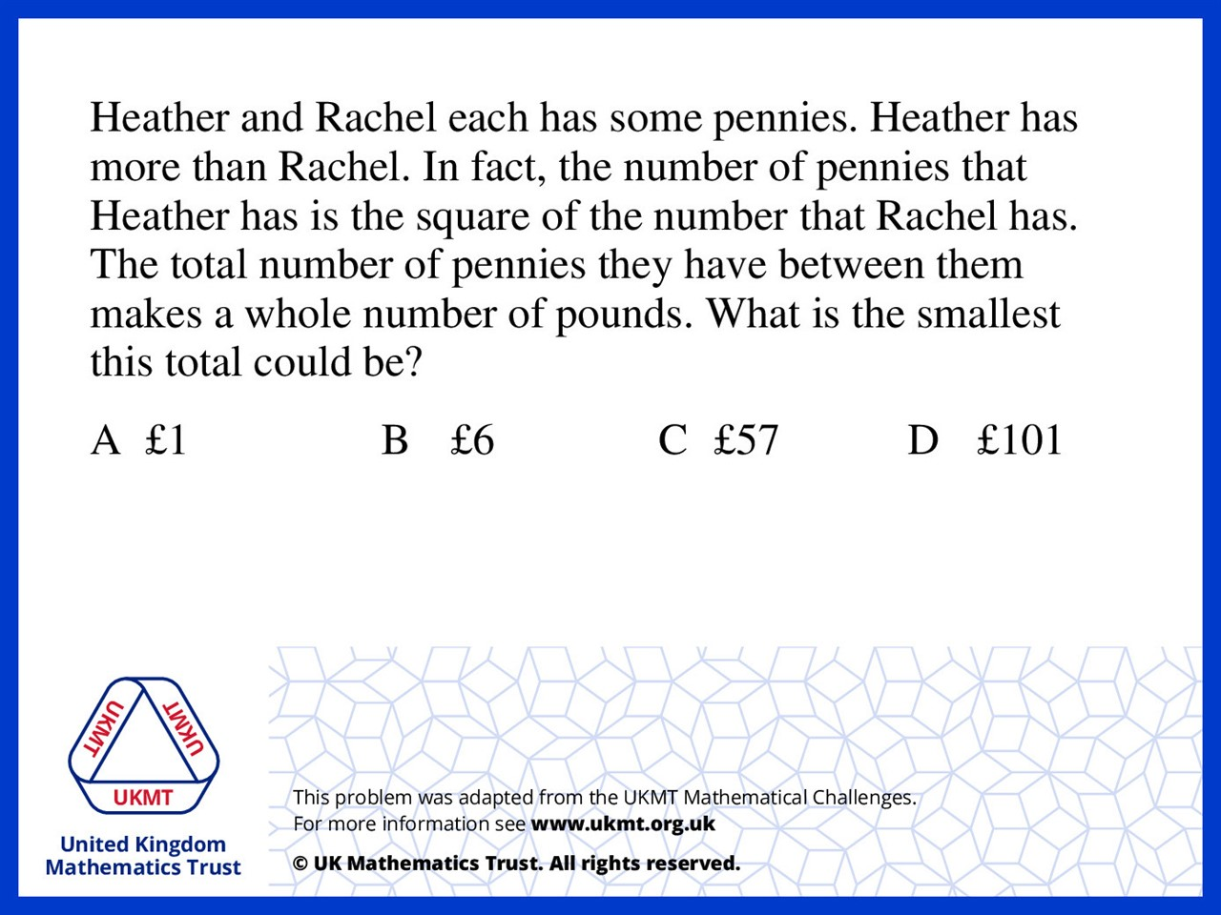
Q2.
24 x 24 = 576
24 + 576 = 600
600 pennies = 6 pounds

Slide 4
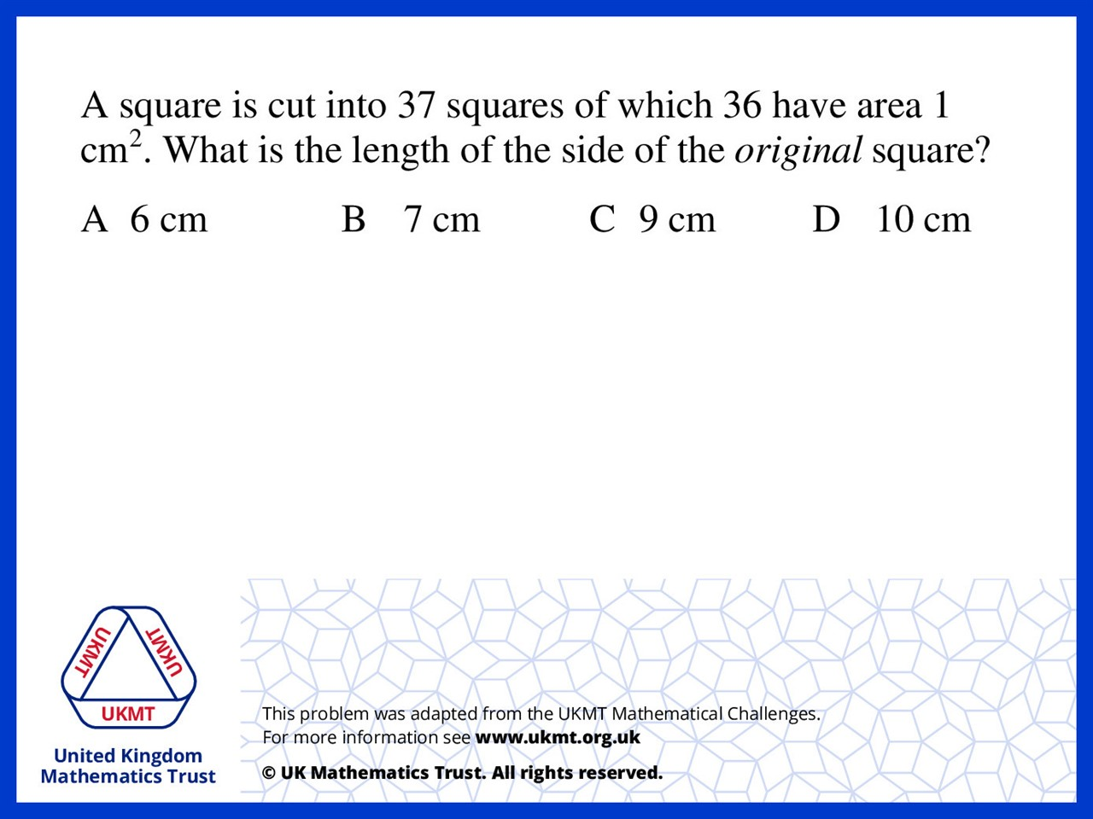
Q3.
A. 36 – 36 = 0
B. 49 – 36 = 13
C. 81 – 36 = 45
D. 100 – 36 = 64 (64 is a squared number)

Slide 5
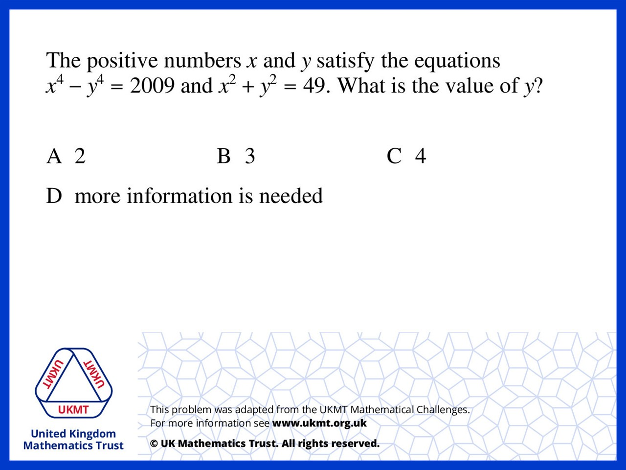
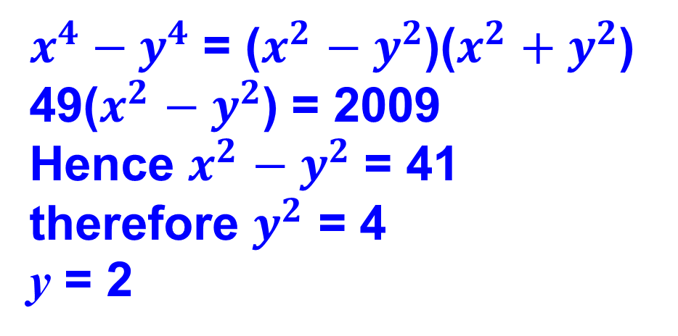
Q4.
$x^{4}{ − y}^{4}$ = ($x^{2}$ ${− y}^{2}$)($x^{2}$ ${+ y}^{2}$)
49($x^{2}$ ${− y}^{2}$) = 2009
Hence $x^{2}$ ${− y}^{2}$ = 41
therefore $y^{2}$ = 4
y = 2

Slide 6
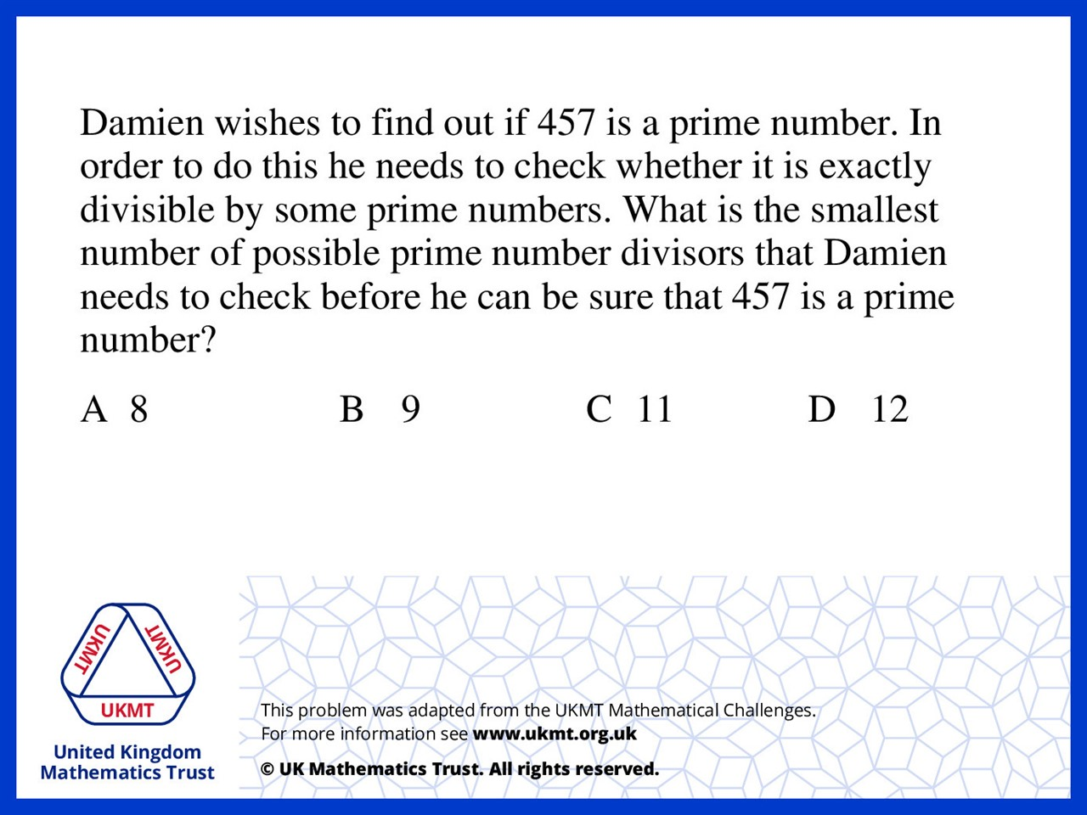
Q5.
21 x 21 = 442
22 x 22 = 484
Check prime numbers below 22: 2,3,5,7,11,13,17,19 (8 numbers)

