Slide 1
FM: Adding and Subtracting
Algebraic Fractions

Slide 2


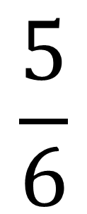
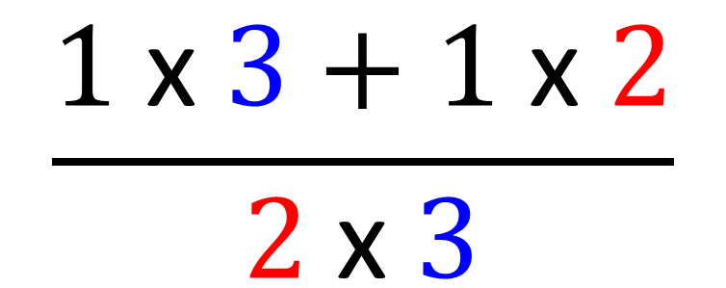
What is the golden rule when adding fractions?
You have a common denominator.
$$\frac{1}{2}$$
$$\frac{1}{3}$$
$$\frac{1 \text{x} 3+1 \text{x} 2}{2 \text{x} 3}$$
$$\frac{5}{6}$$
+
=
=

Slide 3
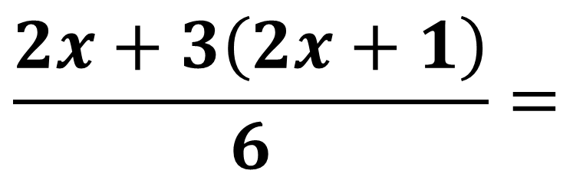
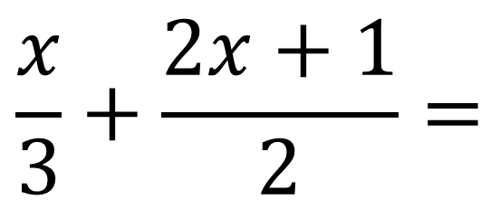
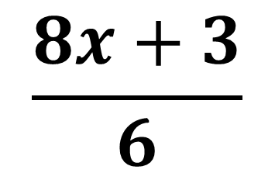
What is the golden rule when adding algebraic fractions?
You have a common denominator.
$$\frac{x}{3}+\frac{2x+1}{2}=$$
$$\frac{2x+3\left(2x+1\right)}{6}=$$
$$\frac{8x+3}{6}$$

Slide 4
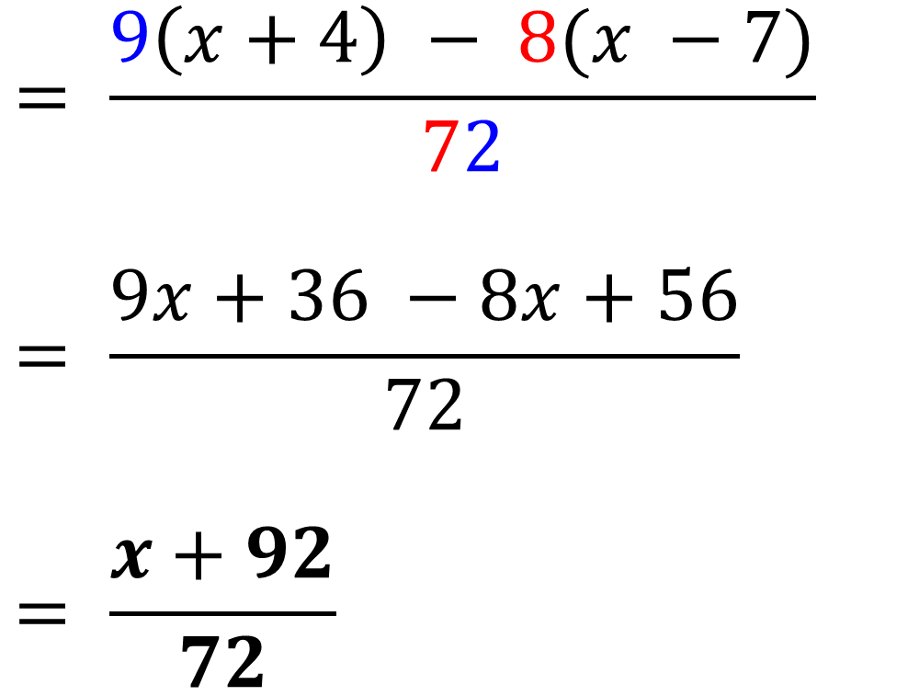
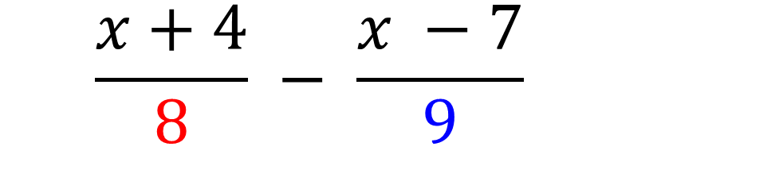
$$= \frac{x+4}{8} − \frac{x −7}{9}$$
$$= \frac{9\left(x+4\right) − 8(x −7)}{72}$$
$$= \frac{9x+36 −8x+56}{72}$$
$$= \frac{x+92}{72}$$

Slide 5
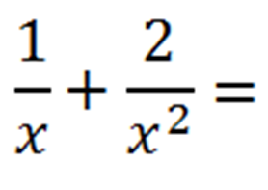
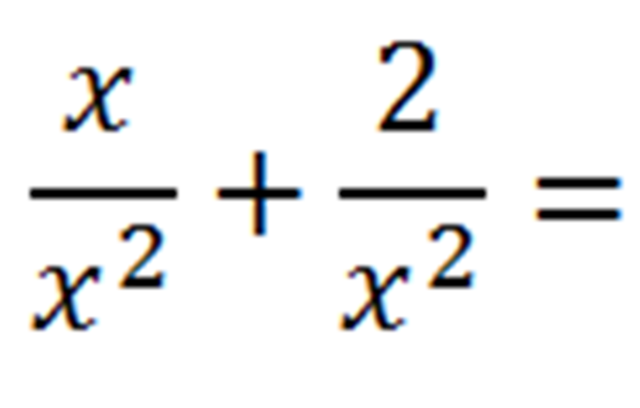
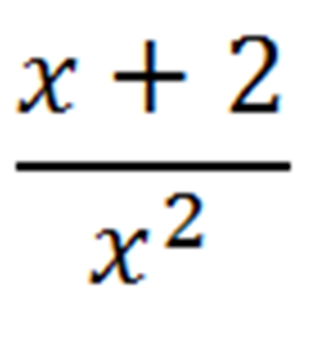

Slide 6
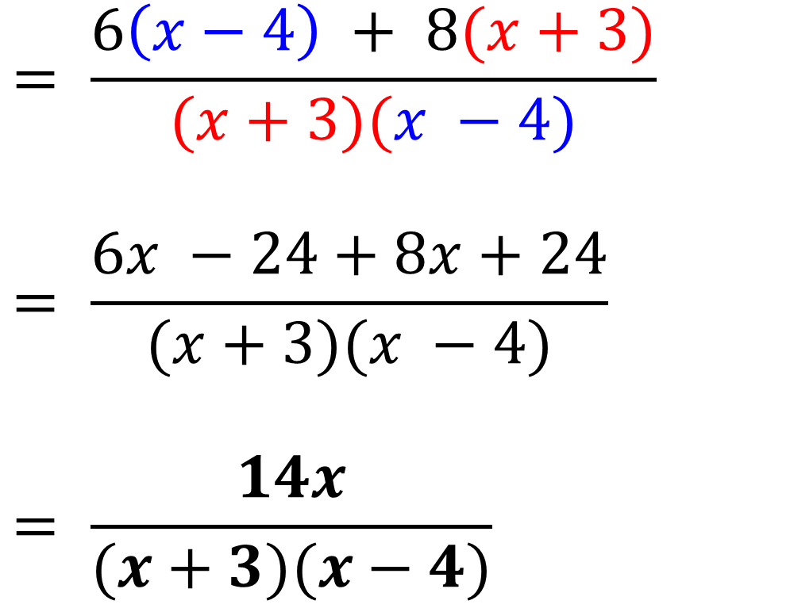
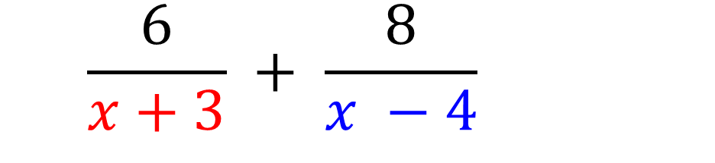
$$= \frac{6}{x+3} + \frac{8}{x −4}$$
$$= \frac{6\left(x−4\right) + 8(x+3)}{(x+3)(x −4)}$$
$$= \frac{6x −24+8x+24}{(x+3)(x −4)}$$
$$= \frac{14x}{(x+3)(x−4)}$$

Slide 7
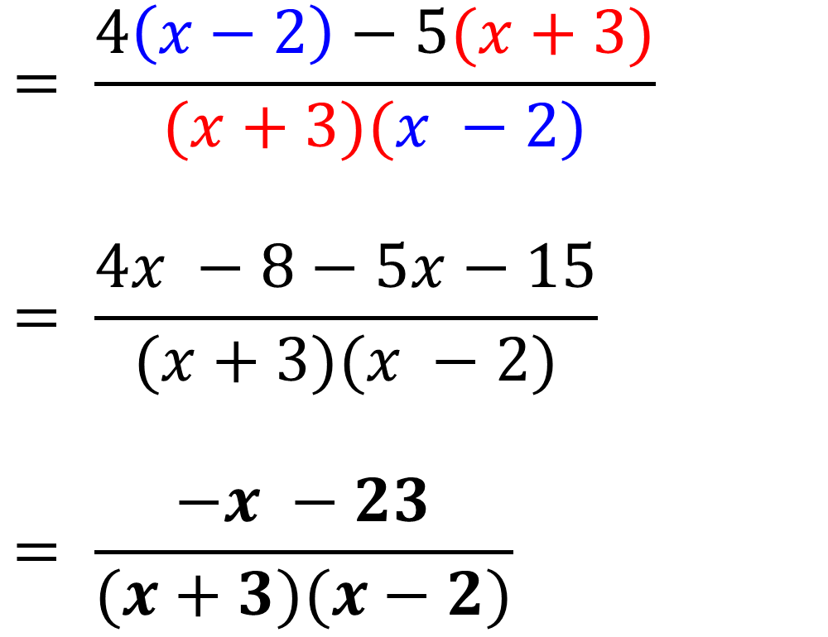
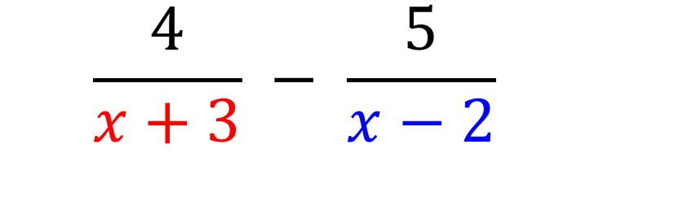
$$= \frac{4}{x+3} − \frac{5}{x−2}$$
$$= \frac{4\left(x−2\right)−5(x+3)}{(x+3)(x −2)}$$
$$= \frac{4x −8−5x−15}{(x+3)(x −2)}$$
$$= \frac{−x −23}{(x+3)(x−2)}$$

Slide 8
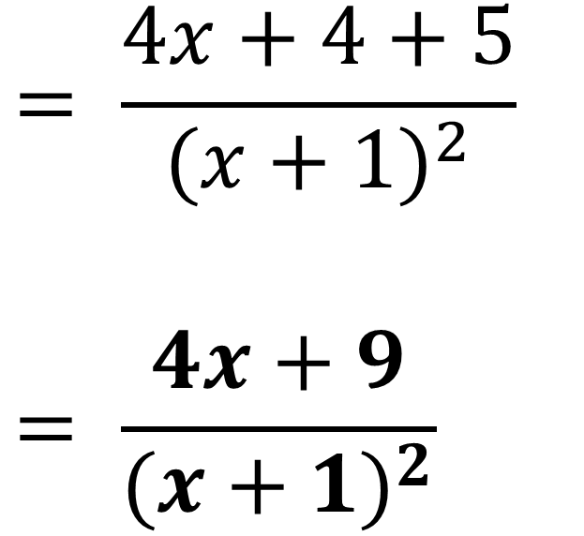
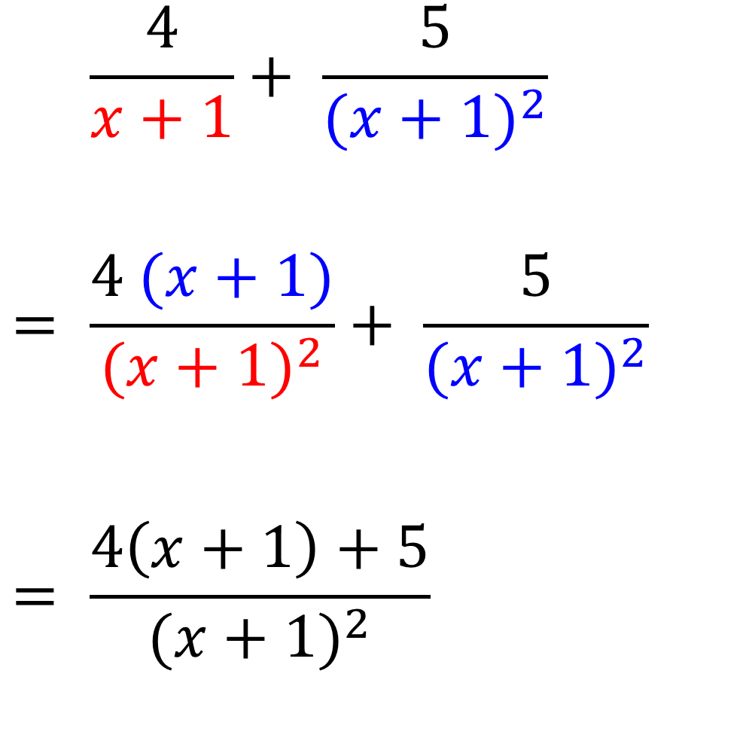
$$= \frac{4}{x+1}+ \frac{5}{{(x+1)}^{2}}$$
$$= \frac{4 (x+1)}{{(x+1)}^{2}}+ \frac{5}{{(x+1)}^{2}}$$
$$= \frac{4\left(x+1\right)+5}{{(x+1)}^{2}}$$
$$= \frac{4x+4+5}{{(x+1)}^{2}}$$
$$= \frac{4x+9}{{(x+1)}^{2}}$$

Slide 9
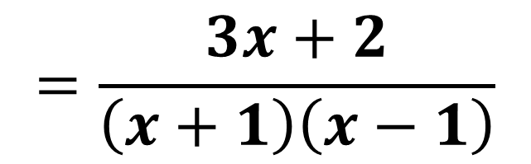
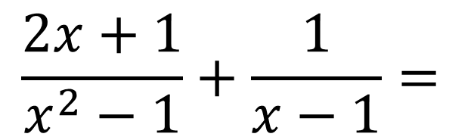
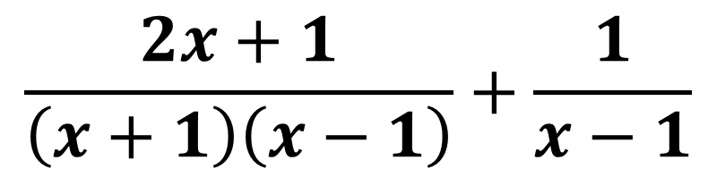
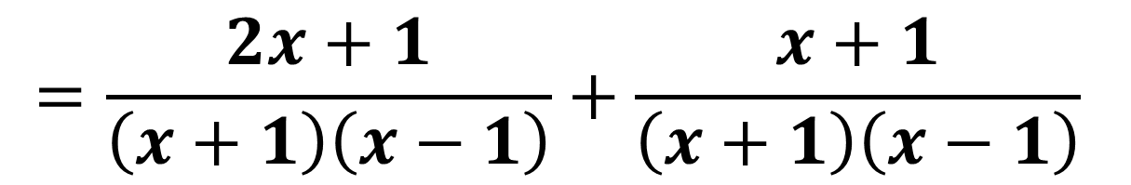
Harder Examples
Hint: Factorise the denominators first where applicable.
$$\frac{2x+1}{x^{2}−1}+\frac{1}{x−1}=$$
$$\frac{2x+1}{\left(x+1\right)\left(x−1\right)}+\frac{1}{x−1}$$
$$=\frac{2x+1}{\left(x+1\right)\left(x−1\right)}+\frac{x+1}{\left(x+1\right)\left(x−1\right)}$$
$$=\frac{3x+2}{\left(x+1\right)\left(x−1\right)}$$

Slide 10
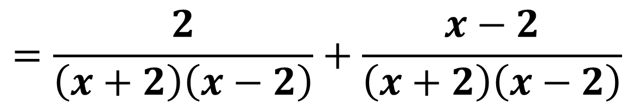
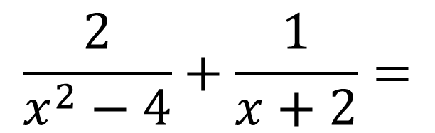
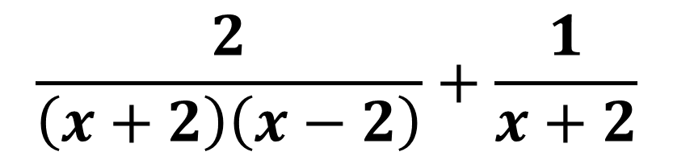
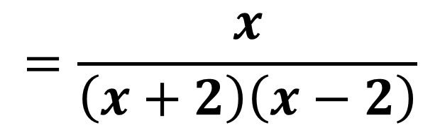
Harder Examples
$$\frac{2}{x^{2}−4}+\frac{1}{x+2}=$$
$$\frac{2}{\left(x+2\right)\left(x−2\right)}+\frac{1}{x+2}$$
$$=\frac{2}{\left(x+2\right)\left(x−2\right)}+\frac{x−2}{\left(x+2\right)\left(x−2\right)}$$
$$=\frac{x}{\left(x+2\right)\left(x−2\right)}$$

