Slide 1
Algebraic Methods
Simplifying Fractions
Chapter 7
(Part 1 of 5)

Slide 2
Simplifying Algebraic Fractions
The golden rule to simplifying algebraic fractions is to factorise.
Not expand the brackets!

Slide 3
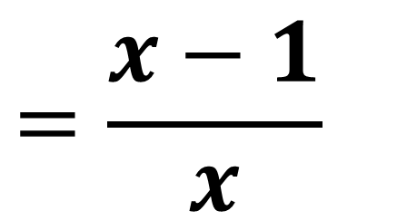
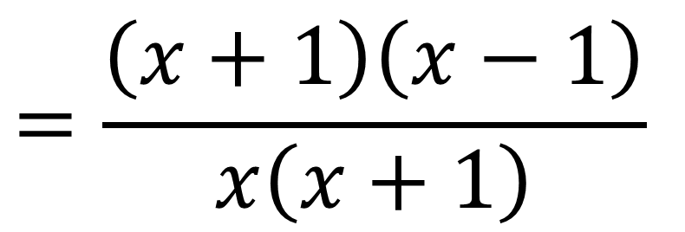
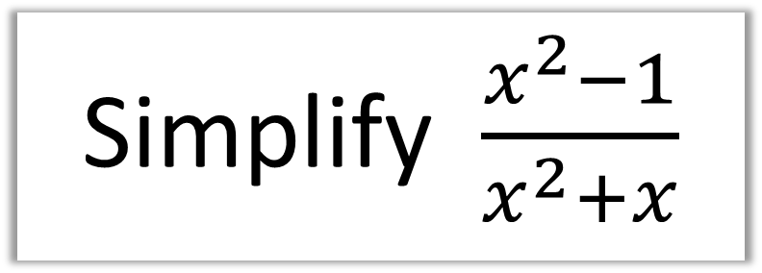
Simplify $\frac{x^{2}−1}{x^{2}+x}$
$$=\frac{\left(x+1\right)\left(x−1\right)}{x\left(x+1\right)}$$
$$=\frac{x−1}{x}$$

Slide 4
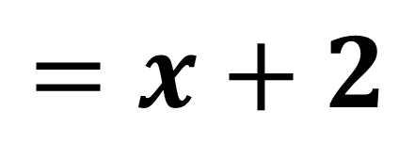
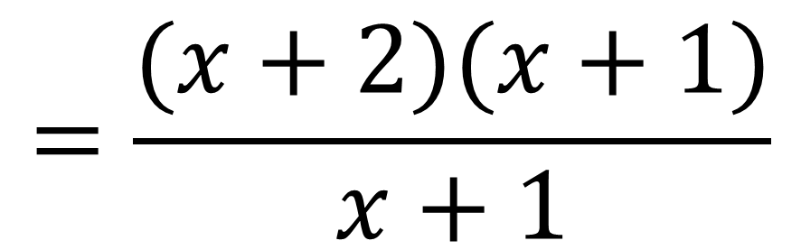
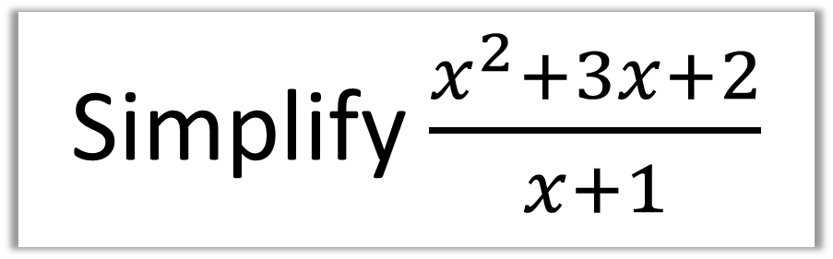
Simplify $\frac{x^{2}+3x+2}{x+1}$
$$=\frac{(x+2)(x+1)}{x+1}$$
$$=x+2$$

Slide 5
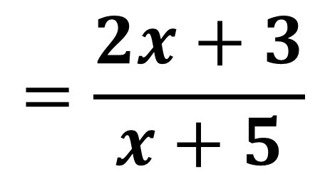
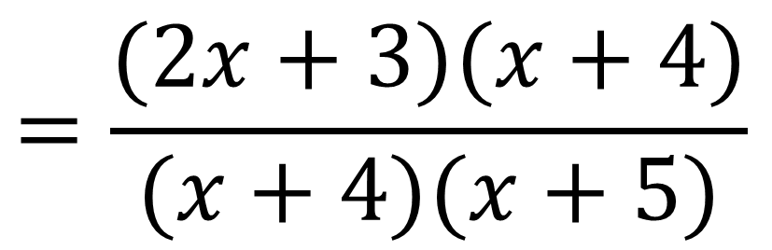
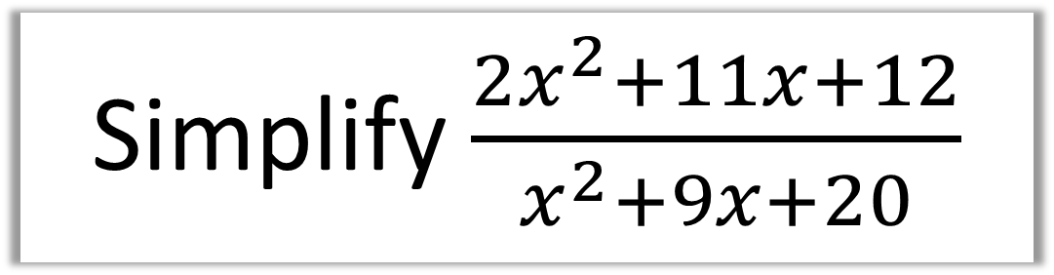
Simplify $\frac{2x^{2}+11x+12}{x^{2}+9x+20}$
$$=\frac{(2x+3)(x+4)}{(x+4)(x+5)}$$
$$=\frac{2x+3}{x+5}$$

Slide 6
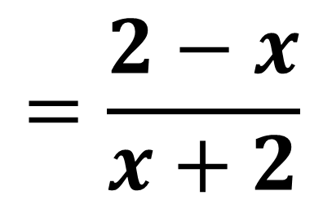
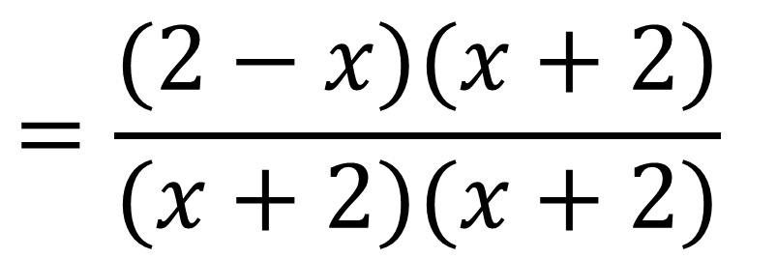
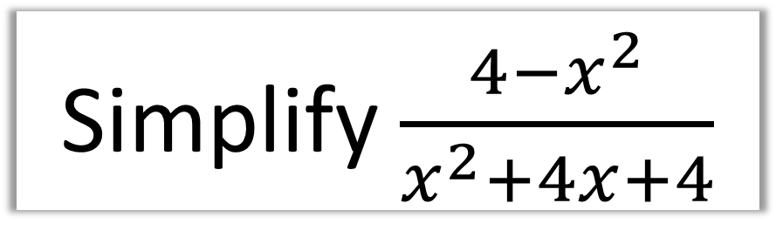
Simplify $\frac{4−x^{2}}{x^{2}+4x+4}$
$$=\frac{(2−x)(x+2)}{(x+2)(x+2)}$$
$$=\frac{2−x}{x+2}$$

