Slide 1
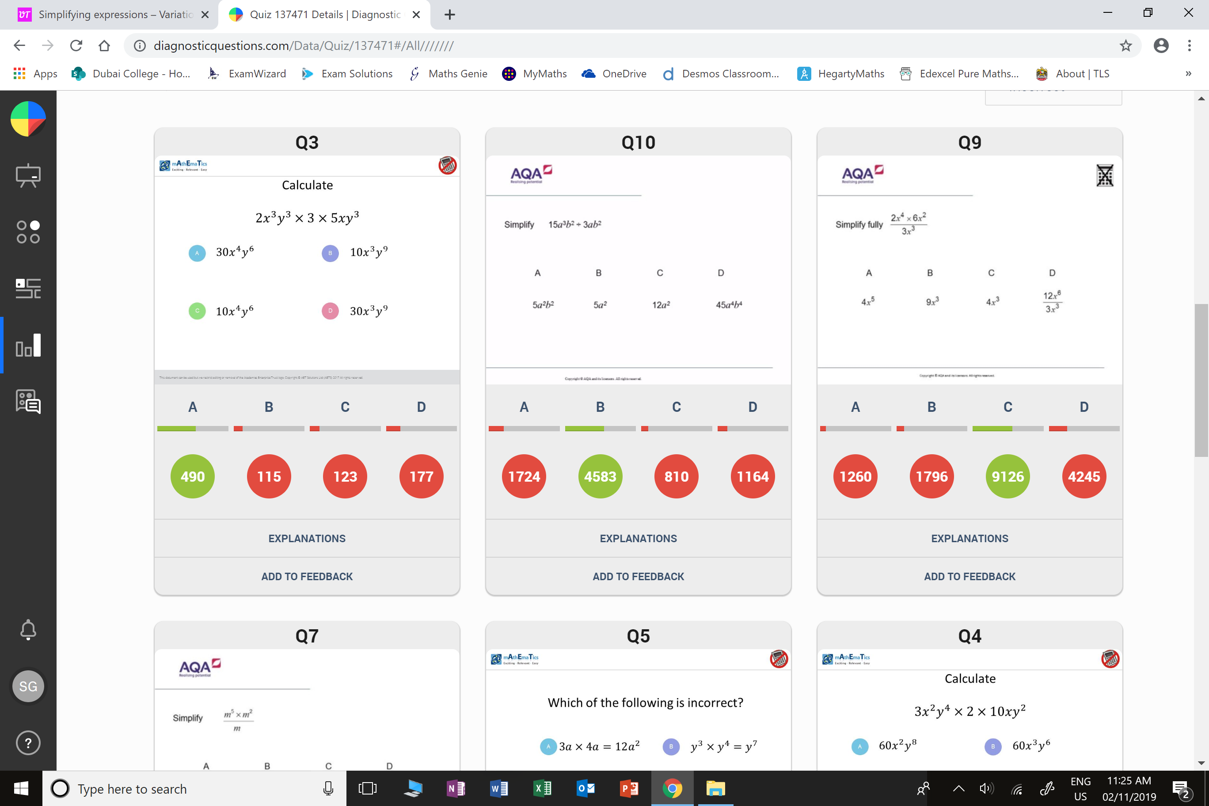
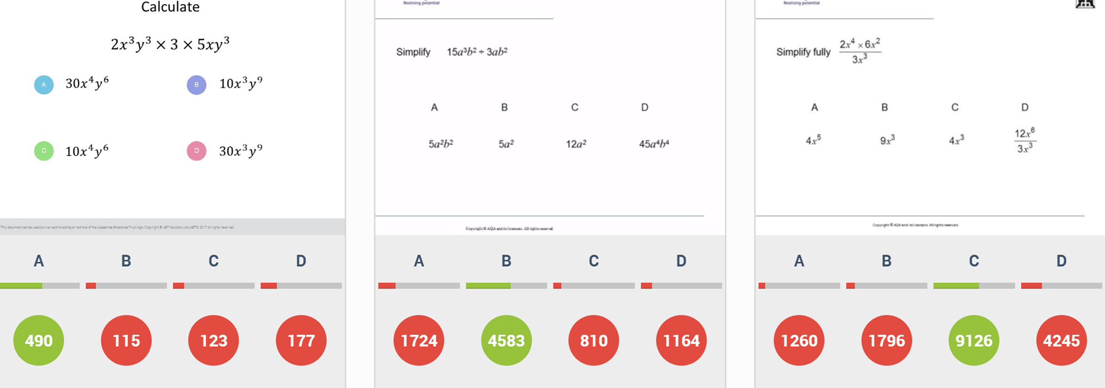
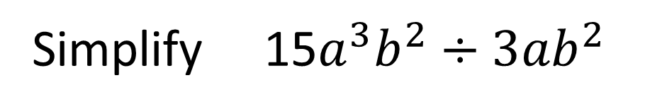
Simplify 15$a^{3}b^{2}÷3{ab}^{2}$
÷
Worst answered question?
Most common wrong answer?

Slide 2
ANSWERS

Slide 3
÷
Worst answered question?

Slide 4
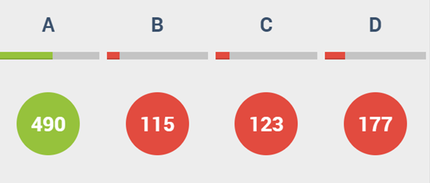
D
They multiplied the powers
instead of adding.

Slide 5
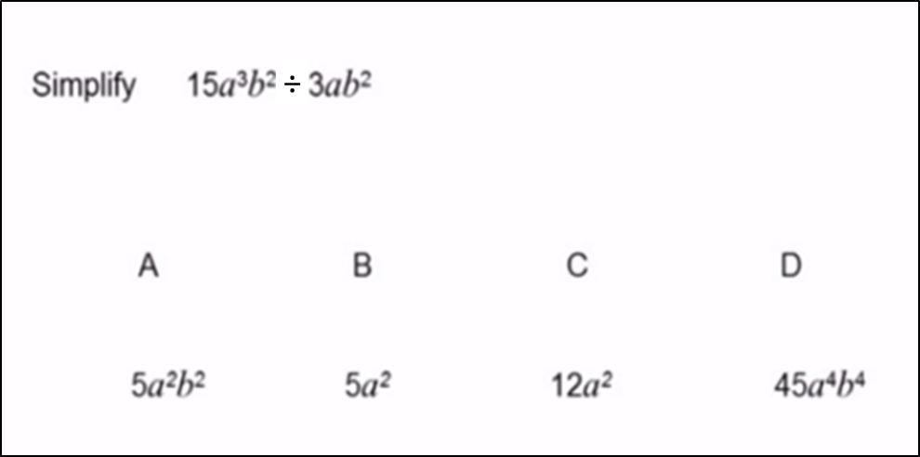

Simplify 15$a^{3}b^{2}÷3{ab}^{2}$
A
They did not divide b² by b² correctly.

