Slide 1
Integration
Trapezium Rule
Chapter 11
(Part 9 of 12)

Slide 2
Trapezium Rule
Sometimes finding the exact area
under the graph by integration is difficult.
You can approximate
the area under a graph
by dividing it into trapeziums.

Slide 3







Trapezium Rule
Work out the area of each trapezium (equal width) and add them together.
$$y3$$
$$y2$$
$$y0$$
$$y1$$
$$h$$
$$h$$
$$h$$

Slide 4

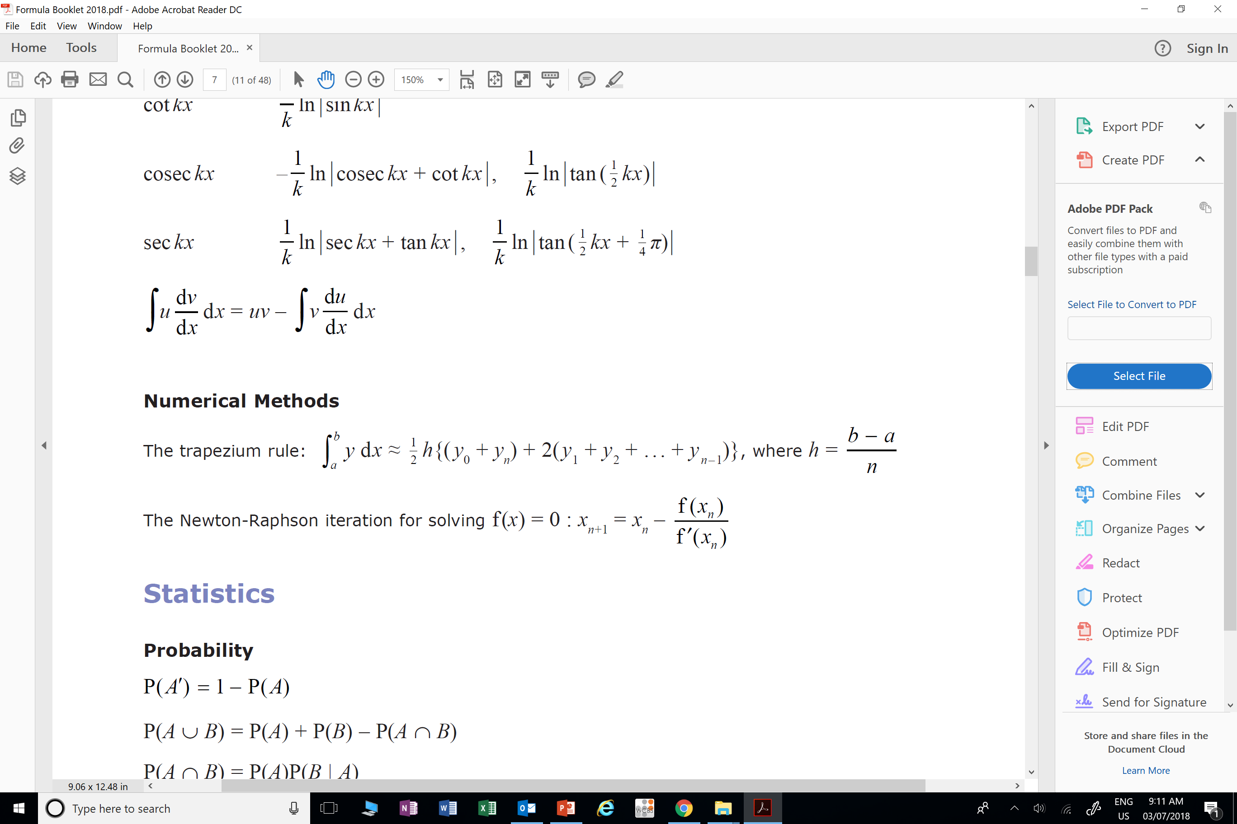

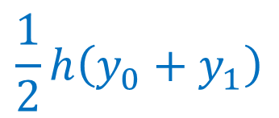



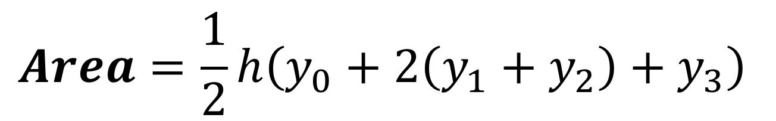

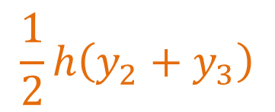



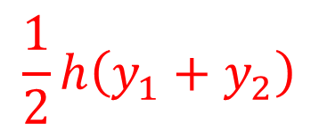
$$\frac{1}{2}h\left(y_{1}+y_{2}\right)$$
$$\frac{1}{2}h\left(y_{2}+y_{3}\right)$$
$$\frac{1}{2}h\left(y_{0}+y_{1}\right)$$
$$y2$$
$$y3$$
$$y2$$
$$y0$$
$$y1$$
$$h$$
$$h$$
$$h$$
$$Area=\frac{1}{2}h\left(y_{0}+2\left(y_{1}+y_{2}\right)+y_{3}\right)$$

Slide 5
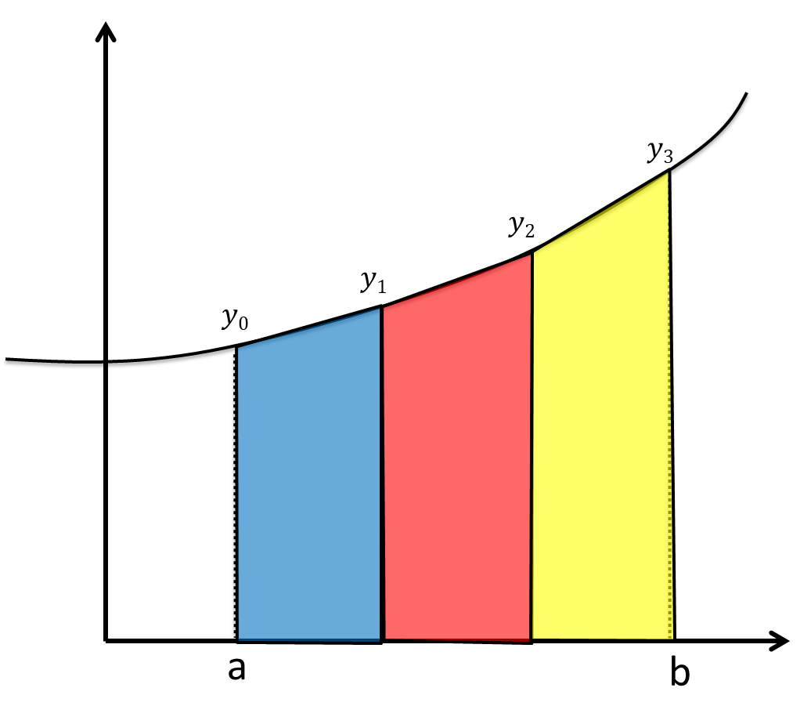
First height
Last height
(All heights in-between) x 2
b – a = TOTAL width
n = number of trapeziums
h = width of EACH trapezium

Slide 6
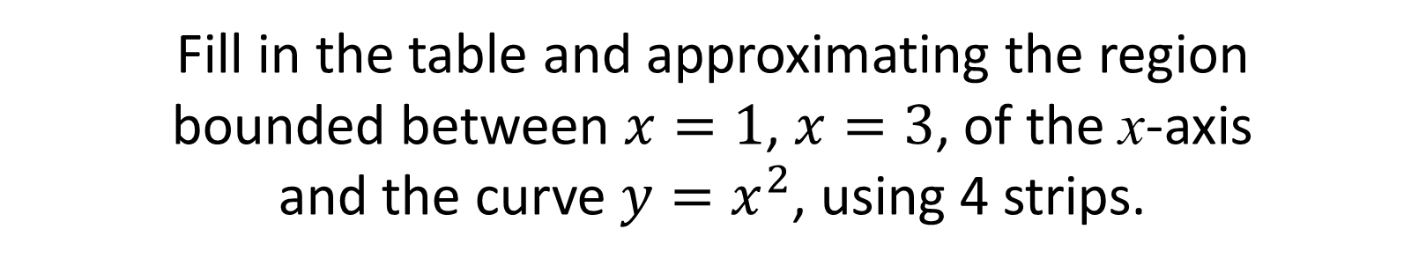
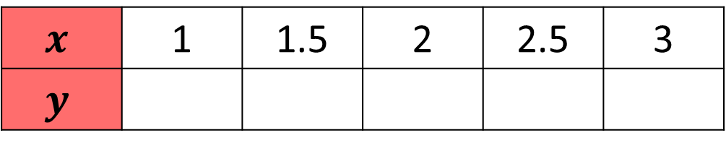
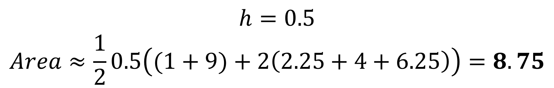
Fill in the table and approximating the region
bounded between $x=1$, $x=3$, of the x-axis
and the curve $y=x^{2}$, using 4 strips.
$$x$$ | 1 | 1.5 | 2 | 2.5 | 3
$$y$$ | 1 | 2.25 | 4 | 6.25 | 9
1 | 2.25 | 4 | 6.25 | 9
$$h=0.5 \\ Area≈\frac{1}{2}0.5\left((1+9)+2\left(2.25+4+6.25\right)\right)=8.75$$

Slide 7
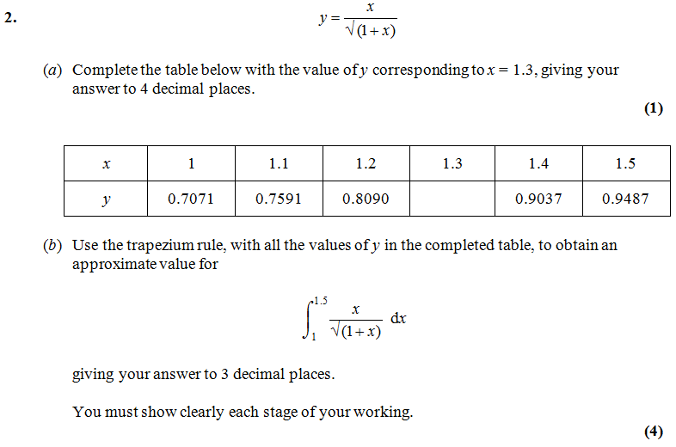
0.8571
$$Area≈\frac{0.1}{2}\left(0.7071+2\left(0.7591+0.8090+0.8571+0.9037\right)+0.9487\right)=0.416$$

Slide 8
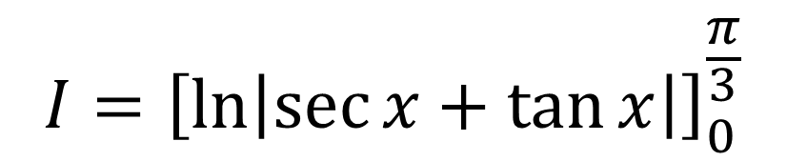
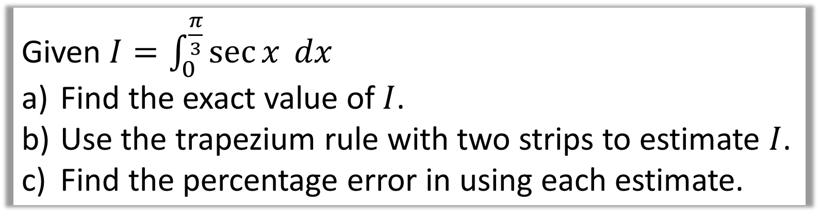
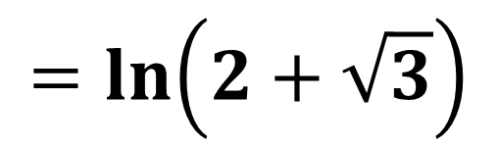
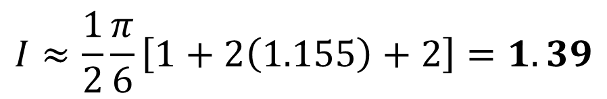
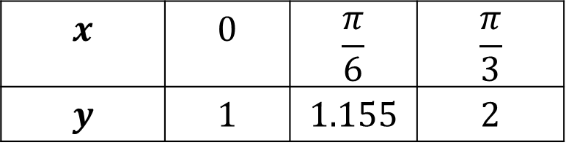
Given $I=\int_{0}^{\frac{π}{3}}{\sec{x} dx}$
Find the exact value of $I$.
Use the trapezium rule with two strips to estimate $I$.
Find the percentage error in using each estimate.
$$I={\left[\ln\left|\sec{x}+\tan{x}\right|\right]}_{0}^{\frac{π}{3}}$$
$$x$$ | $$0$$ | $$\frac{π}{6}$$ | $$\frac{π}{3}$$
$$y$$ | $$1$$ | $$1.155$$ | $$2$$
$$=\ln\left(2+\sqrt{3}\right)$$
$$I≈\frac{1}{2}\frac{π}{6}\left[1+2\left(1.155\right)+2\right]=1.39$$
Error is 5.6%

Slide 9
