Slide 1
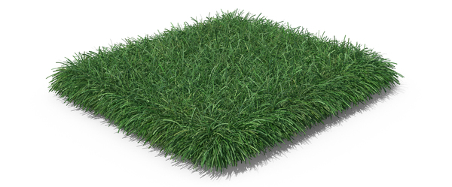
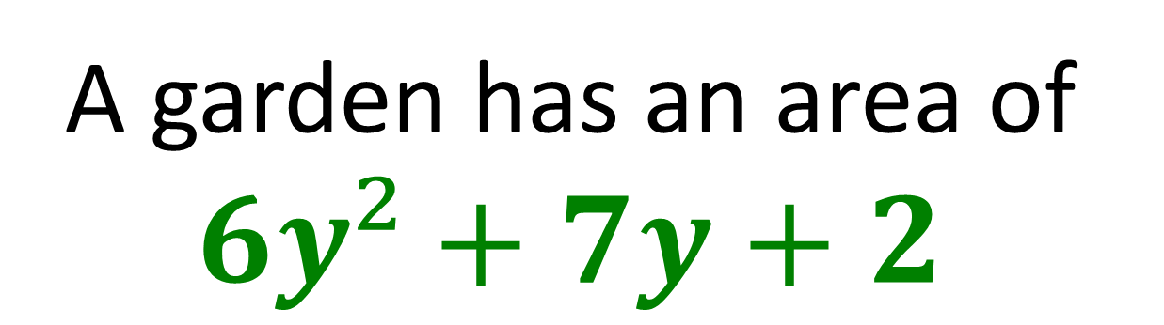
A garden has an area of
$$6y²+7y+2$$
i) What is the length and width of the garden?
ii) If y = 1, Work out the perimeter of the garden.

Slide 2
ANSWERS

Slide 3

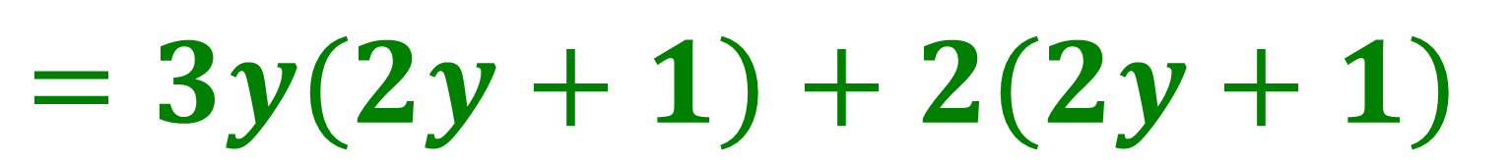
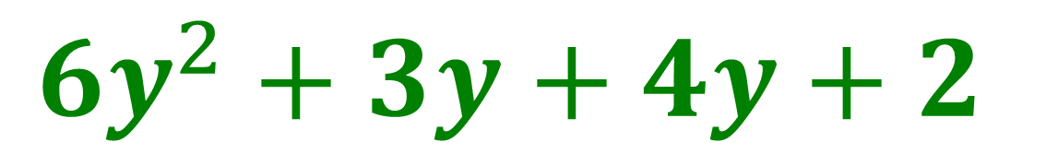
A garden has an area of
$$6y²+7y+2$$
i) What is the length and width of the garden?
$$6y^{2}+3y+4y+2$$
$$=3y(2y+1)+2(2y+1)$$
$$=(3y+2)(2y+1)$$

Slide 4

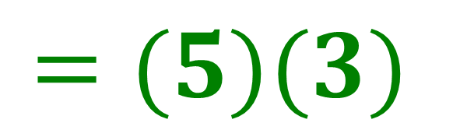
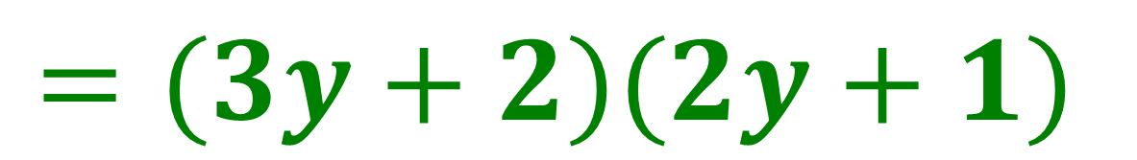
A garden has an area of
$$6y²+7y+2$$
ii) If y = 1, Work out the perimeter of the garden.
$$=(3y+2)(2y+1)$$
$$=(5)(3)$$
$$=15$$

