Slide 1
LO: Angles and Parallel Lines

Slide 2
What can you say about these pairs of lines?
Parallel lines will never meet.
They stay an equal distance apart.

Slide 3
Which pair of lines are parallel?
A
B
C
A and B - Arrow heads show that lines are parallel.

Slide 4
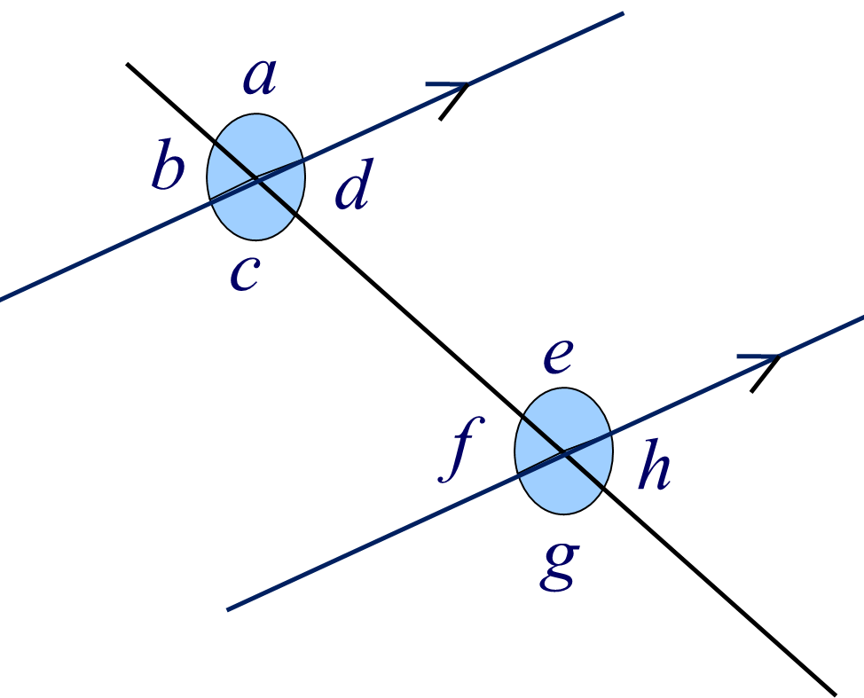
Which angles are equal to each other?
c
e
g
a | = |  | = |  | =
h | = |  | = |  | =
f
b
d

Slide 5
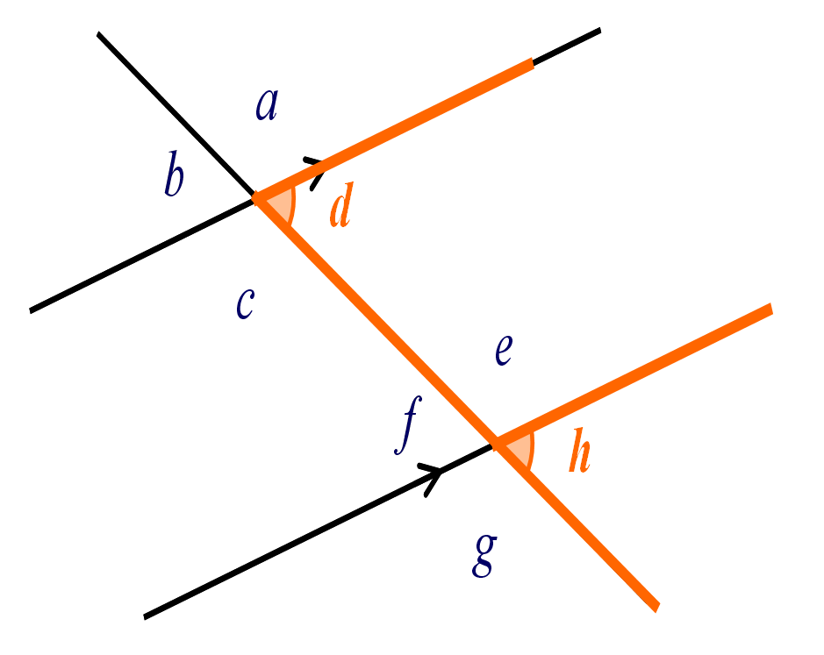
What letter can you see highlighted?
F
Corresponding Angle
What is the connection
between d and h?
They are same size.

Slide 6

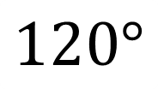
Corresponding or Not
$$120°$$
$$x°$$
Corresponding

Slide 7


Corresponding or Not
$$55°$$
$$x°$$
Corresponding

Slide 8

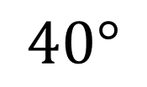
Corresponding or Not
$$40°$$
$$x°$$
Corresponding

Slide 9

Corresponding or Not
$$120°$$
$$x°$$
Not

Slide 10

Corresponding or Not
$$40°$$
$$x°$$
Not

Slide 11
What letter can you see highlighted?
Z
Alternate Angle
What is the connection
between d and f ?
They are same size.

Slide 12


Alternate or Not
$$15°$$
$$x°$$
Alternate

Slide 13

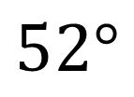
Alternate or Not
$$52°$$
$$x°$$
Not

Slide 14
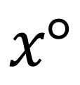

Alternate or Not
$$102°$$
$$x°$$
Alternate

Slide 15

Alternate or Not
$$102°$$
$$x°$$
Not

Slide 16
What letter can you see highlighted?
a
b
C
Co-interior Angle
d
c
e
What is the connection
between d and e?
f
h
g
They add to 180°

Slide 17
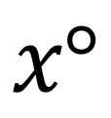
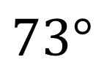
Co-Interior or Not
$$73°$$
$$x°$$
Co-interior

Slide 18


Co-Interior or Not
$$113°$$
$$x°$$
Co-interior

Slide 19

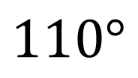
Co-Interior or Not
$$110°$$
$$x°$$
Not

Slide 20


Co-Interior or Not
$$x°$$
$$110°$$
Not

Slide 21
What letter can you see highlighted?
a
b
X
Opposite Angles
d
c
e
f
What is the connection
between b and d ?
h
g
They are same size

Slide 22
Opposite or Not
$$x°$$
$$110°$$
Opposite

Slide 23


Opposite or Not
$$x°$$
$$30°$$
Not

Slide 24

Opposite or Not
$$45°$$
$$x°$$
Not

Slide 25

Opposite or Not
$$x°$$
$$45°$$
Opposite

Slide 26
Alternate Angles (Z): equal angles
Corresponding Angles (F): equal angles
Co-Interior Angles (C): add to 180ᵒ
Opposite Angles (X): equal angles

Slide 27
Angles A and B are equal because
A) They are alternate angles
B) They are angles on a straight line
A
C) Co-interior Angles add up to 180˚
B
D) They are opposite angles

Slide 28
Angles A and B are equal because
A) They are alternate angles
B) They are angles on a straight line
A
C) They are corresponding angles
B
D) They are opposite angles

Slide 29
Angles A and B are equal because
A) They are alternate angles
B) They are angles on a straight line
A
C) They are opposite angles
B
D) They are corresponding angles

Slide 30
Angles A and B are equal because
A) They are opposite angles
B) Co-interior Angles add up to 180˚
C) They are alternate angles
A
B
D) They are angles on a straight line

Slide 31
Angles A and B are equal because
A) They are opposite angles
B) They are angles on a straight line
A
C) They are corresponding angles
B
D) They are alternate angles

Slide 32
Angles A and B add up to 180° because
A) Co-interior Angles add up to 180˚
B) They are opposite angles
A
C) They are corresponding angles
B
D) They are angles on a straight line

Slide 33
Angle A is 25° because
A) Alternate angles are equal
B) Co-interior Angles add up to 180˚
A
C) Angles on a straight line add up to 180°
155°
D) Corresponding angles are equal
Not accurately drawn

Slide 34
Angle A is 130° because
A) They are angles on a straight line
B) Alternate angles are equal
130°
C) Opposite angles are equal
A
D) Co-interior Angles add up to 180˚
Not accurately drawn

Slide 35
What is angle A?
A) 41° degrees because opposite angles are equal
B) 41° degrees because corresponding angles are equal
A
41°
C) 41° degrees because alternate angles are equal
D) 139° because angles on a straight line add up to 180°
Not accurately drawn

Slide 36
Angle A is 40° because
A) Opposite angles are equal
40°
B) Alternate angles are equal
A
C) Co-interior Angles add up to 180˚
D) Corresponding angles are equal
Not accurately drawn

Slide 37
Angle A is 35° because
A) Opposite angles are equal
B) Corresponding angles are equal
145°
A
C) Co-interior Angles add up to 180˚
D) Alternate angles are equal
Not accurately drawn

Slide 38
What is angle A?
A) 50° degrees because angles on a straight line add up to 180°
B) 130° degrees because alternate angles are equal
A
130°
C) 230° degrees because angles at a point add up to 360°
D) 130° degrees because opposite angles are equal
Not accurately drawn

Slide 39
This diagram cannot be correct because?
Alternate angles are equal
145°
Opposite angles are equal
35°
Angles at a point add up to 360°
35°
135°
35°
Angles on a straight line add up to 180°
Not accurately drawn

