Slide 1
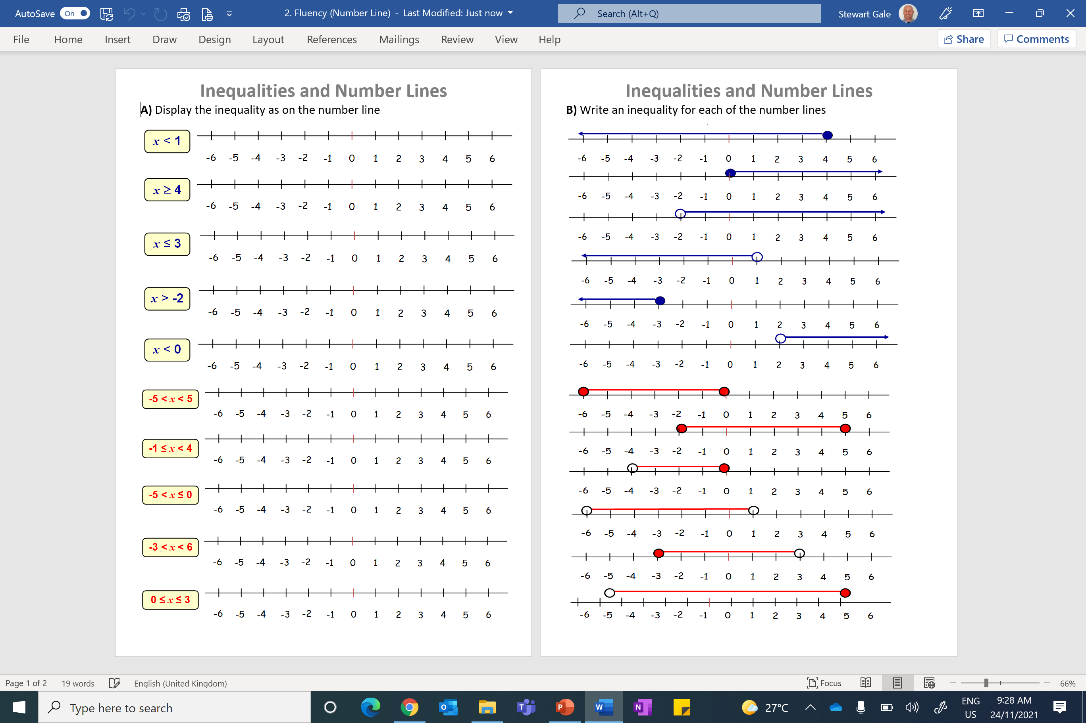

Slide 2
ANSWERS

Slide 3
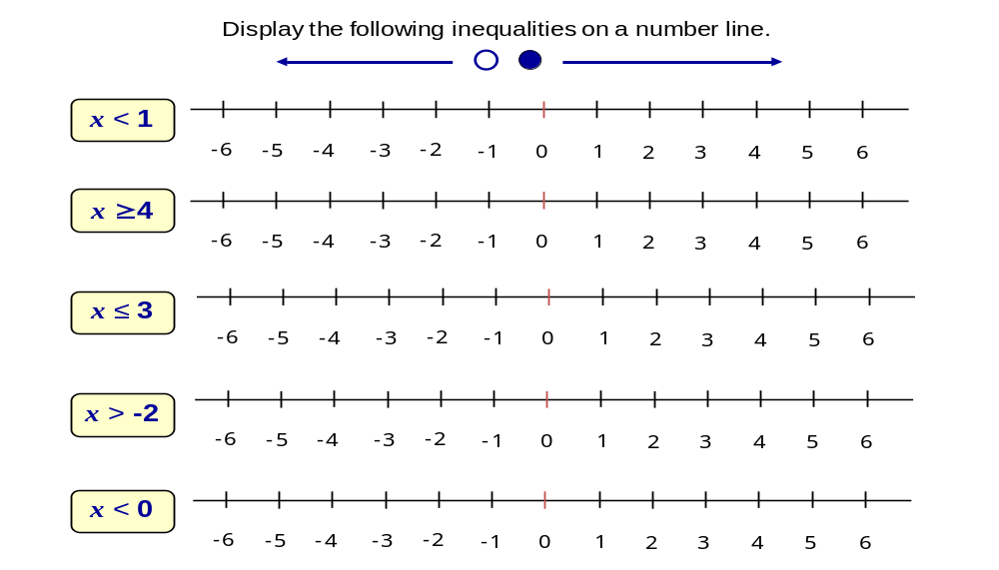

Slide 4
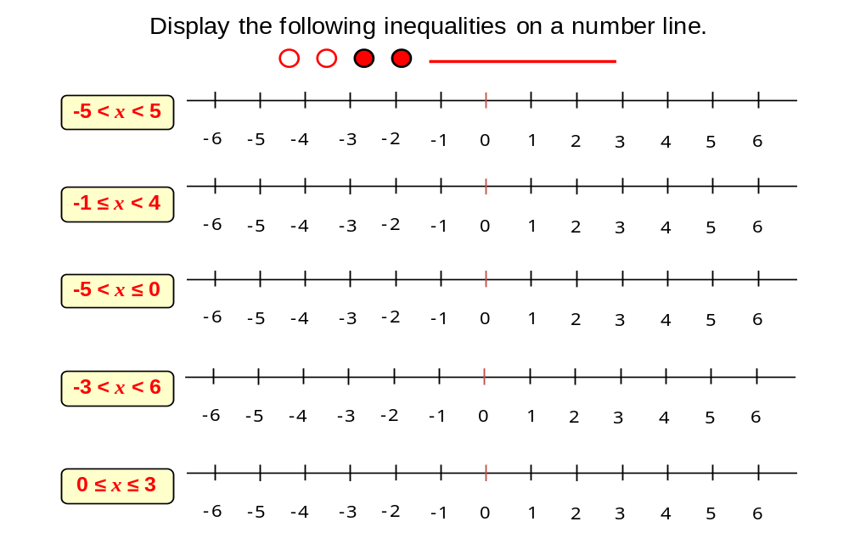

Slide 5
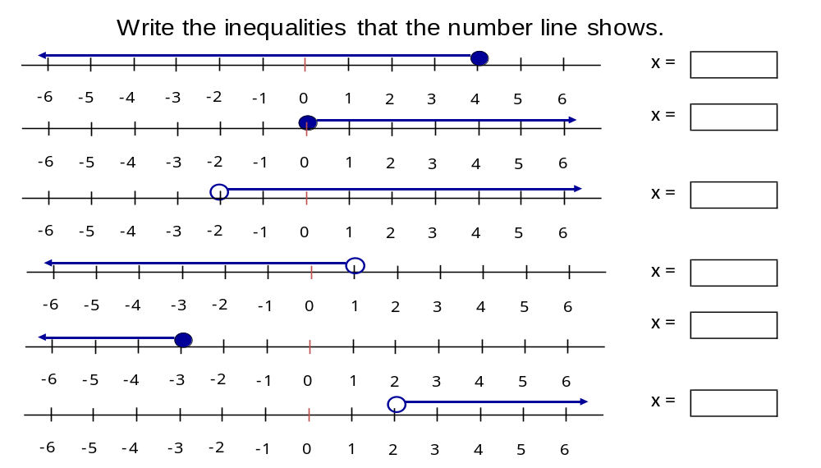
x ≤ 4
x ≥ 0
x > -2
x < 1
x ≤ -3
x > 2

Slide 6
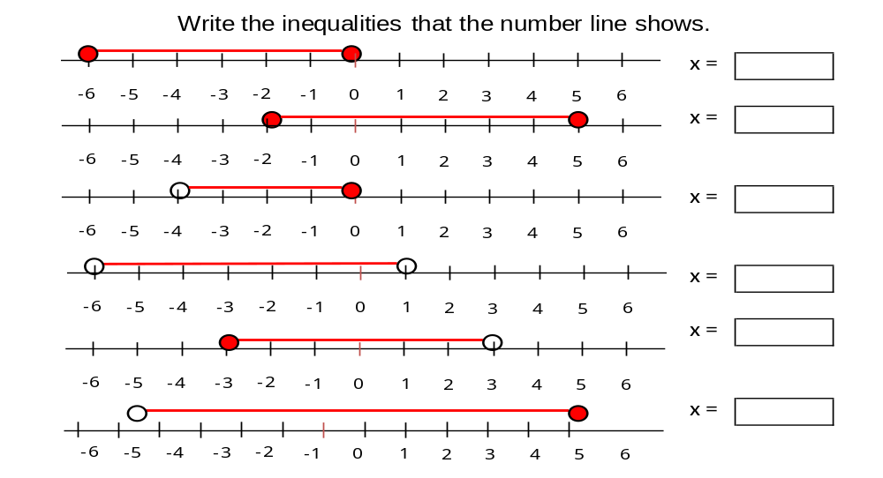
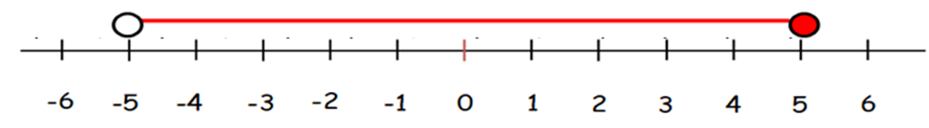
-6 ≤ x ≤ 0
-2 ≤ x ≤ 5
-4 < x ≤ 0
-6 < x < 1
-3 ≤ x < 3
-5 < x ≤ 5

