Slide 1
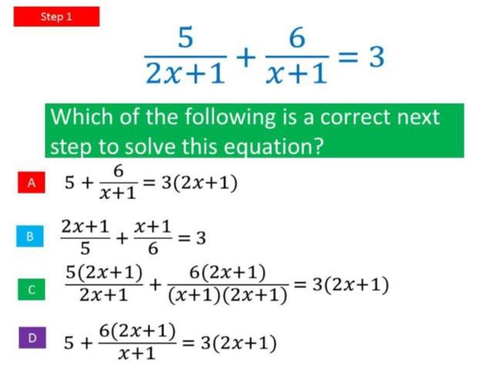
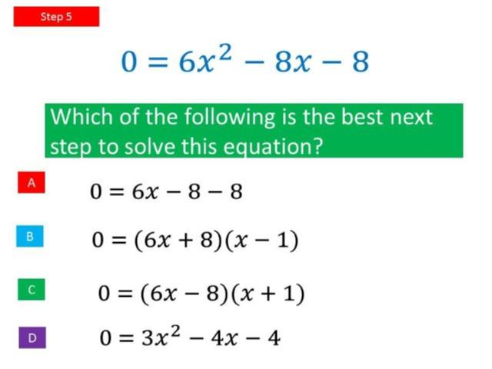
Worst answered question?
Most common wrong answer?

Slide 2
ANSWERS

Slide 3
Worst answered question?

Slide 4
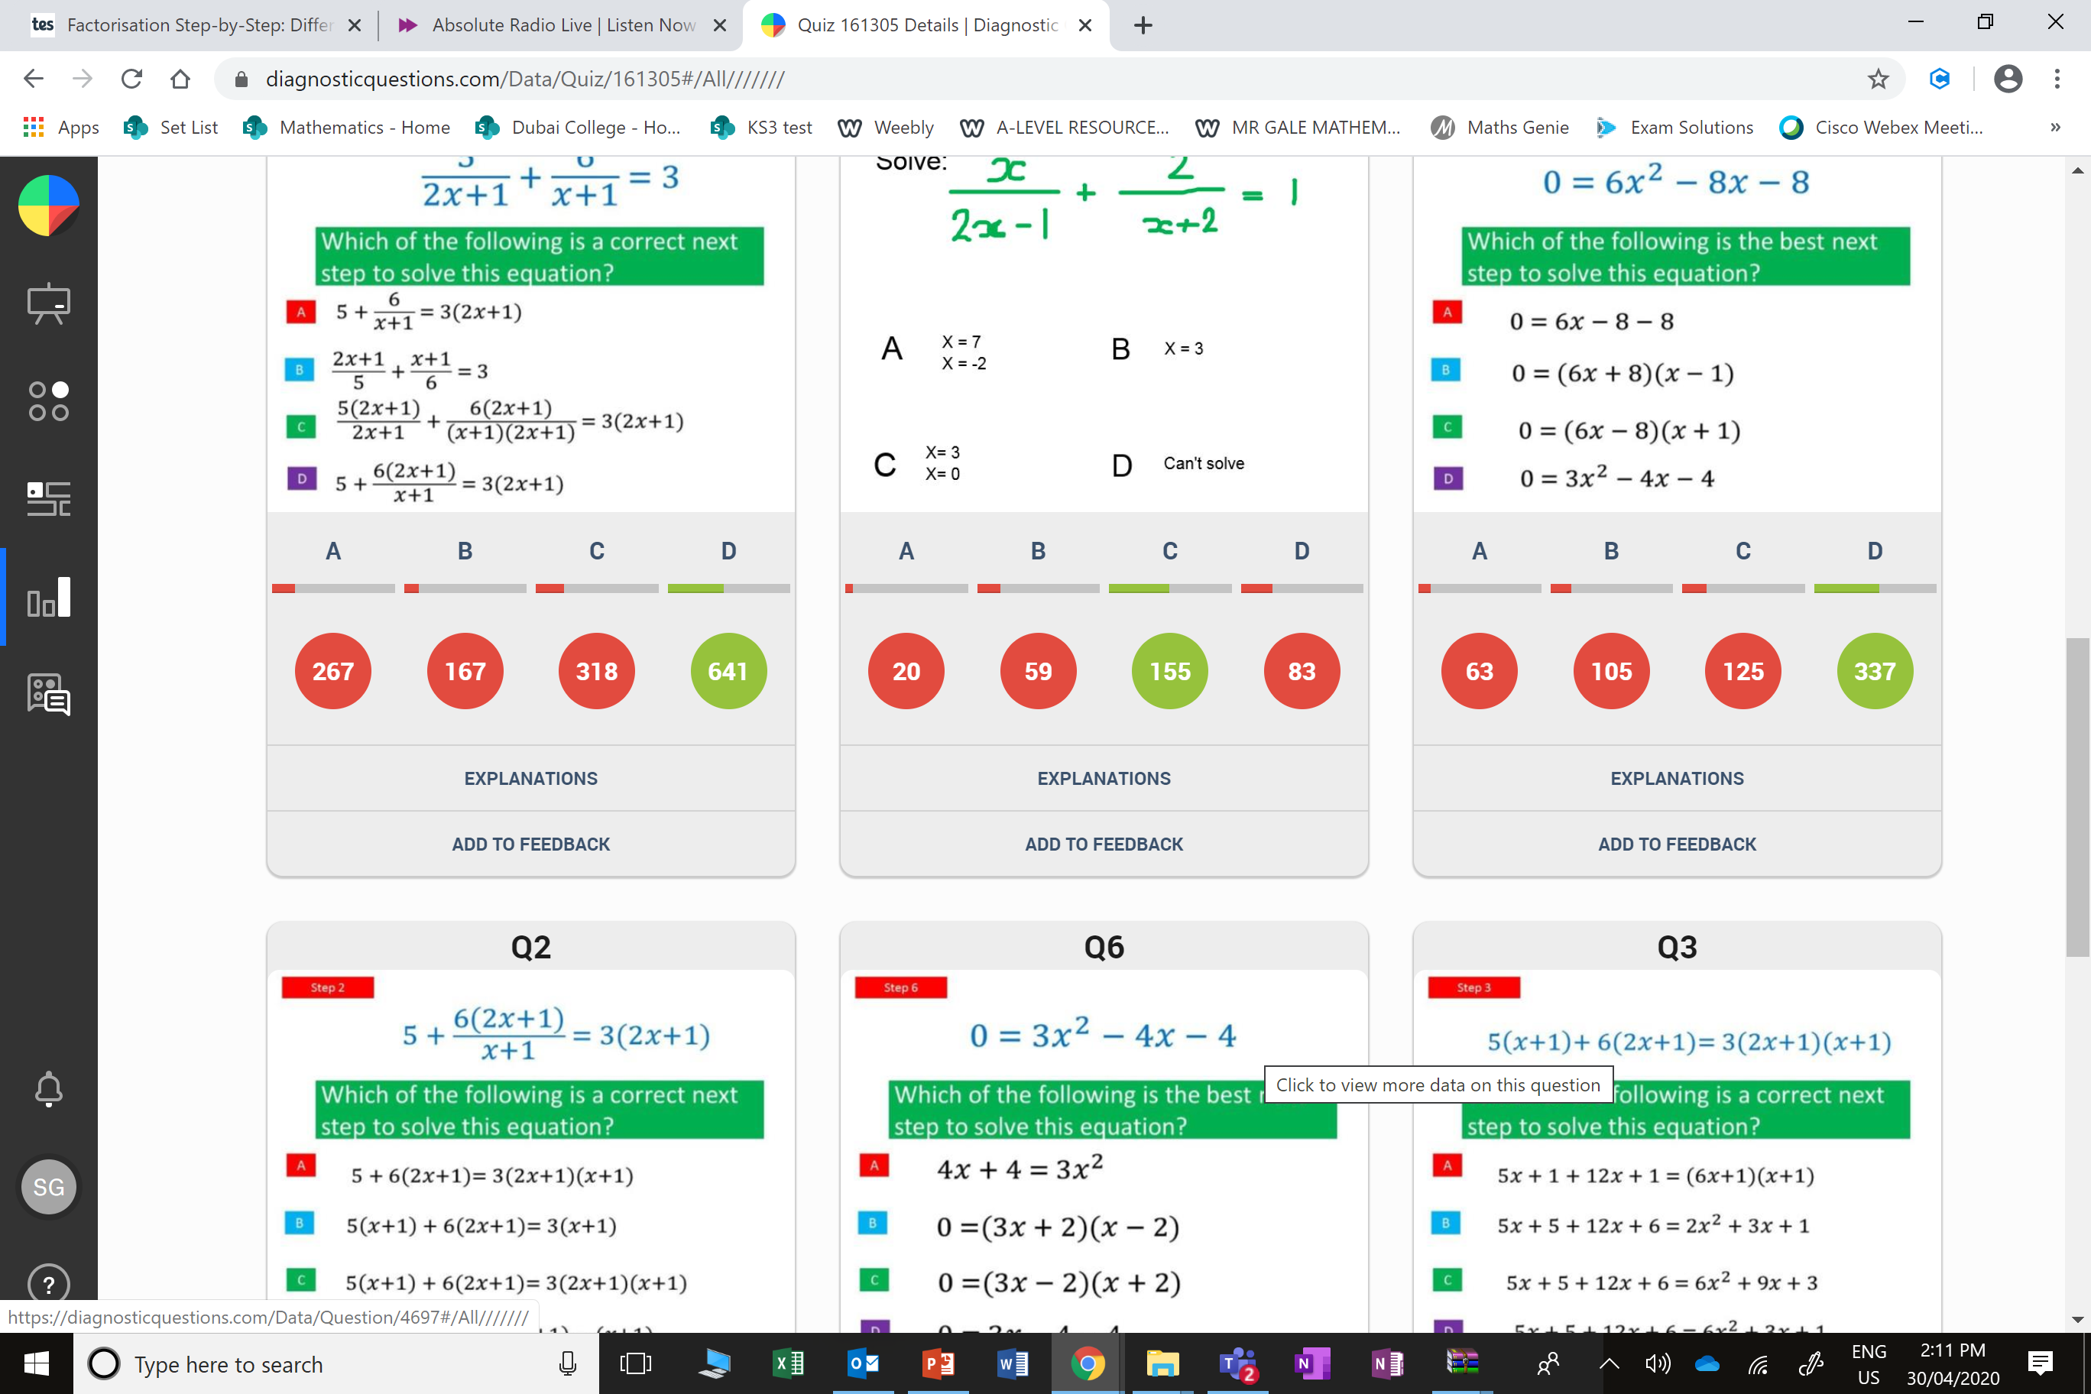
C
They cross multiplied the numerators with the wrong brackets.

Slide 5
D
They simplified rather than factorising.

