Slide 1
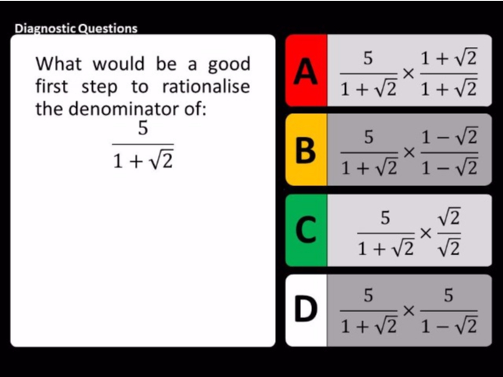
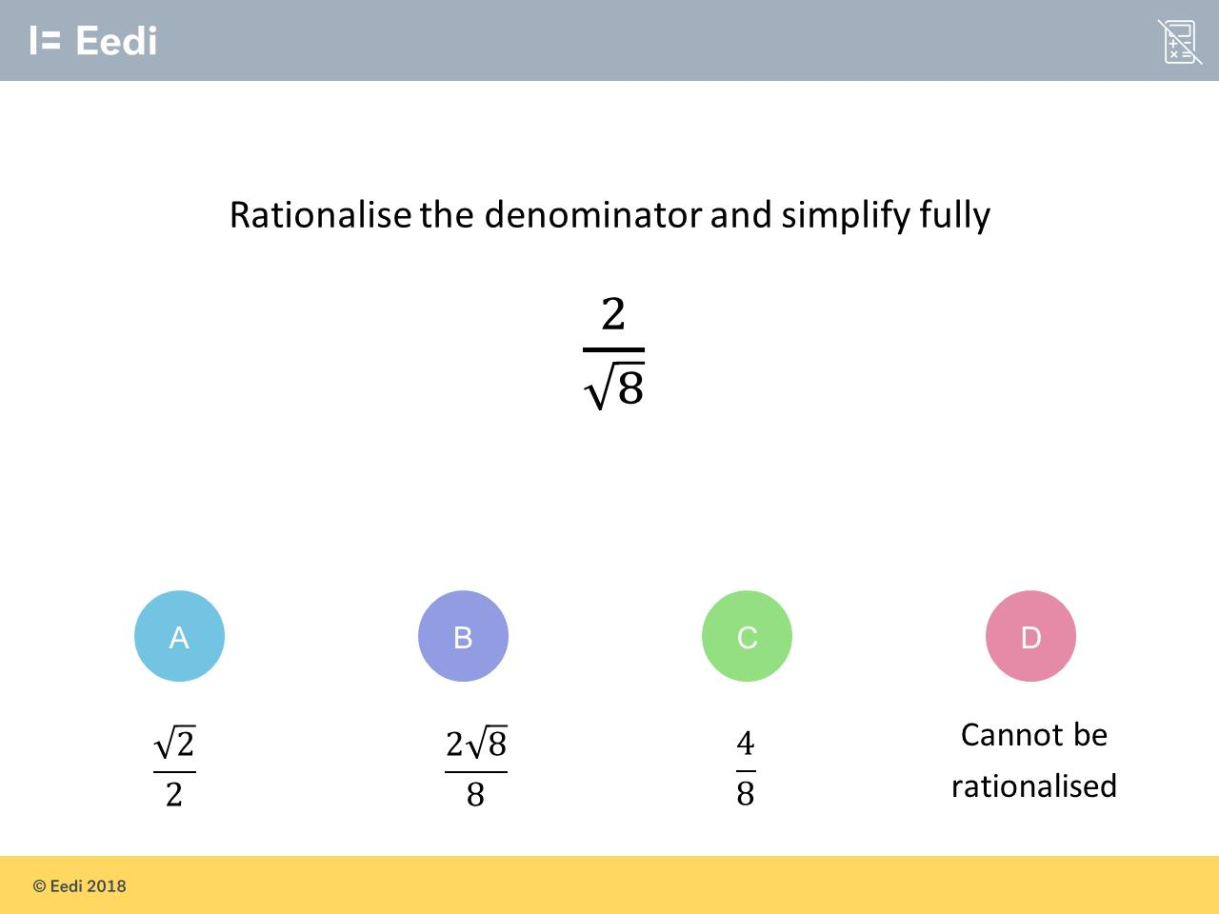
Worst answered question?
Most common wrong answer?

Slide 2
ANSWERS

Slide 3
Worst answered question?

Slide 4
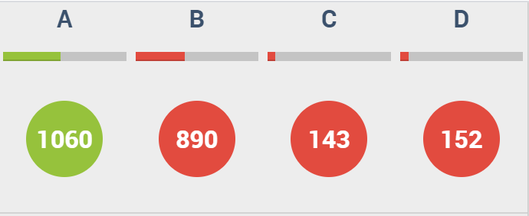
B
They rationalized the denominator but forgot to simplify.

Slide 5
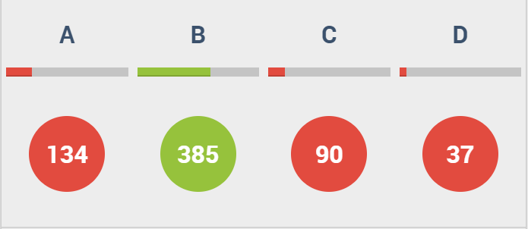
A
They forgot to change the sign from an addition to a subtraction.

