Slide 1
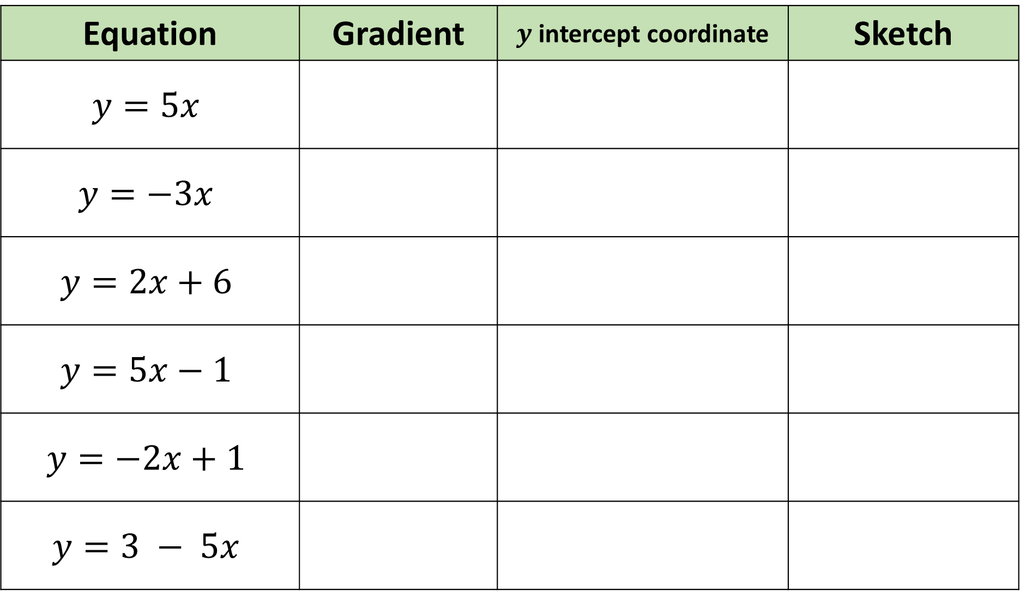
Equation | Gradient | $y$ intercept coordinate | Sketch
$$y=5x$$
$$y=−3x$$
$$y=2x+6$$
$$y=5x−1$$
$$y=−2x+1$$
$$y=3 − 5x$$
1.
2.
3.
4.
5.
6.

Slide 2
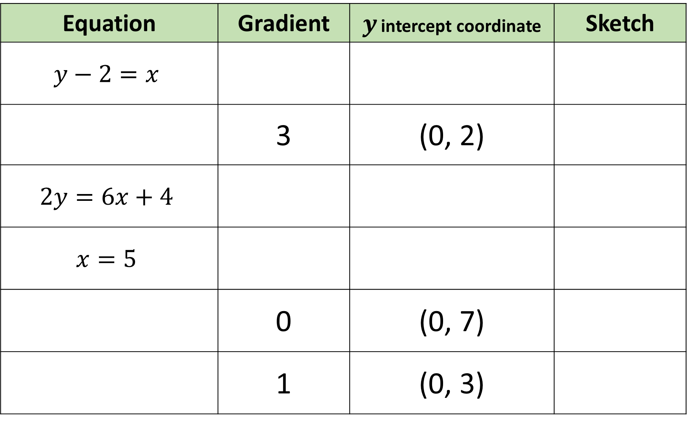
Equation | Gradient | $y$ intercept coordinate | Sketch
$$y−2=x$$
 | 3 | (0, 2)
$$2y=6x+4$$
$$x=5$$
 | 0 | (0, 7)
 | 1 | (0, 3)
7.
8.
9.
10.
11.
12.

Slide 3
ANSWERS

Slide 4
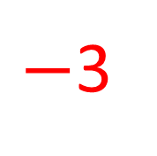
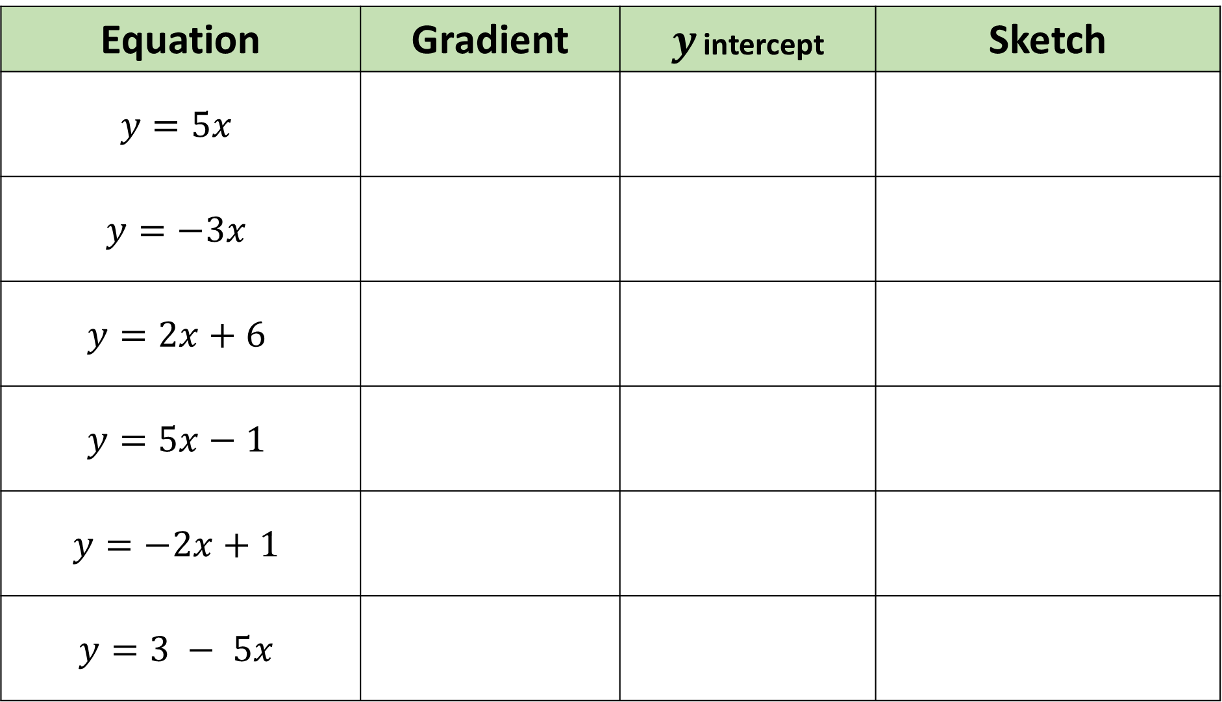
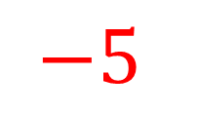
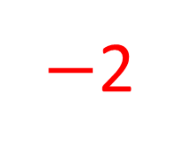
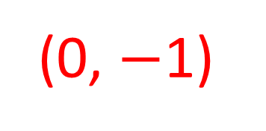
Equation | Gradient | $y$ intercept | Sketch
$$y=5x$$
$$y=−3x$$
$$y=2x+6$$
$$y=5x−1$$
$$y=−2x+1$$
$$y=3 − 5x$$
5
(0, 0)
1.
$−$3
(0, 0)
2.
3.
2
(0, 6)
4.
5
(0, $−$1)
$−$2
(0, 1)
5.
$$−5$$
(0, 3)
6.

Slide 5

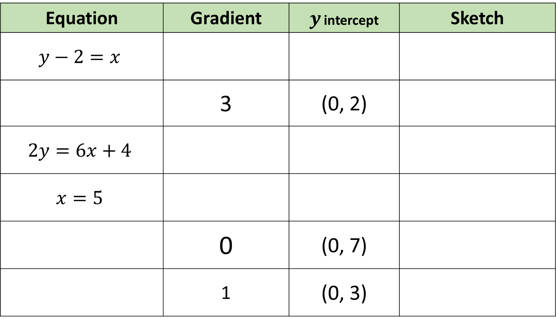



Equation | Gradient | $y$ intercept | Sketch
$$y−2=x$$
 | 3 | (0, 2)
$$2y=6x+4$$
$$x=5$$
 | 0 | (0, 7)
 | 1 | (0, 3)
1
(0, 2)
7.
$$y=3x+2$$
8.
3
(0, 2)
9.
$$8$$
None
10.
$$y=7$$
11.
$$y=x+3$$
12.

