Slide 1
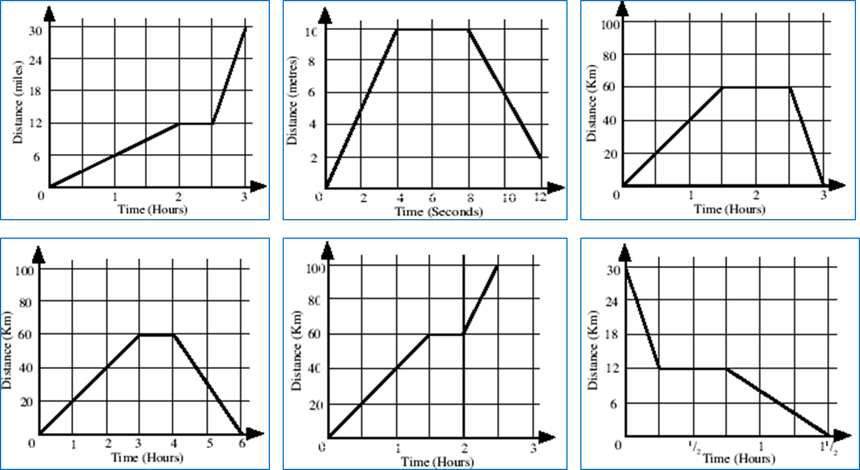
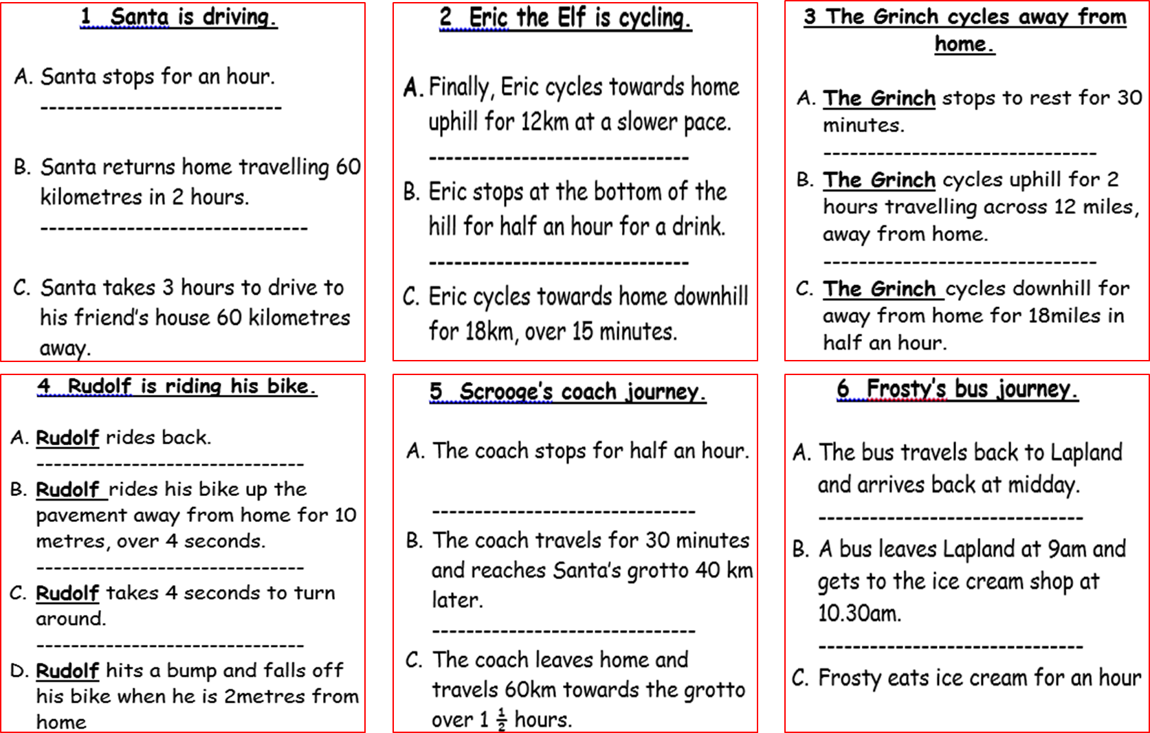
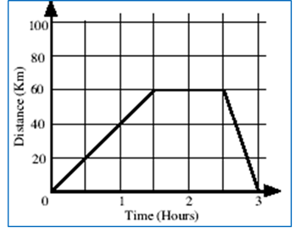
Find the story that matches the graph.
Put the story in the right order to match what happens in the graph.
Label the graph with the correct letter for the matching part of the story.

Slide 2
ANSWERS

Slide 3
B – A – C

Slide 4
B – C – A – D

Slide 5
C – A – B

Slide 6
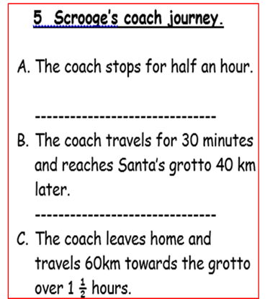
C – A – B

Slide 7
B – C – A

Slide 8
A – B – C

