Slide 1
FM: Equation of Line

Slide 2


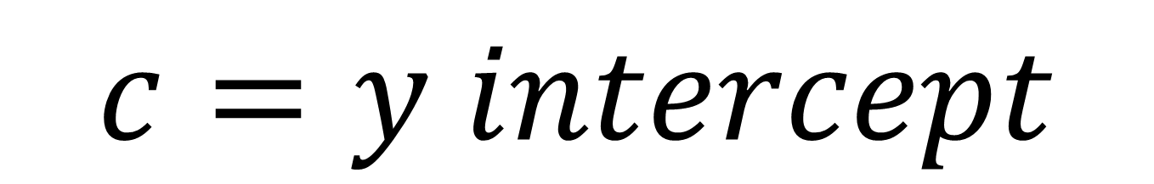
Lines and Equations
$$y=mx+c$$
$$m=gradient$$
$$c=y intercept$$

Slide 3
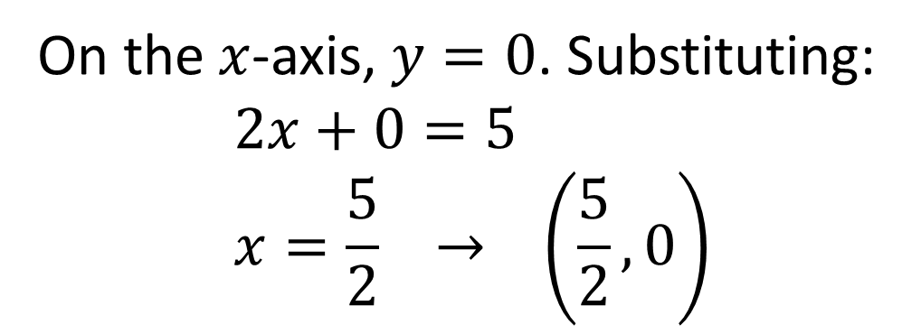
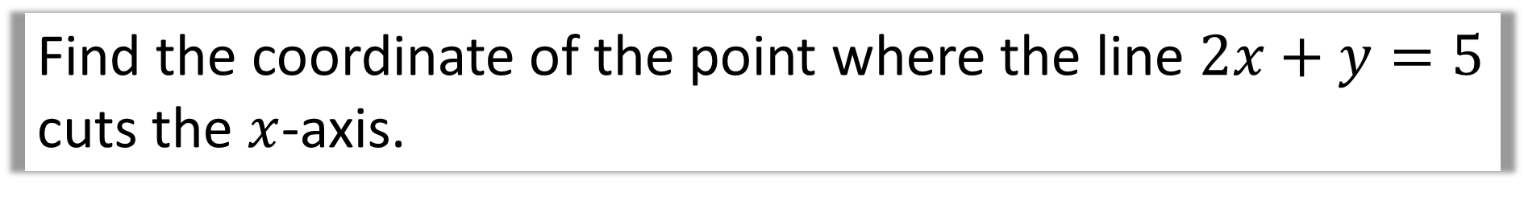
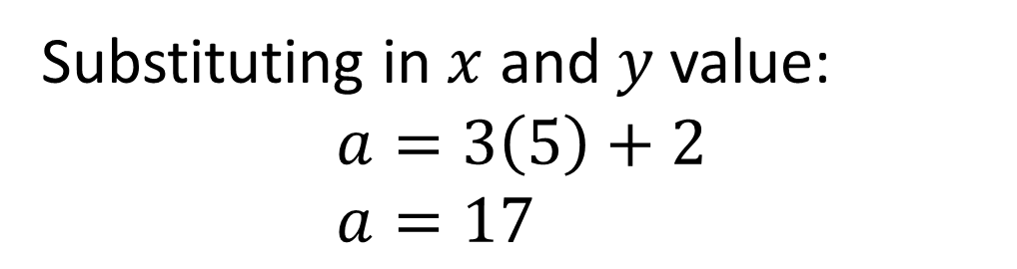
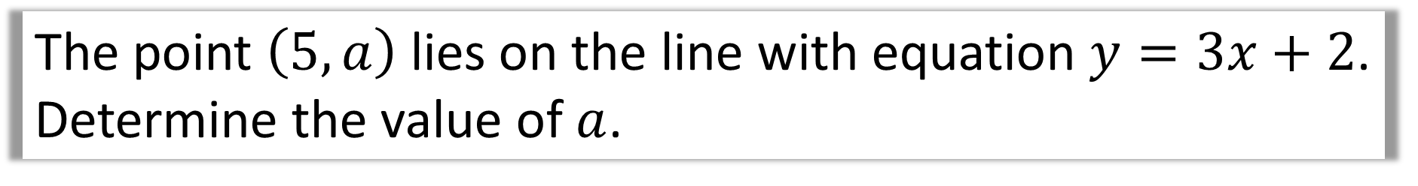
The point $\left(5,a\right)$ lies on the line with equation $y=3x+2$. Determine the value of $a$.
Substituting in $x$ and $y$ value:
$$a=3\left(5\right)+2 \\ a=17$$
Find the coordinate of the point where the line $2x+y=5$ cuts the $x$-axis.
On the $x$-axis, $y=0$. Substituting:
$$2x+0=5 \\ x=\frac{5}{2} → \left(\frac{5}{2}, 0\right)$$

Slide 4
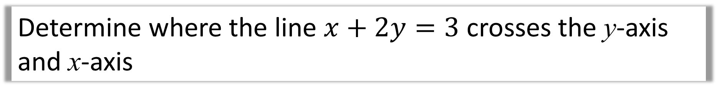
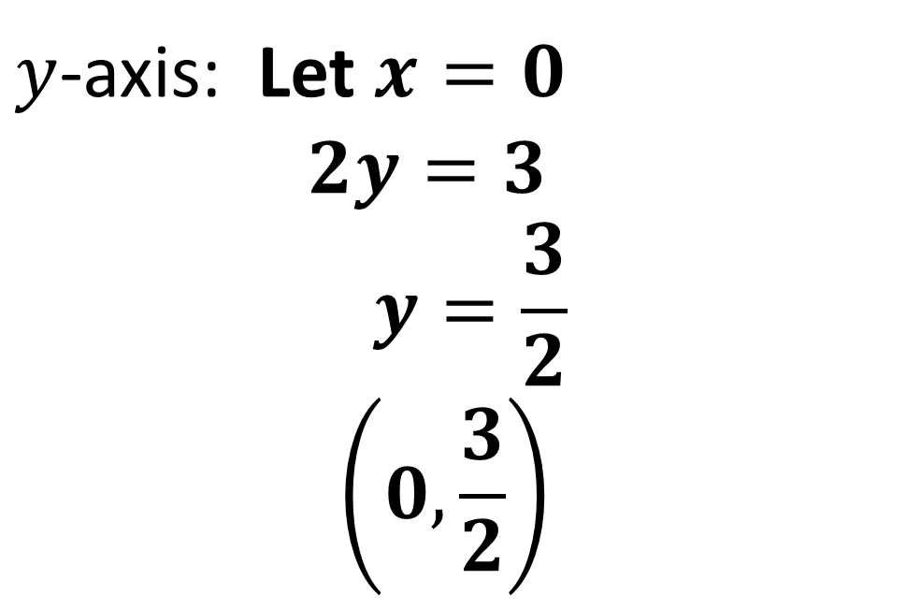
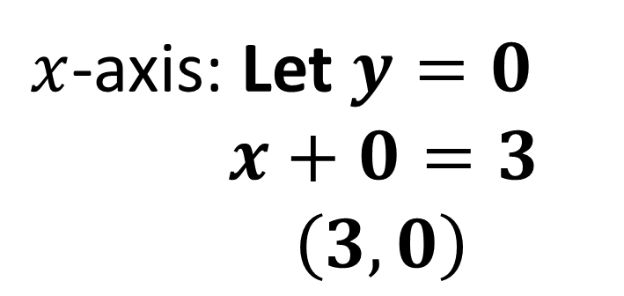
Determine where the line $x+2y=3$ crosses the y-axis and x-axis
$x$-axis: Let $y=0$
$x+0=3$
$\left(3,0\right)$
$y$-axis: Let $x=0$
$$2y=3$$
$$y=\frac{3}{2} \\ \left(0,\frac{3}{2}\right)$$

Slide 5
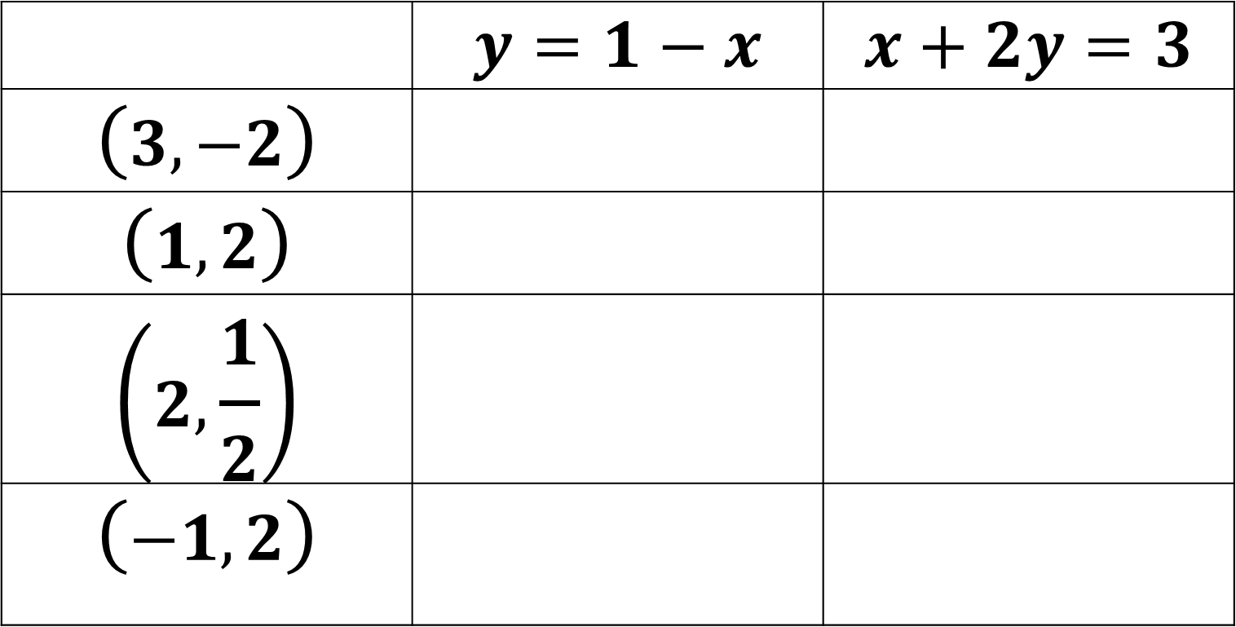
Put a tick or cross to determine whether each of the following points are on the line with the given equation.
 | $$y=1−x$$ | $$x+2y=3$$
$$\left(3,−2\right)$$
$$\left(1,2\right)$$
$$\left(2,\frac{1}{2}\right)$$
$$\left(−1,2\right)$$
✓ | ✗
✗ | ✗
✗ | ✓
✓ | ✓

Slide 6

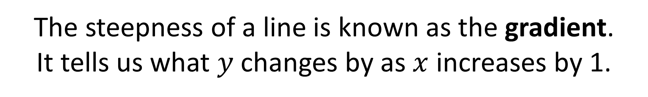
Gradients
The steepness of a line is known as the gradient.
It tells us what $y$ changes by as $x$ increases by 1.
Gradient
$$1$$

Slide 7



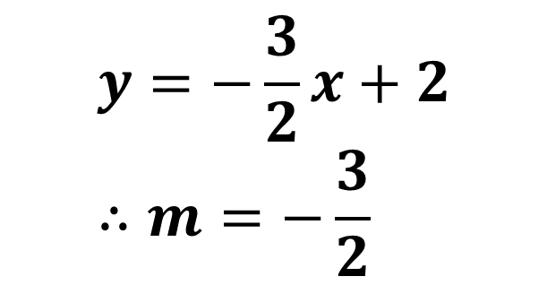
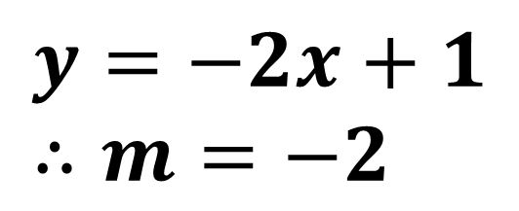
We can get the gradient of a line using just its equation.
Rearrange into the form $y=mx+c$ (i.e. make $y$ the subject)
What is the gradient of $y+2x=1$?
$$y=−2x+1 \\ ∴m=−2$$
What is the gradient of $2y+3x=4$?
$$y=−\frac{3}{2}x+2 \\ ∴m=−\frac{3}{2}$$

Slide 8
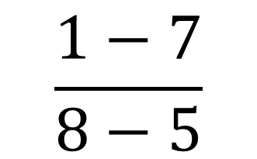
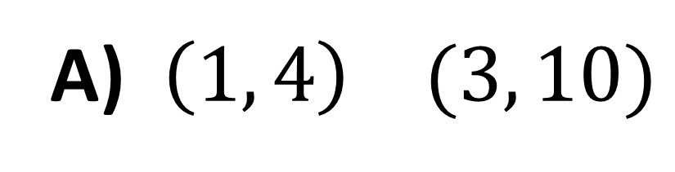
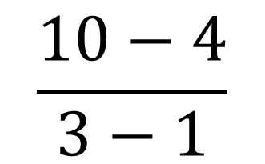
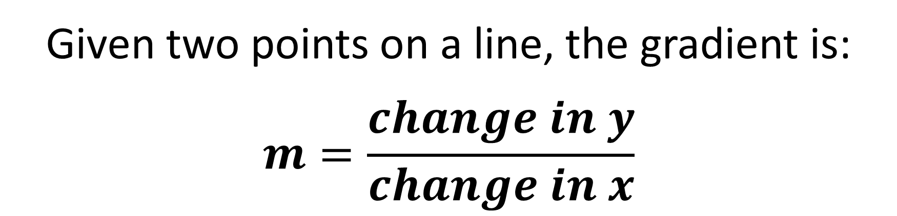
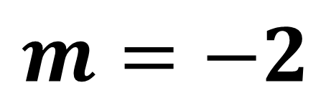
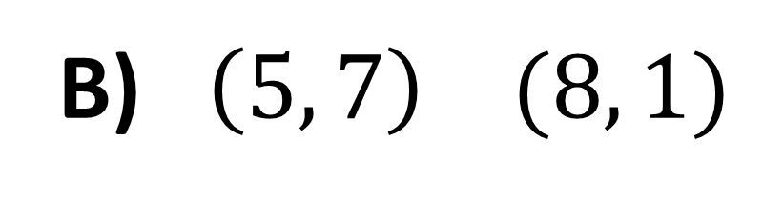
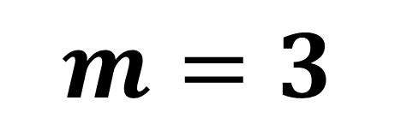
Given two points on a line, the gradient is:
$$m=\frac{change in y}{change in x}$$
A) $\left(1, 4\right) (3, 10)$
B) $\left(5, 7\right) (8, 1)$
$$\frac{10−4}{3−1}$$
$$\frac{1−7}{8−5}$$
$$m=3$$
$$m=−2$$

Slide 9




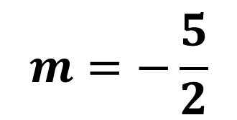
There are 3 ways in which we can
calculate the gradient:
a. Counting Squares
b. Using the equation
c. Using two points
$$2y=4−5x$$
$$\left(1, 4\right), \left(4, 13\right)$$
$$m=−\frac{5}{2}$$
$$m=−3$$
$$m=3$$

Slide 10

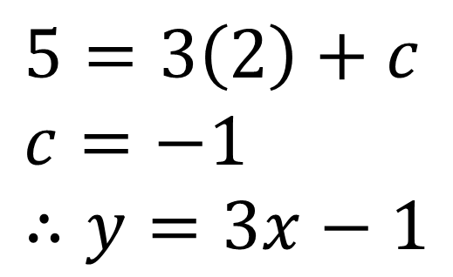
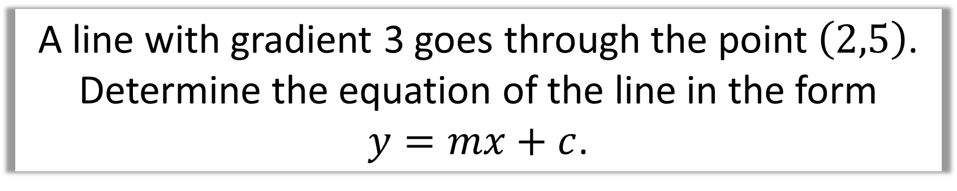
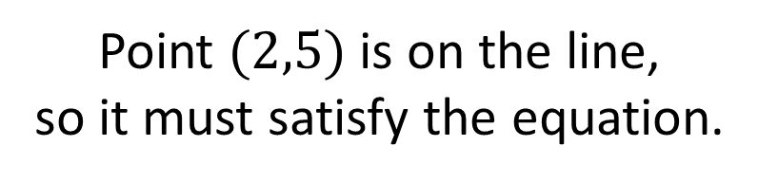
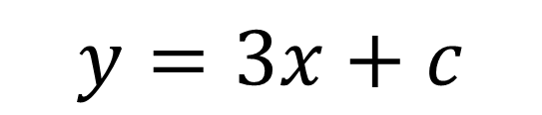
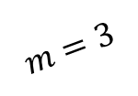
Equations given gradients/points
A line with gradient 3 goes through the point $\left(2,5\right)$.
Determine the equation of the line in the form
$y=mx+c$.
$$y=3x+c$$
$$m=3$$
Point $(2,5)$ is on the line,
so it must satisfy the equation.
$$\left(2,5\right)$$
$$5=3\left(2\right)+c \\ c=−1 \\ ∴y=3x−1$$

Slide 11

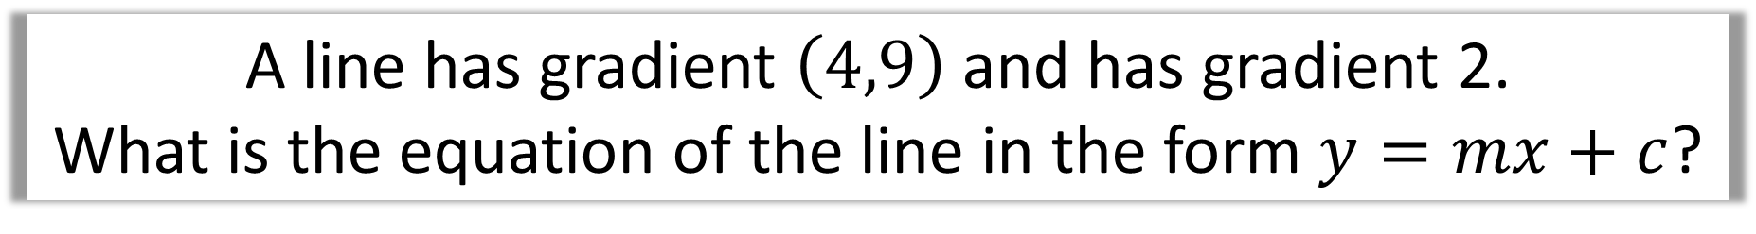


A line has gradient $\left(4,9\right)$ and has gradient 2.
What is the equation of the line in the form $y=mx+c$?
$$y=2x+c$$
$$9=2\left(4\right)+c \\ c=1$$
$$∴y=2x+1$$

Slide 12
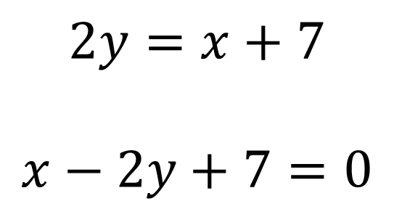
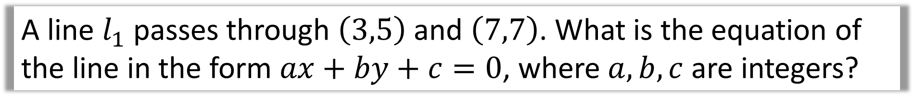
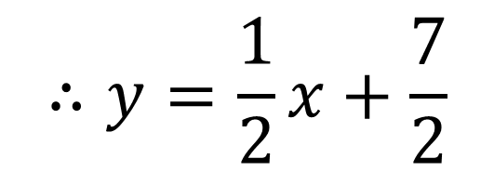
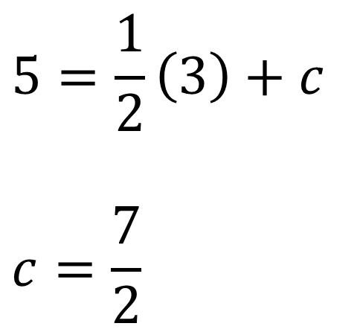
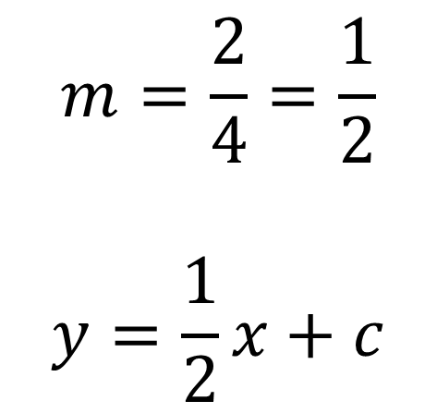
A line $l_{1}$ passes through $\left(3,5\right)$ and $\left(7,7\right)$. What is the equation of the line in the form $ax+by+c=0$, where $a, b, c$ are integers?
$$m=\frac{2}{4}=\frac{1}{2}$$
$$y=\frac{1}{2}x+c$$
$$5=\frac{1}{2}\left(3\right)+c$$
$$c=\frac{7}{2}$$
We want a form where there are no fractions and
0 is on one side:
$$2y=x+7$$
$$x−2y+7=0$$
$$∴y=\frac{1}{2}x+\frac{7}{2}$$

Slide 13
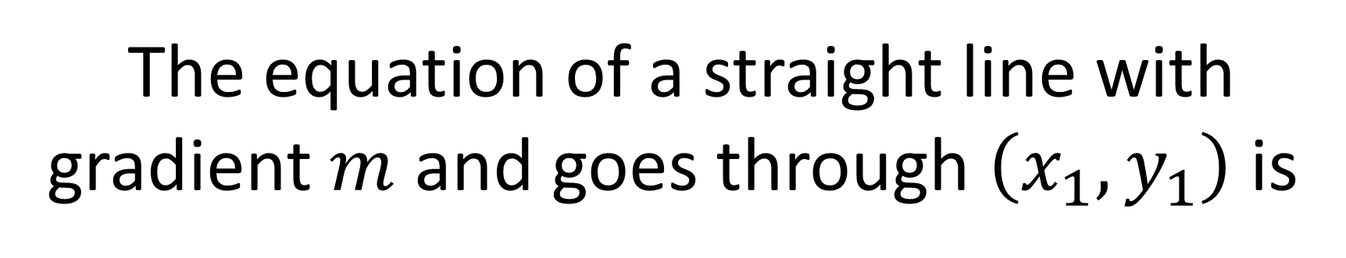

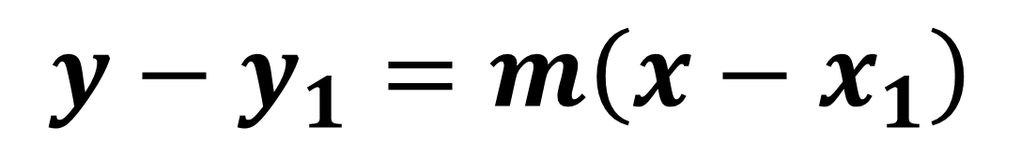
Another way
$$\left(x_{1},y_{1}\right)$$
The equation of a straight line with gradient $m$ and goes through $\left(x_{1}, y_{1}\right)$ is
$$y−y_{1}=m\left(x−x_{1}\right)$$

Slide 14
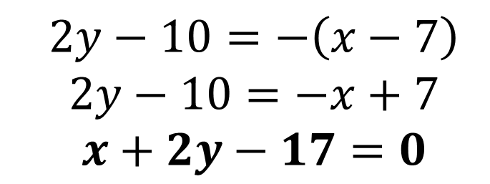
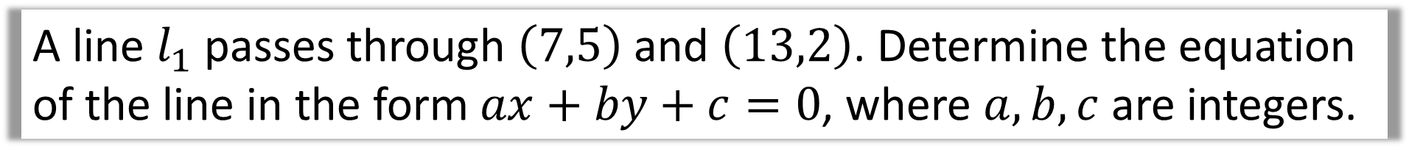
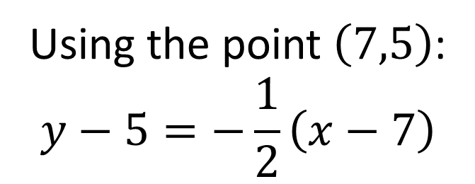
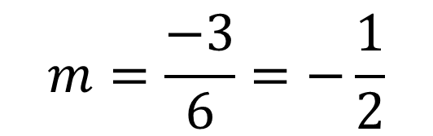
A line $l_{1}$ passes through $\left(7,5\right)$ and $\left(13,2\right)$. Determine the equation of the line in the form $ax+by+c=0$, where $a, b, c$ are integers.
$$m=\frac{−3}{6}=−\frac{1}{2}$$
Using the point $\left(7,5\right)$:
$$y−5=−\frac{1}{2}\left(x−7\right)$$
$$2y−10=−\left(x−7\right) \\ 2y−10=−x+7 \\ x+2y−17=0$$

