Slide 1
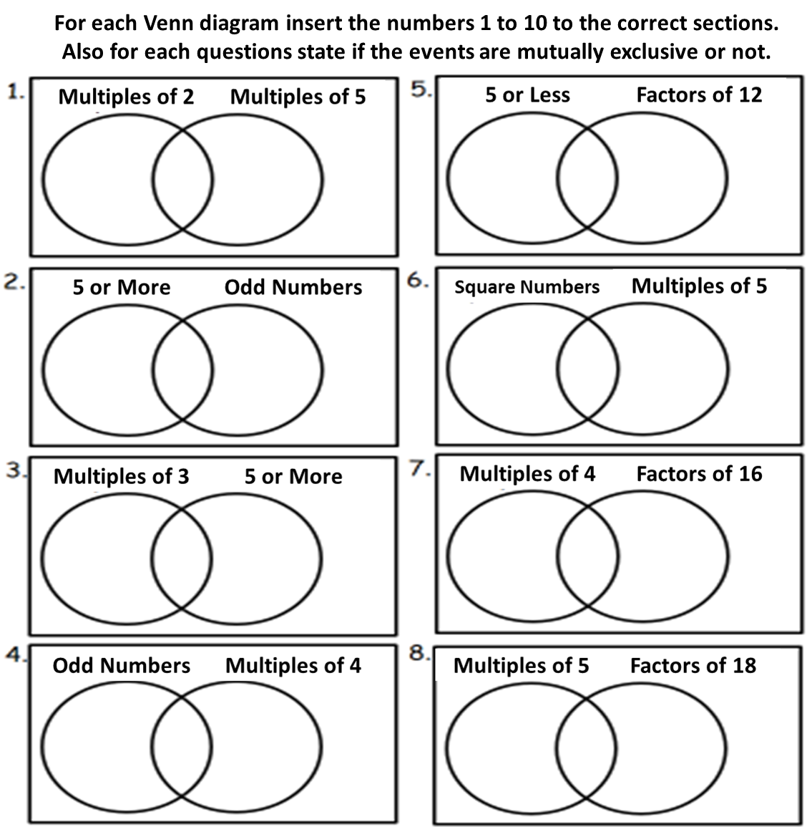

Slide 2
ANSWERS

Slide 3
4
Not
Mutually Exclusive
2
5
10
1
8
6
3
7
9
1
Not
Mutually Exclusive
6
5
10
7
3
4
9
8
2

Slide 4
7
2
Not
Mutually Exclusive
3
6
10
9
5
1
8
4
1
8
2
9
Mutually Exclusive
3
7
4
6
5
10

Slide 5
Not
Mutually Exclusive
1
6
8
5
2
3
7
4
9
10
2
1
5
8
Mutually Exclusive
4
3
10
9
6
7

Slide 6
6
9
1
Not
Mutually Exclusive
4
2
5
8
7
3
10
5
2
8
1
Mutually Exclusive
10
9
7
6
3
4

