Slide 1
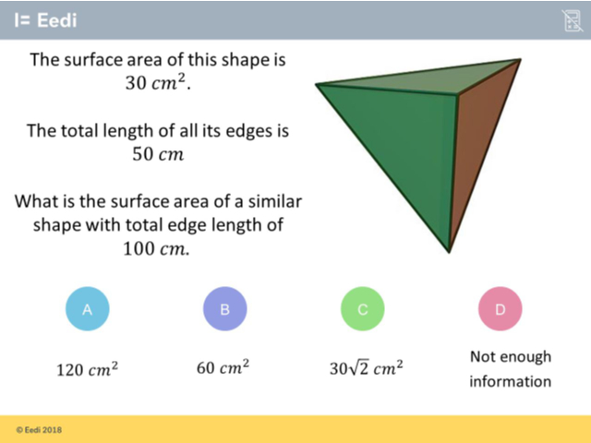
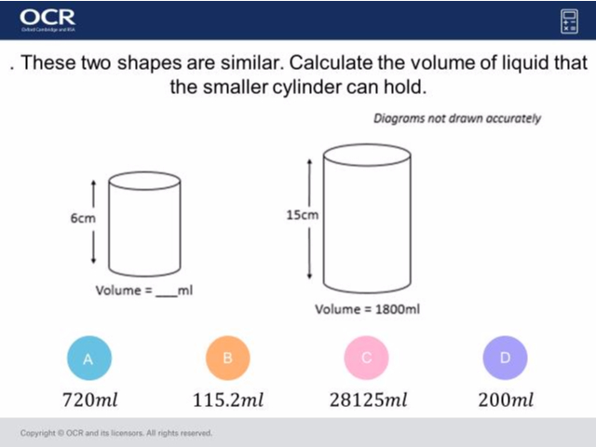
Worst answered question?
Most common wrong answer?

Slide 2
ANSWERS

Slide 3
Worst answered question?

Slide 4
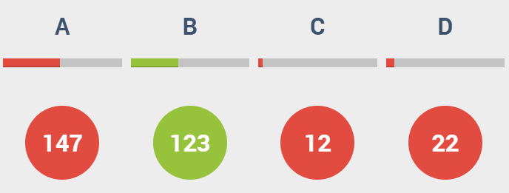
A
They used length scale factor to calculate the volume.

Slide 5
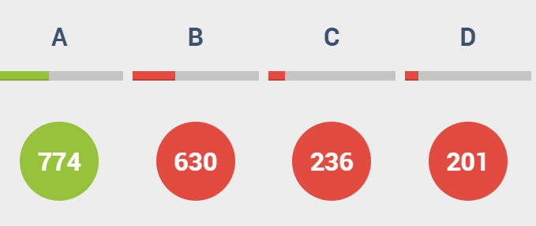
B
They used the length scale factor to calculate the area.

