Slide 1

Diagnostic Assessment .Delta 2
Unit 6
Recurring Decimals to Fractions
% Increase and Decrease
Express a number as a %
Percentage Change
Reverse Percentages
Compound Interest

Slide 2
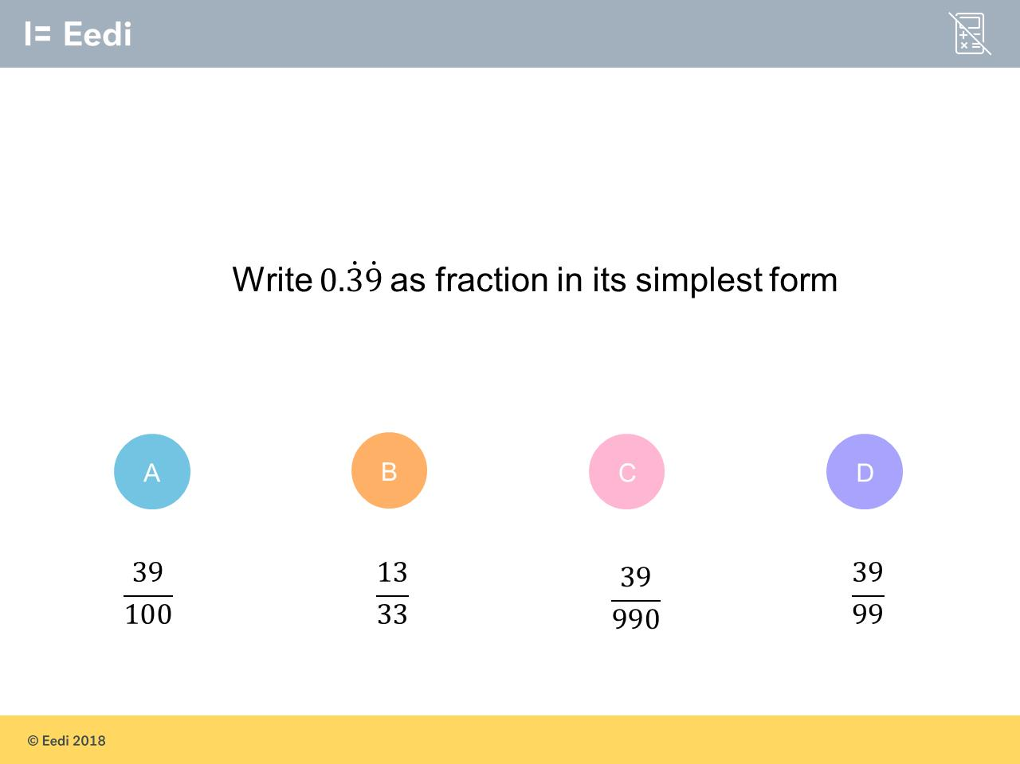
Question 1 – Recurring Decimals to Fractions

Slide 3
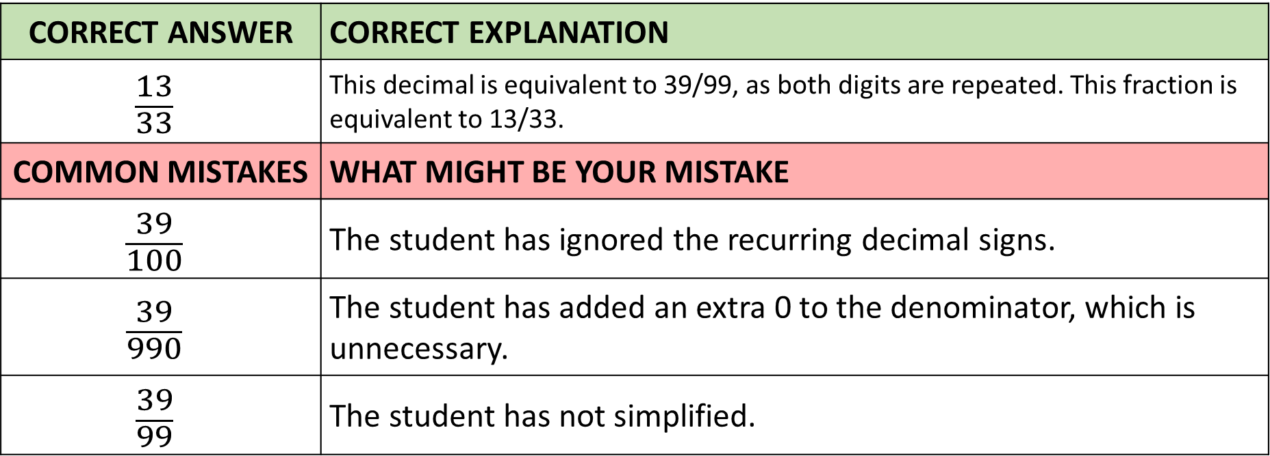
Answer 1 – Recurring Decimals to Fractions
CORRECT ANSWER | CORRECT EXPLANATION
$$\frac{13}{33}$$ | This decimal is equivalent to 39/99, as both digits are repeated. This fraction is equivalent to 13/33.
COMMON MISTAKES | WHAT MIGHT BE YOUR MISTAKE
$$\frac{39}{100}$$ | The student has ignored the recurring decimal signs.
$$\frac{39}{990}$$ | The student has added an extra 0 to the denominator, which is unnecessary.
$$\frac{39}{99}$$ | The student has not simplified.

Slide 4
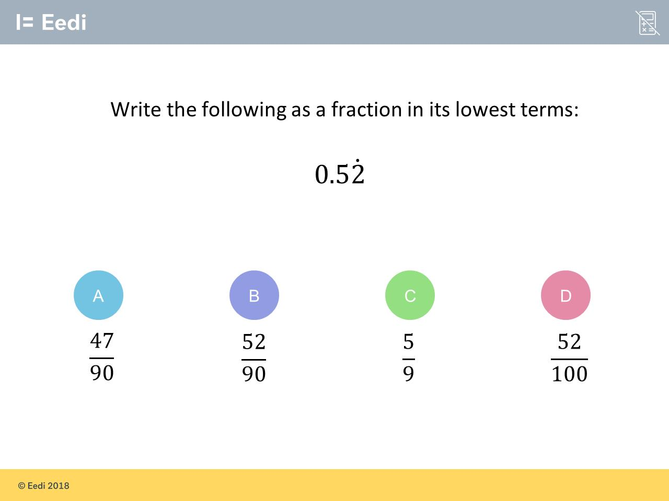
Question 2 – Recurring Decimals to Fractions

Slide 5
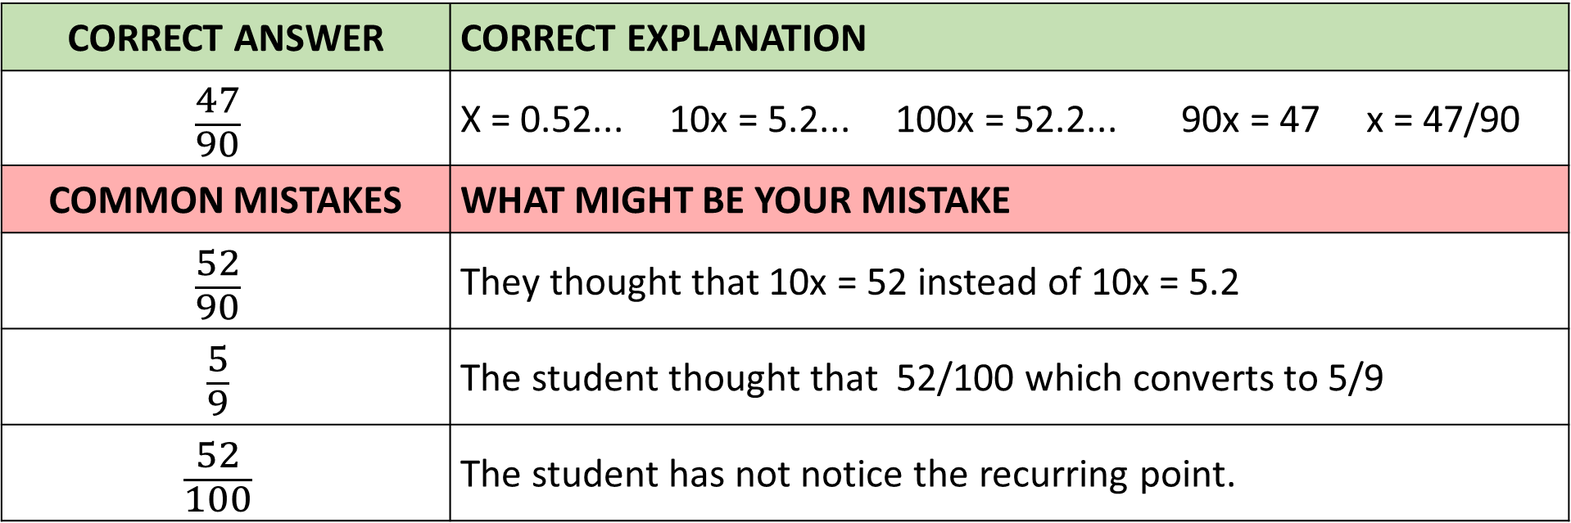
Answer 2 – Recurring Decimals to Fractions
CORRECT ANSWER | CORRECT EXPLANATION
$$\frac{47}{90}$$ | X = 0.52... 10x = 5.2... 100x = 52.2... 90x = 47 x = 47/90
COMMON MISTAKES | WHAT MIGHT BE YOUR MISTAKE
$$\frac{52}{90}$$ | They thought that 10x = 52 instead of 10x = 5.2
$$\frac{5}{9}$$ | The student thought that 52/100 which converts to 5/9
$$\frac{52}{100}$$ | The student has not notice the recurring point.

Slide 6
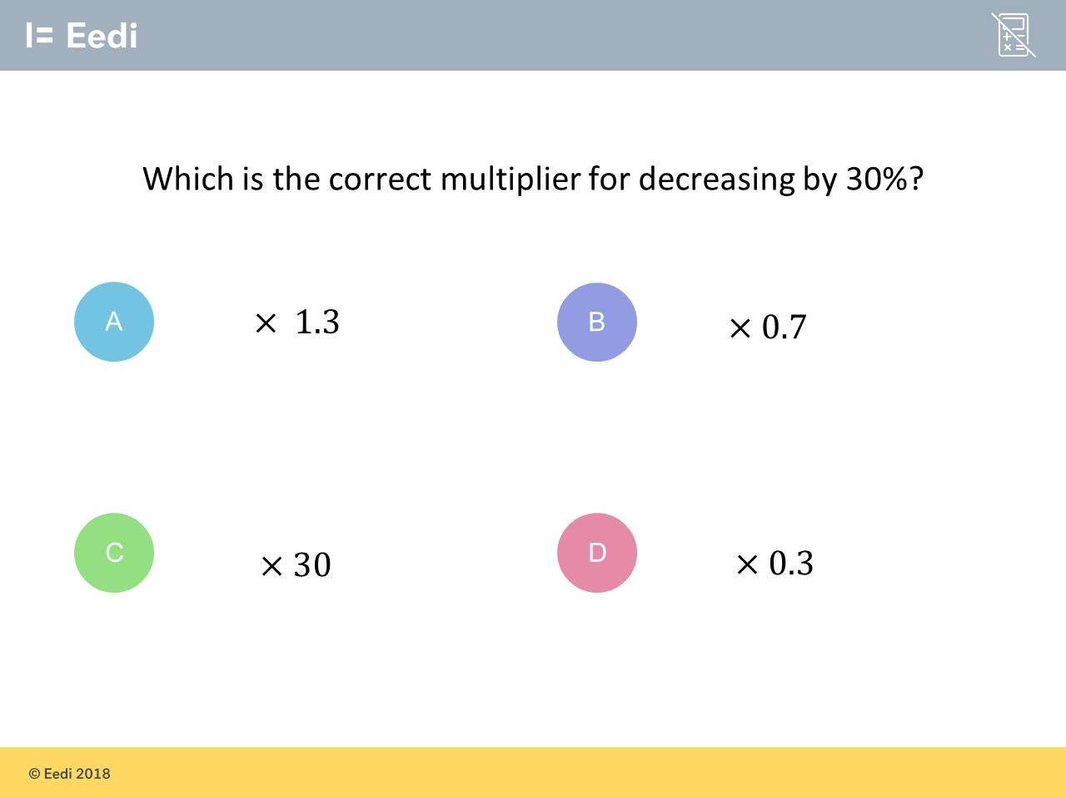
Question 3 – % Increase and Decrease

Slide 7
Answer 3 – % Increase and Decrease
CORRECT ANSWER | CORRECT EXPLANATION
B | The student has given the multiplier for increasing by 30%.
COMMON MISTAKES | WHAT MIGHT BE YOUR MISTAKE
A | The student has found the number of people who just ordered food.
C | The student may have repeated the number from the question. They may benefit from revising this topic.
D | The student may be finding 30%, but has forgotten to subtract from the original 100%.

Slide 8
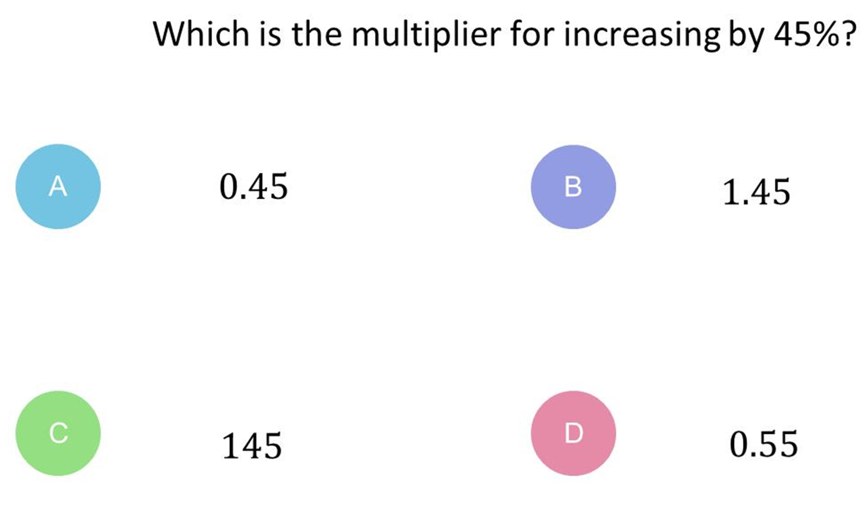
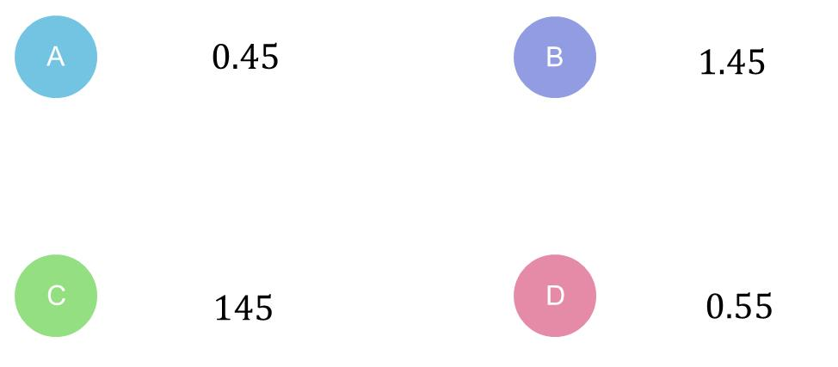
Question 4 – % Increase and Decrease

Slide 9
Answer 4 – % Increase and Decrease
CORRECT ANSWER | CORRECT EXPLANATION
B | To increase a number by a percentage, the multiplier is 1 followed by the decimal for that percentage.
COMMON MISTAKES | WHAT MIGHT BE YOUR MISTAKE
A | The student has given the multiplier for finding 45%. They have forgotten to include the 1.
C | The student has forgotten to divide by 100.
D | The student has given the multiplier for decreasing a number by 45%. Answers

Slide 10
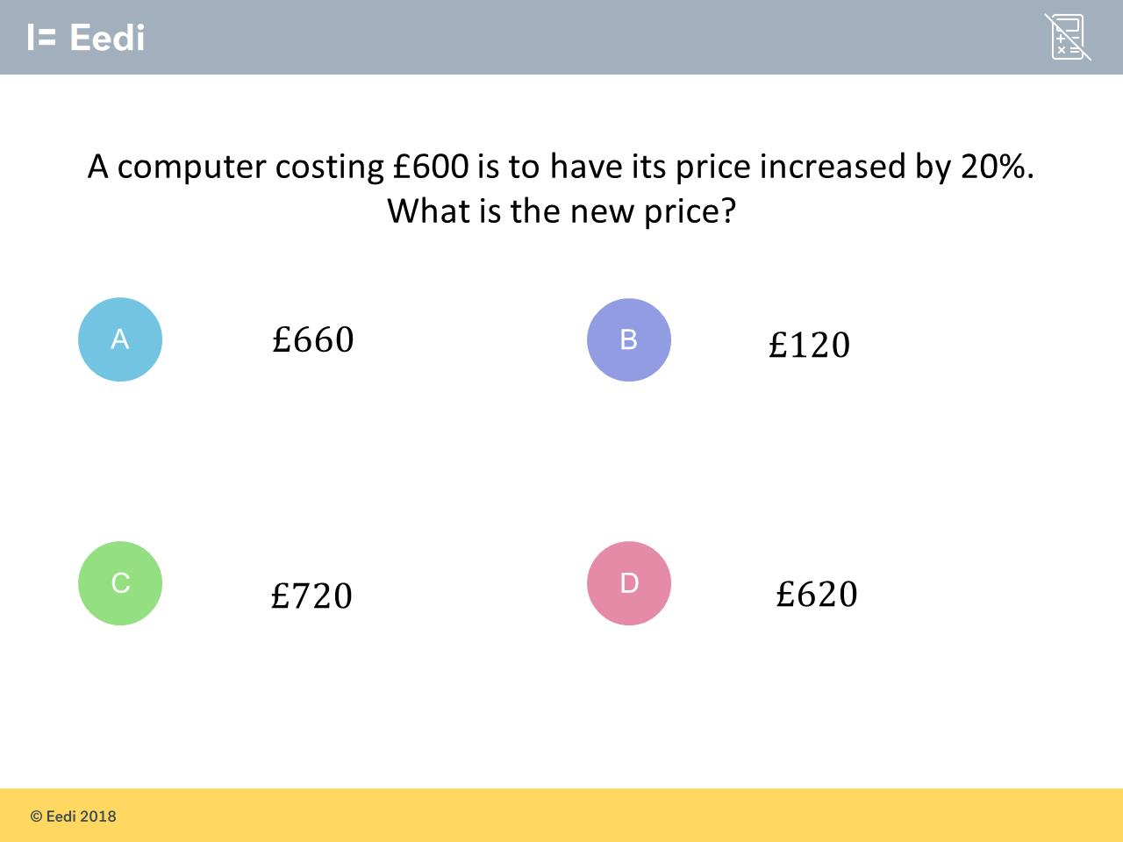
Question 5 – % Increase and Decrease

Slide 11
Answer 5 – % Increase and Decrease
CORRECT ANSWER | CORRECT EXPLANATION
£720 | We need to find 600 × 1.2 = 720.
COMMON MISTAKES | WHAT MIGHT BE YOUR MISTAKE
£660 | The student has increased the price by 10%.
£120 | The student has found 20%, but not increased the price.
£620 | The student has increased £600 by £20.

Slide 12
Question 6 – Express a number as a %
Ash buys and sells used cars
He buys a car for £1500 and latter sells it for £2150.
What percentage was the profit?

Slide 13
Answer 6 – Express a number as a %
Ash buys and sells used cars
He buys a car for £1500 and latter sells it for £2150.
What percentage was the profit?
CORRECT ANSWER | CORRECT EXPLANATION
43.3% | We have £2150 - £1500 = £650, then £650/£1500 = 43.3%.
COMMON MISTAKES | WHAT MIGHT BE YOUR MISTAKE
650% | The student has given the increase in pounds, rather than the percentage.
30% | The student has calculated the increase in price.
21.5% | The student has taken the new amount and divided by 100. They may benefit from revising this topic.

Slide 14
Question 7 – Express a number as a %
What is 140 as a percentage of 70?

Slide 15
Answer 7 – Express a number as a %
What is 140 as a percentage of 70?
CORRECT ANSWER | CORRECT EXPLANATION
200 | We have 140/70 × 100 = 200%.
COMMON MISTAKES | WHAT MIGHT BE YOUR MISTAKE
2 | The student has forgotten to multiply by 100.
50 | The student has reversed the question, finding 70 as a percentage of 140.
70 | The student may have repeated the number from the question. They may benefit from revising this topic.

Slide 16
Question 8 – Percentage Change
A phone costing 400 is in a sale.
The sale price is 300.
What percentage decrease is this?

Slide 17
Answer 8 – Percentage Change
A phone costing 400 is in a sale.
The sale price is 300.
What percentage decrease is this?
CORRECT ANSWER | CORRECT EXPLANATION
25% | We have (400-300)/400 = 100/400 = 25%.
COMMON MISTAKES | WHAT MIGHT BE YOUR MISTAKE
¼ % | The student has given their answer as a fraction rather than a percentage.
100% | The student has given the reduction in pounds, rather than finding the percentage
33.3% | The student may have found the reduction as a percentage of the sale price.

Slide 18
Question 9 – Reverse Percentages
A jacket is £245 in the sale after a 30% reduction
How much did the jacket cost before the sale?

Slide 19
Answer 9 – Reverse Percentages
A jacket is £245 in the sale after a 30% reduction
How much did the jacket cost before the sale?
CORRECT ANSWER | CORRECT EXPLANATION
£350 | The multiplier for reduction is 0.7, so to find the original price we divide by 0.7. This gives £245 × 100/70 = £350.
COMMON MISTAKES | WHAT MIGHT BE YOUR MISTAKE
£275 | The student has added £30 to the sale price.
£171.50 | The student has reduced the sale price by £30%, rather than using the inverse multiplier.
£318.50 | The student has increased the sale price by 30%, rather than using the inverse multiplier.

Slide 20
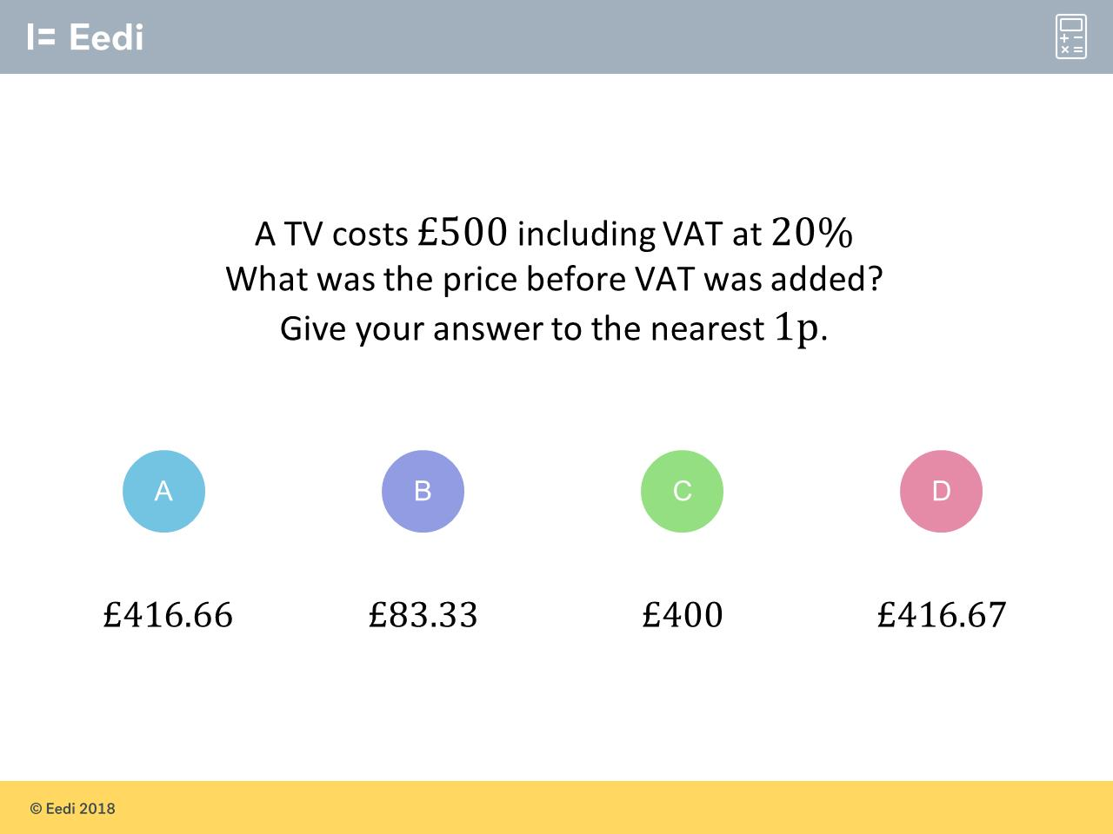
Question 10 – Reverse Percentages

Slide 21
Answer 10 – Reverse Percentages
CORRECT ANSWER | CORRECT EXPLANATION
£416.67 | The multiplier for increase is 1.2, so to find the original price we divide by 1.2. This gives £500 × 100/120 = £416.67.
COMMON MISTAKES | WHAT MIGHT BE YOUR MISTAKE
£416.66 | The student has not rounded correctly.
£83.33 | The student has found the amount of VAT, but not reduced cost.
£400 | The student has reduced the cost by 20%, rather than using the inverse multiplier.

Slide 22
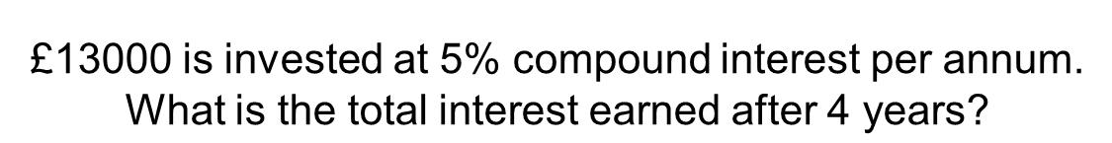
Question 11 – Compound Interest

Slide 23
Answer 11 – Compound Interest
CORRECT ANSWER | CORRECT EXPLANATION
£2801.58 | We have £13000 × 1.05^4 - £13000 = £2801.58.
COMMON MISTAKES | WHAT MIGHT BE YOUR MISTAKE
£2600 | The student has found the interest earned as if it were simple interest.
£15600 | The student has used simple interest, rather than compound, and found the investment.
£15801.58 | The student has found the value of the investment, not the interest.

Slide 24
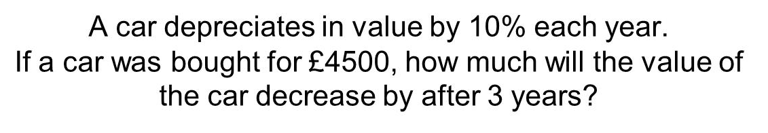
Question 12 – Compound Interest

Slide 25
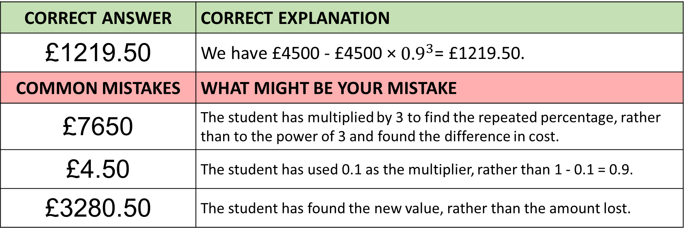
Answer 12 – Compound Interest
CORRECT ANSWER | CORRECT EXPLANATION
£1219.50 | We have £4500 - £4500 × ${0.9}^{3}$= £1219.50.
COMMON MISTAKES | WHAT MIGHT BE YOUR MISTAKE
£7650 | The student has multiplied by 3 to find the repeated percentage, rather than to the power of 3 and found the difference in cost.
£4.50 | The student has used 0.1 as the multiplier, rather than 1 - 0.1 = 0.9.
£3280.50 | The student has found the new value, rather than the amount lost.

Slide 26
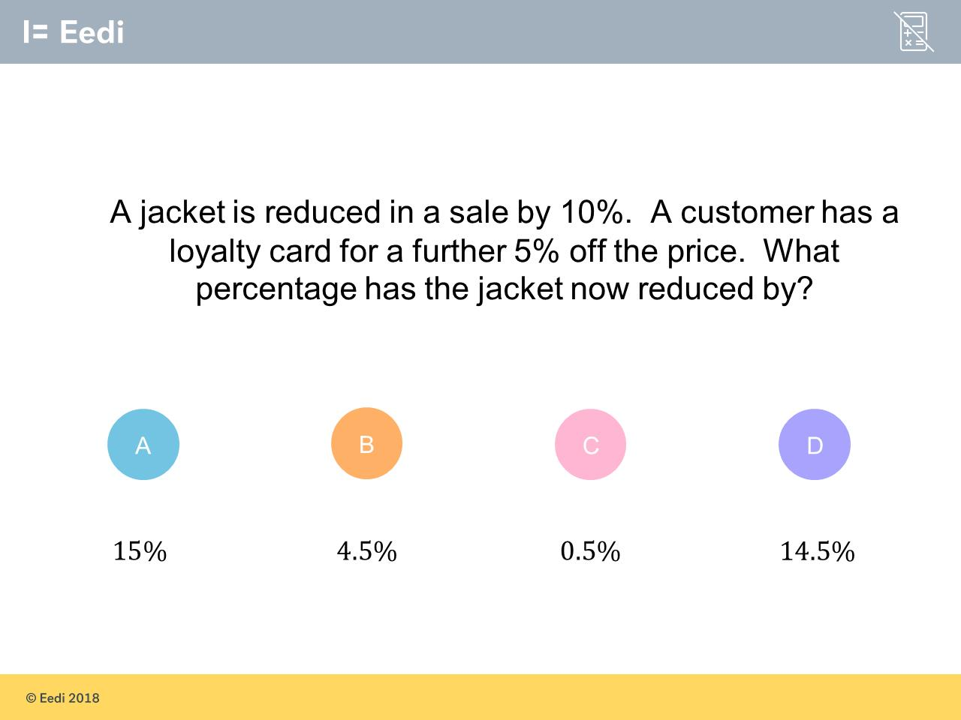
Question 13 – Compound Interest

Slide 27
Answer 13 – Compound Interest
CORRECT ANSWER | CORRECT EXPLANATION
14.5% | We have 0.9 × 0.95 = 0.855. Then 1 - 0.855 = 0.145, so we have 14.5%.
COMMON MISTAKES | WHAT MIGHT BE YOUR MISTAKE
15% | The student has added the percentages, rather than multiplying.
4.5% | The student has used an increase of 10% and a decrease of 5%.
0.5% | The student has found 10% of 5%.

